Slide 1
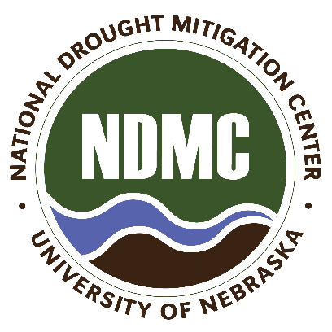
NE Drought Conditions CARC Update: Nov. 12, 2021
Brian Fuchs
National Drought Mitigation Center
University of Nebraska-Lincoln
School of Natural Resources

Slide 2
Regional Climatic and Drought Conditions…

Slide 3
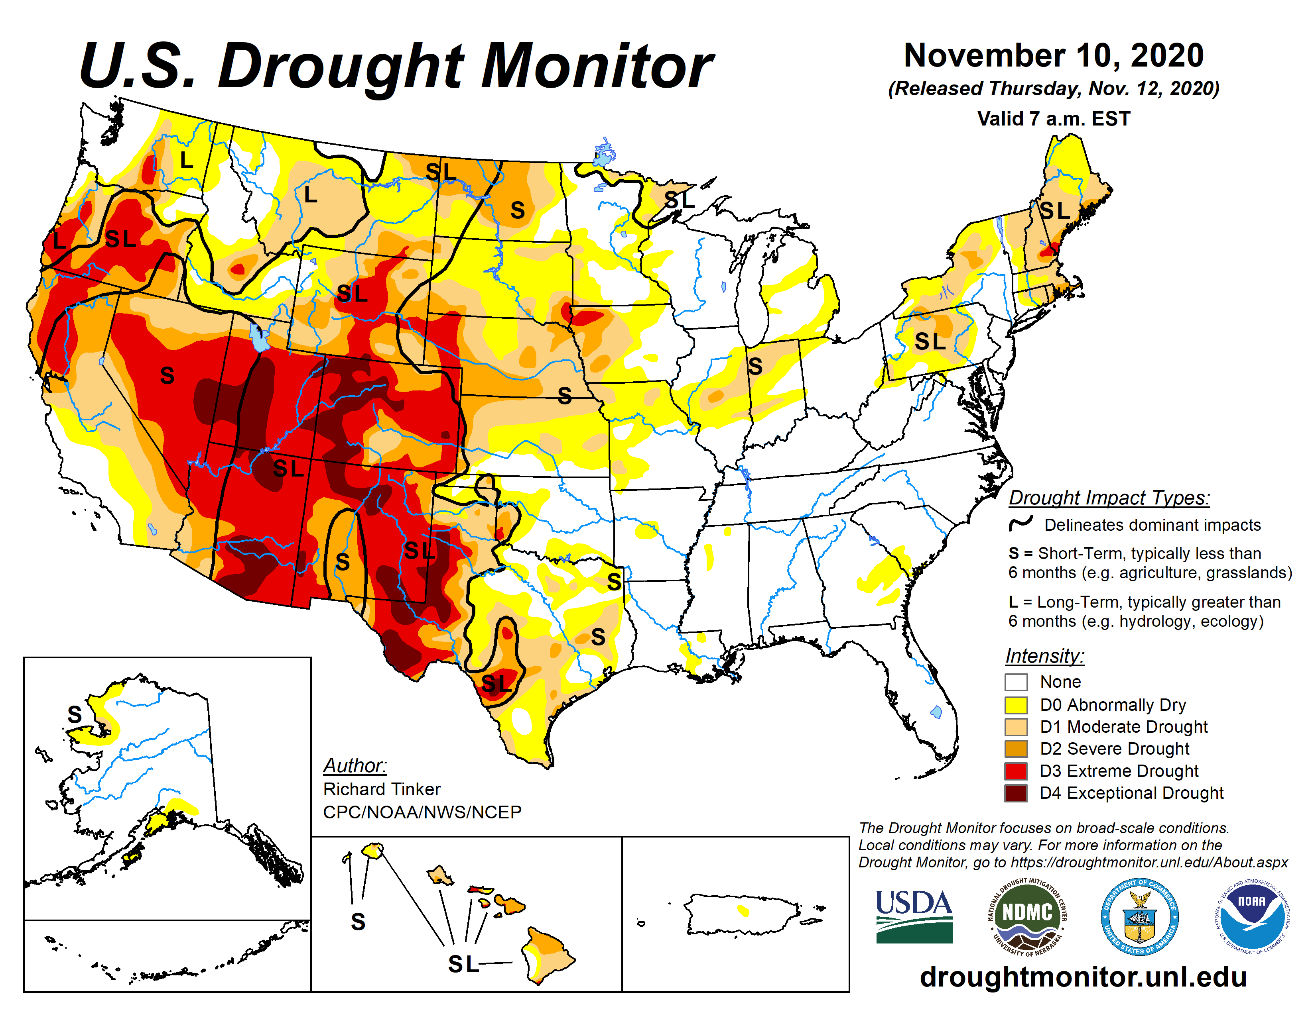
Last year at this time…..

Slide 4
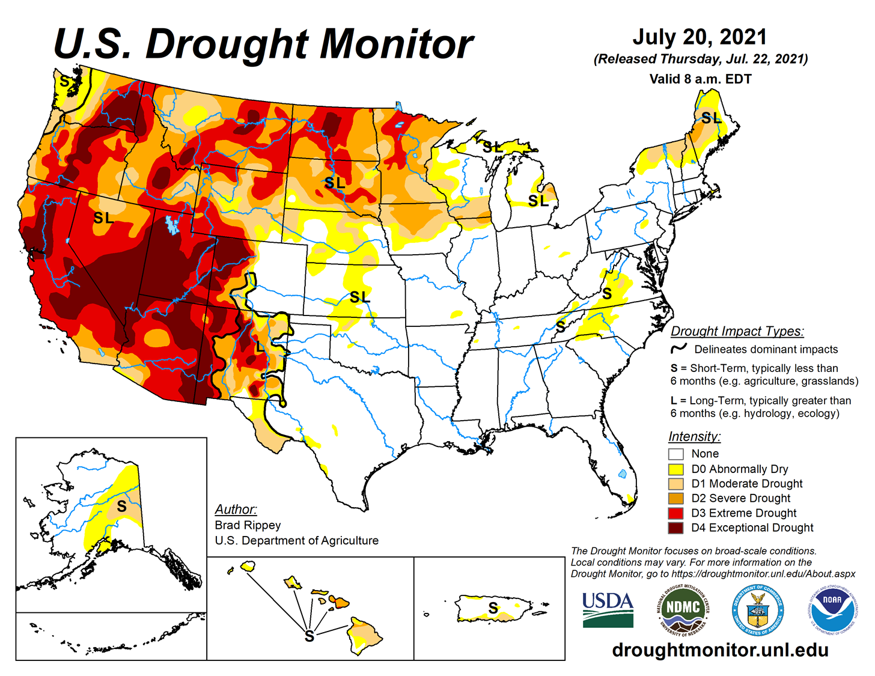
Last CARC Meeting…..

Slide 5
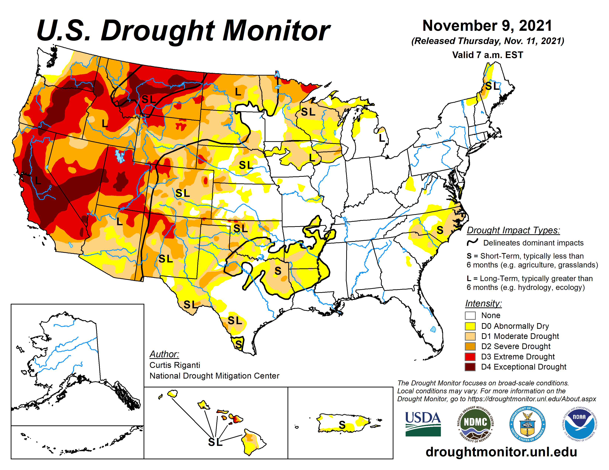

Slide 6
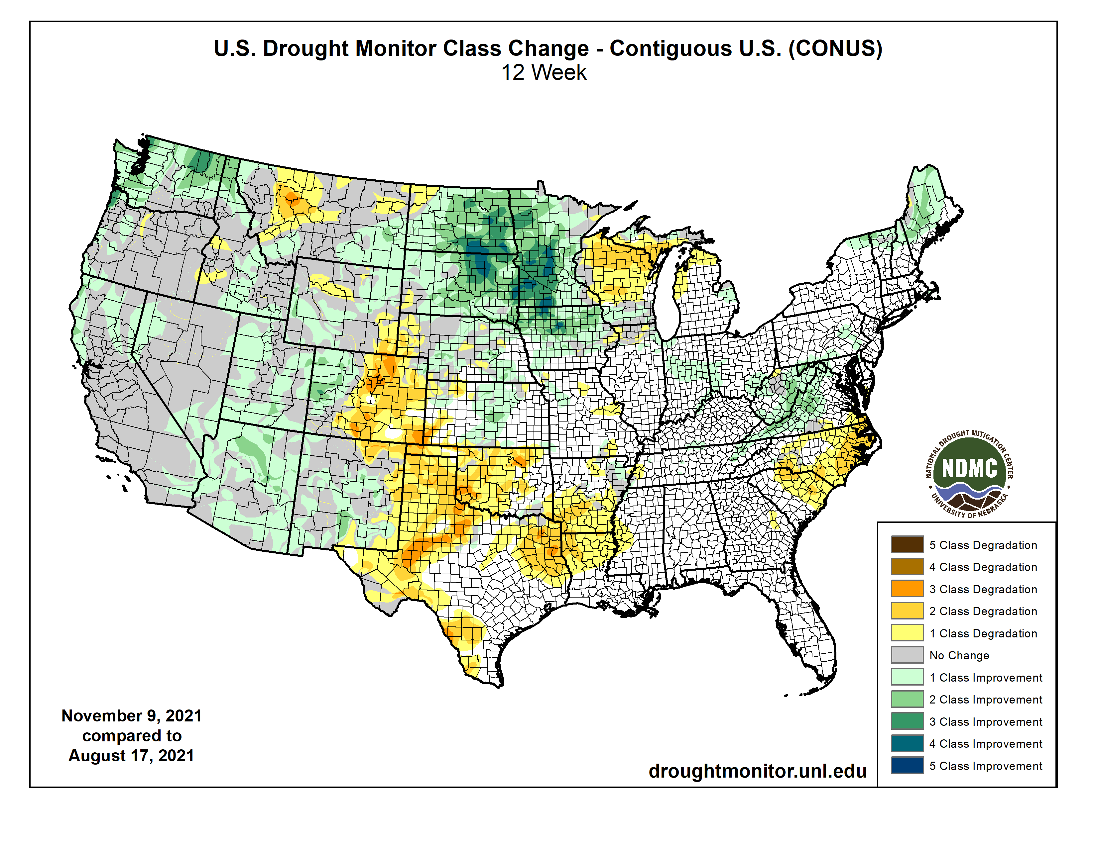

Slide 7
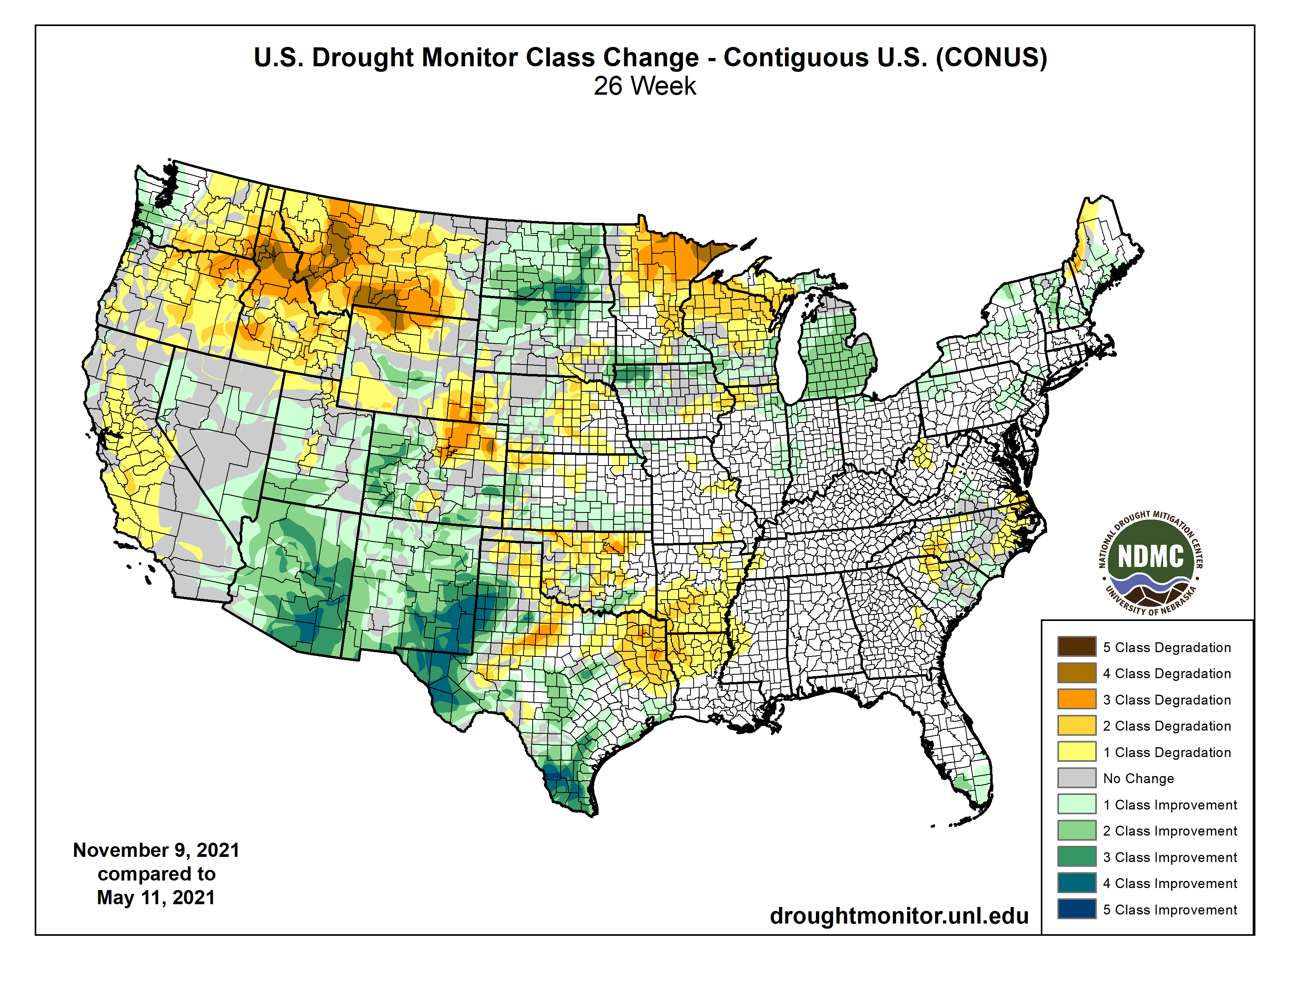

Slide 8
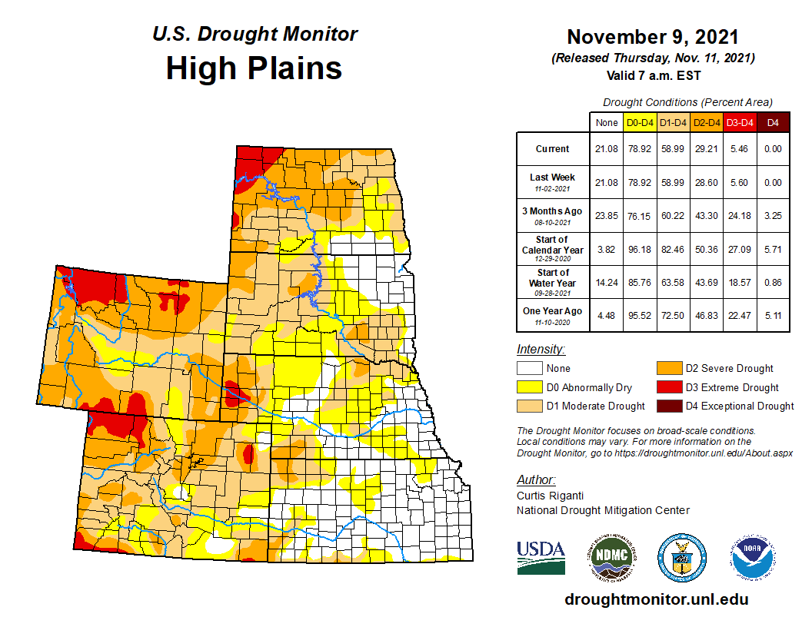


Slide 9
Last CARC meeting

Slide 10
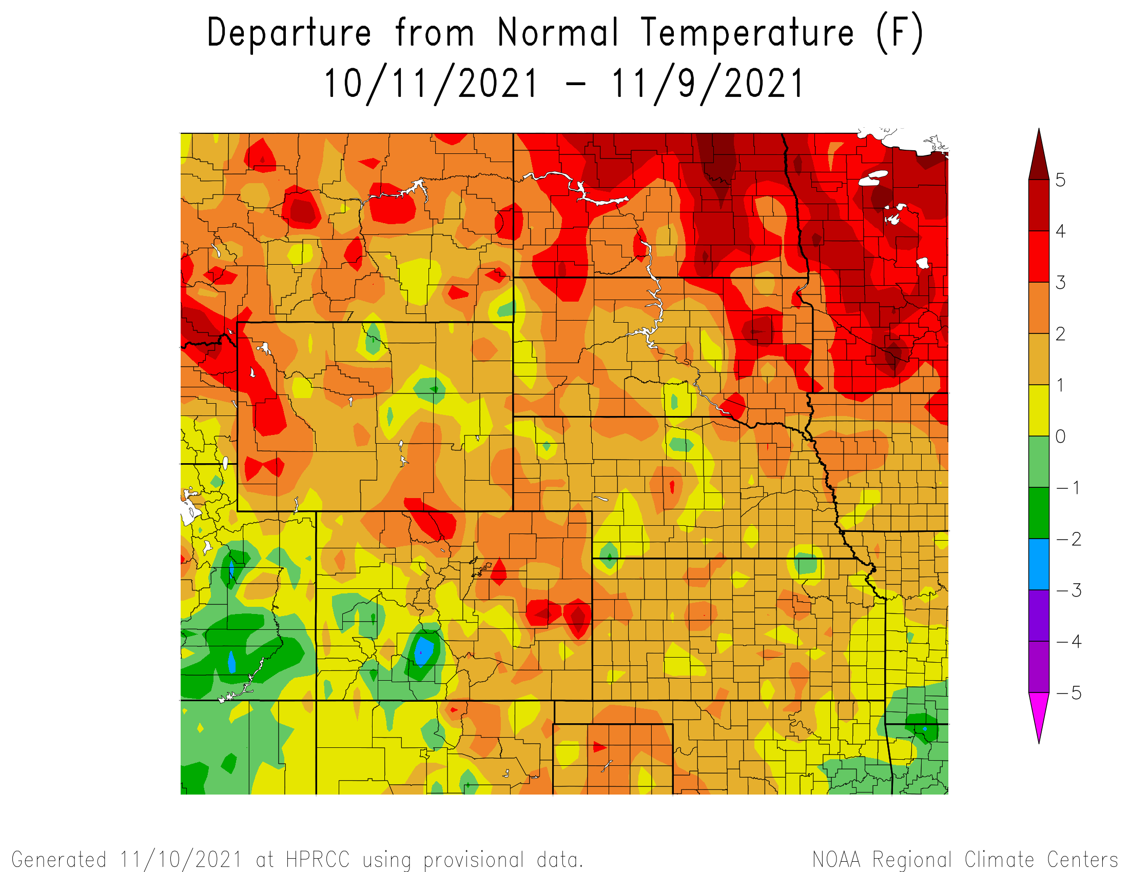
Departure from Normal Temperatures over the last 30 days

Slide 11
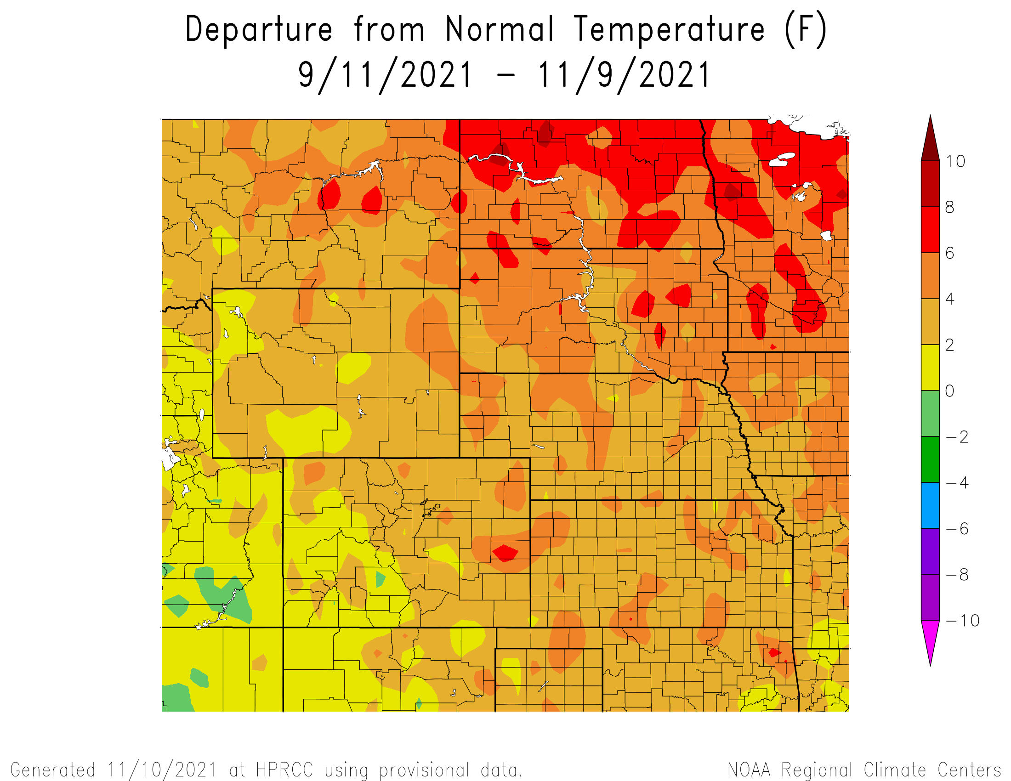
Departure from Normal Temperatures over the last 60 days

Slide 12
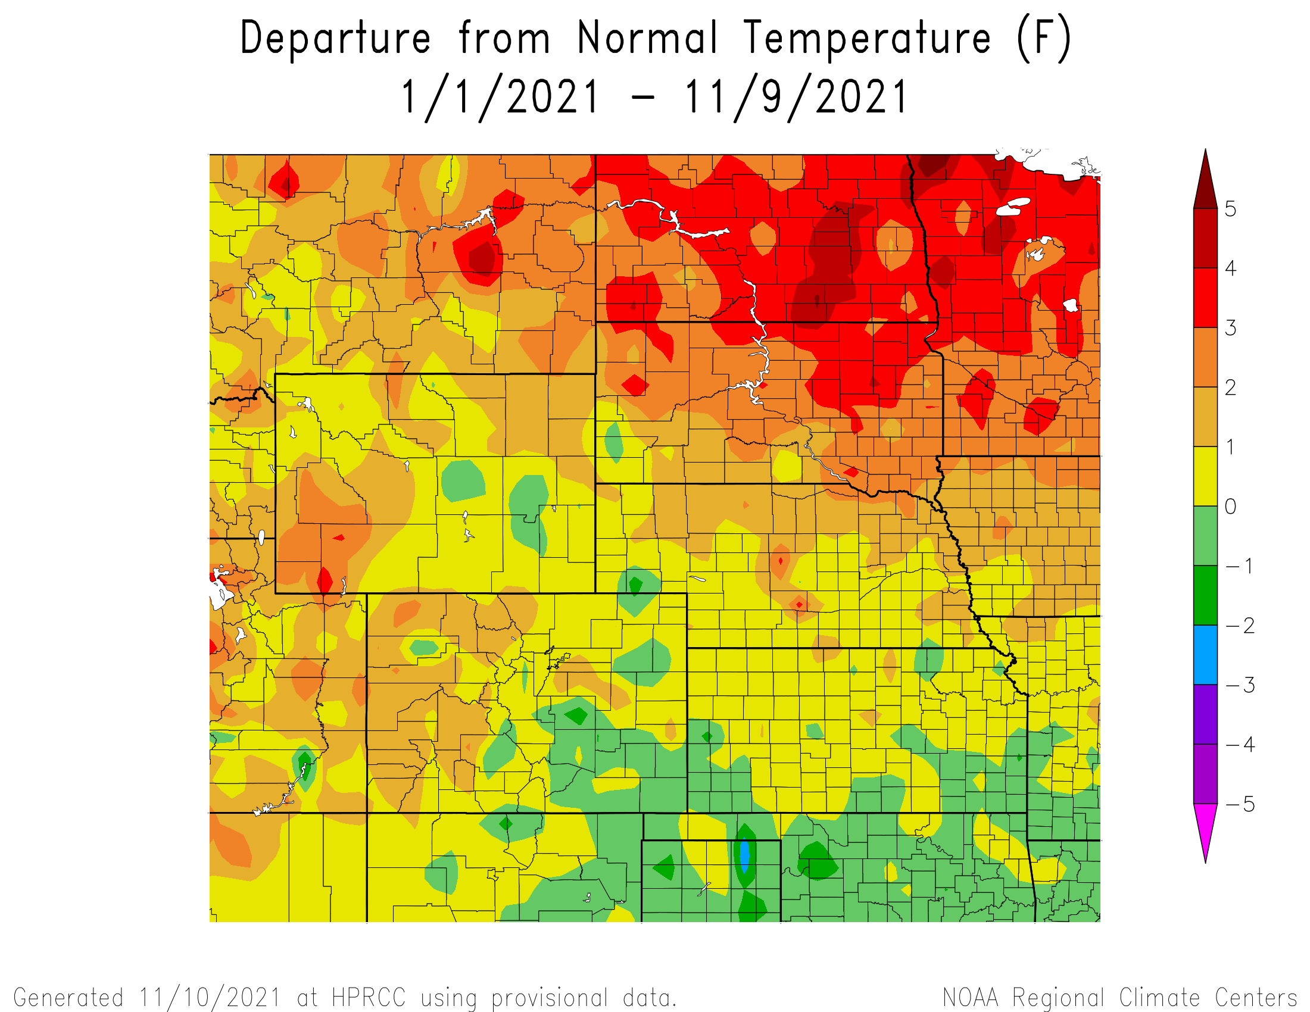
Departure from Normal Temperatures for the Calendar Year

Slide 13
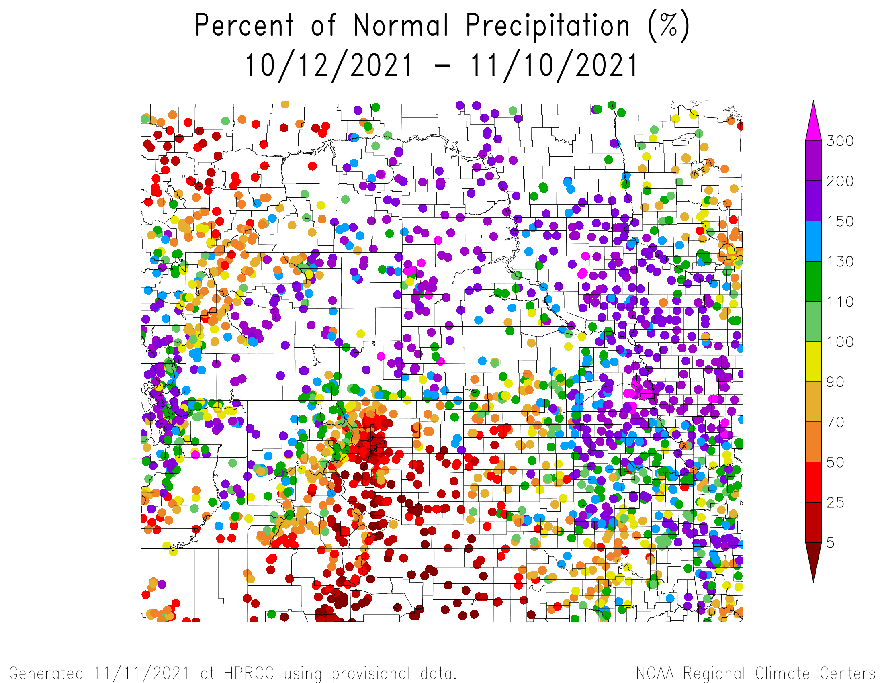
Percent of Normal Precipitation over the last 30 days

Slide 14
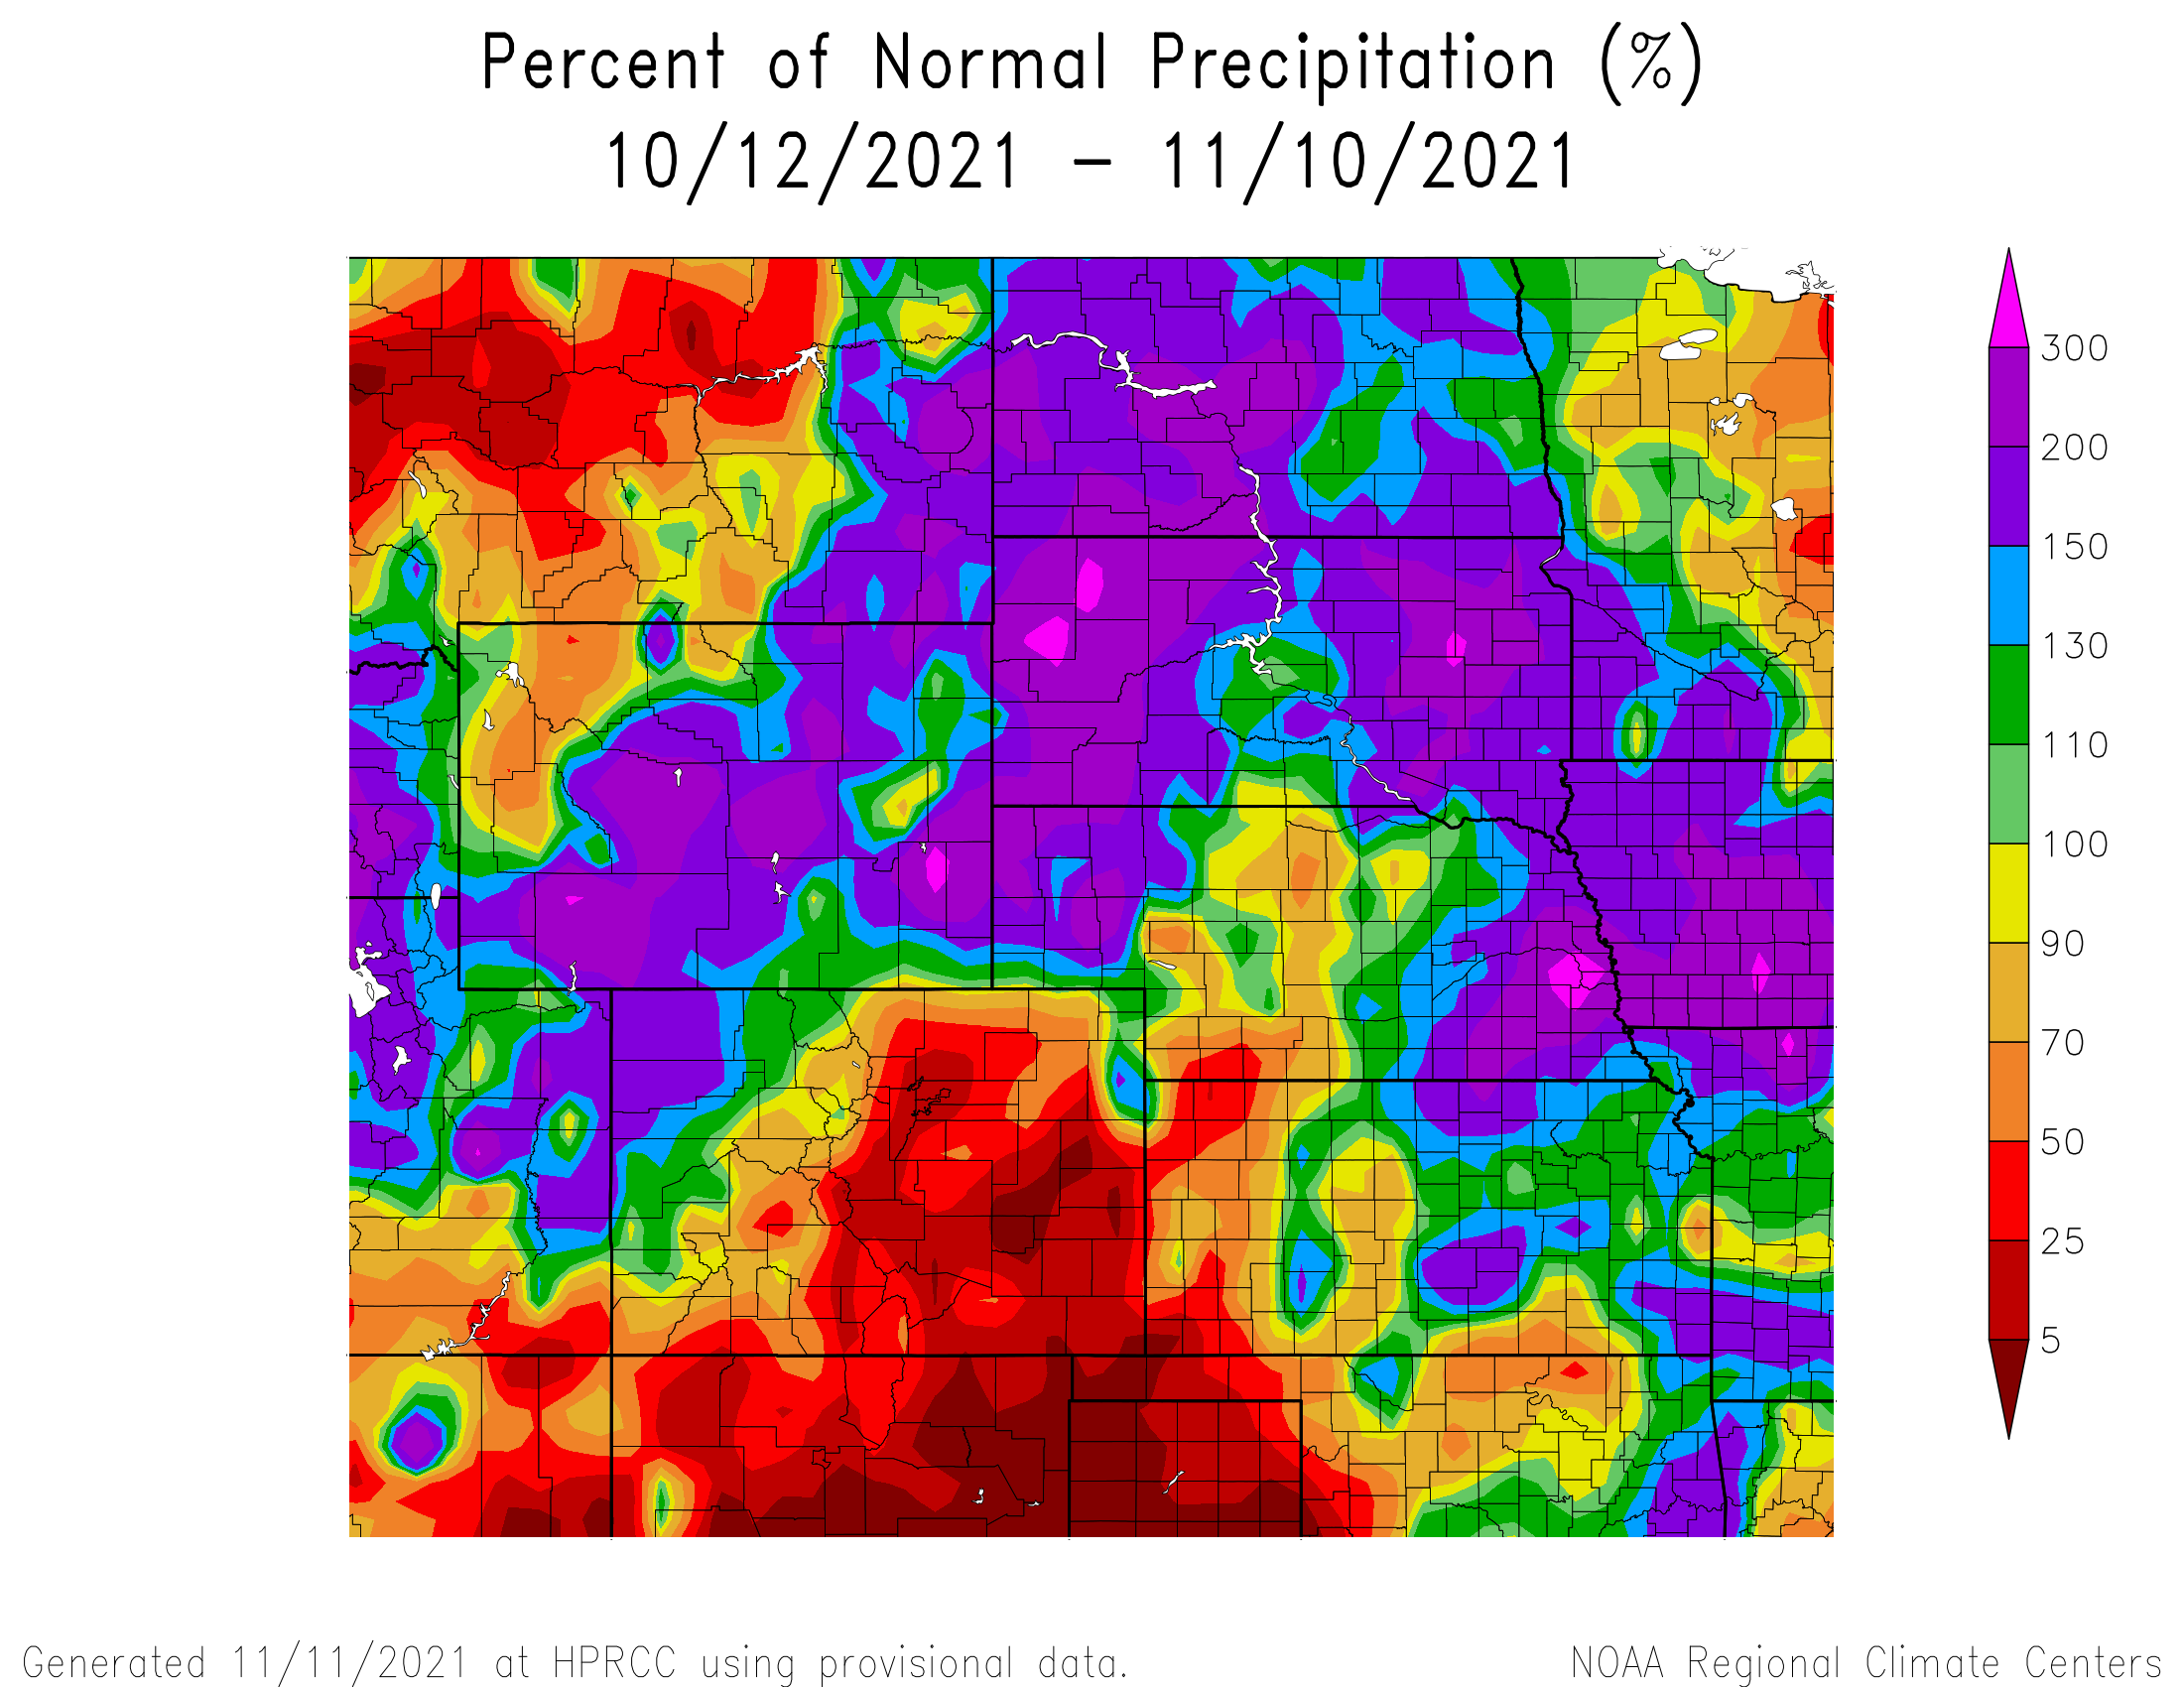
Percent of Normal Precipitation over the last 30 days

Slide 15
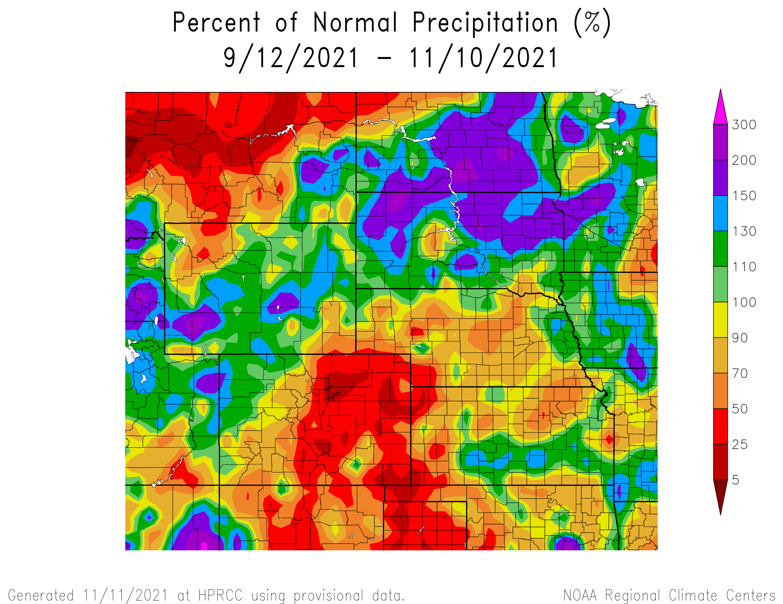
Percent of Normal Precipitation over the last 60 days

Slide 16
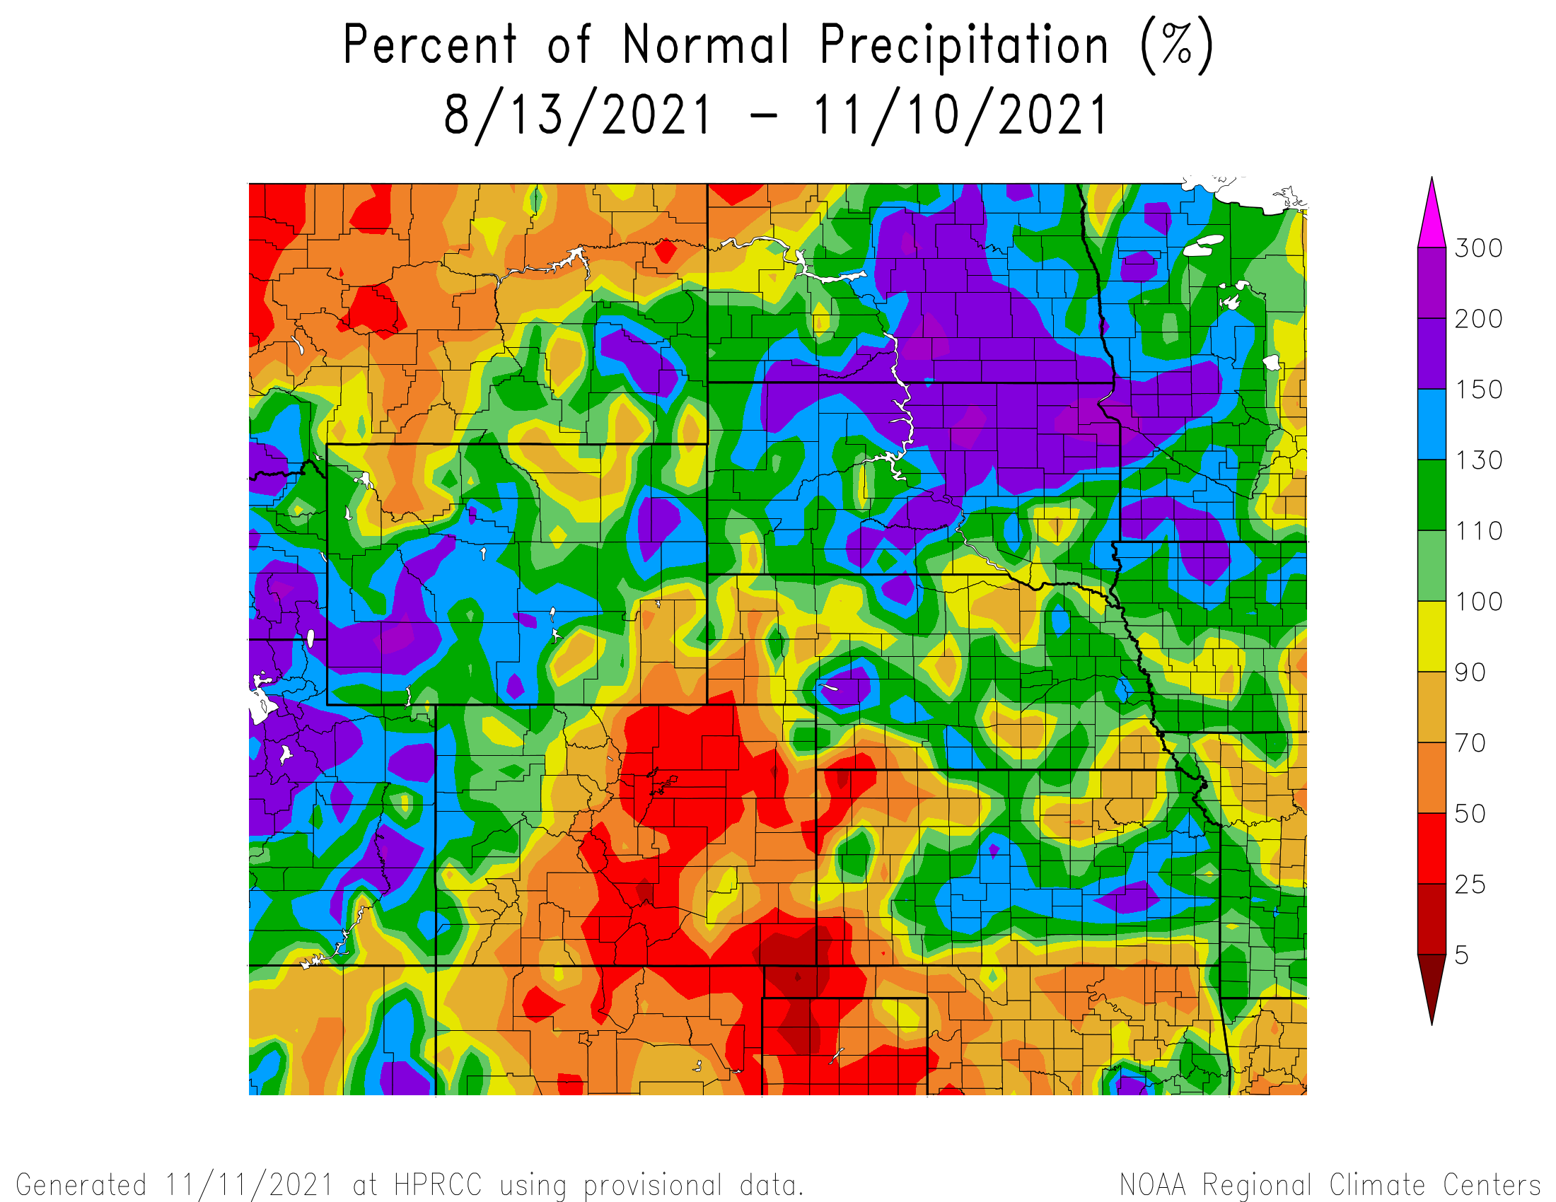
Percent of Normal Precipitation over the last 90 days

Slide 17
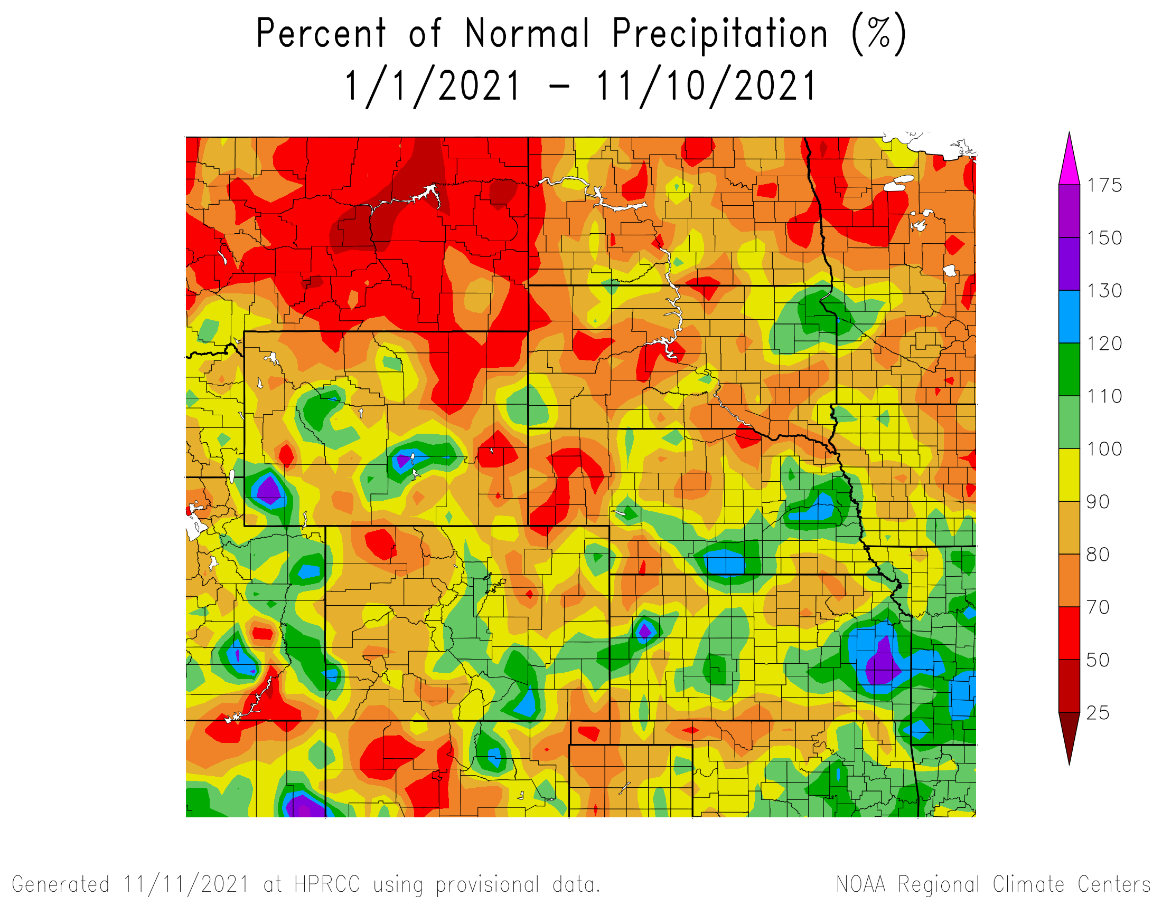
Percent of Normal Precipitation for the calendar year

Slide 18
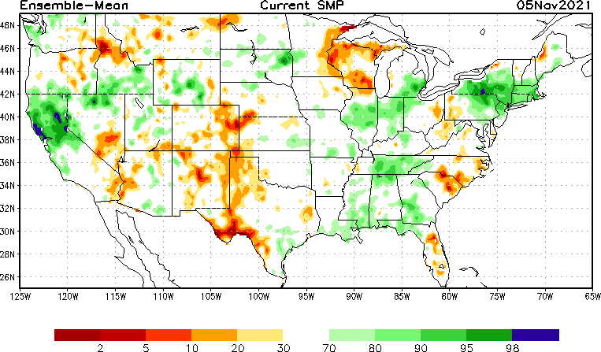
NLDAS Soil Moisture Model: Current Soil Moisture Anomaly

Slide 19
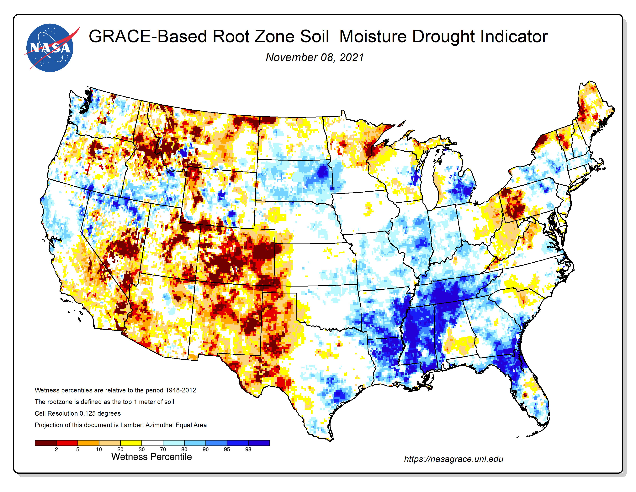
NASA GRACE-Based Root Zone Soil Moisture
https://nasagrace.unl.edu/

Slide 20
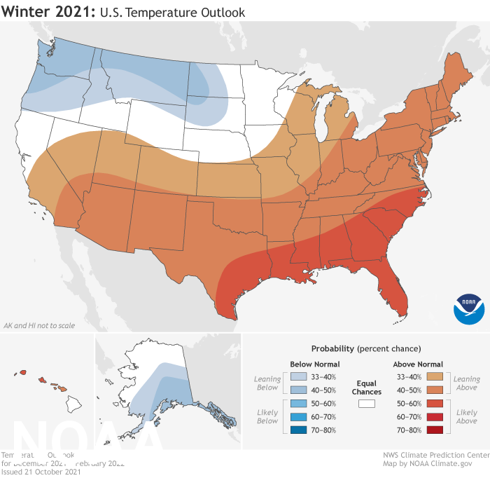
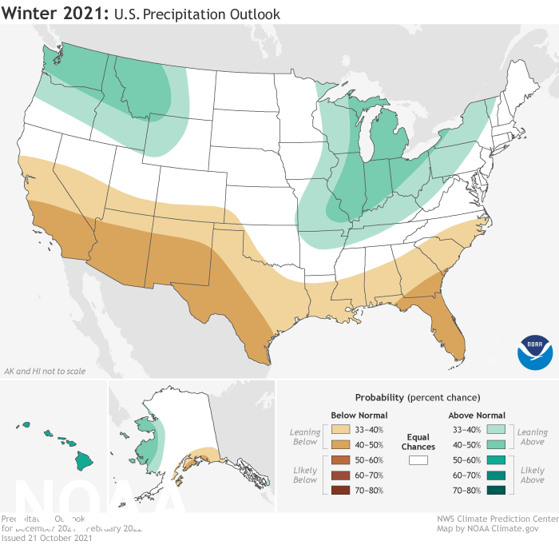
NOAA’s Official Winter Outlook

Slide 21
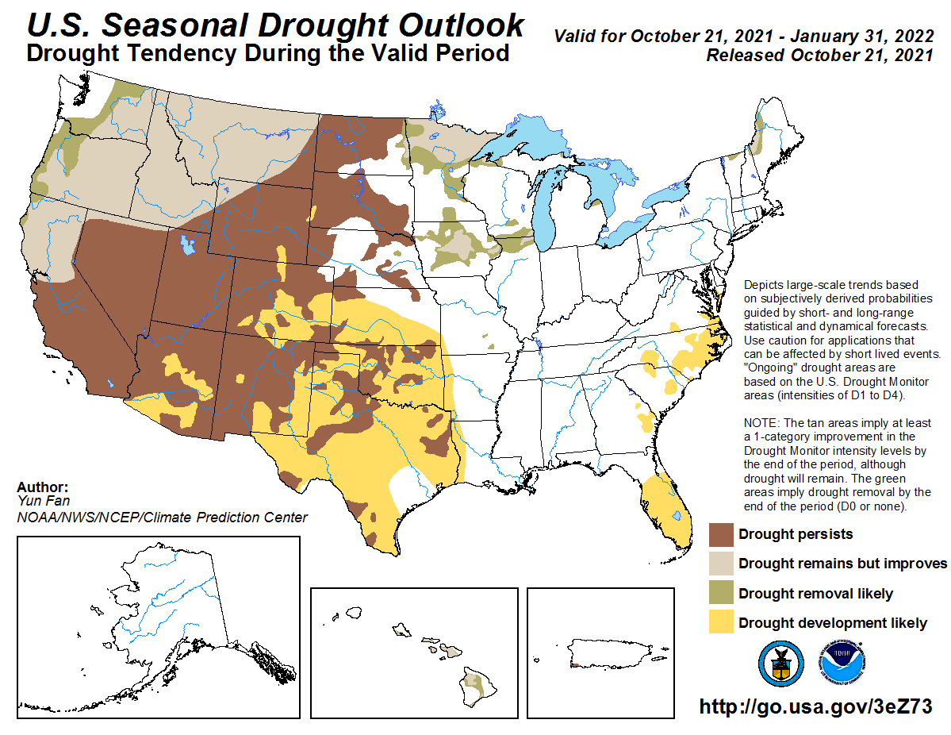

Slide 22
What should we “expect” with a La Nina winter?
Slides provided by Mike Moritz, National Weather Service in Hastings, NE

Slide 23


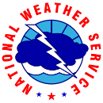
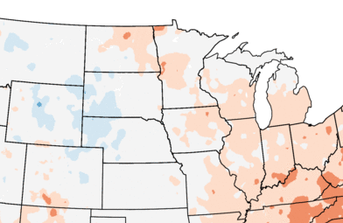
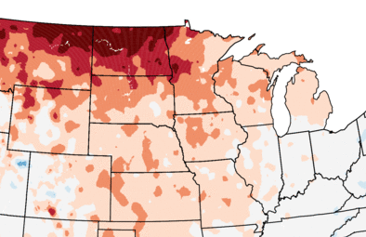
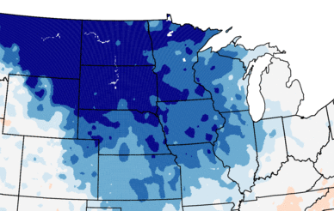
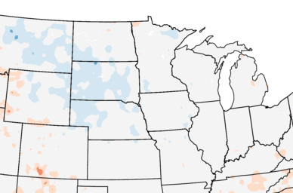
Average Temperature Trends during the Last 30 Years (1991-2020)
Key Points
December
January
December has been trending slightly warmer east of the Mississippi River & slightly colder from Wyoming into western Nebraska & western South Dakota.
January is warmer across much of Central Region. Strongest warming in the Northern Plains.
February swings the other way, showing appreciable cooling, especially in the Northern Plains.
There has been a slight cooling during meteorological winter (DJF) in the Northern & Central Plains. Elsewhere little change.
Typically Warmer
WINTER OUTLOOK 2021-22
February
Winter (DJF)
Typically Colder
Data Source: 5km Gridded Dataset (nClimGrid)
National Centers for Environmental Information
NATIONAL WEATHER SERVICE
weather.gov

Slide 24
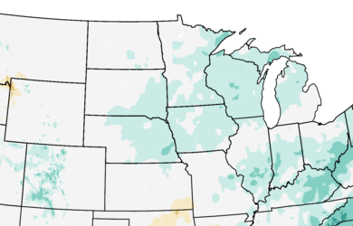
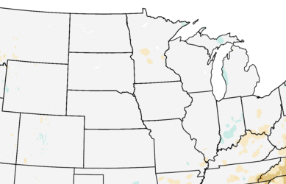
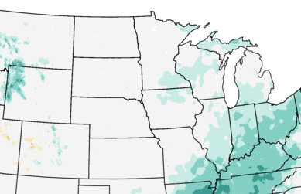
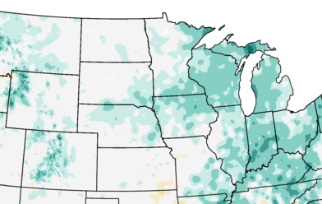
Precipitation Trends during the Past 30 Years (1991-2020)
December
January
Key Points
December shows a trend for increasing precipitation across much of Central Region.
January is essentially unchanged.
February shows an increase in precipitation from southeast Missouri northeast into Michigan & western Wyoming.
The Winter (DJF) shows an increase in precipitation across much of Central Region.
Wetter
WINTER OUTLOOK 2021-22
February
Winter (DJF)
Normal to Slightly Wetter
Data Source: 5km Gridded Dataset (nClimGrid)
National Centers for Environmental Information
NATIONAL WEATHER SERVICE
weather.gov

Slide 25
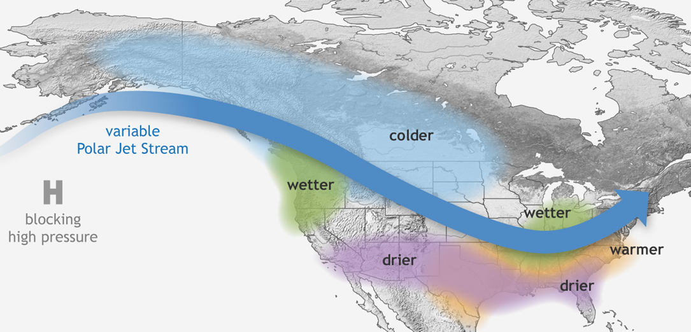
La Niña – What’s Expected This Winter
Strength:
Moderate
Since 1990, the Northern Plains has seen highly variable temperatures during La Niña, so there is more uncertainty.
Stronger La Niñas, like this one, can shift storm tracks further northwest, so this area can also see wetter-than-normal winters.
Typical Impacts
Temperatures:
  There tends to be a strong tendency for colder-than-normal conditions from southeast Alaska southeast into the Northern Plains.
  There is a strong tendency for warmer-than-normal conditions across the southern and eastern United States.
Precipitation:
There is a strong tendency for wetter-than-normal conditions from the Tennessee/Ohio river valleys into the southern Great Lakes & Pacific Northwest
There is a strong tendency for drier-than-normal conditions across the southern United States.
WINTER OUTLOOK 2021-22
WINTER OUTLOOK 2021-22
Dec-Mar
Dec-Mar
Oct-Apr
Typical Wintertime La Niña Pattern
Oct-Apr
Image courtesy of NOAA
Moderate La Niña Winters: 1955-56, 1970-71, 1984-85, 2010-11, & 2020-21.
NATIONAL WEATHER SERVICE
weather.gov
NATIONAL WEATHER SERVICE
weather.gov

Slide 26
Climate/Drought Summary
Temperatures have been warmer than normal throughout the High Plains into the Autumn season. Ideal for harvest conditions, but still contributing to the drought in the region. Over the last 60 days, most all the region was 2-4 degrees above normal with the greatest departures in the Dakota’s where departures were 6-8 degrees above normal.
Much of the region has recorded above normal temperatures this year with the Dakota’s being the warmest with departures of 3-5 degrees above normal for 2021. Precipitation has been spotty and inconsistent this year with some areas very wet at times and then followed up by dryness or vice versa. A few pockets in eastern NE, northcentral and southeast KS, southern CO, central WY, and northeast South Dakota are showing above normal precipitation for the year.
Nebraska is currently showing 31.57 percent of the state in drought. Most of the drought is moderate drought (D1) to severe drought (D2) with a pocket of extreme drought (D3) in the panhandle. This compares to early July when 21.77% of the state was in drought with only 2.15% in D2.
The seasonal drought outlook that goes through the end of January has current drought persisting during this time.

Slide 27
Nebraska Water Supply Update…

Slide 28
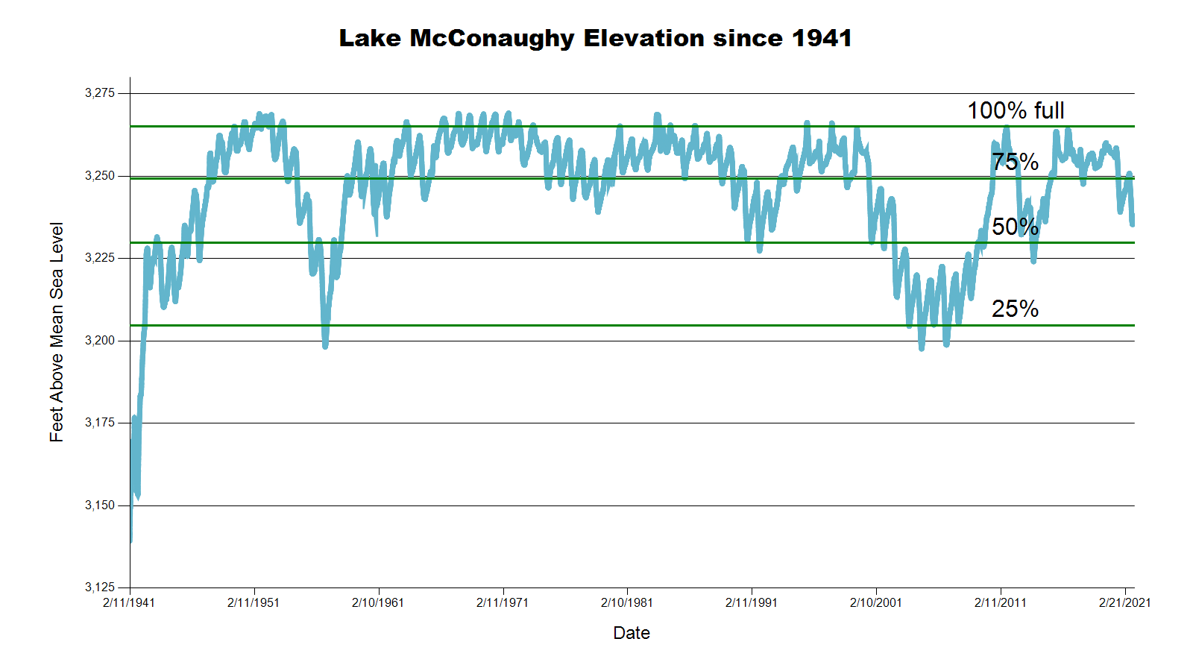
3238.0 feet 59.8% Full
3243.3 feet 66.7% Full
July 2021 CARC meeting
SOURCE: CNPPID www.cnppid.com

Slide 29
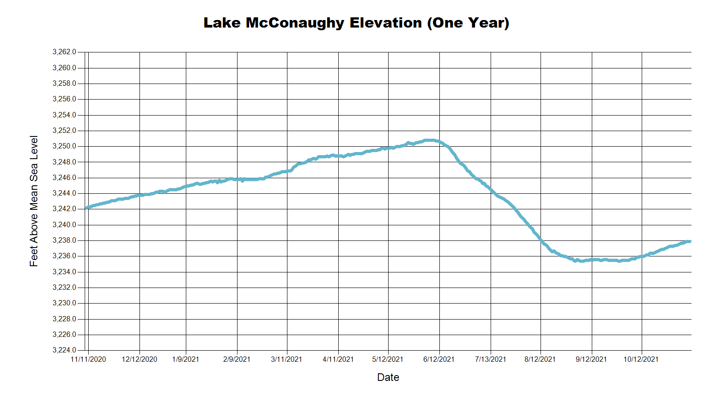
3243.4 Feet
68.8% of Max
December 2020
3238.0 Feet
59.8% of Max
November 2021
3243.3 Feet
68.7% of Max
July 2021
SOURCE: CNPPID www.cnppid.com

Slide 30
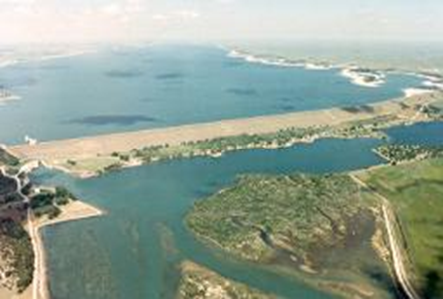
November 2021 CARC Meeting
SOURCE: CNPPID www.cnppid.com

Slide 31
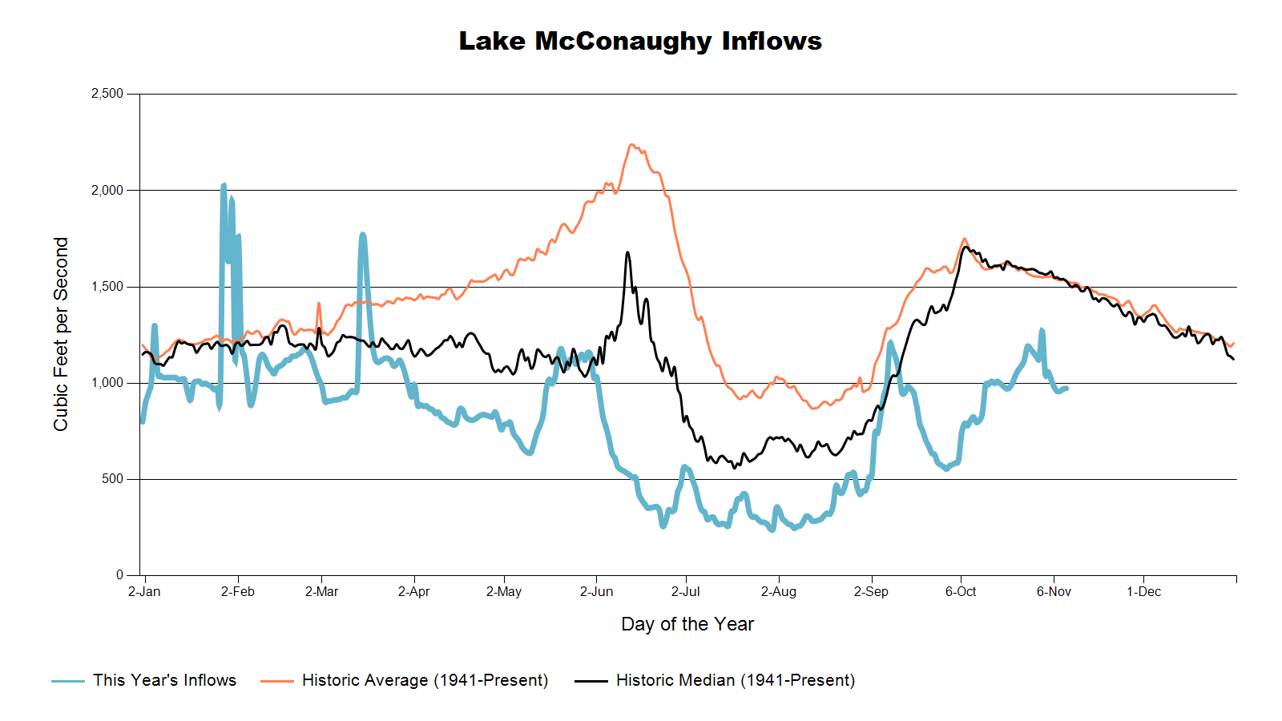

Slide 32
Lake McConaughy
Hydraulic Project Operations manager Cory Steinke reported that Lake McConaughy’s elevation rose half a foot last week and is now at 3237.4 feet (59.1 % capacity). Inflows into the lake were about 1,100 cubic feet per second with outflows at 415 cfs.
SOURCE: CNPPID News Release, November 2, 2021
www.cnppid.com

Slide 33
North Platte Basin data
https://www.usbr.gov/gp/lakes_reservoirs/wareprts/main_menu.html#supply

Slide 34
North Platte River Basin Inflow

Slide 35
North Platte River Basin Storage

Slide 36
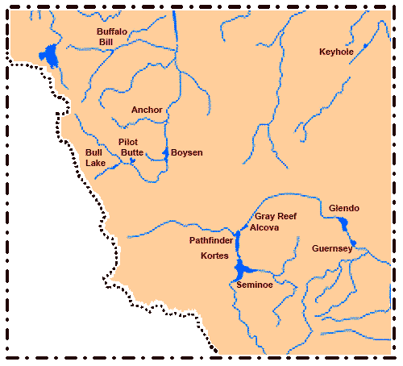
North Platte River Basin
Seminoe: 31.0 of conservation pool
Pathfinder: 59.6% of conservation pool
Glendo: 37.7% of conservation pool
Alcova: 85.2% of conservation pool
Source: BOR https://www.usbr.gov/gp/lakes_reservoirs/wyoming_lakes.html

Slide 37
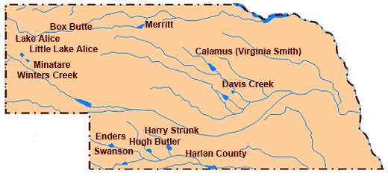
Republican River Basin
Hugh Butler: 42.3%(54.7%) of conservation pool
Enders: 18.5% (21.1%) of conservation pool
Harry Strunk: 67.4%(86.3%) of conservation pool
Swanson: 42.6% (57.7%) of conservation pool
*values in red are from the last CARC meeting in July 2021.
Source: BOR http://www.usbr.gov/gp/lakes_reservoirs

Slide 38
Republican River Basin
Harlan County Current Conditions
Conservation Pool is 88.4% full (94.7%)
277,639 Acre-Feet in storage compared to 297,486 Acre-Feet (AF) of water in storage during July 2021
Last year at this time, 275,408 AF was in storage (November 2020)
Historical average storage for this time of the year is 275,354 AF
*values in red are from the last CARC meeting in July 2021
Source: BOR http://www.usbr.gov/gp/lakes_reservoirs/

Slide 39
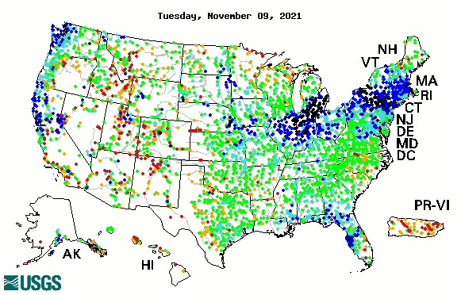

14-day average streamflow compared to historical streamflow for the day of year

Slide 40
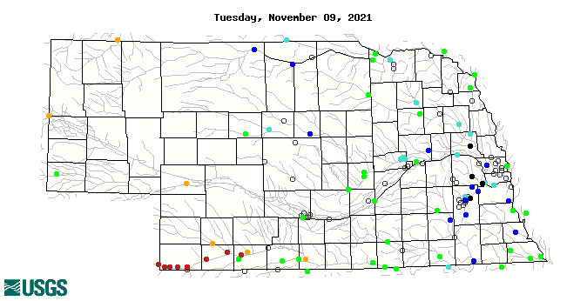
14-day average streamflow compared to historical streamflow for the day of year
94th Percentile
16th Percentile
93rd Percentile
58thPercentile
23rd Percentile
5thPercentile

Slide 41
Water Supply Summary
Lake McConaughy is currently 59.8 percent of capacity and has been slowly rising since the end of the irrigation season.
Upstream reservoirs in Wyoming are low with the series of dams on the north Platte basin only at 45% of capacity.
The Republican River basin reservoirs are lower than they were in July 2021 as water levels have stabilized with the end of irrigation season and less demand.
Harlan County Reservoir is holding about 20,000 acre-feet less water now than in July 2021.
Harlan County is holding about 2,000 acre-feet more water than the historical average for this time of year.

Slide 42
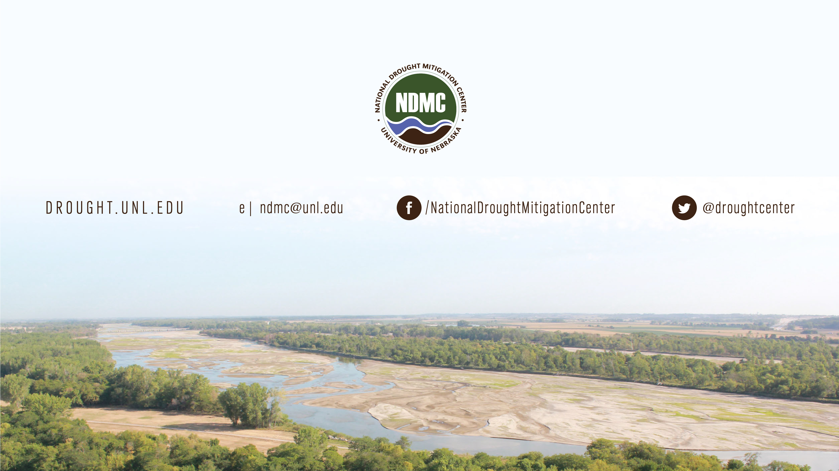
Brian Fuchs
bfuchs2@unl.edu
402-472-6775
National Drought Mitigation Center
School of Natural Resources
University of Nebraska-Lincoln

