Slide 1
United States Department of Agriculture
National Agricultural Statistics Service
May Crop Report
June Acreage
July Crop Report
July 19 Crop Progress and Condition
Nicholas Streff
USDA NASS
July 22, 2021

Slide 2
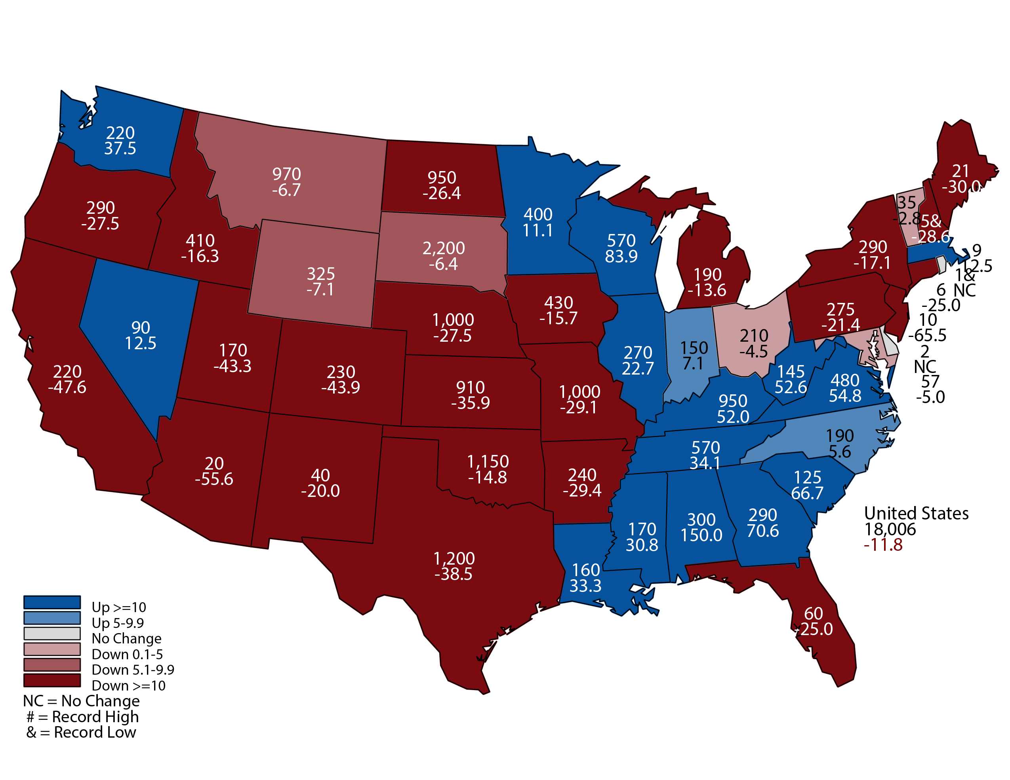
May 2021 Hay Stocks
Thousand Tons and Percent Change from Previous Year
May 12, 2021
Notes:
10 yr avg Stocks= 1,129,000
2020 Production: 6.4 million tons
10 yr average 5.8 million tons.
Year Stocks in Nebraska
2021 1,000,000
2020 1,380,000
2019 1,070,000
2018 700,000
2017 1,275,000
2016 1,450,000
2015 1,250,000
2014 1,150,000
2013 610,000
2012 1,070,000
2011 1,335,000
2010 1,000,000

Slide 3
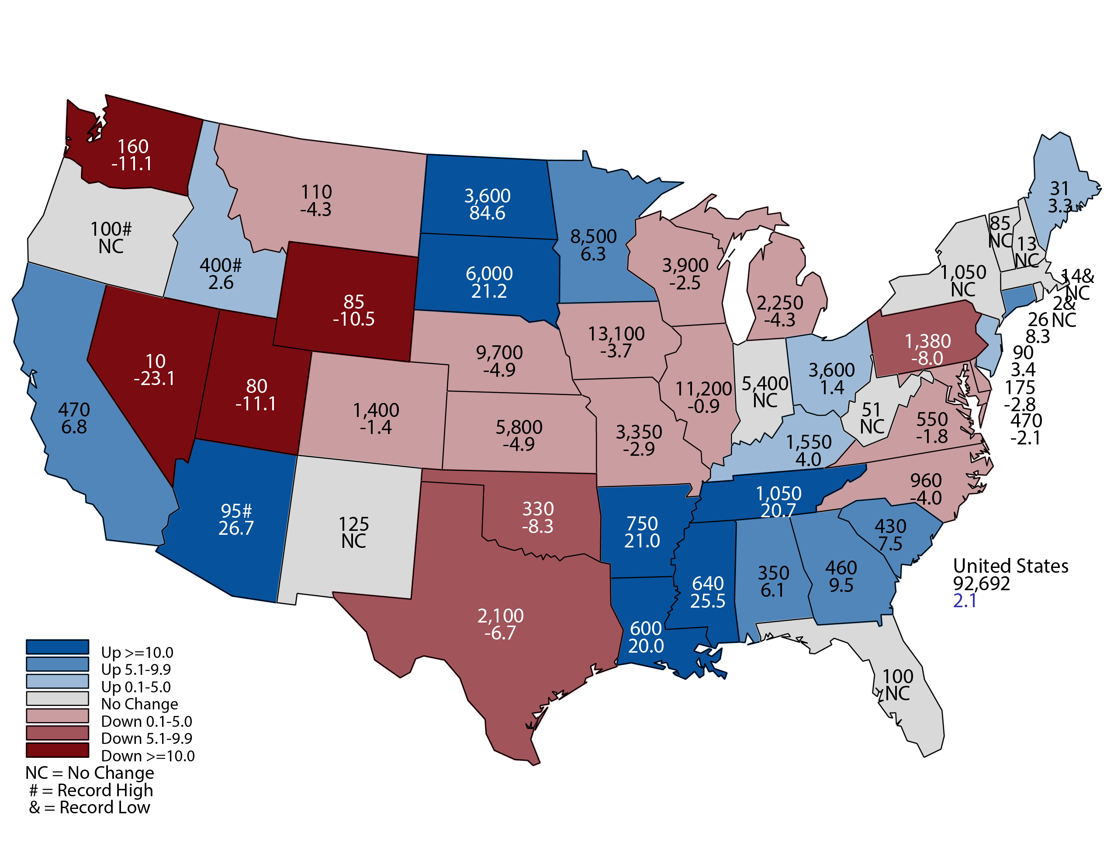
2021 Corn Planted Acreage
Thousand Acres and Percent Change from Previous Year
June 30, 2021
Notes:
Corn Planted Acres
Nebraska 9.7 million acres planted down from 10.2 million last year.
Based on survey responses from farmers and ranchers.
NE Sample Size 3,200 and 5,500.

Slide 4
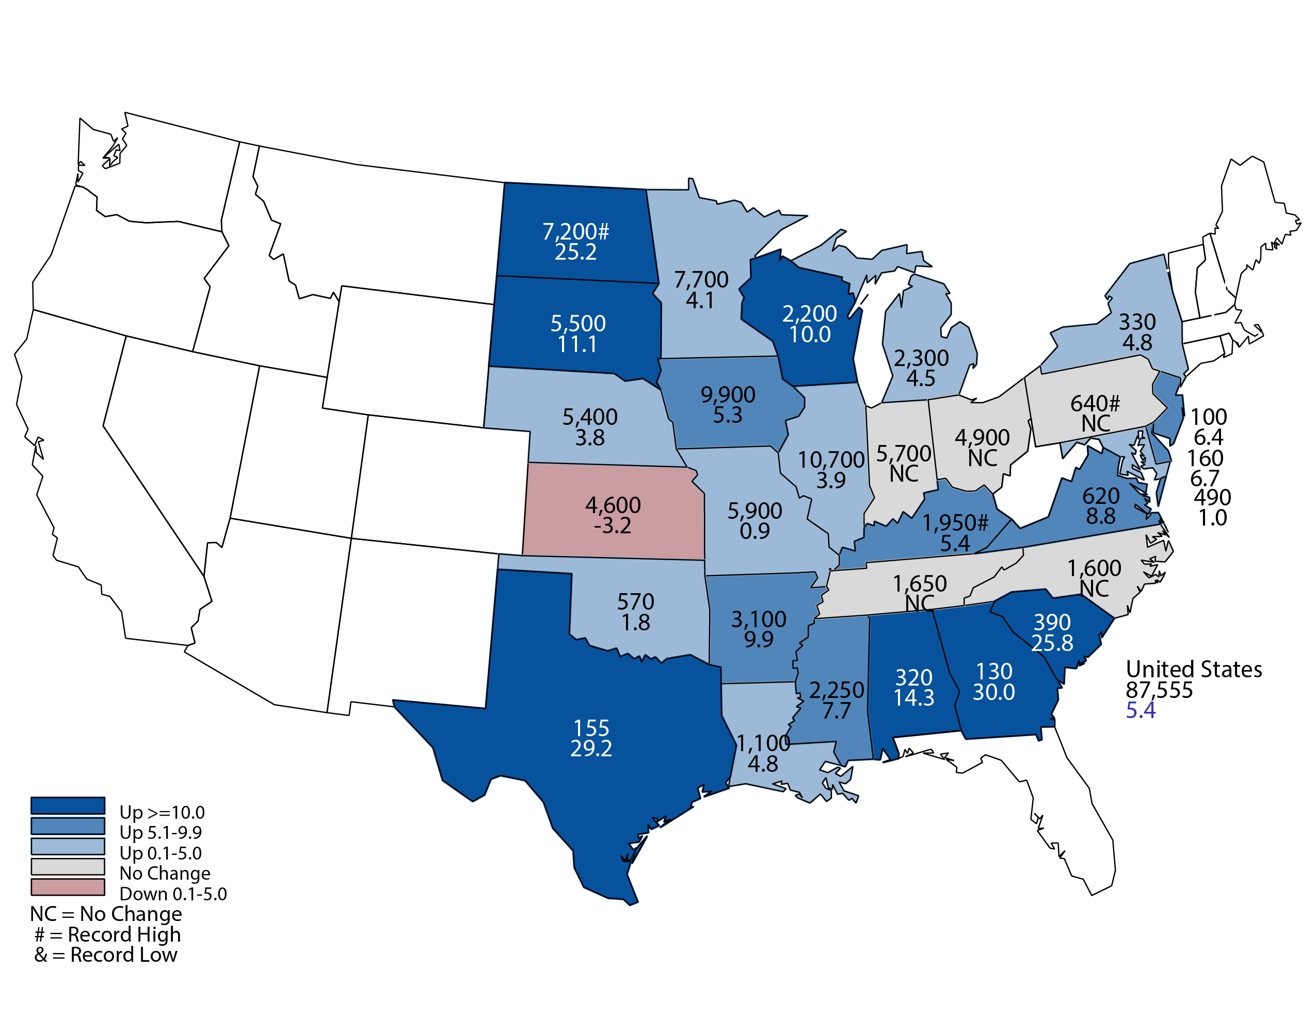
2021 Soybean Planted Acreage
Thousand Acres and Percent Change from Previous Year
June 30, 2021
Notes:
Soybean Planted Acres
Nebraska 5.4 million acres up from 5.2 million acres last year.

Slide 5
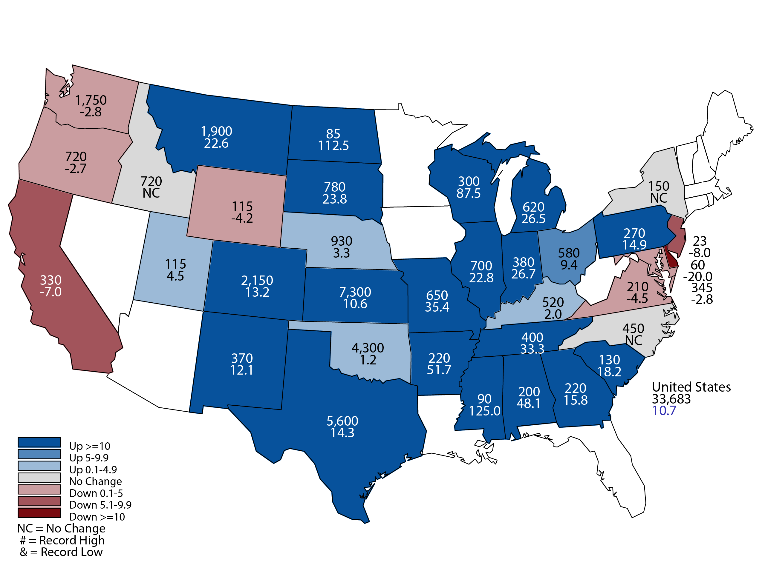
2021 Winter Wheat Planted Acres
Thousand Acres and Percent Change from Previous Year
June 30, 2021
Notes:
Winter Wheat Planted Acres
Nebraska 930,000 acres up from 900,000 last year.
Last year was a record low planting.

Slide 6
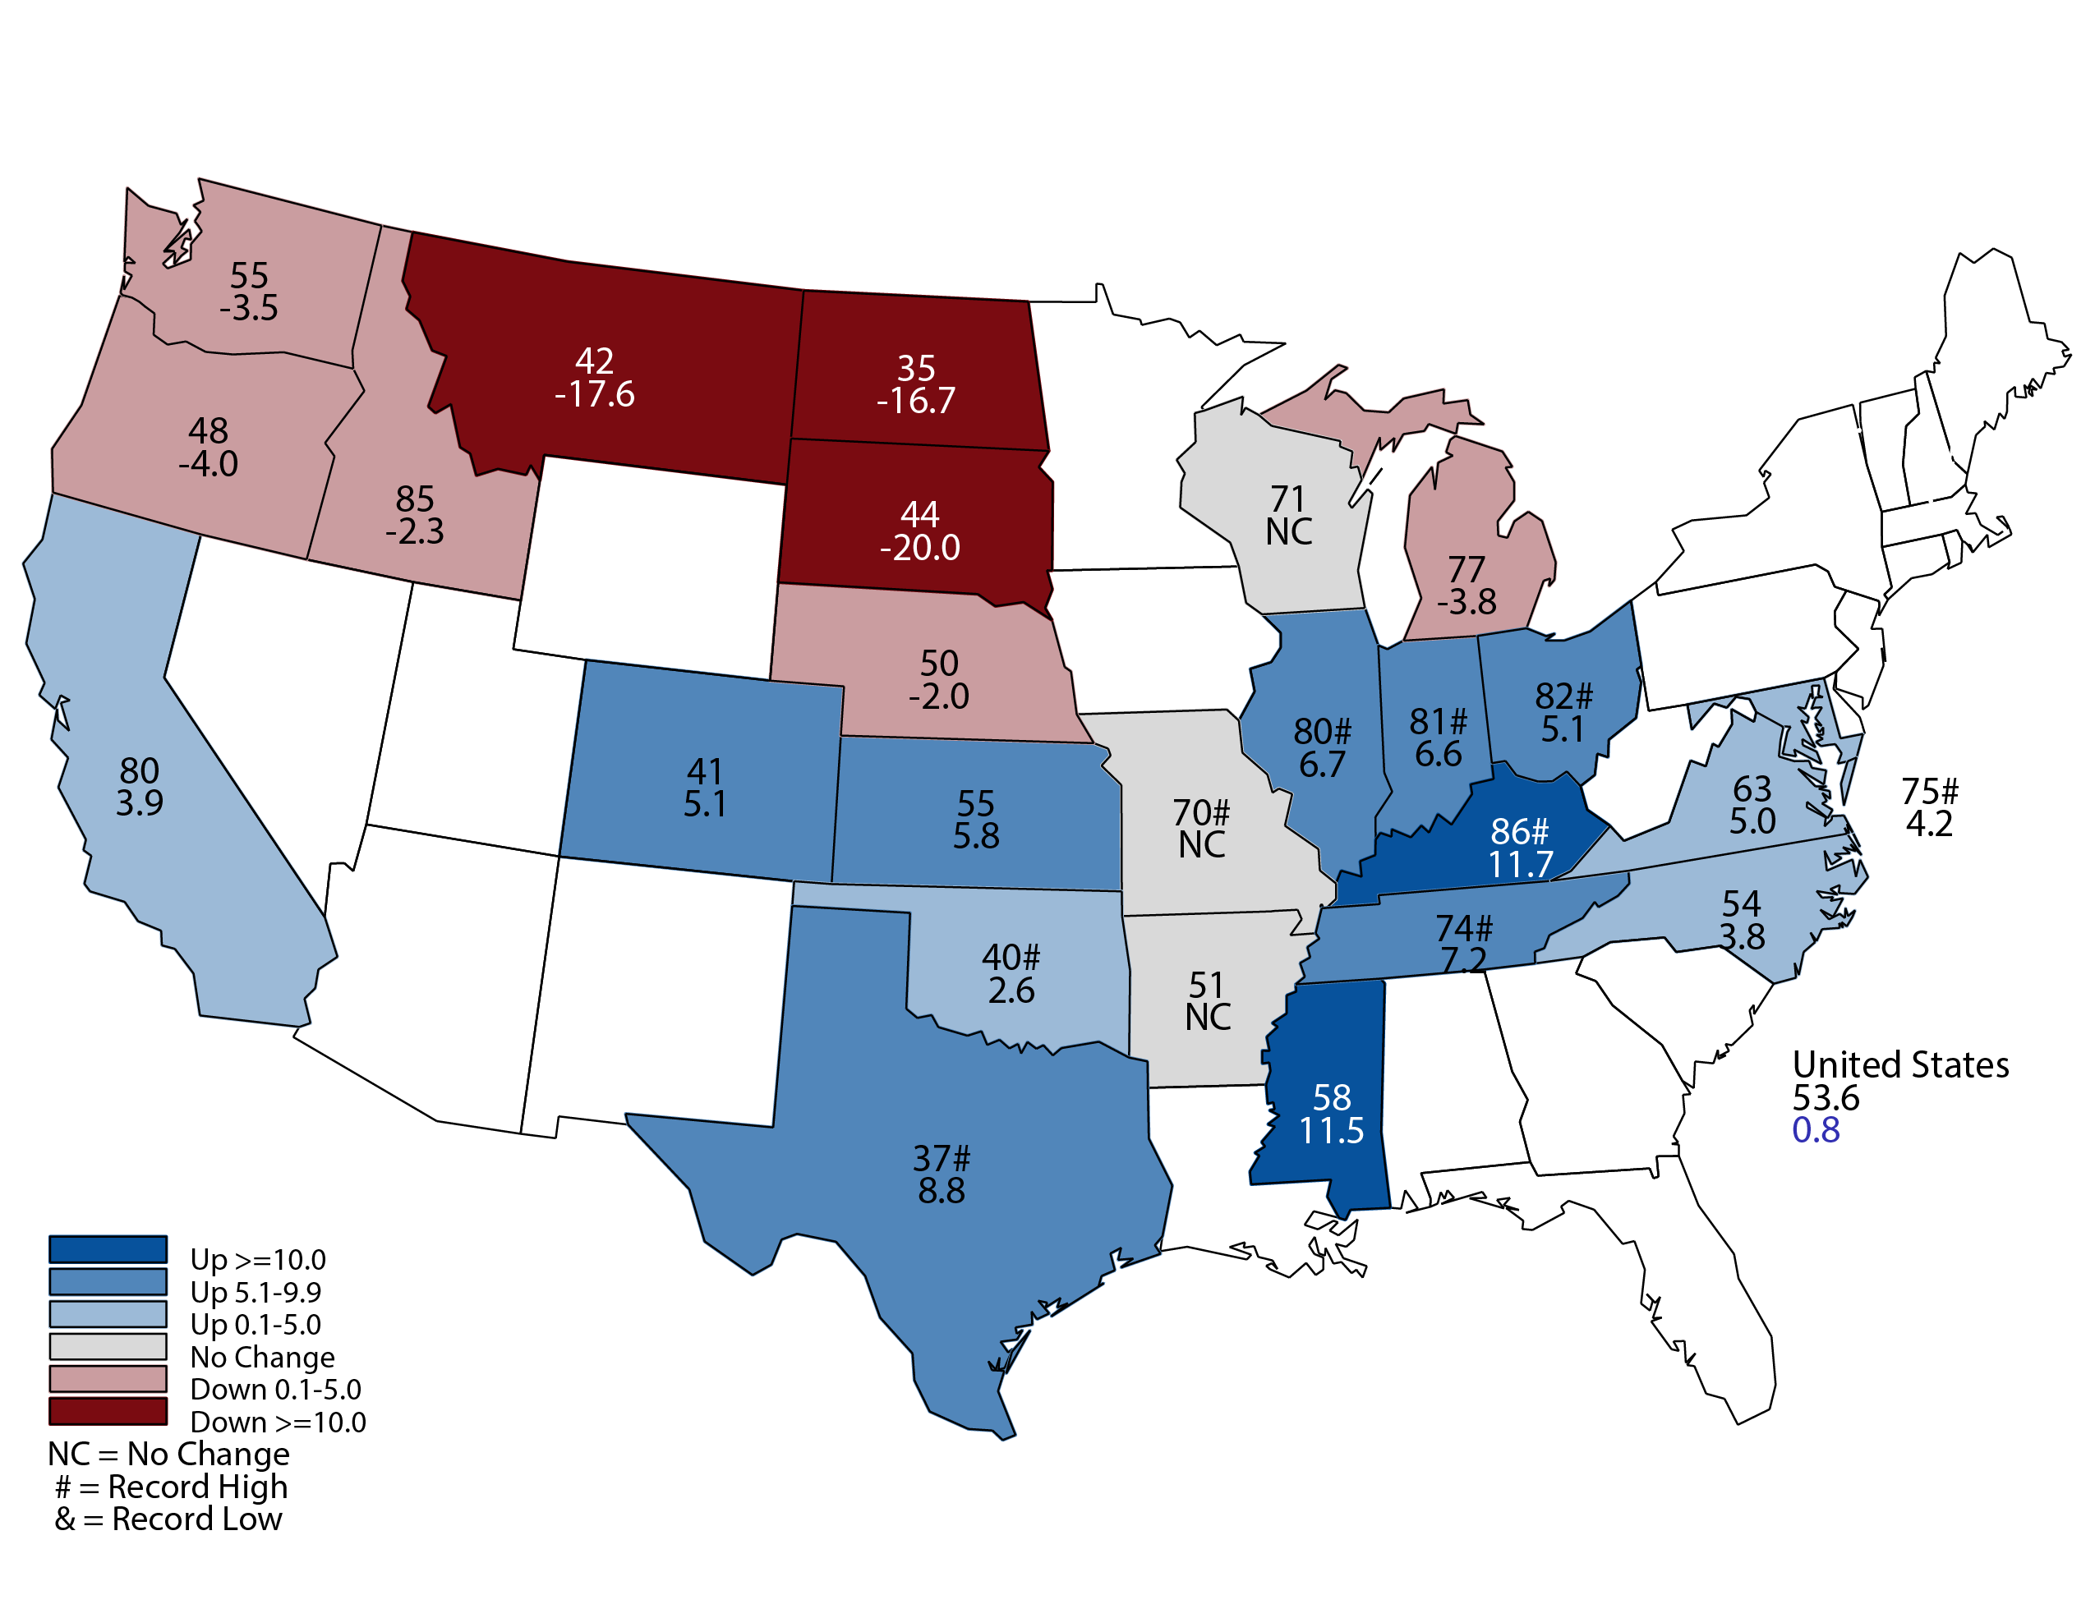
July 2021 Winter Wheat Yield
Bushels and Percent Change from Previous Month
7-12-21
Notes:
Winter Wheat Yield
Nebraska winter wheat yield is forecast at 50 bushels per acre, up 9 bushels from last year.
Production is forecast @ 42.0 million bushels, up 23% from last year.

Slide 7
Crop Progress and Condition July 18
 | Very Poor | Poor | Fair | Good | Excellent
Corn | 1% | 4% | 17% | 52% | 26%
Soybeans | 1% | 2% | 16% | 57% | 24%
Pasture and Range | 4% | 10% | 57% | 27% | 2%
 | Very Short | Short | Adequate | Surplus
Topsoil Moisture | 4% | 27% | 67% | 2%
Subsoil Moisture | 7% | 34% | 58% | 1%
7-19-21
Notes:
Corn is 78% good to excellent
Soybeans 81% good to excellent
Pasture and Range 29% good to excellent
Moisture
Topsoil is 69% Adequate to Surplus
Subsoil is 59% Adequate to Surplus

Slide 8
Crop Progress and Condition July 18
7-19-21
Notes:
Corn 78 percent good to excellent

Slide 9
7-19-21

Slide 10
Crop Progress and Condition July 18
Corn Percent Rated Good to Excellent
29
42
30
76
74
68
91
78
75
65
73
78
74
62
83
84
74
58
7-19-21
Notes:
Dakota and MN are below 50%.

Slide 11
Crop Progress and Condition July 18
7-19-21
Notes:
Soybean 81 percent good to excellent

Slide 12
7-19-21

Slide 13
Crop Progress and Condition July 18
7-19-21
Notes:
Pasture: 29 % good to excellent

Slide 14
Crop Progress and Condition July 18
7-19-21
Notes:
When you add Fair to the chart, the numbers look better. 86%

Slide 15
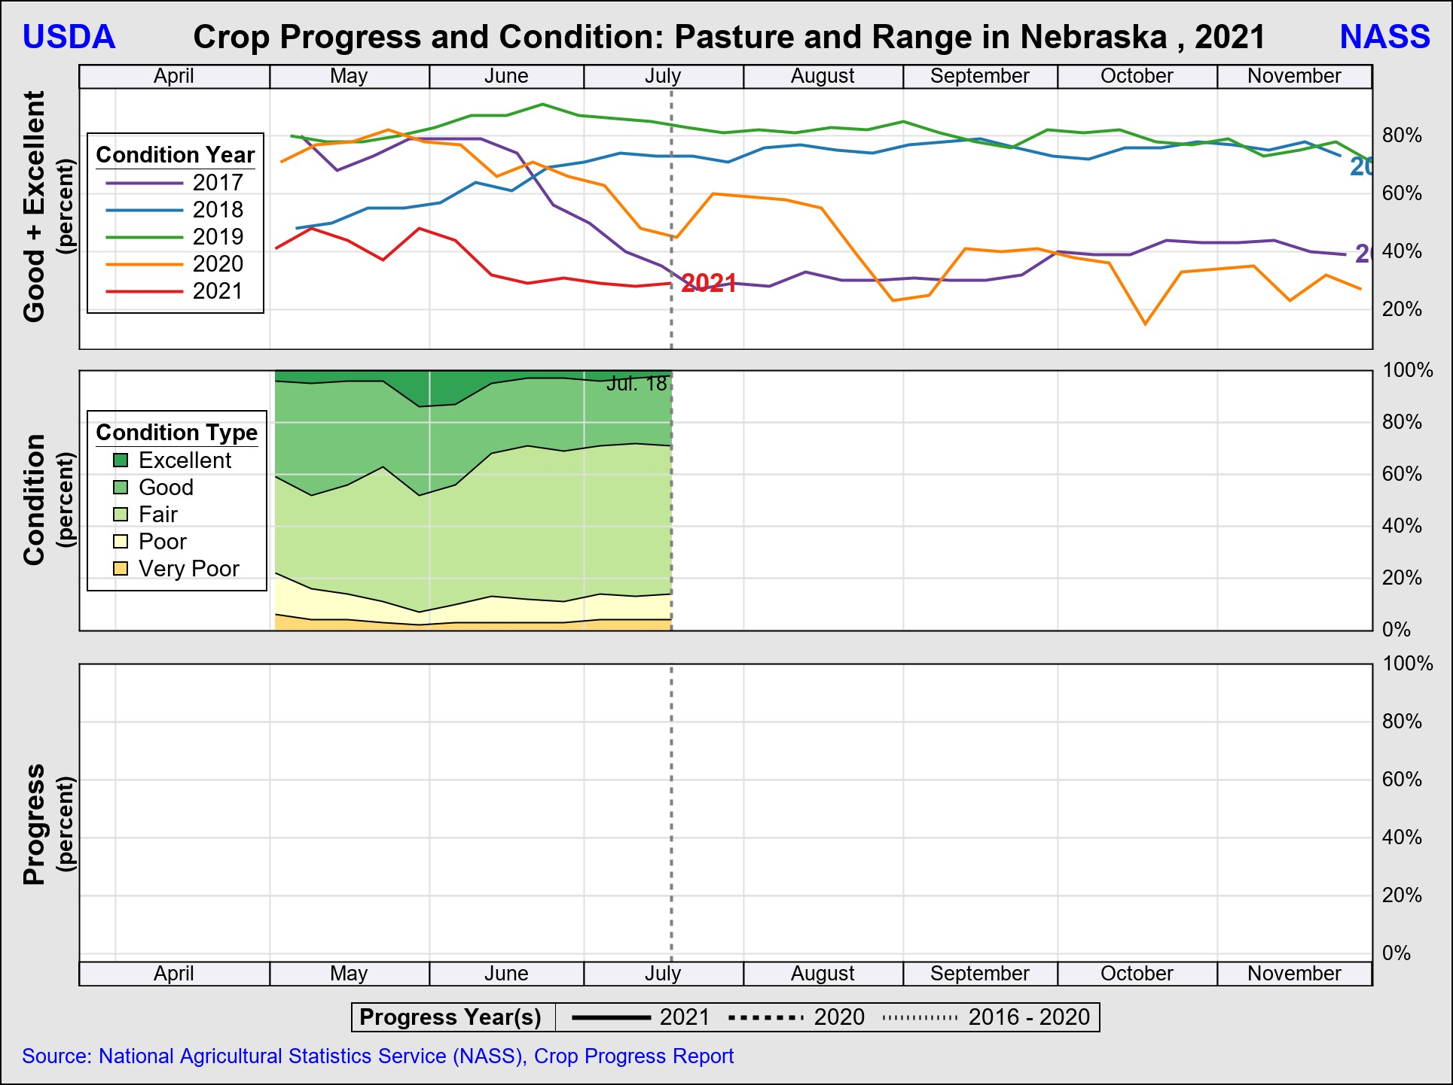
7-19-21

Slide 16
Crop Progress and Condition July 18
 | 7/18/2021 | Last Year | 5-Year Average
Winter Wheat: Harvested | 60% | 75% | 67%
Corn: Silking | 54% | 55% | 54%
Corn: Dough | 4% | 3% | 4%
Soybeans: Blooming | 74% | 72% | 62%
Soybeans: Setting Pods | 30% | 28% | 16%
7-19-21
Notes:
All crops are currently developing ahead of average.

Slide 17
Upcoming Reports
Release Date | Title
July 23 | Cattle on Feed
August 12 | Crop Production
August 27 | Cash Rent County Estimates
Notes:
August 12 Crop Production will have first survey based yield and production forecast for row crops and hay.

Slide 18
United States Department of Agriculture
National Agricultural Statistics Service
All Reports Available At
www.nass.usda.gov
For Questions
402-437-5541
800-582-6443
Nicholas.Streff@usda.gov

