Slide 1

NE Drought Conditions CARC Update: April 8, 2022
Brian Fuchs
National Drought Mitigation Center
University of Nebraska-Lincoln
School of Natural Resources

Slide 2
Regional Climatic and Drought Conditions…

Slide 3
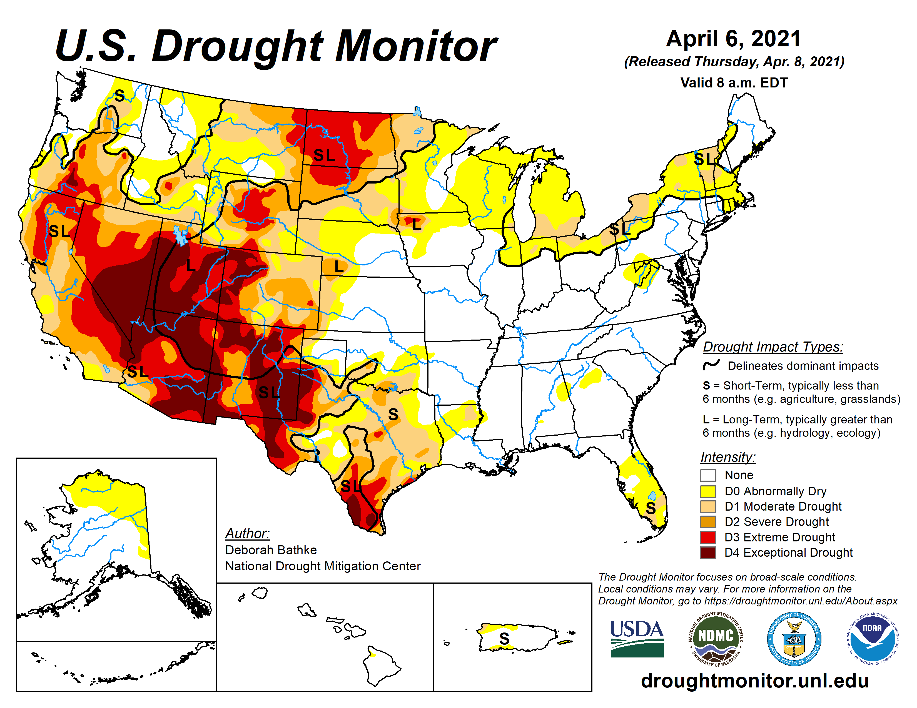
Last year at this time…..

Slide 4
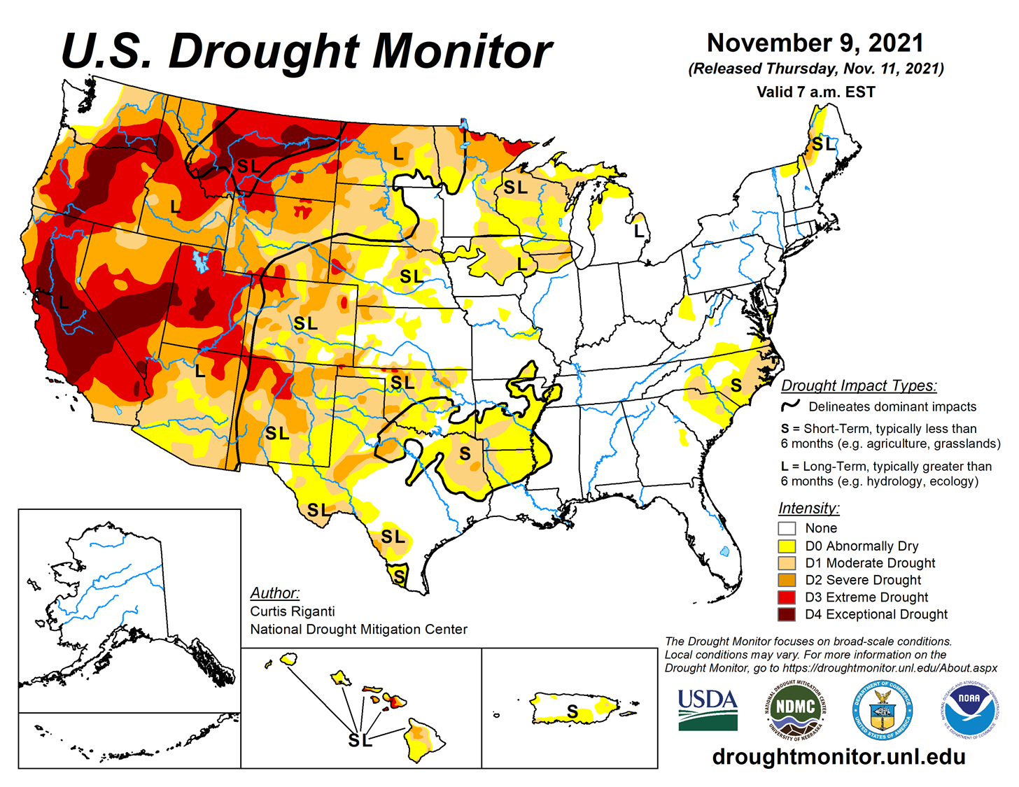
Last CARC Meeting…..

Slide 5
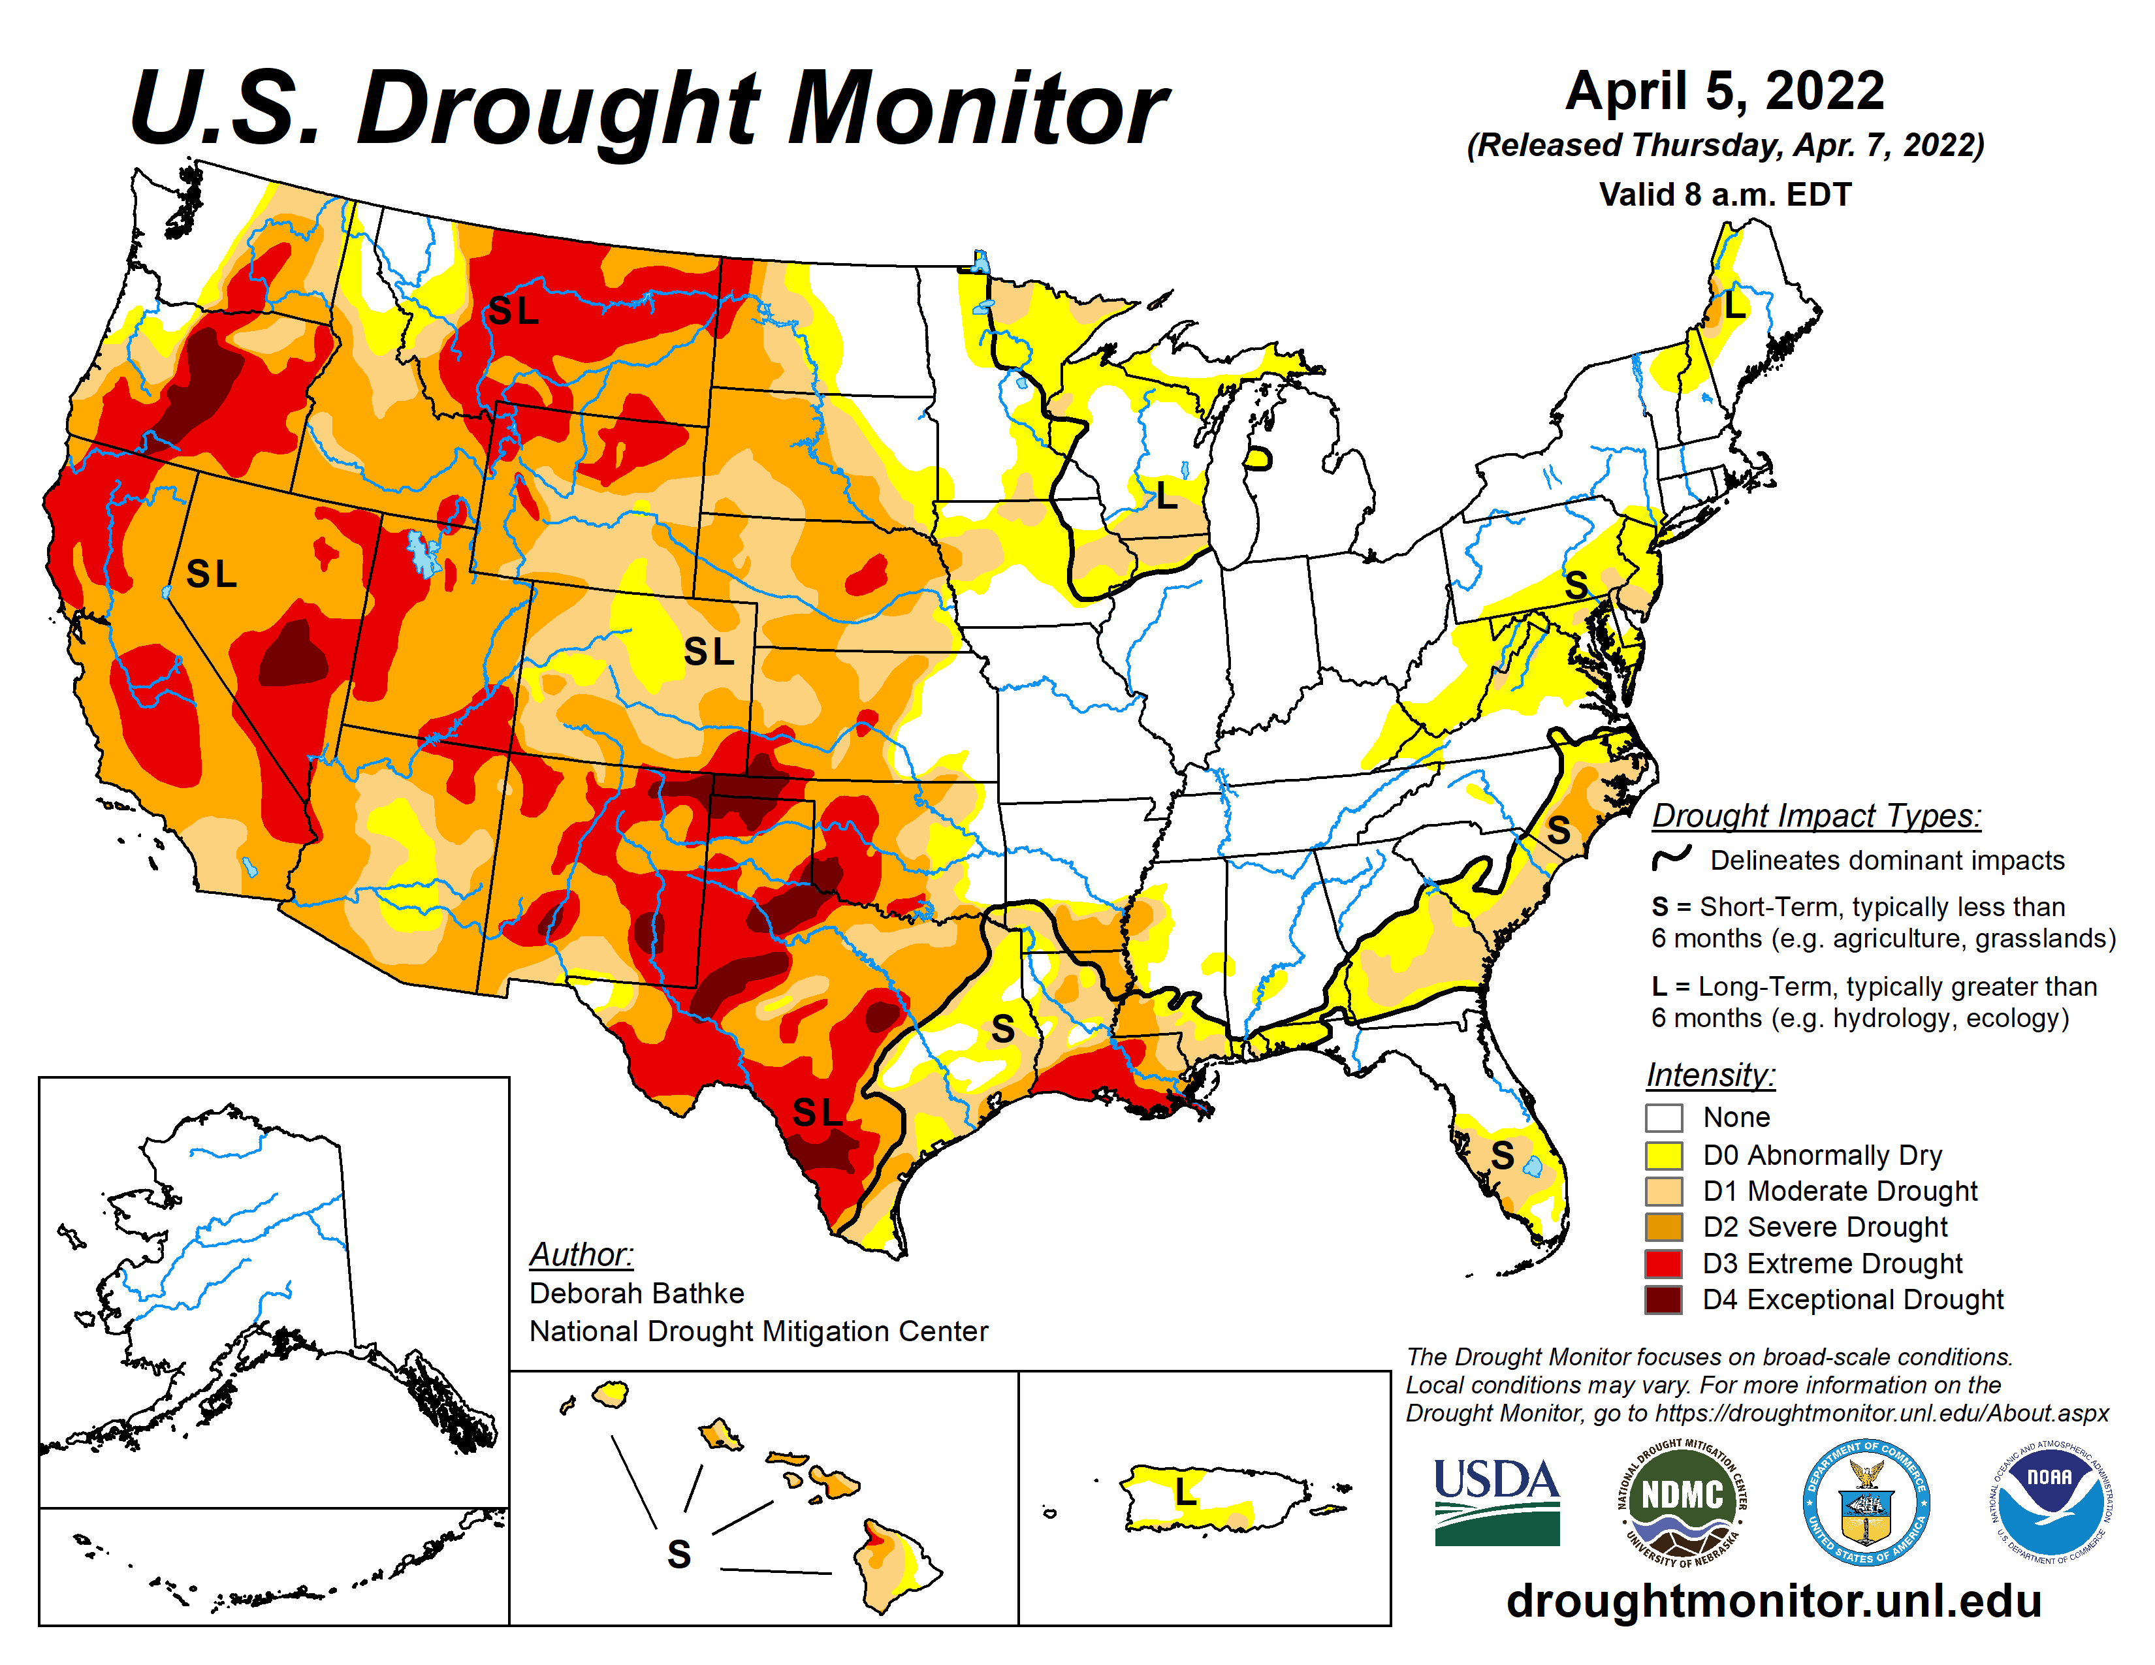

Slide 6
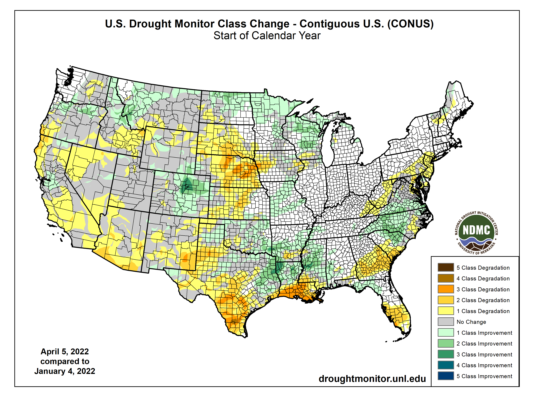

Slide 7
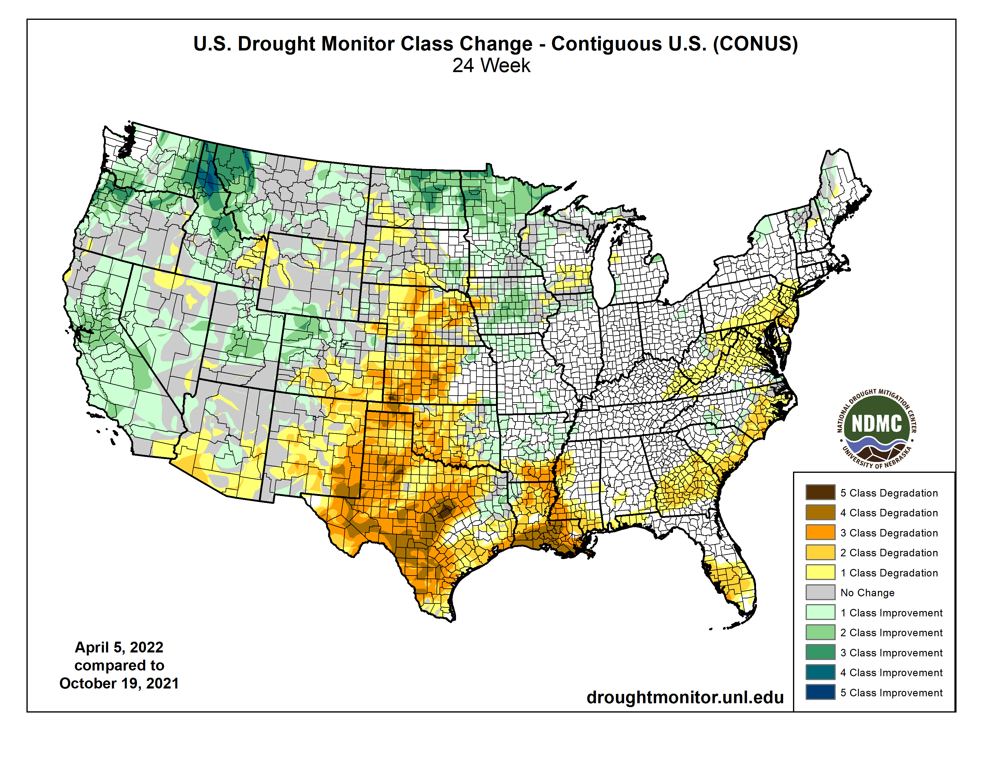

Slide 8
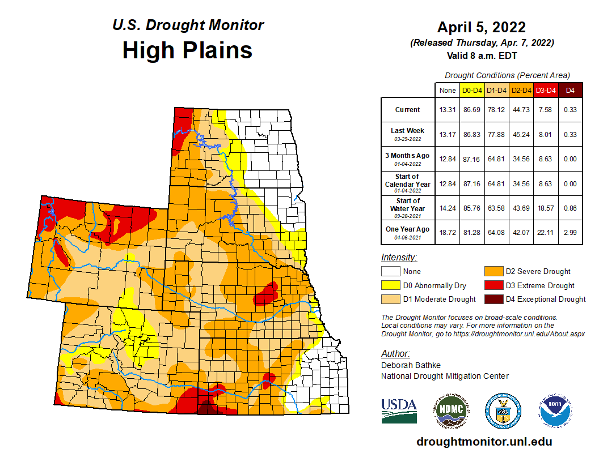


Slide 10
Last CARC meeting

Slide 11
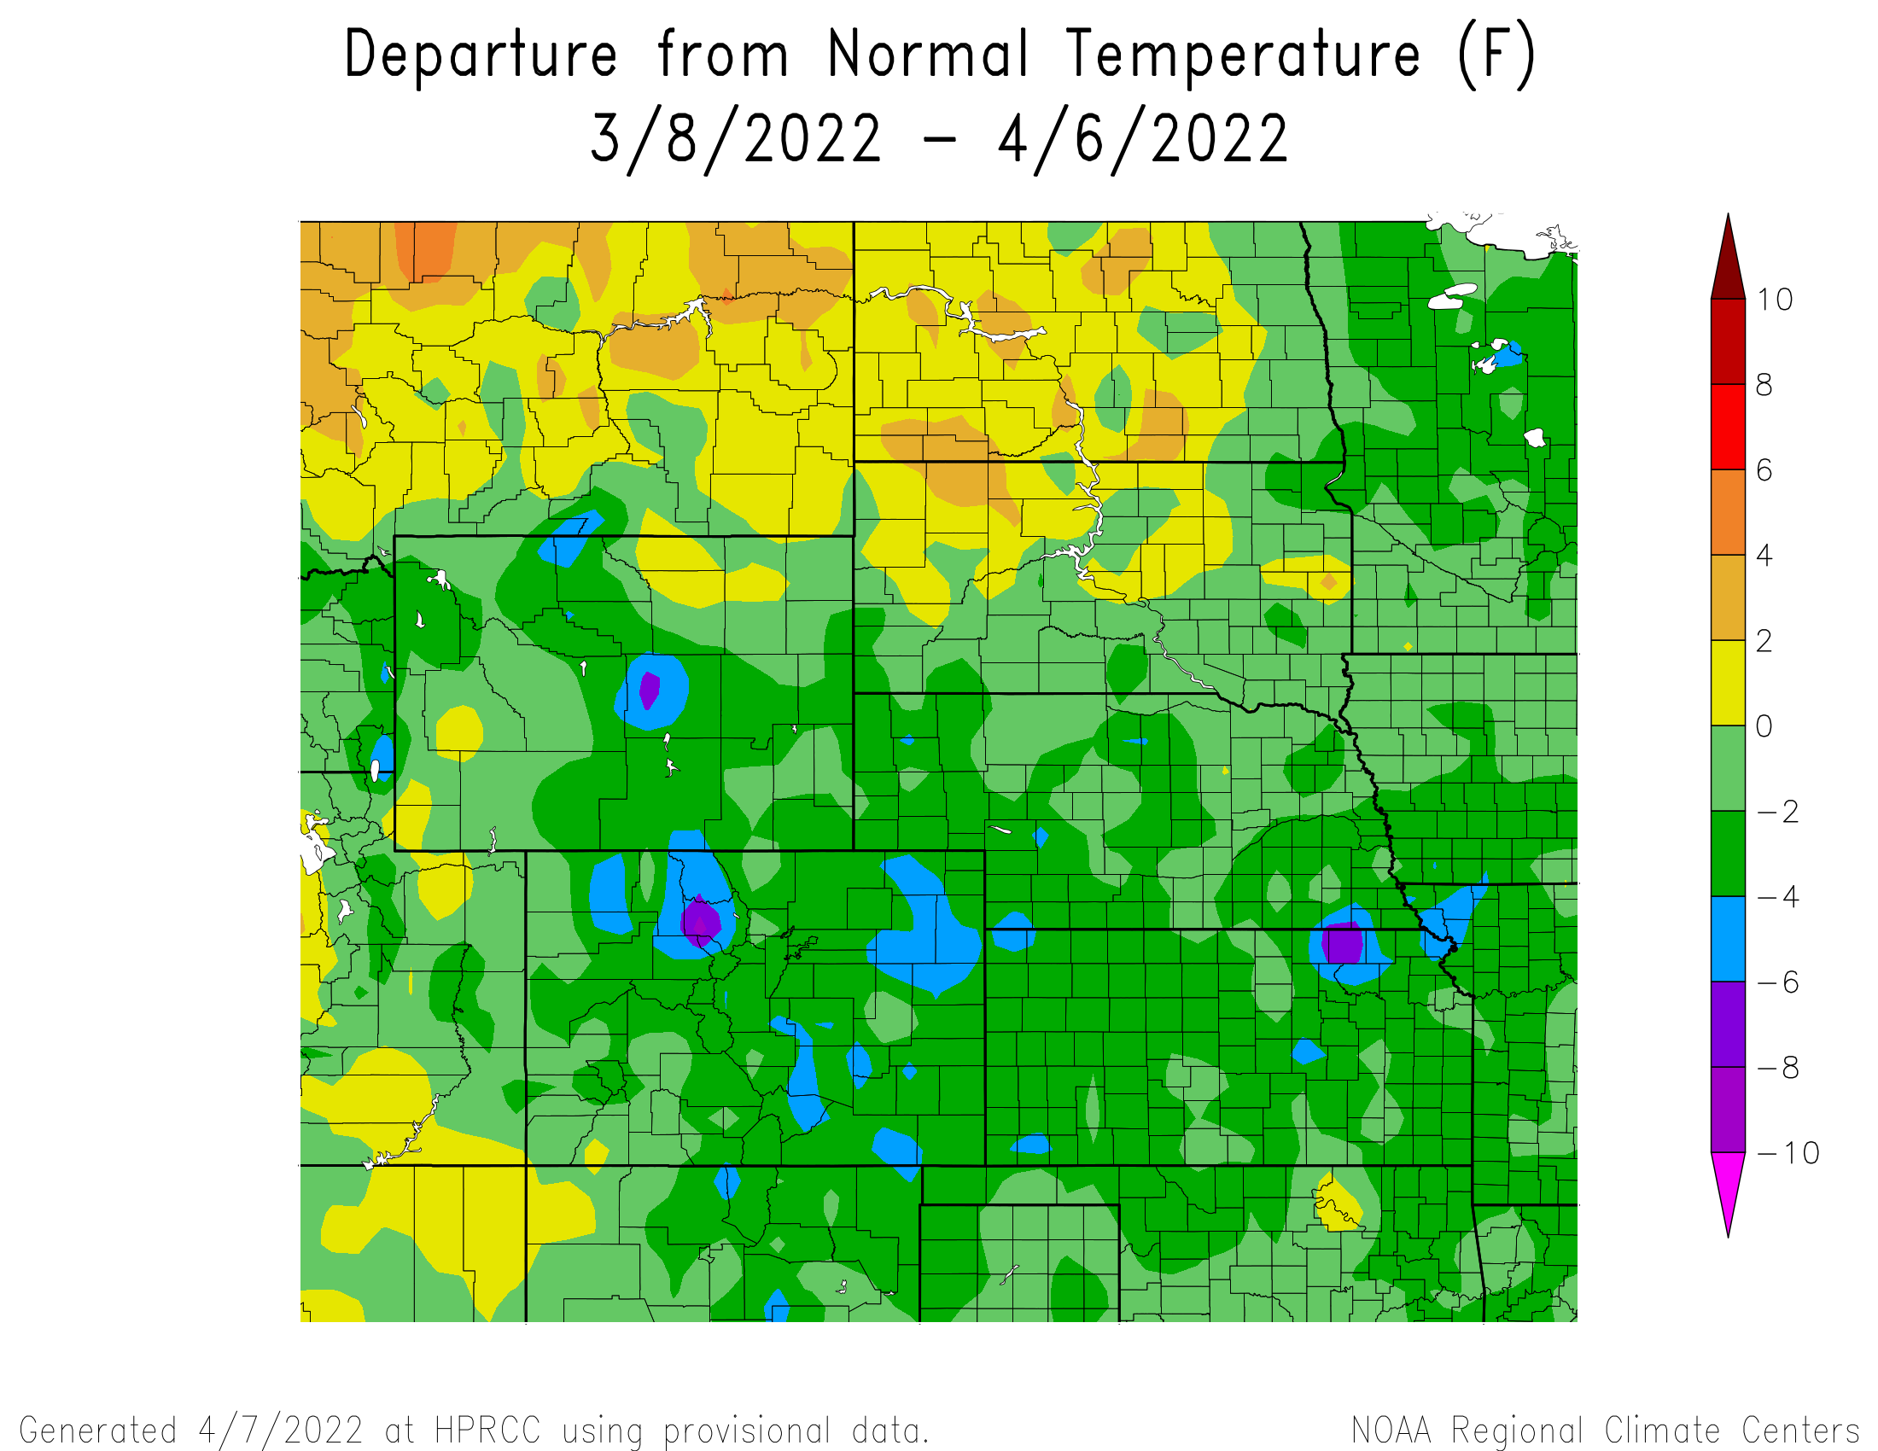
Departure from Normal Temperatures over the last 30 days

Slide 12
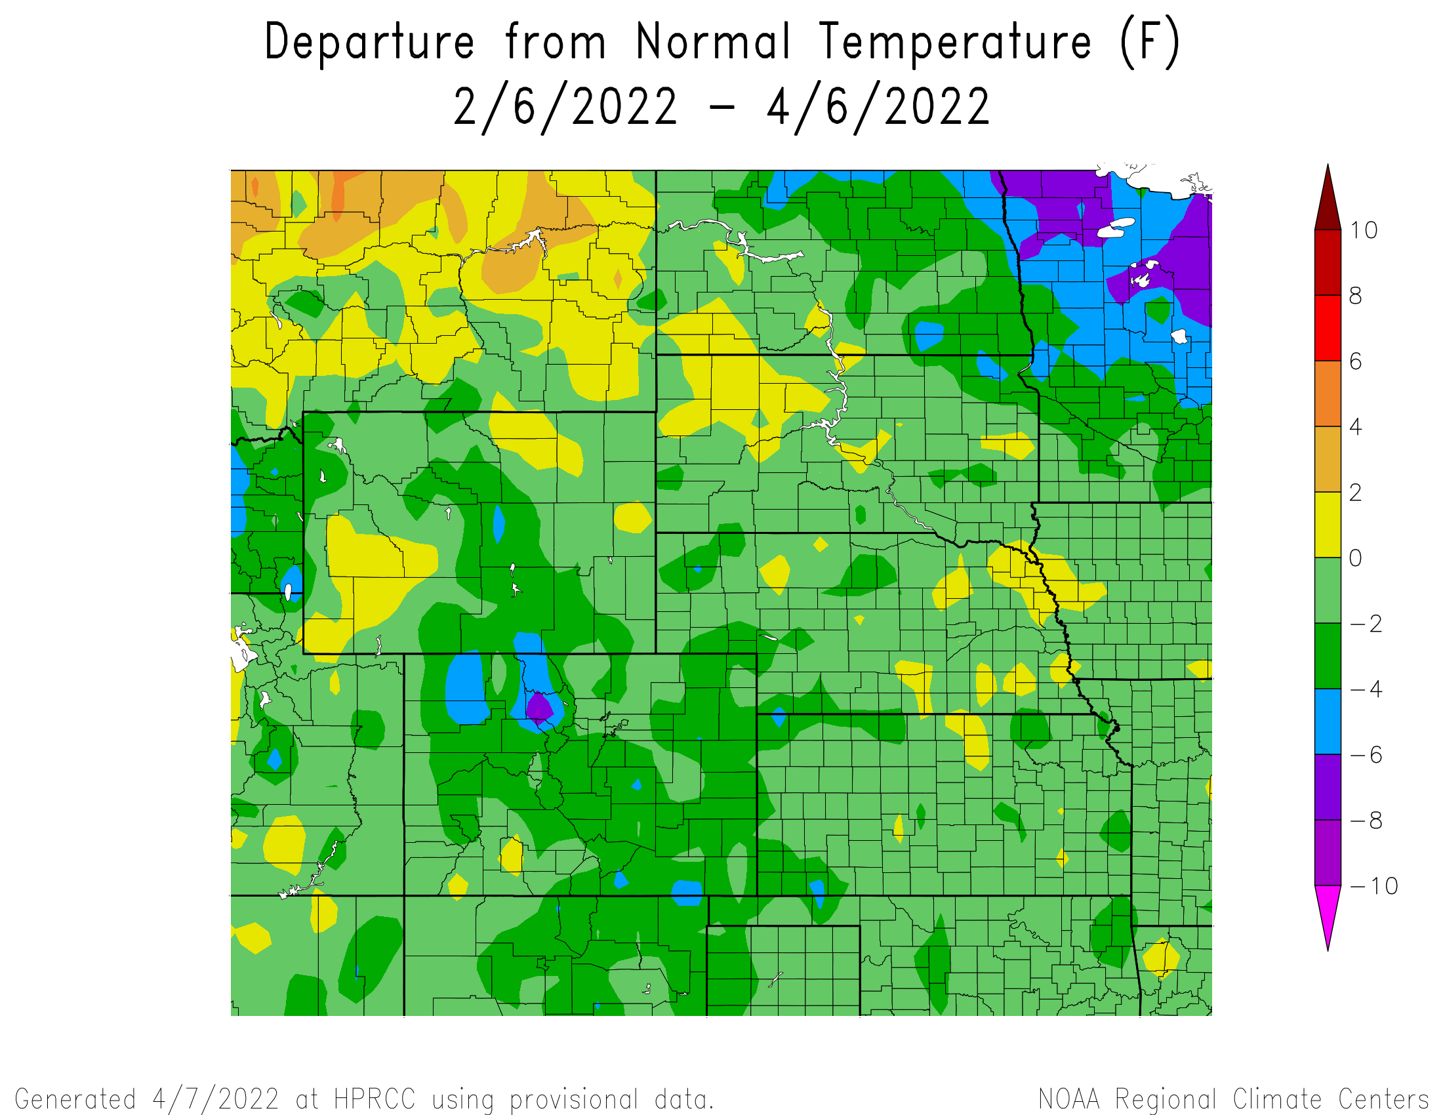
Departure from Normal Temperatures over the last 60 days

Slide 13
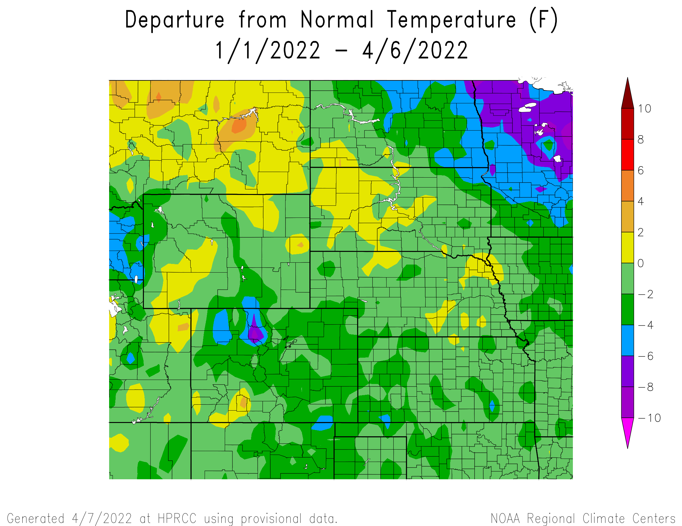
Departure from Normal Temperatures for the Calendar Year

Slide 14
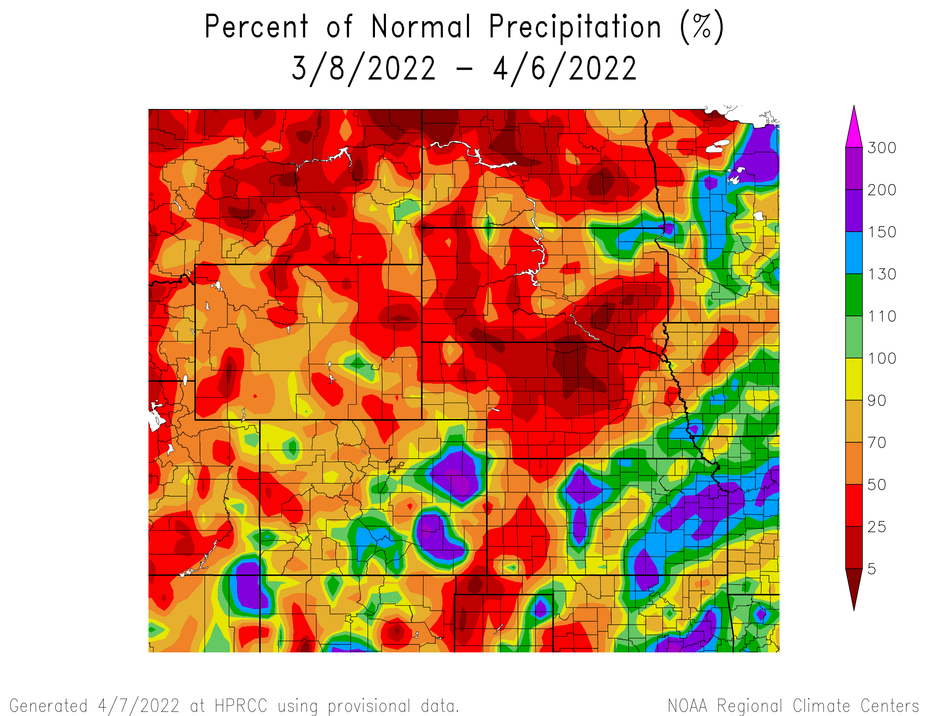
Percent of Normal Precipitation over the last 30 days

Slide 15
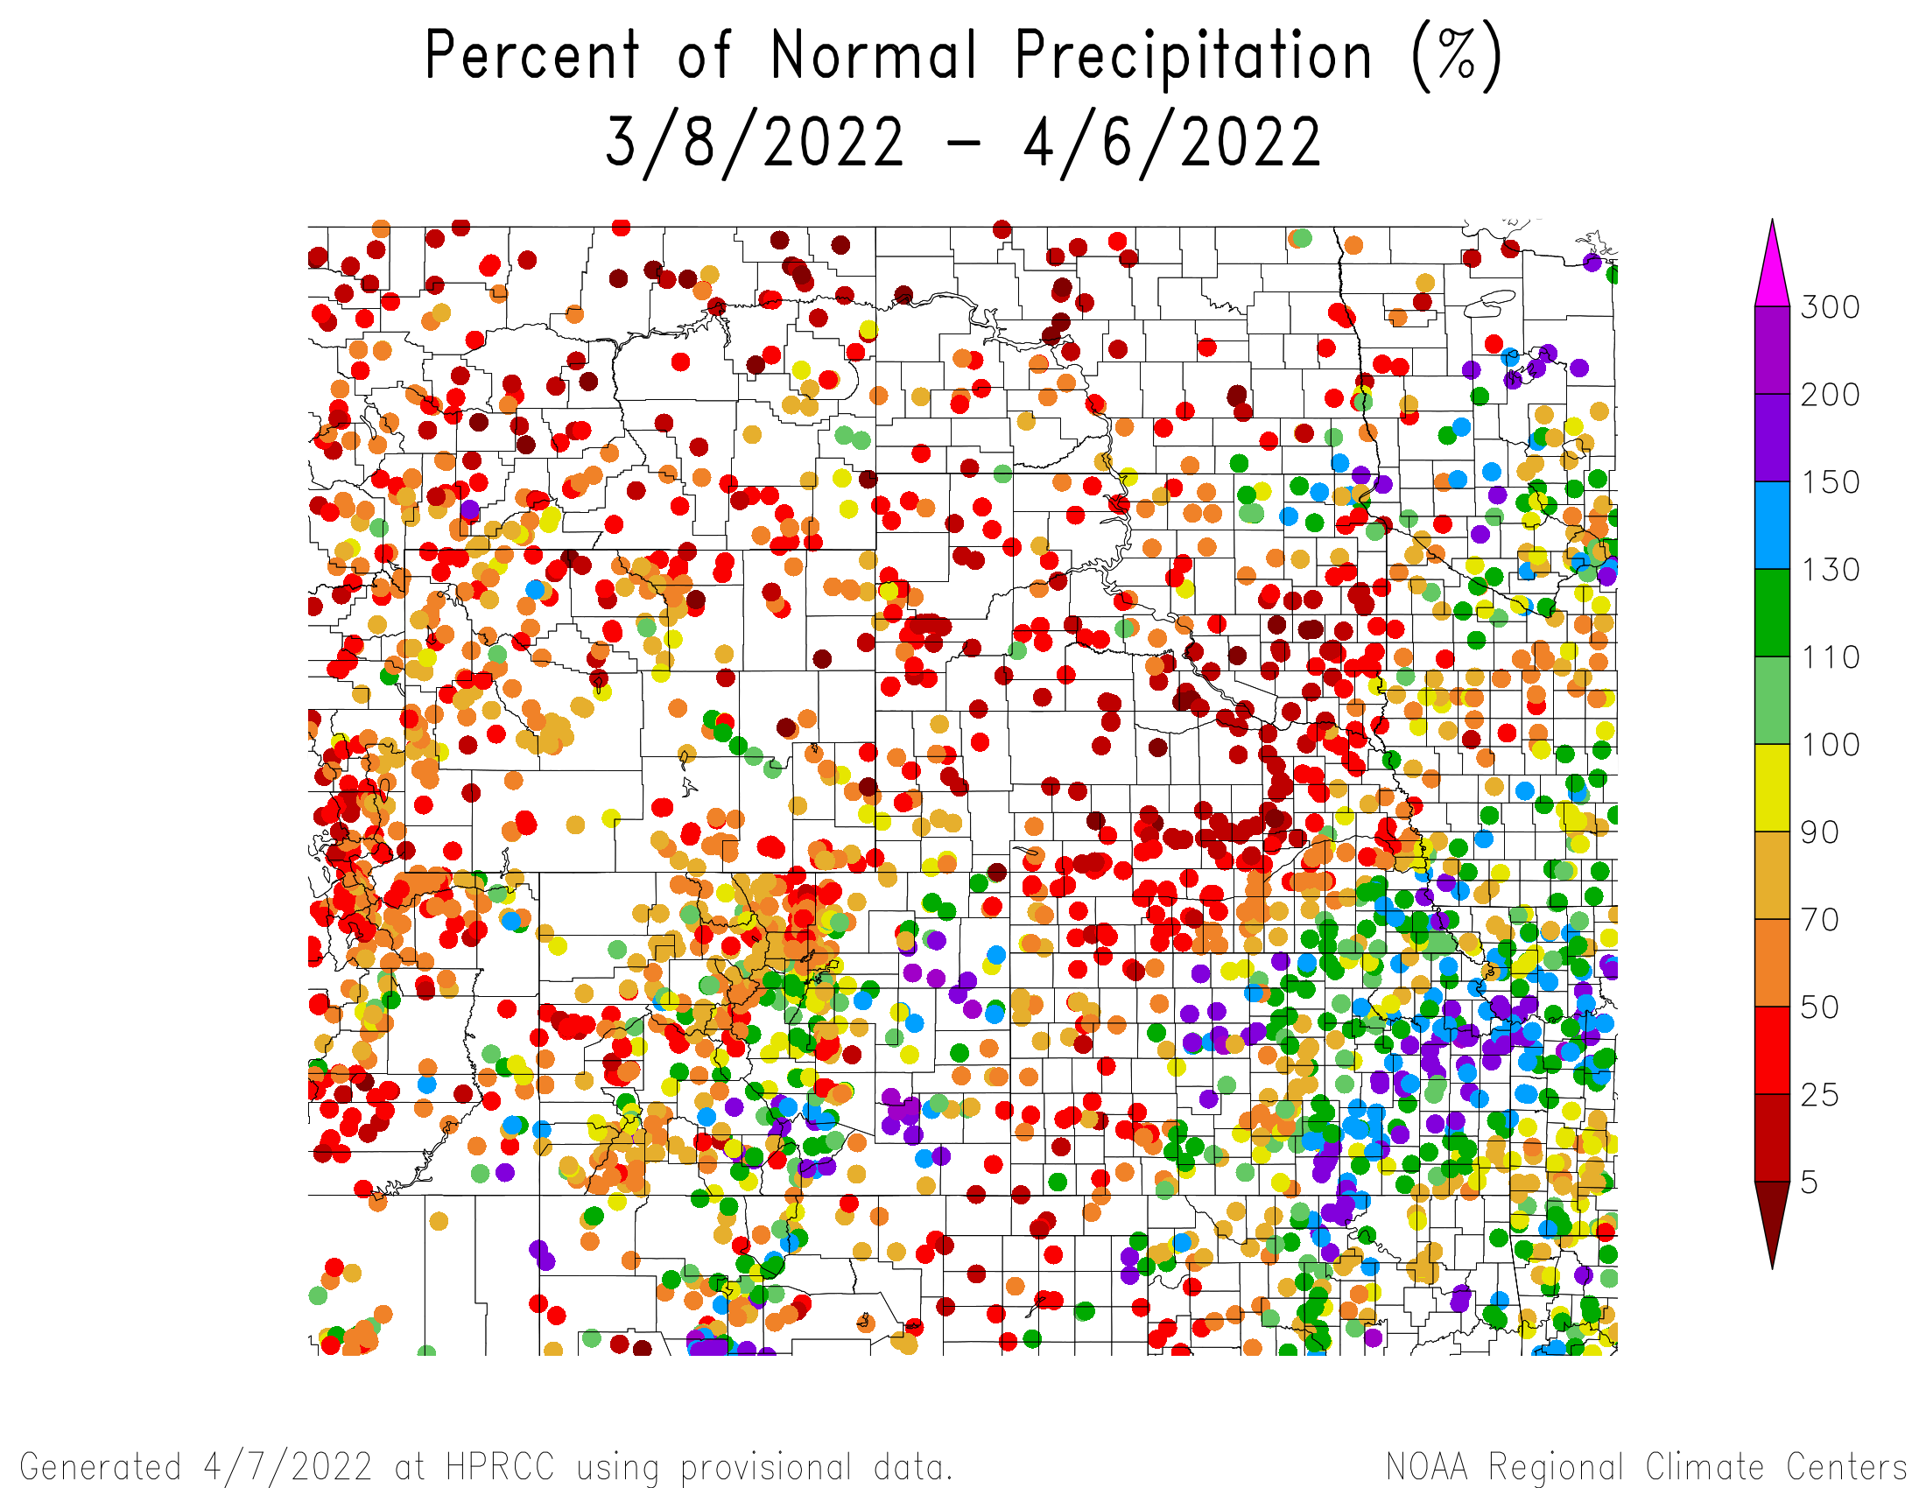
Percent of Normal Precipitation over the last 30 days

Slide 16
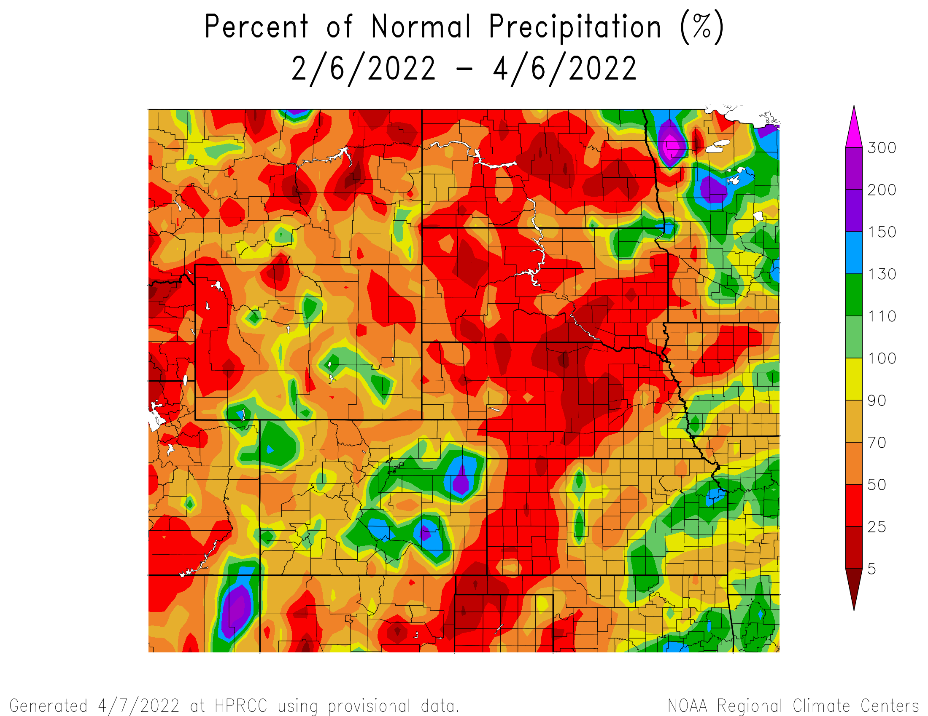
Percent of Normal Precipitation over the last 60 days

Slide 17
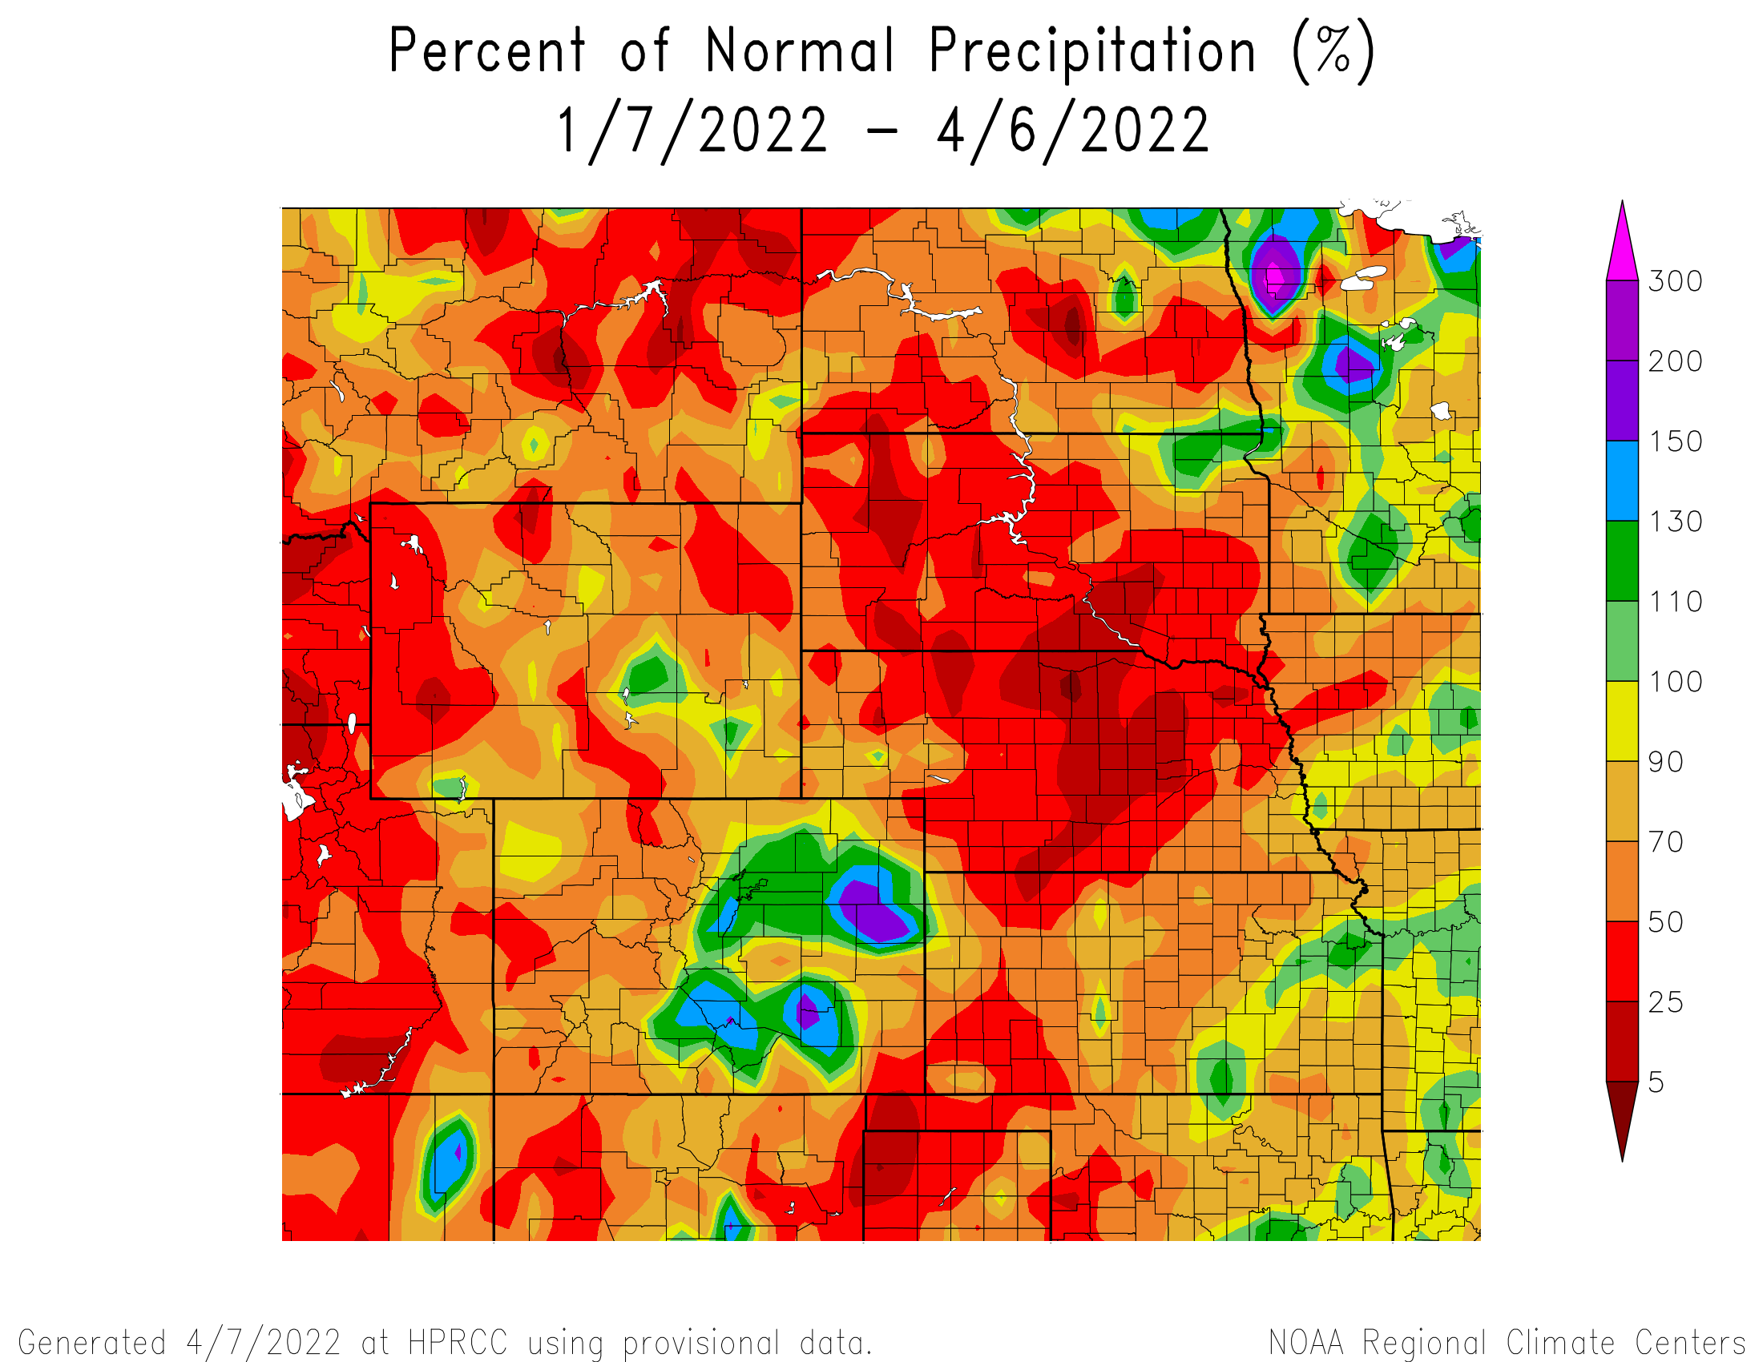
Percent of Normal Precipitation over the last 90 days

Slide 18
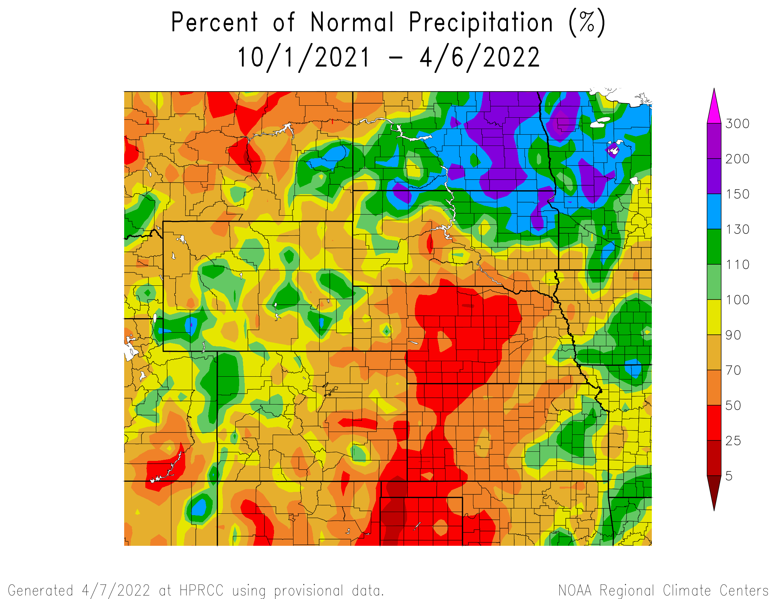
Percent of Normal Precipitation for the current water year

Slide 19
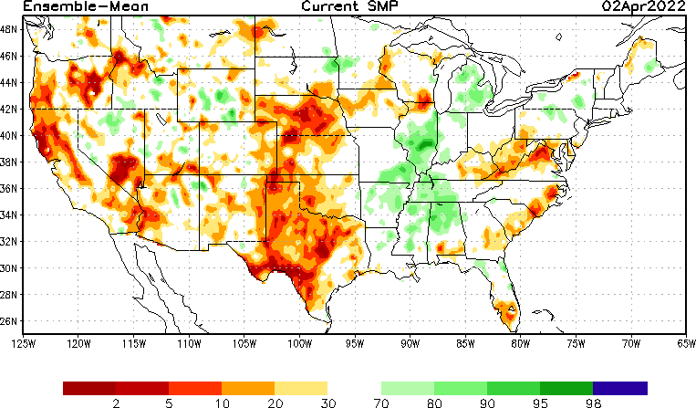
NLDAS Soil Moisture Model: Current Soil Moisture Anomaly

Slide 20
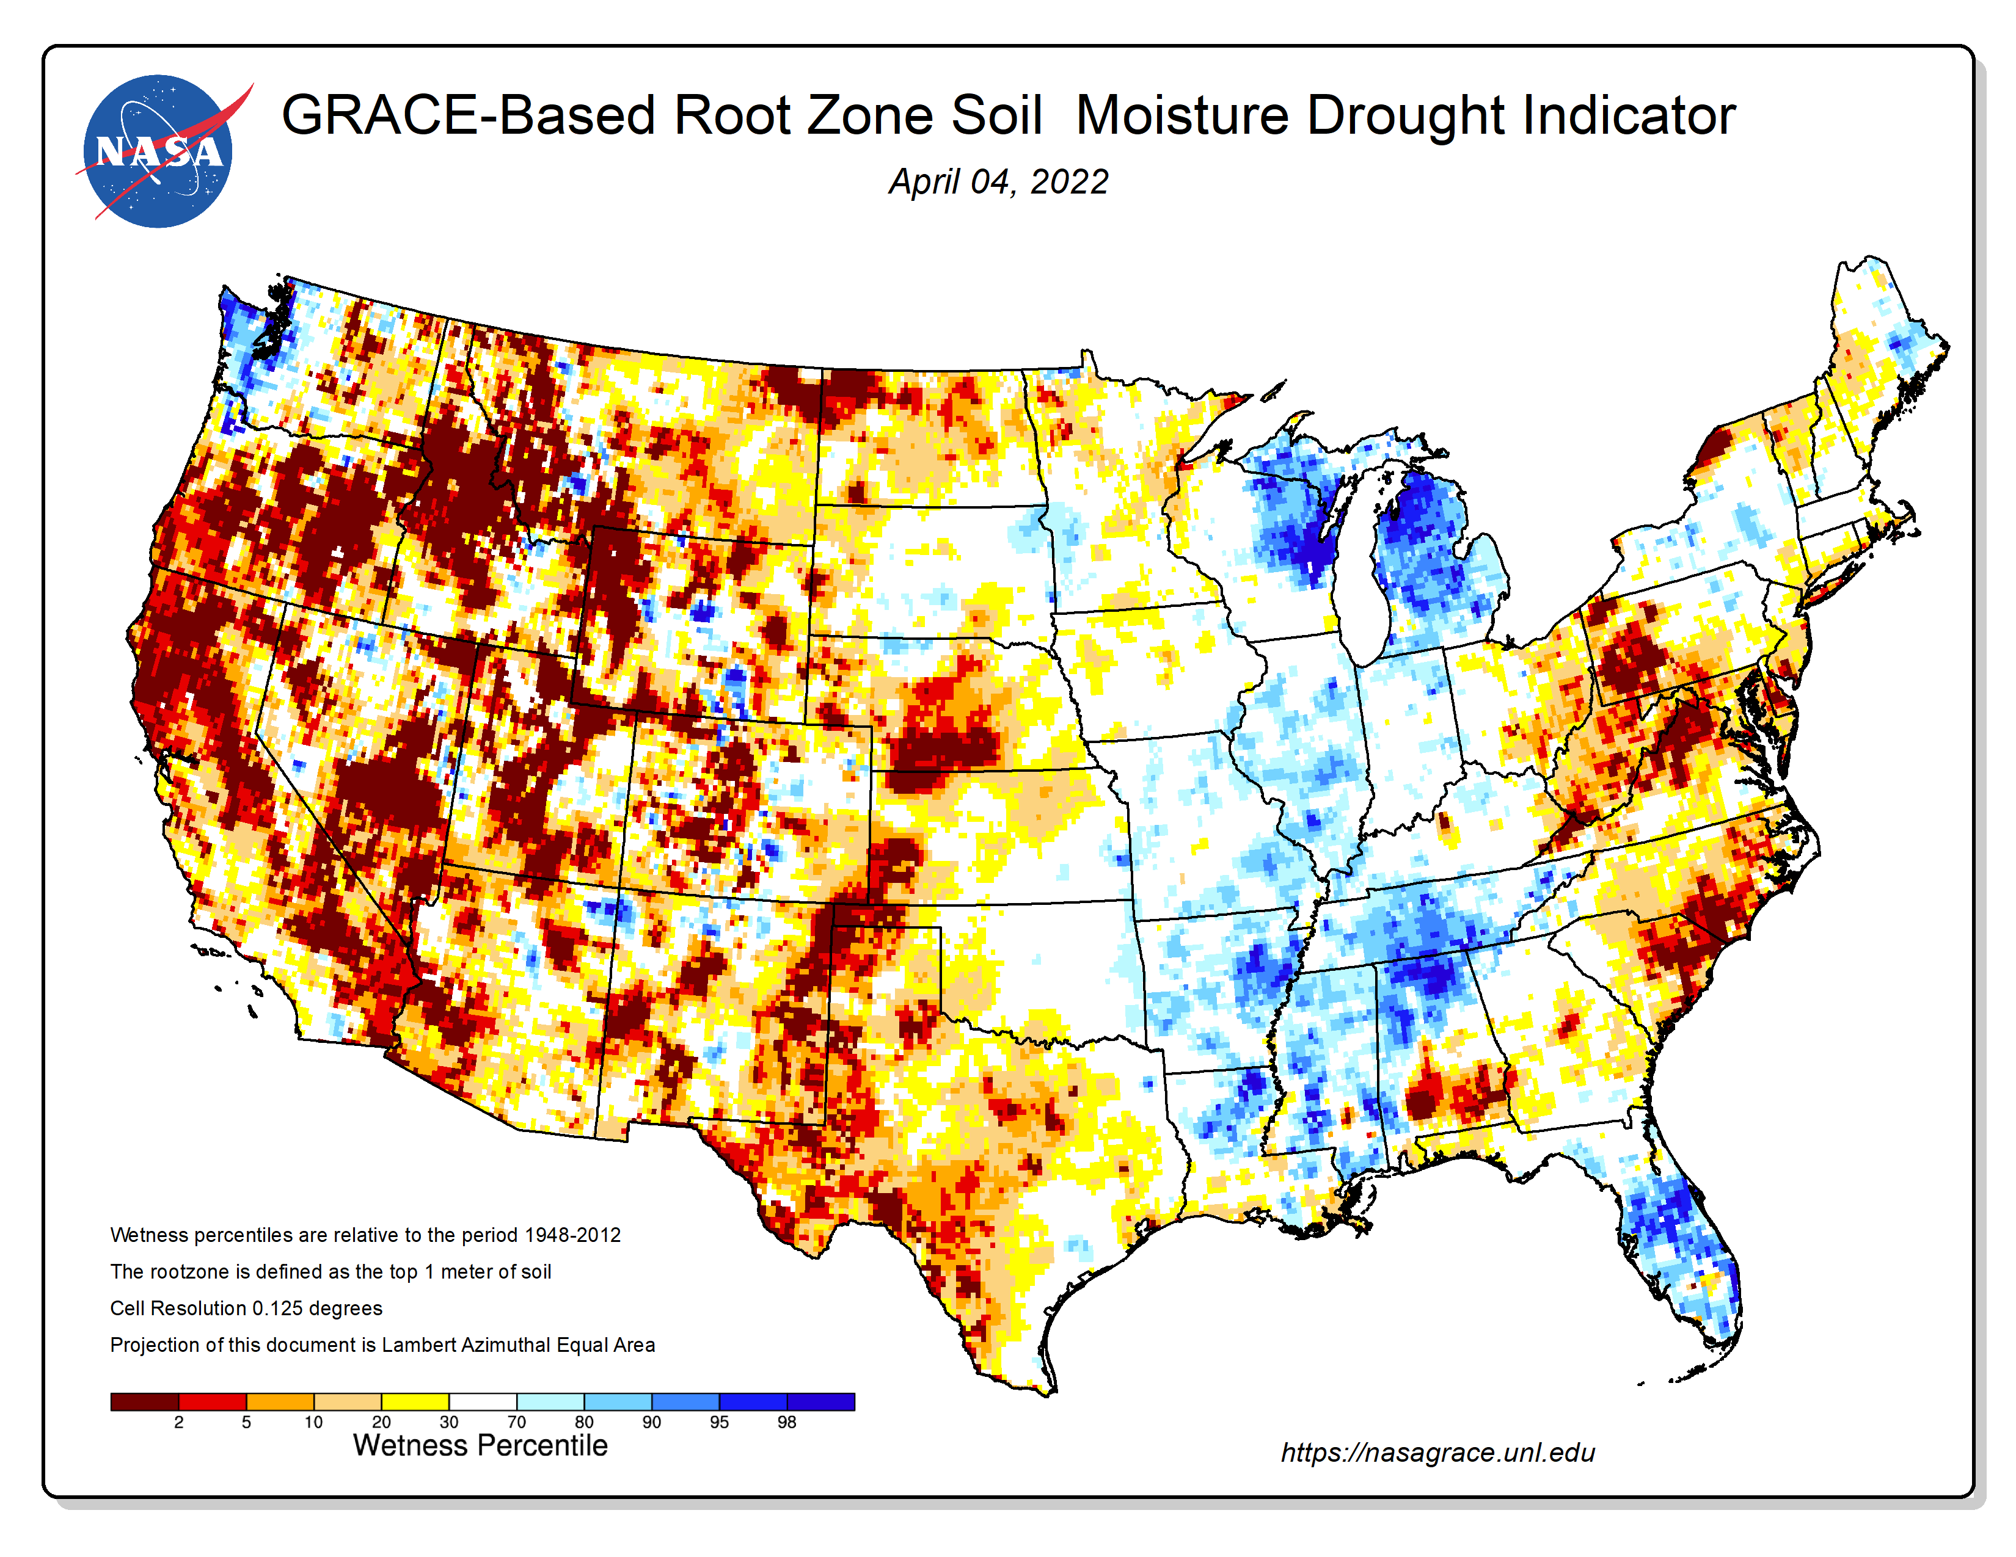
NASA GRACE-Based Root Zone Soil Moisture
https://nasagrace.unl.edu/

Slide 21
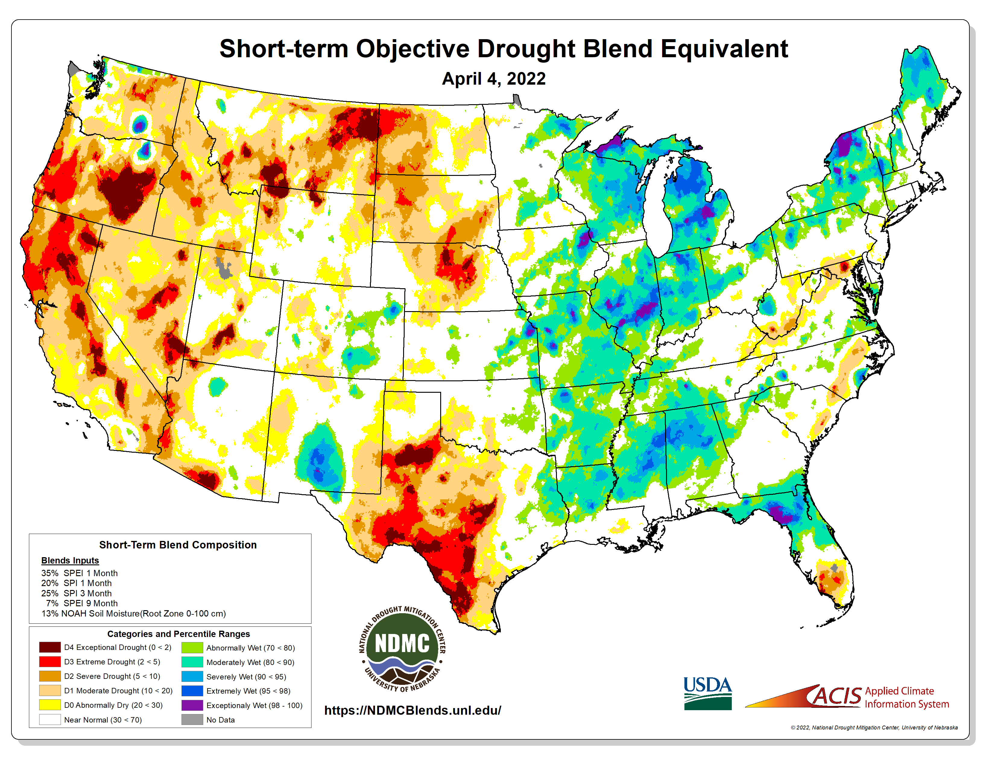
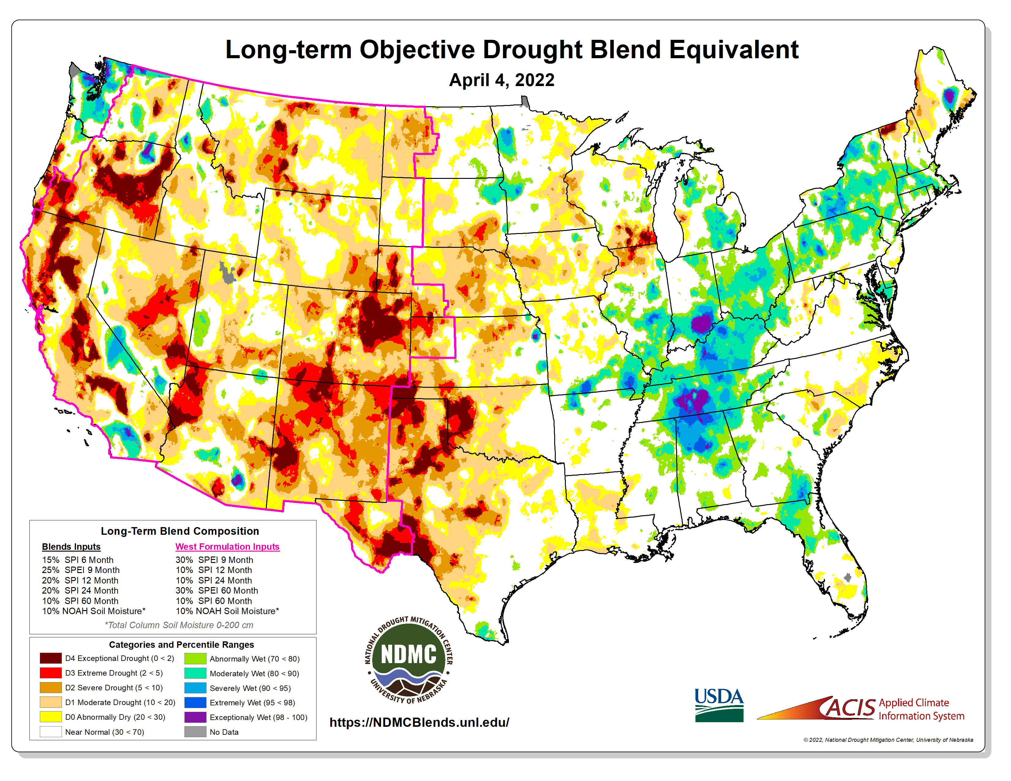
https://ndmcblends.unl.edu/
NDMC’s weekly Objective Blends for both short-term and long-term drought

Slide 22
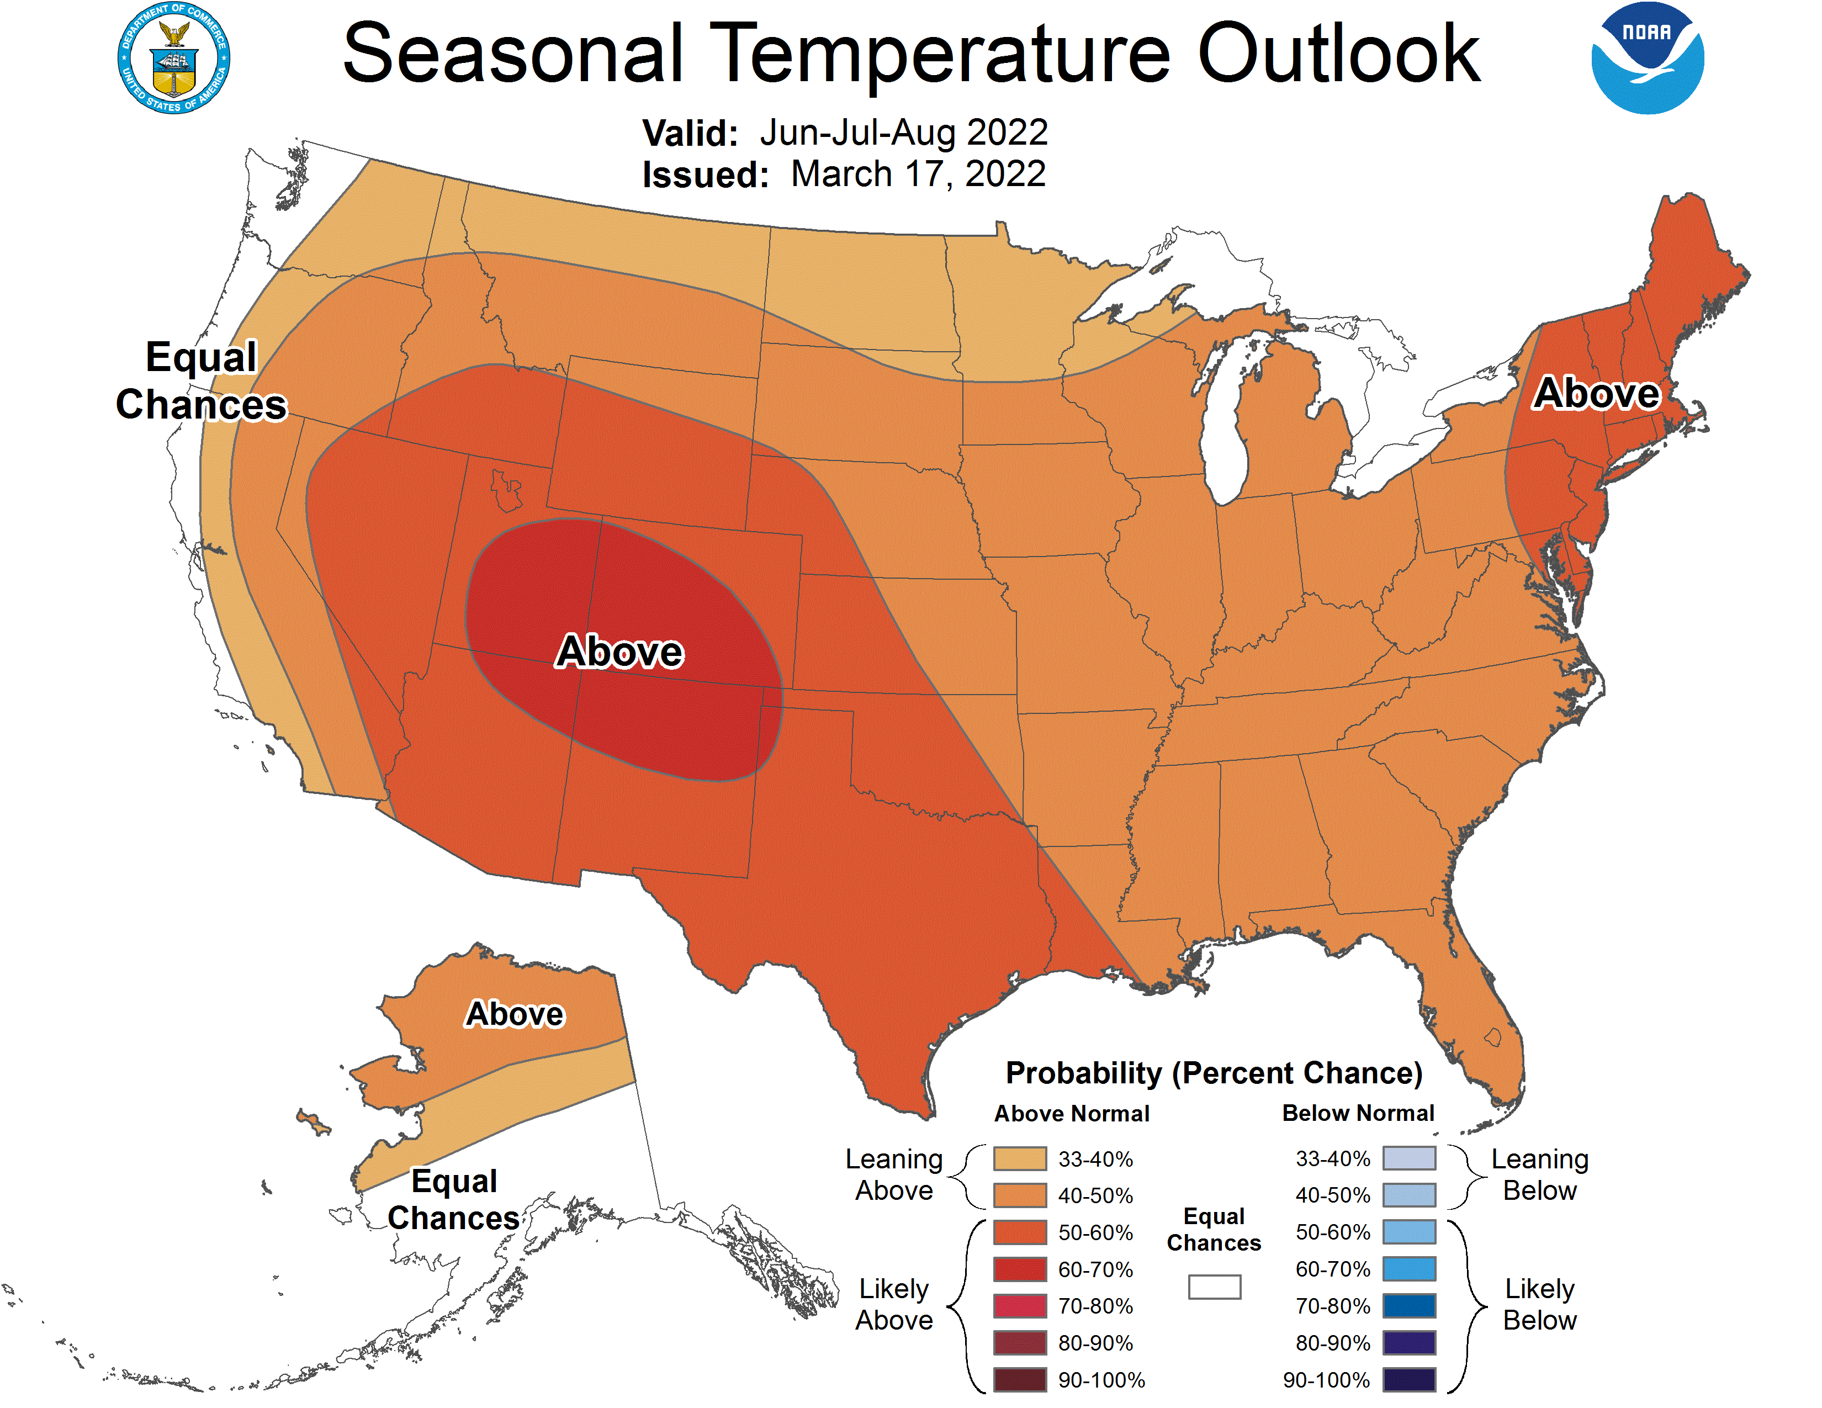
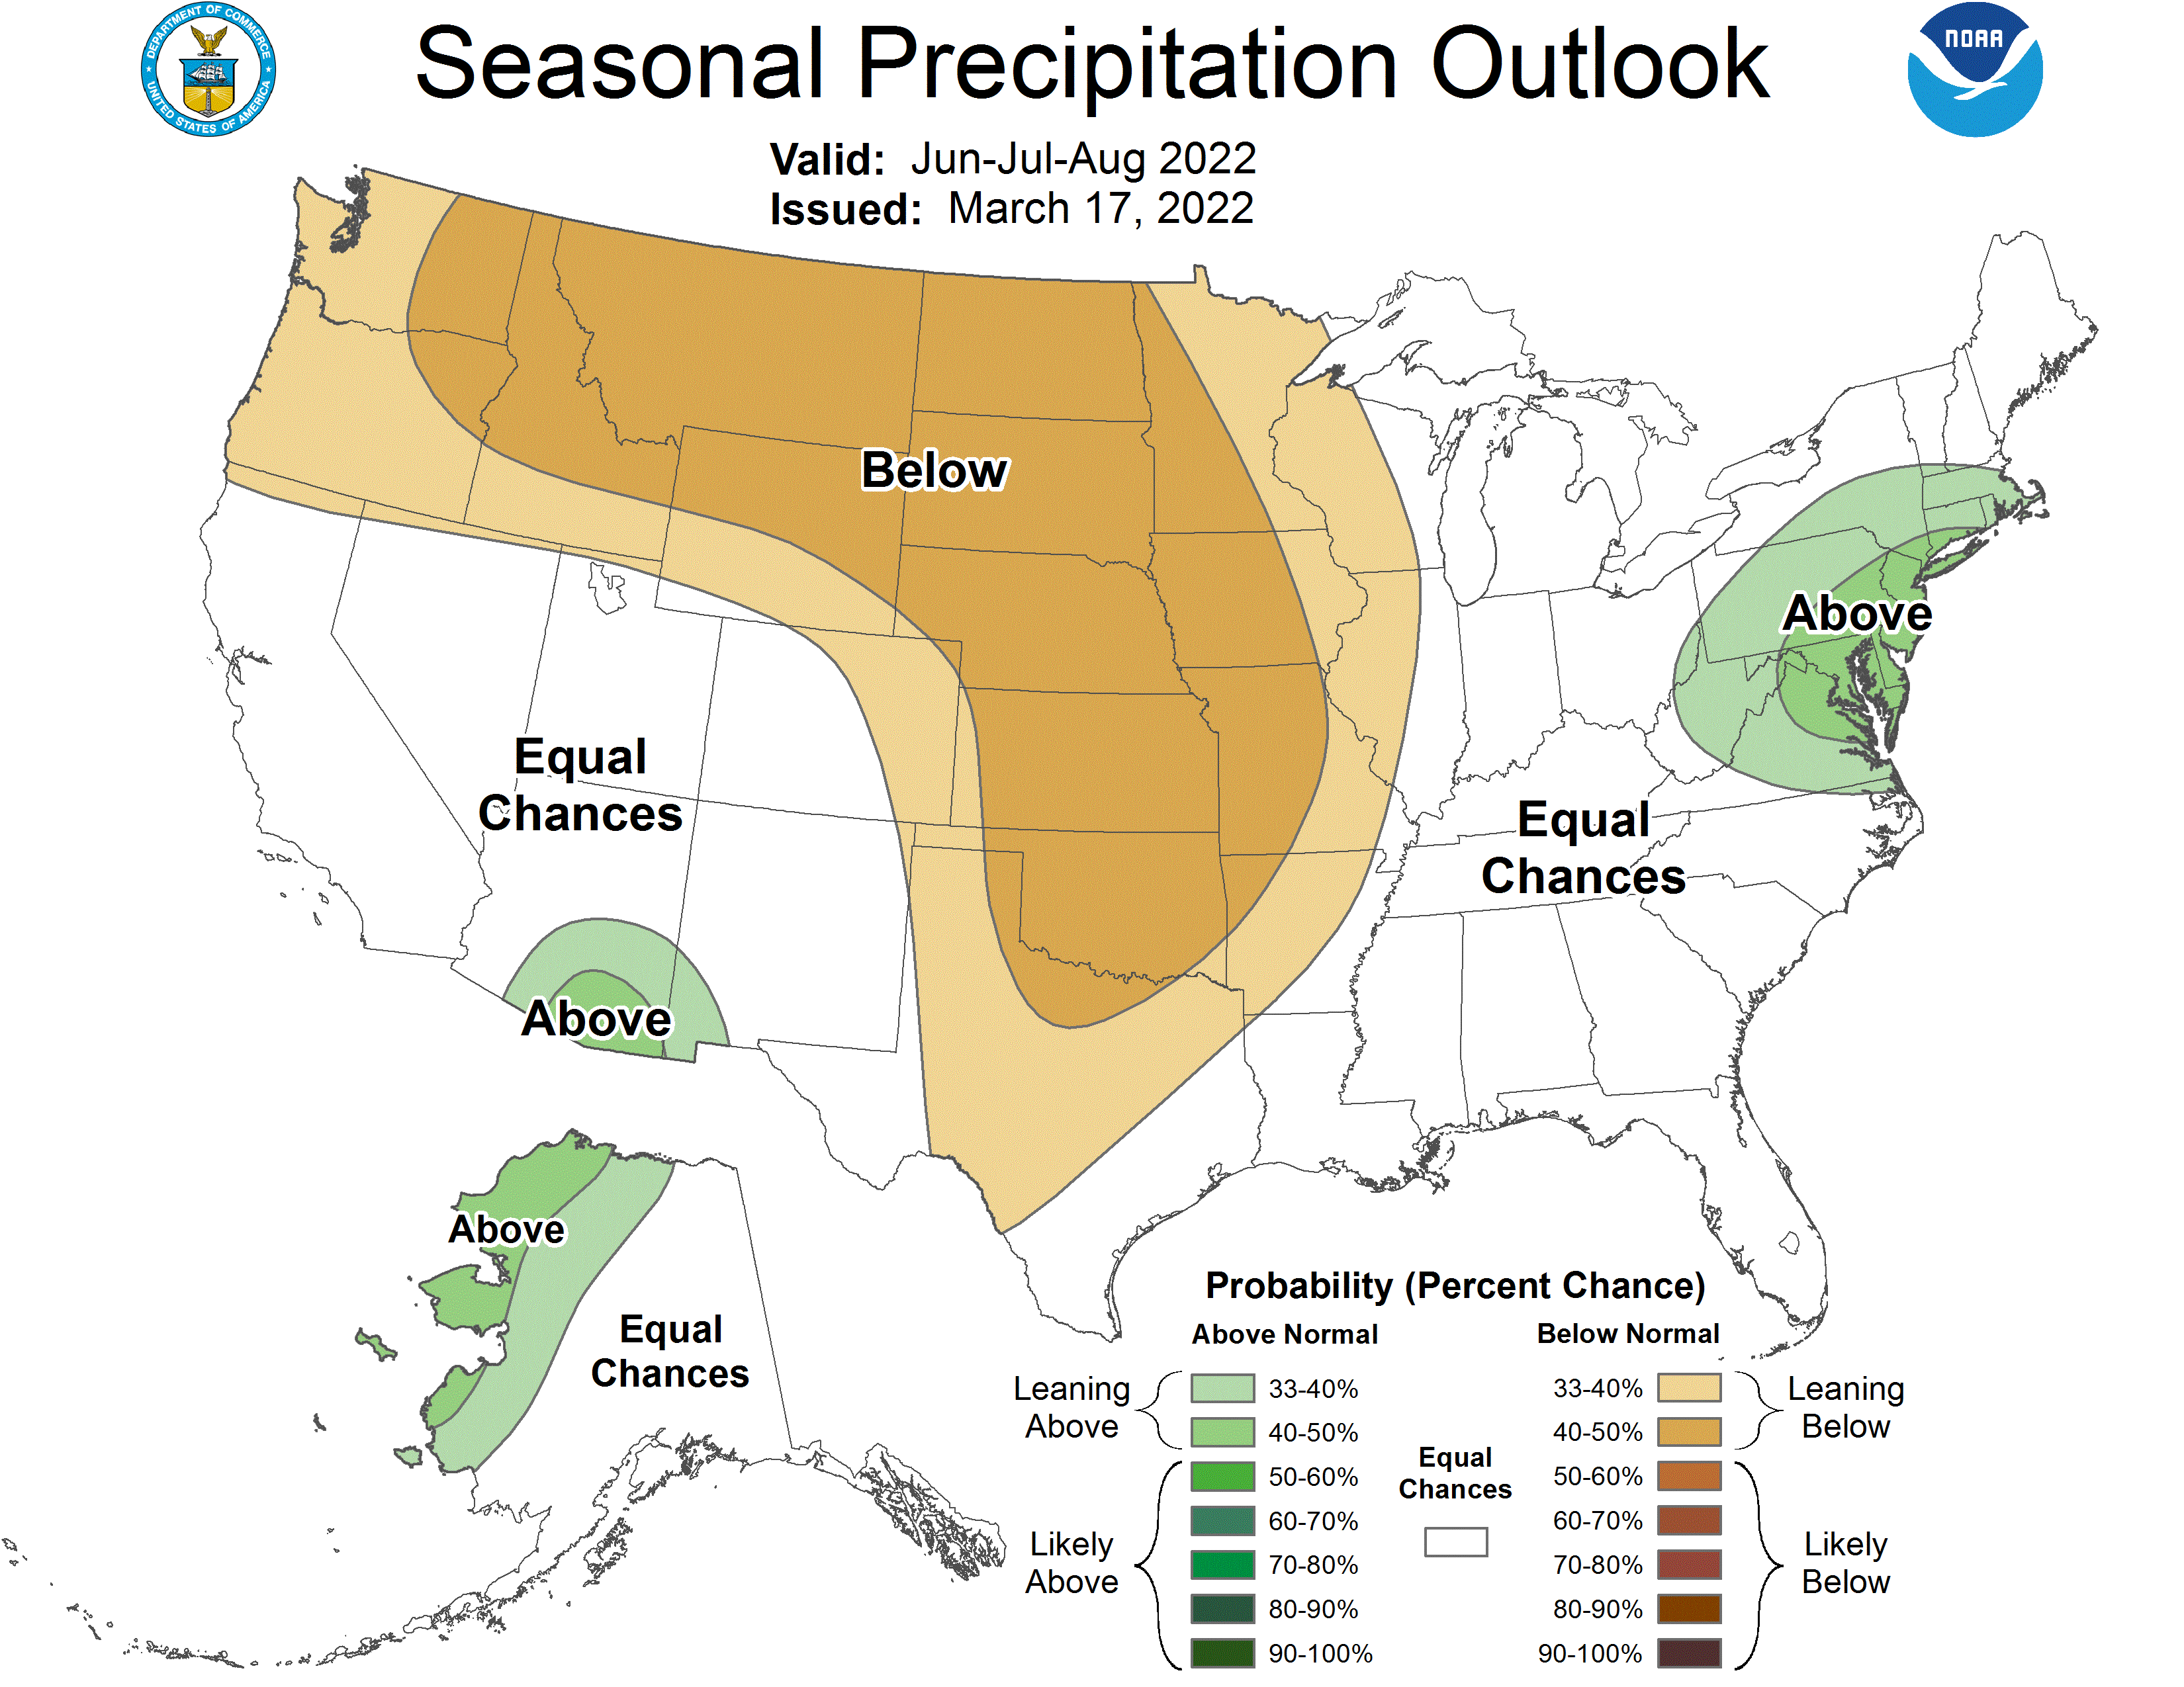
NOAA’s Official Summer Outlook

Slide 23
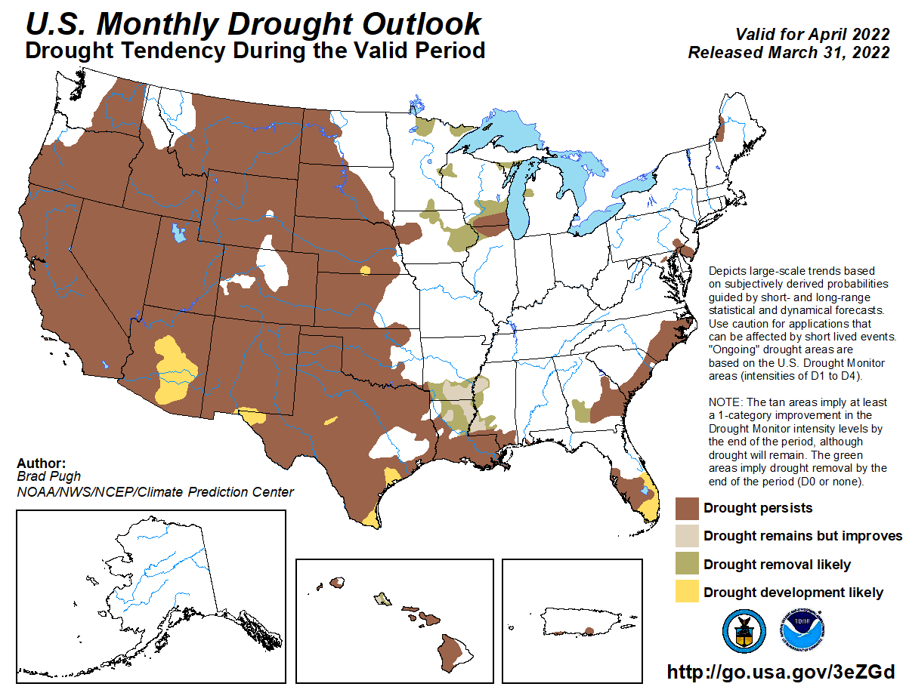

Slide 24
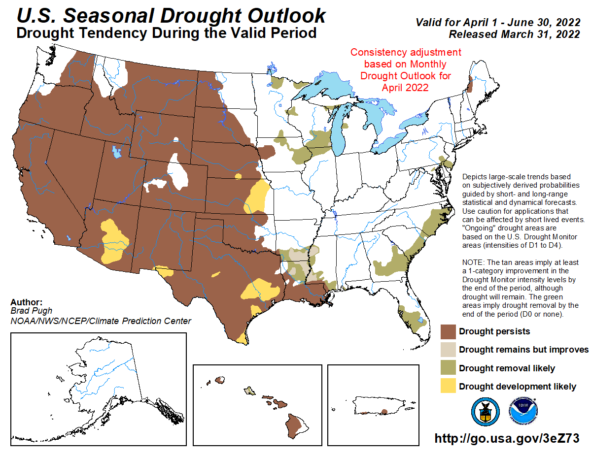

Slide 25
Climate/Drought Summary
Temperatures have been cooler than normal throughout the High Plains into spring. Unlike 2012 where we have an early “green up” and unseasonably warm weather that year. Over the last 60 days, most all the region was 2-4 degrees below normal with the greatest departures in the Rocky Mountains and eastern Dakotas which were 3-4 degrees below normal.
Much of the region has recorded below normal temperatures this year. Precipitation has been spotty and inconsistent for the current water year that began October 1, 2021 with most of the region recording precipitation amounts that are well below normal. The exception was in the eastern Dakotas which were very wet last fall.
Nebraska is currently showing 96.43 percent of the state in drought. Most of the drought is moderate drought (D1) to severe drought (D2) with a pocket of extreme drought (D3) in central Nebraska. This compares to early November when 31.57% of the state was in drought with 13.98% in D2 or worse at that time.
The seasonal drought outlook that goes through the end of June has current drought persisting during this time for most all regions west of the Missouri River.

Slide 26
Nebraska Water Supply Update…

Slide 27
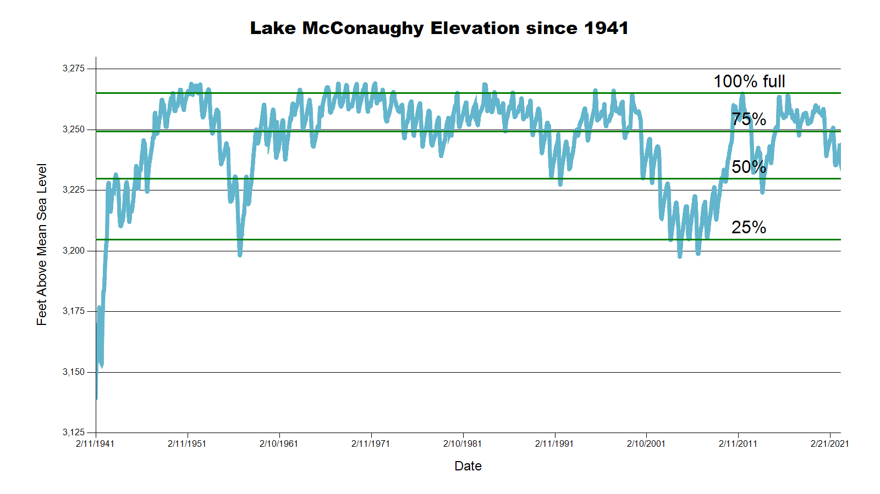
3243.7 feet 67.2% Full
SOURCE: CNPPID www.cnppid.com

Slide 28
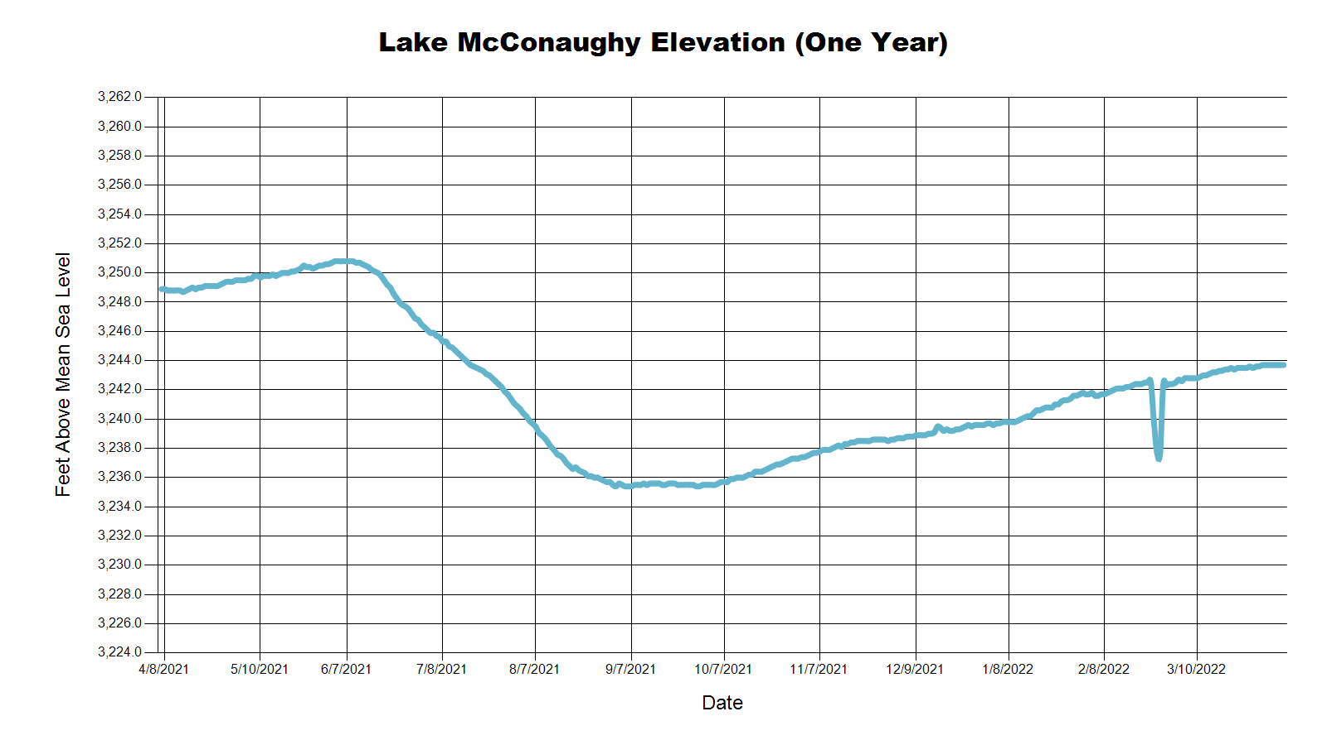
3243.7 Feet
67.2% of Max
April 2022
3238.0 Feet
59.8% of Max
November 2021
3243.3 Feet
68.7% of Max
July 2021
SOURCE: CNPPID www.cnppid.com

Slide 29
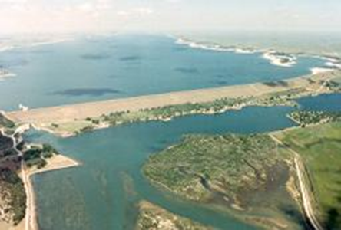
April 2022 CARC Meeting
SOURCE: CNPPID www.cnppid.com

Slide 30
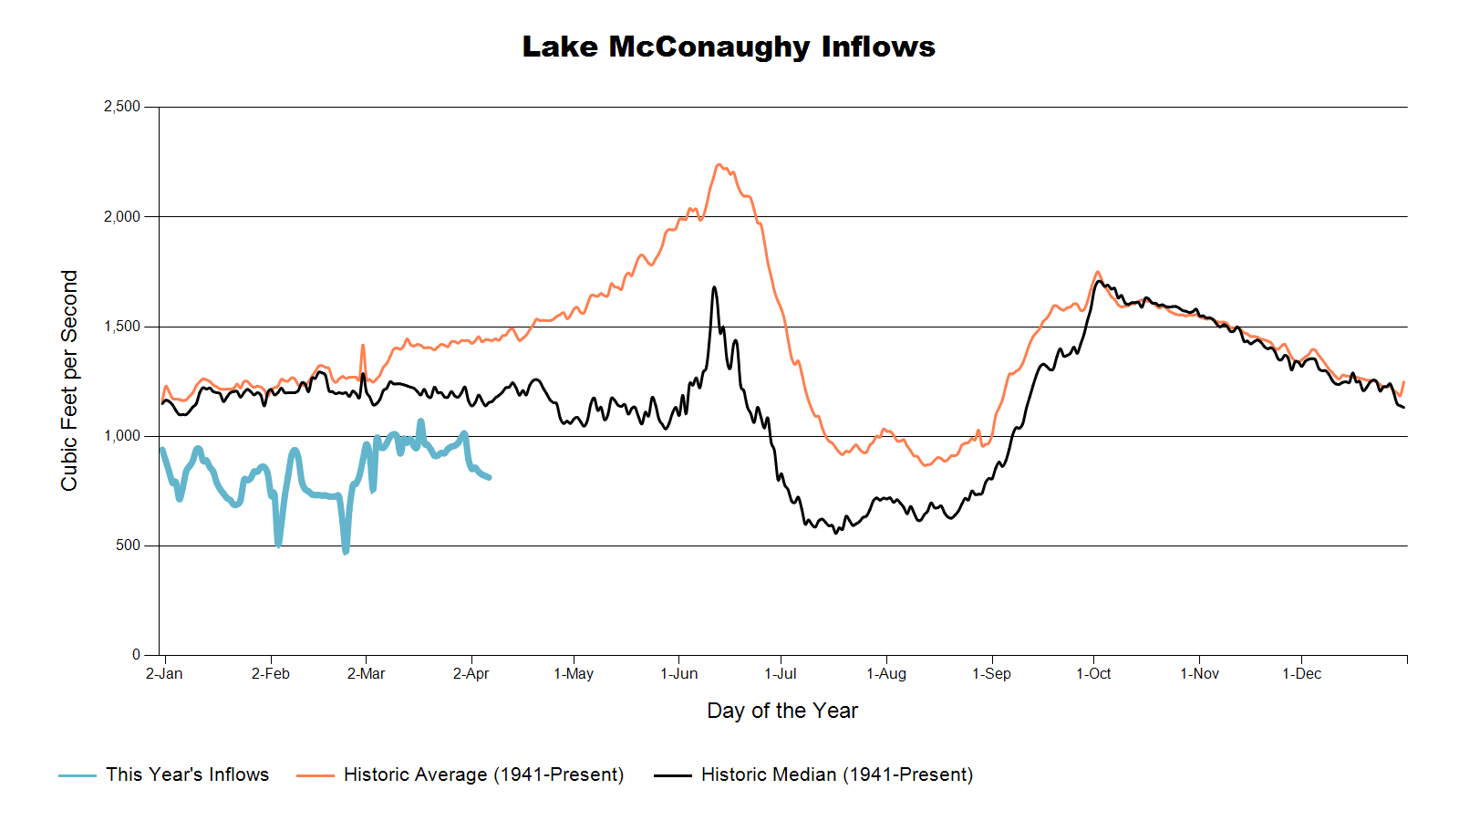

Slide 31
Lake McConaughy
Civil engineer Tyler Thulin reported that Lake McConaughy’s elevation was at 3243.7 feet as of Monday morning (67.2% of capacity). Inflows have averaged 800 cubic feet per second (cfs) with releases of about 550 cfs. Current snowpack accumulation is at 89% median average in the North Platte River basin and 94% in the South Platte river basin.
SOURCE: CNPPID News Release, April 4, 2022
www.cnppid.com

Slide 34
North Platte Basin data
https://www.usbr.gov/gp/lakes_reservoirs/wareprts/main_menu.html#supply

Slide 35
North Platte River Basin Inflow

Slide 36
North Platte River Basin Storage

Slide 37
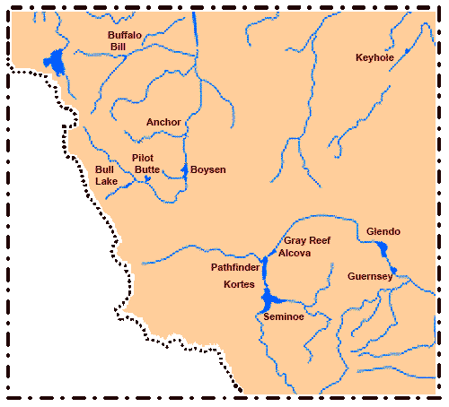
North Platte River Basin
Seminoe: 29.7% of conservation pool, 31% last CARC meeting
Pathfinder: 60.6% of conservation pool, 59.6% last CARC meeting
Glendo: 73.0% of conservation pool, 37.7% last CARC meeting
Alcova: 89.2% of conservation pool, 85.2% last CARC meeting
Source: BOR https://www.usbr.gov/gp/lakes_reservoirs/wyoming_lakes.html

Slide 38
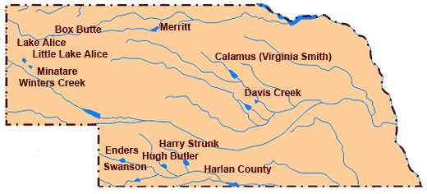
Republican River Basin
Hugh Butler: 47.3%(42.3%) of conservation pool
Enders: 19.6% (18.5%) of conservation pool
Harry Strunk: 96.5%(67.4%) of conservation pool
Swanson: 47.8% (42.6%) of conservation pool
*values in red are from the last CARC meeting
Source: BOR http://www.usbr.gov/gp/lakes_reservoirs

Slide 39
Republican River Basin
Harlan County Current Conditions
Conservation Pool is 95.2% full (88.4%)
298,901 Acre-Feet in storage compared to 277,639 Acre-Feet (AF) of water in storage during November 2021
Last year at this time, 315,700 AF was in storage (April 2022)
Historical average storage for this time of the year is 278,605 AF
*values in red are from the last CARC meeting
Source: BOR http://www.usbr.gov/gp/lakes_reservoirs/

Slide 40
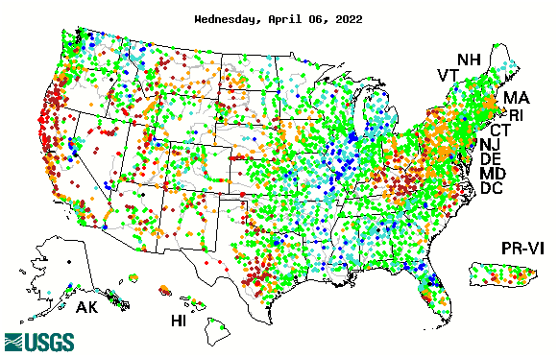

14-day average streamflow compared to historical streamflow for the day of year

Slide 41
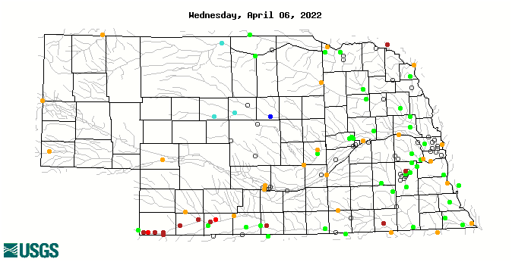
14-day average streamflow compared to historical streamflow for the day of year
85th Percentile
14th Percentile
61st Percentile
19thPercentile
23th Percentile
5thPercentile

Slide 42
Water Supply Summary
Lake McConaughy is currently 67.2 percent of capacity and has been slowly rising since the end of the irrigation season and through the winter.
Upstream reservoirs in Wyoming are mixed for this time of year with most being higher than last November, but a few are still lower.
The Republican River basin reservoirs are higher than they were in November 2021 as water levels have stabilized with the end of irrigation season and less demand and have added water during the winter months.
Harlan County Reservoir is holding about 22,000 acre-feet more water now than in November 2021 and is also about 20,000 acre-feet more than the historical average for this time of year.

Slide 43
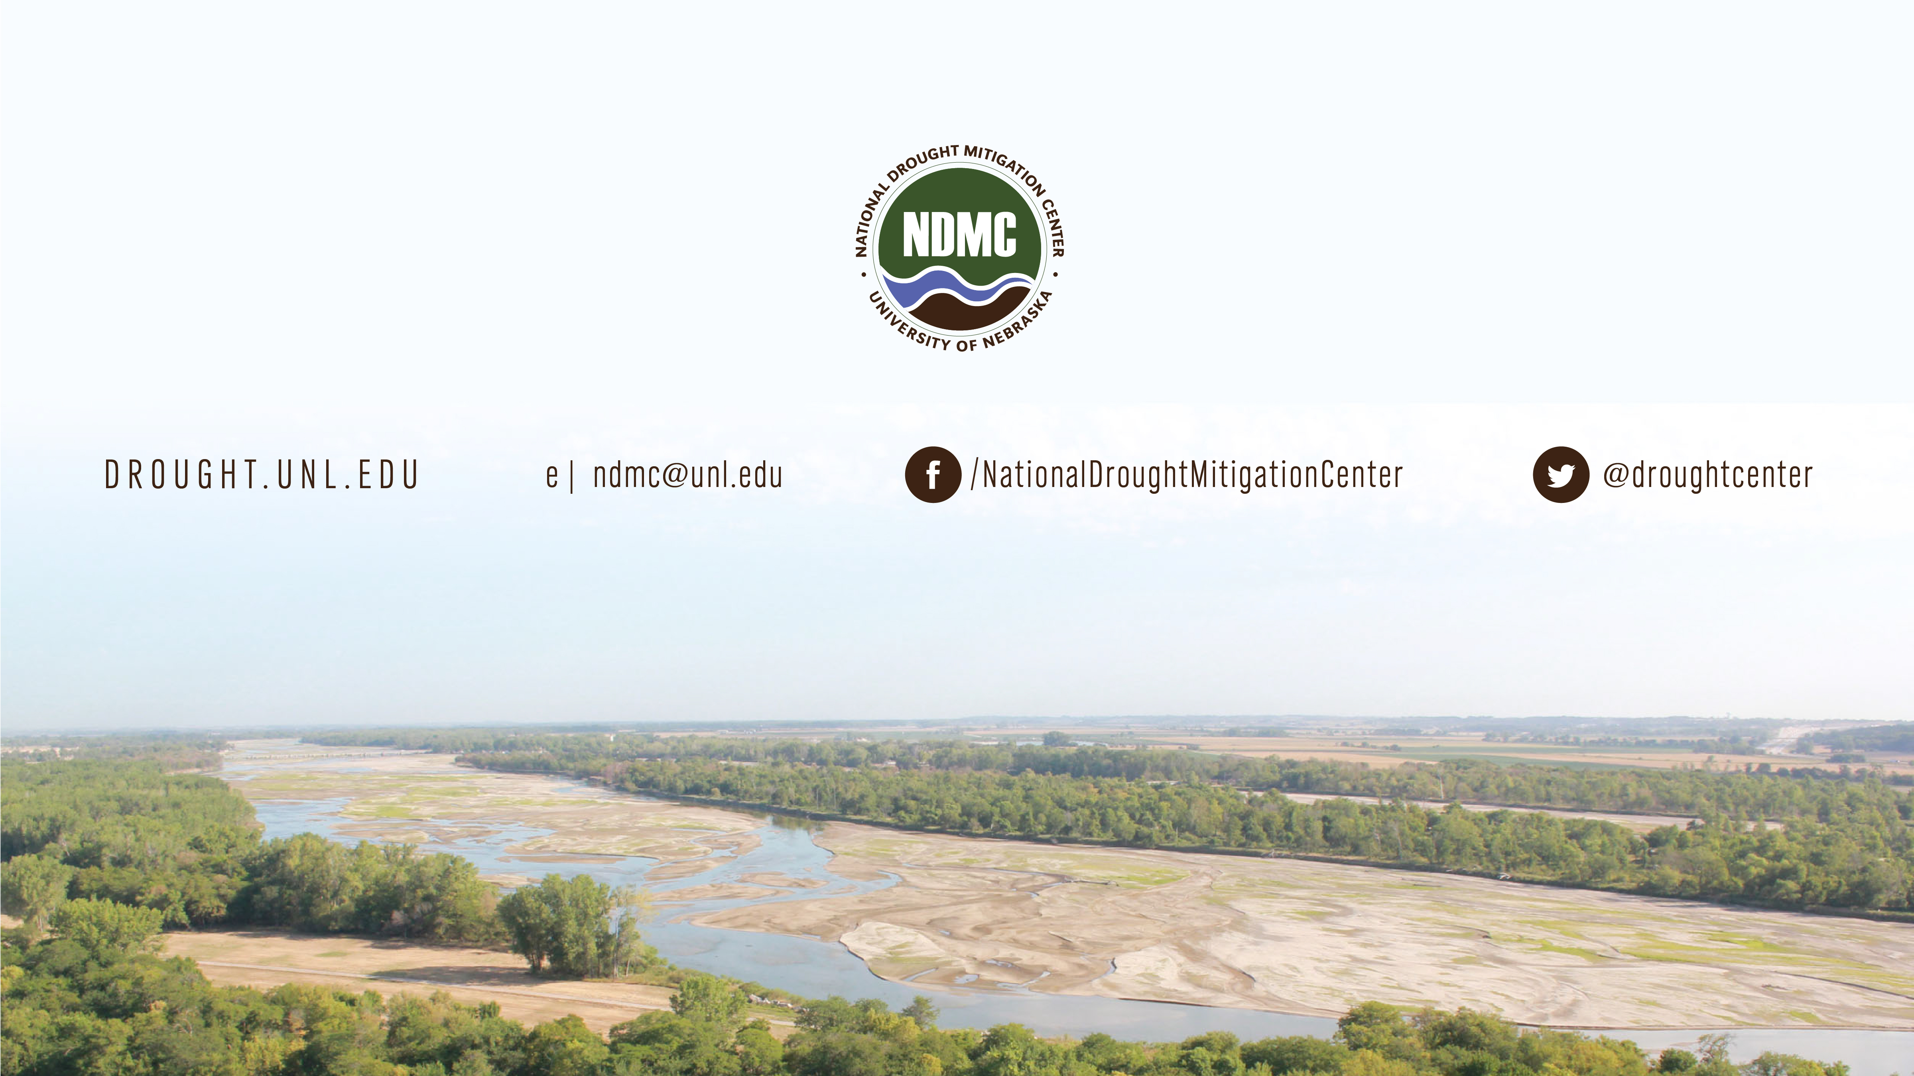
Brian Fuchs
bfuchs2@unl.edu
402-472-6775
National Drought Mitigation Center
School of Natural Resources
University of Nebraska-Lincoln

