Slide 1
Nebraska Climate Update
Martha D shulski
mshulski3@unl.edu
402-472-6711
School of natural resources
University of Nebraska LIncoln
CARC Meeting
29 July, 2020

Slide 2
Today’s presentation
Recap and recent conditions
Impacts – increasing dryness taking a toll on pasture conditions, recent heat didn’t seem significant on corn
Outlook – warmth favored in the near term
Notes:
Here I outlined the similar trends for the Nebraska and global annual average temperature. I also point out the high variability in Nebraska and difference in regional vs. global scales. I use the analogy that global change is like an escalator that is increasing at an accelerating rate. The variability is like we jump up or down a few steps while still going up.

Slide 3
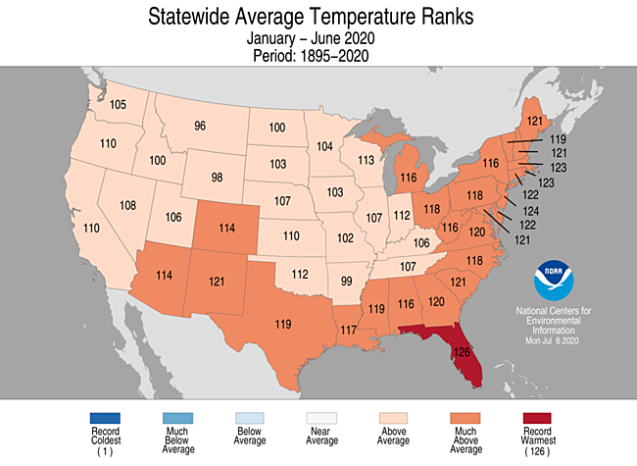
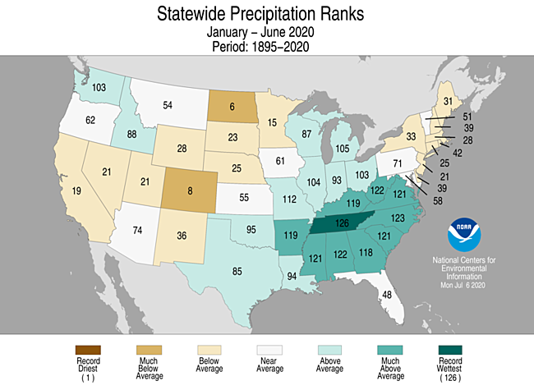
Recap
2020 YTD | above average temperatures; 25th driest
Source: https://ncdc.noaa.gov/temp-and-precip/us-maps/
Notes:
Here I outlined the similar trends for the Nebraska and global annual average temperature. I also point out the high variability in Nebraska and difference in regional vs. global scales. I use the analogy that global change is like an escalator that is increasing at an accelerating rate. The variability is like we jump up or down a few steps while still going up.

Slide 4
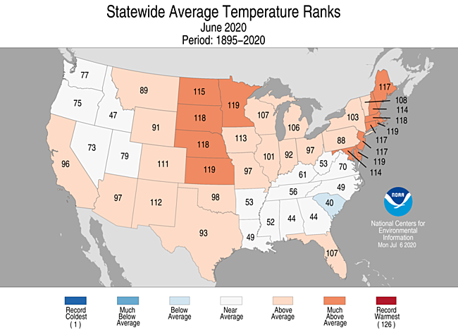
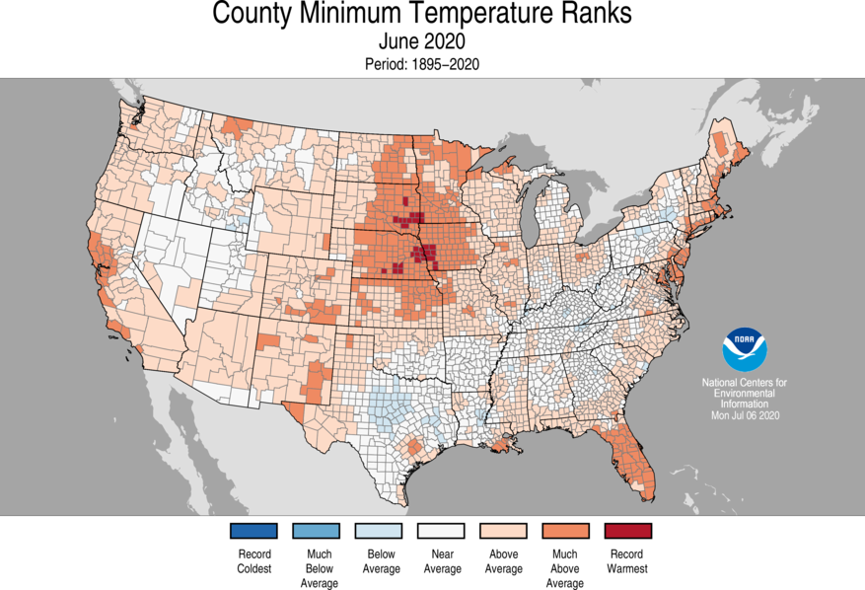
Recap
June temperature | rapid and dramatic switch from May; 9th warmest in Nebraska; nightime lows particularly warm
Source: https://ncdc.noaa.gov/temp-and-precip/us-maps/
Notes:
Here I outlined the similar trends for the Nebraska and global annual average temperature. I also point out the high variability in Nebraska and difference in regional vs. global scales. I use the analogy that global change is like an escalator that is increasing at an accelerating rate. The variability is like we jump up or down a few steps while still going up.

Slide 5
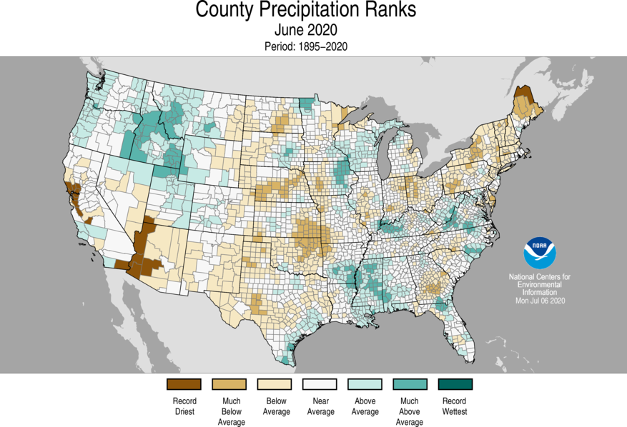
Recap
June precipitation |
predominant dryness in Nebraska (18th driest on record)
but with localized exceptions
Source: https://ncdc.noaa.gov/temp-and-precip/us-maps/
Notes:
Here I outlined the similar trends for the Nebraska and global annual average temperature. I also point out the high variability in Nebraska and difference in regional vs. global scales. I use the analogy that global change is like an escalator that is increasing at an accelerating rate. The variability is like we jump up or down a few steps while still going up.

Slide 6
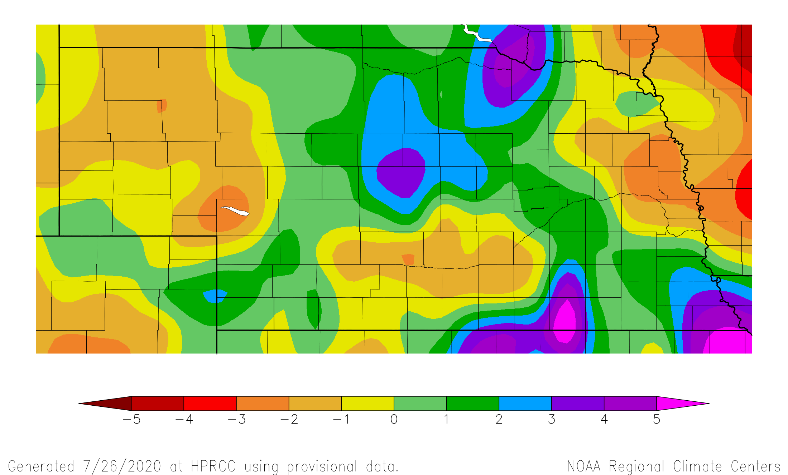
Recap
Precipitation | have’s and the have not’s
30 day precipitation departure from normal
26 Jun – 25 Jul
Source: https:// hprcc.unl.edu/maps.php?map=ACISClimateMaps
Notes:
Here I outlined the similar trends for the Nebraska and global annual average temperature. I also point out the high variability in Nebraska and difference in regional vs. global scales. I use the analogy that global change is like an escalator that is increasing at an accelerating rate. The variability is like we jump up or down a few steps while still going up.

Slide 7
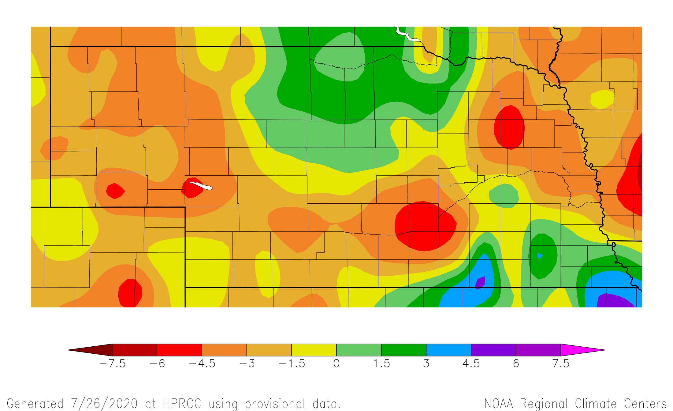
Recap
Precipitation | have’s and the have not’s
60 day precipitation departure from normal
27 May – 25 Jul
Source: https:// hprcc.unl.edu/maps.php?map=ACISClimateMaps
Notes:
Here I outlined the similar trends for the Nebraska and global annual average temperature. I also point out the high variability in Nebraska and difference in regional vs. global scales. I use the analogy that global change is like an escalator that is increasing at an accelerating rate. The variability is like we jump up or down a few steps while still going up.

Slide 8
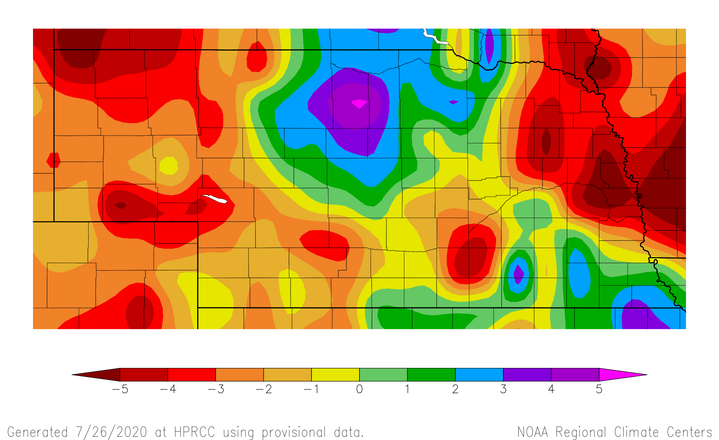
Recap
Precipitation | have’s and the have not’s
90 day precipitation departure from normal
27 Apr – 25 Jul
Source: https:// hprcc.unl.edu/maps.php?map=ACISClimateMaps
Notes:
Here I outlined the similar trends for the Nebraska and global annual average temperature. I also point out the high variability in Nebraska and difference in regional vs. global scales. I use the analogy that global change is like an escalator that is increasing at an accelerating rate. The variability is like we jump up or down a few steps while still going up.

Slide 9
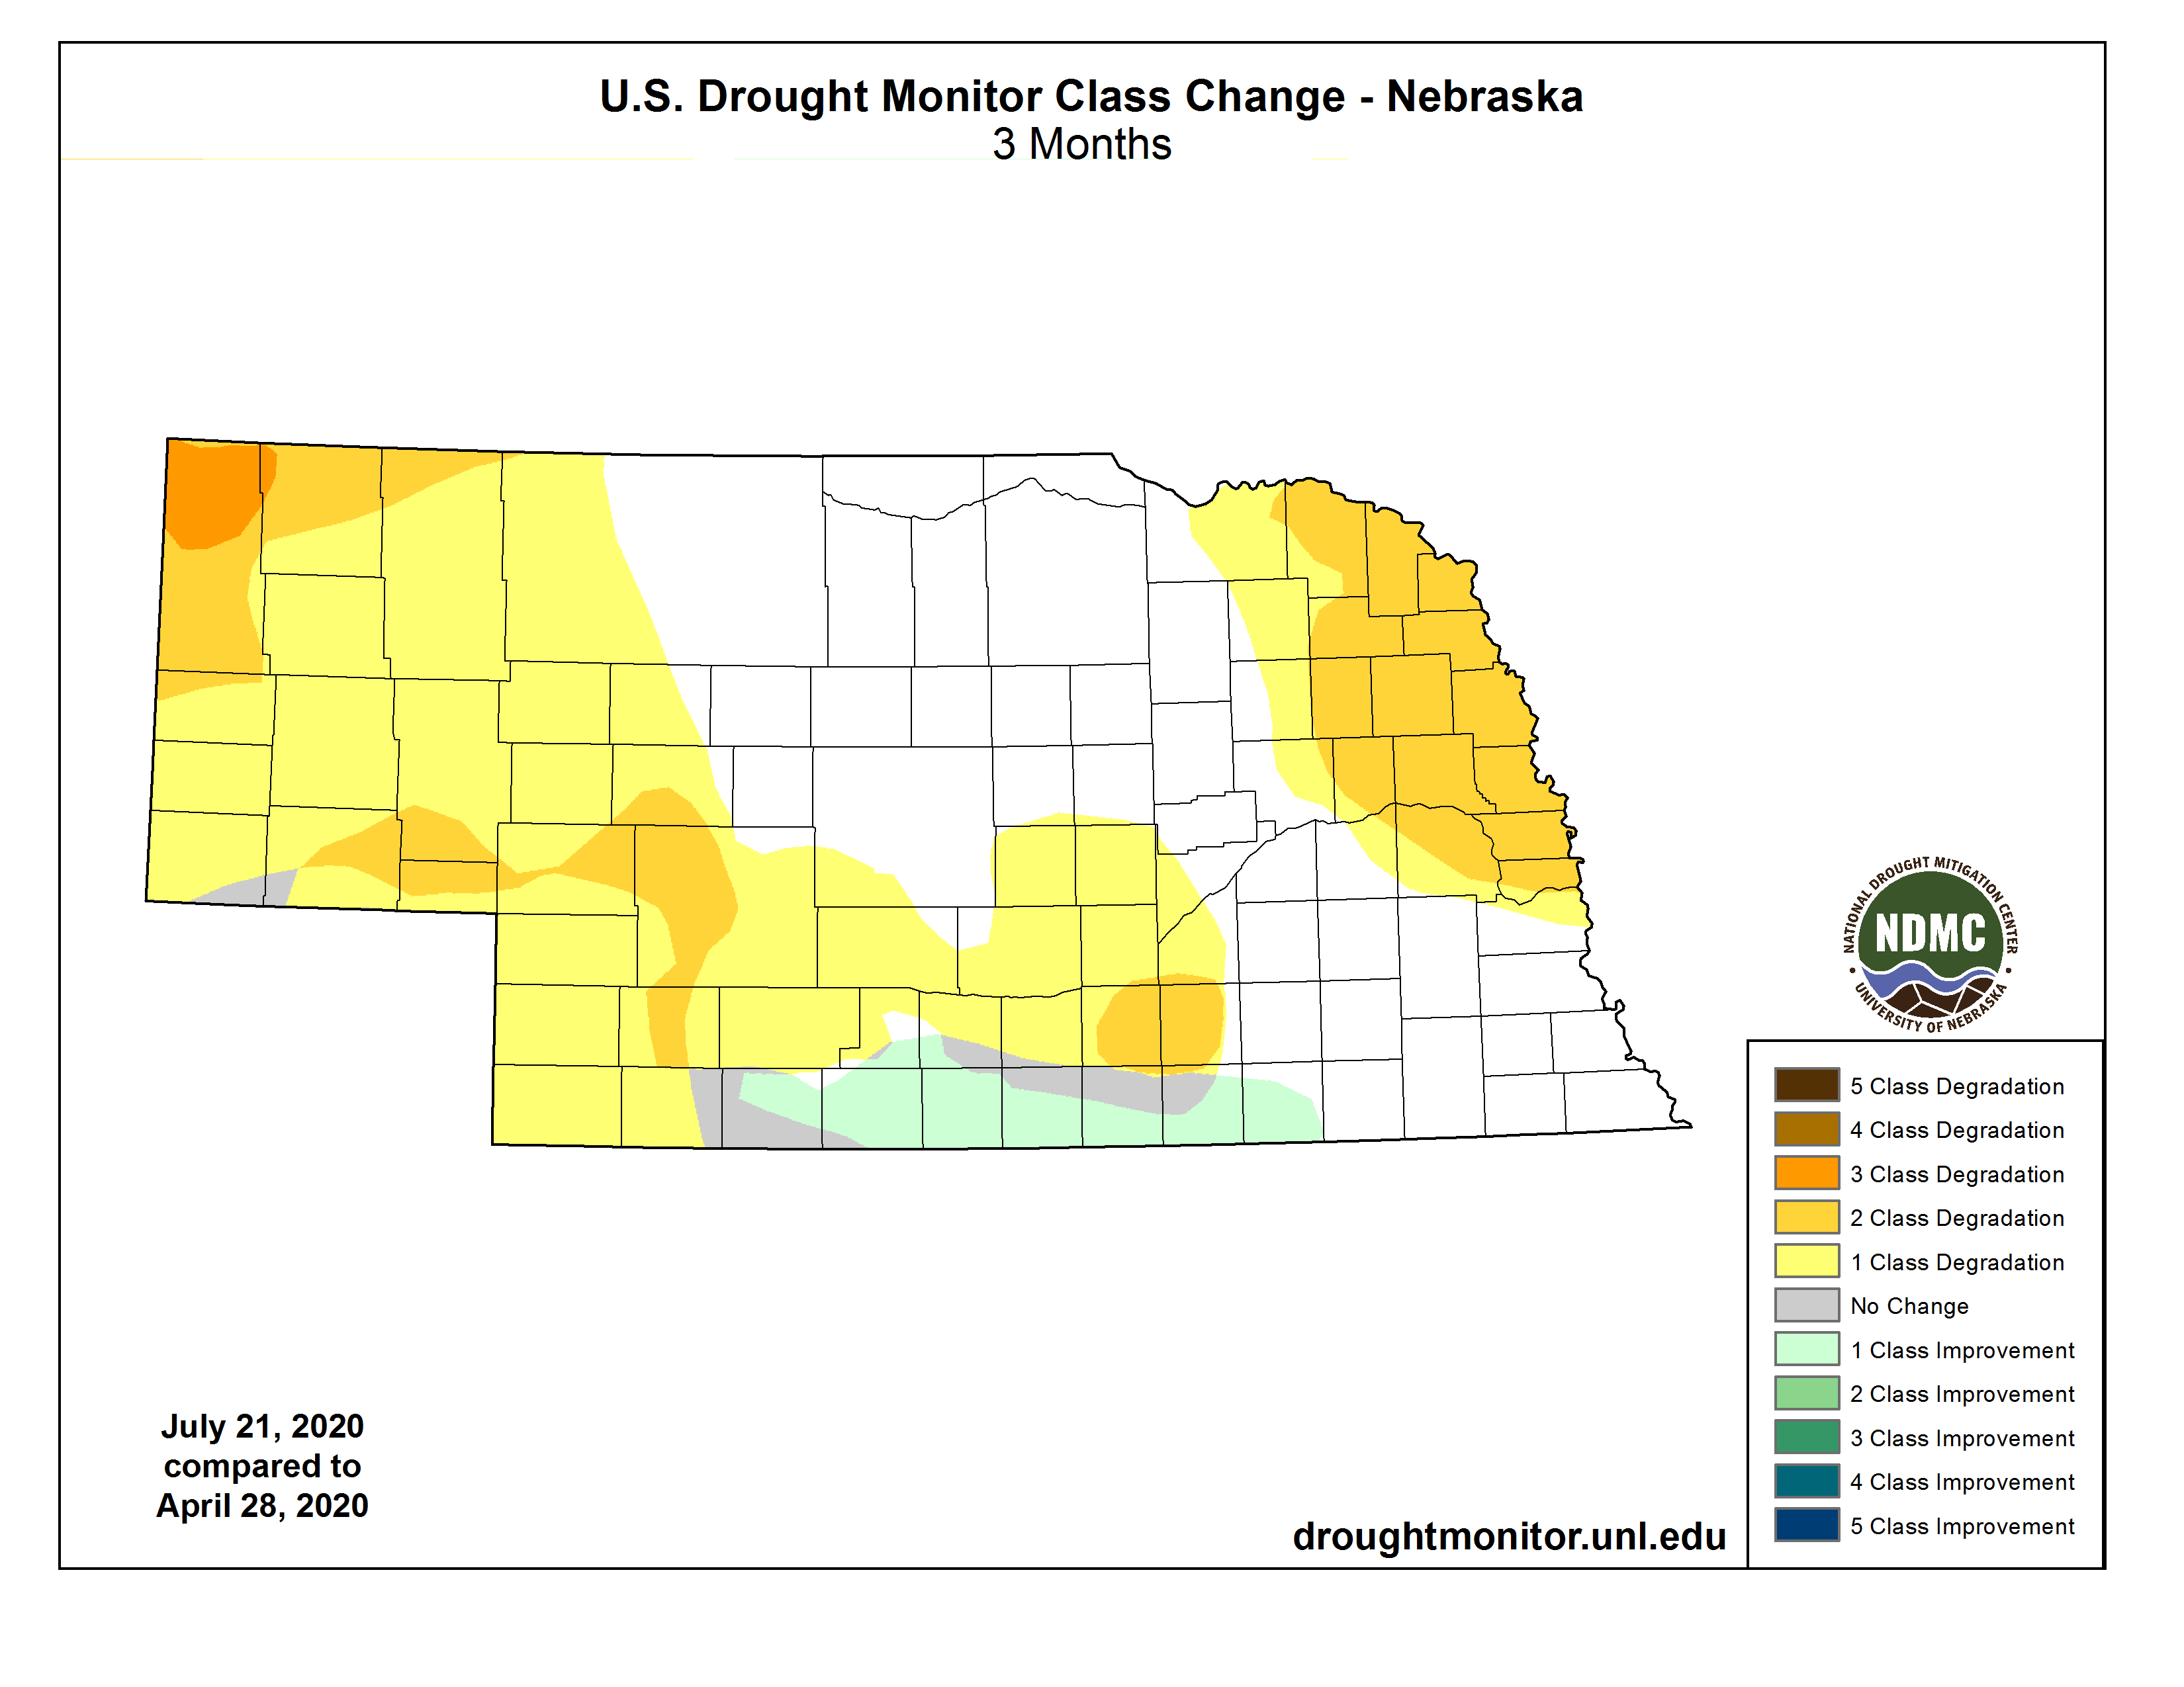
Recap
Drought |
one to three class degradations over the past 90 days
Source: https://droughtmonitor.unl.edu/maps/
Notes:
Here I outlined the similar trends for the Nebraska and global annual average temperature. I also point out the high variability in Nebraska and difference in regional vs. global scales. I use the analogy that global change is like an escalator that is increasing at an accelerating rate. The variability is like we jump up or down a few steps while still going up.

Slide 10
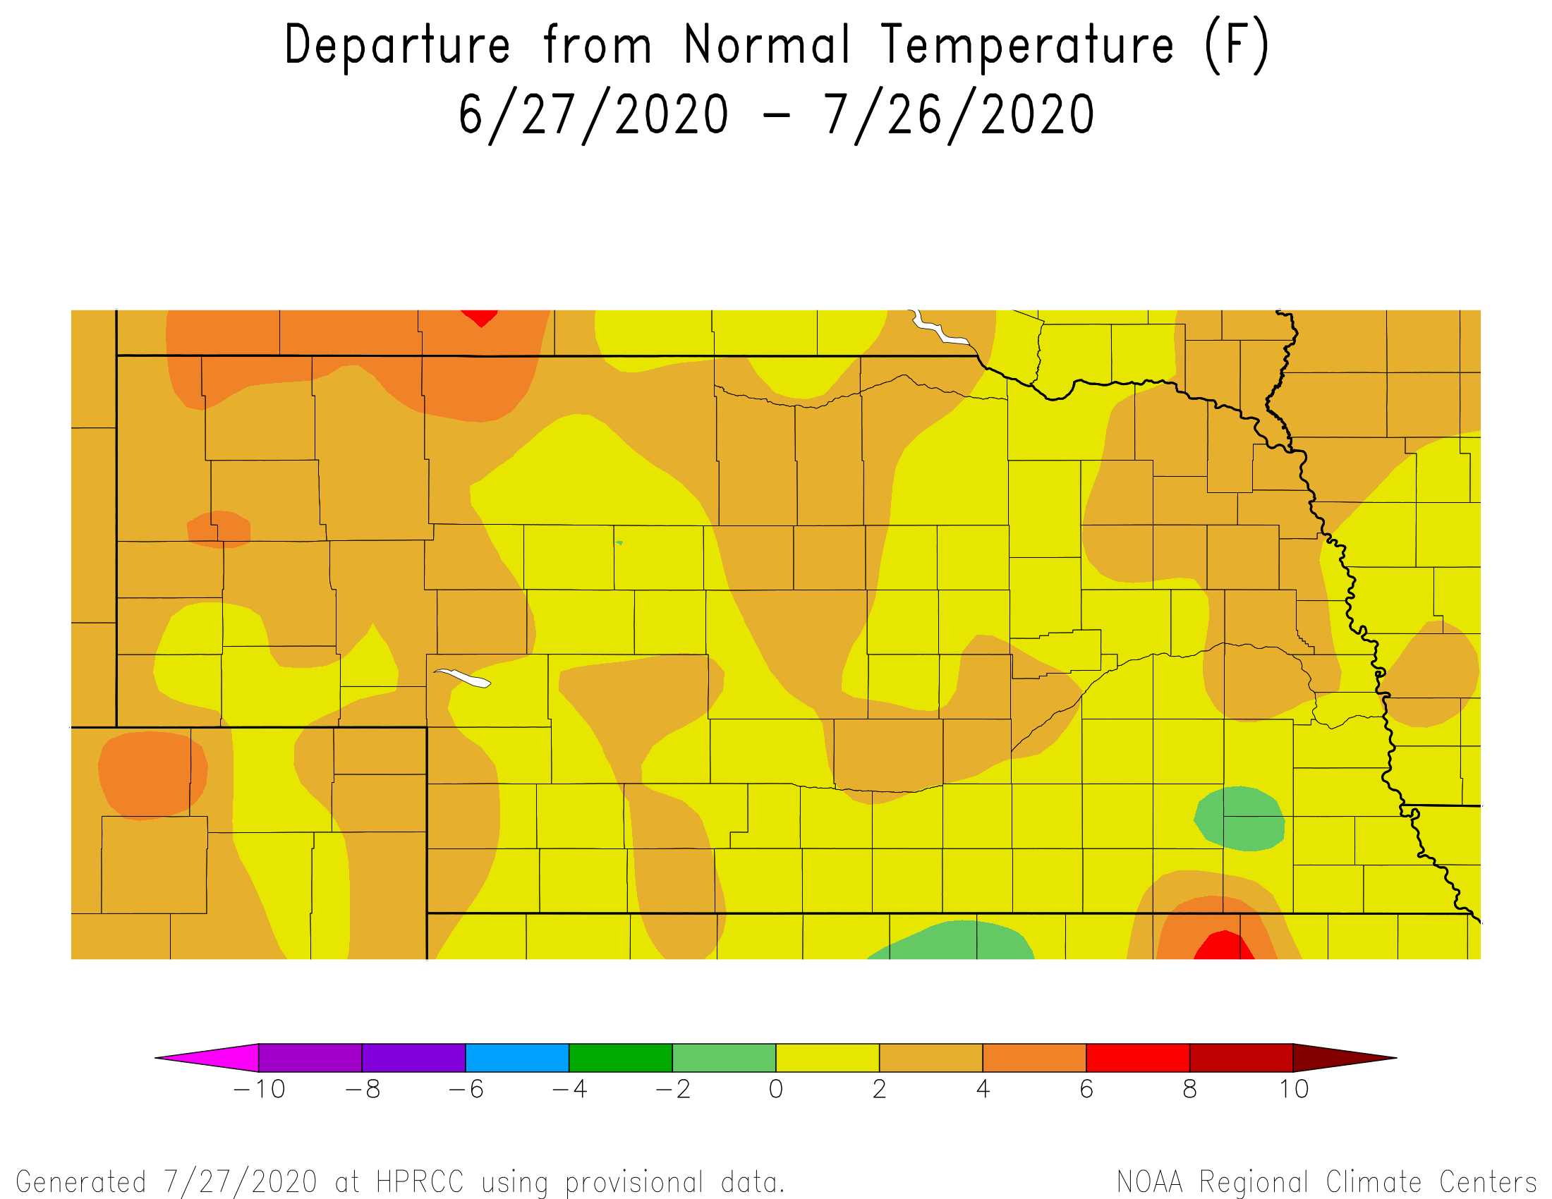
Recent conditions
30 day temperatures |
continued warmth for Nebraska
will probably rank in the top 25 warmest Julys
Source: https:// hprcc.unl.edu/maps.php?map=ACISClimateMaps
Notes:
Here I outlined the similar trends for the Nebraska and global annual average temperature. I also point out the high variability in Nebraska and difference in regional vs. global scales. I use the analogy that global change is like an escalator that is increasing at an accelerating rate. The variability is like we jump up or down a few steps while still going up.

Slide 11
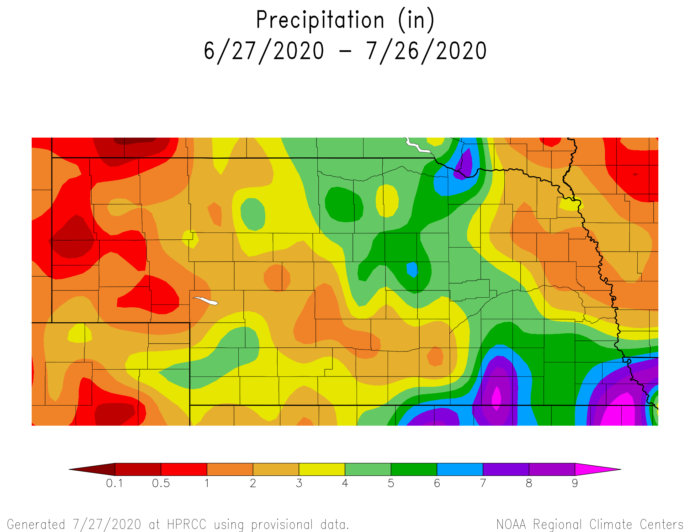
Recent conditions
30 day precipitation |
localized areas of heavy precipitation
notable dryness across the panhandle, northeast and southcentral
Source: https:// hprcc.unl.edu/maps.php?map=ACISClimateMaps
Notes:
Here I outlined the similar trends for the Nebraska and global annual average temperature. I also point out the high variability in Nebraska and difference in regional vs. global scales. I use the analogy that global change is like an escalator that is increasing at an accelerating rate. The variability is like we jump up or down a few steps while still going up.

Slide 12
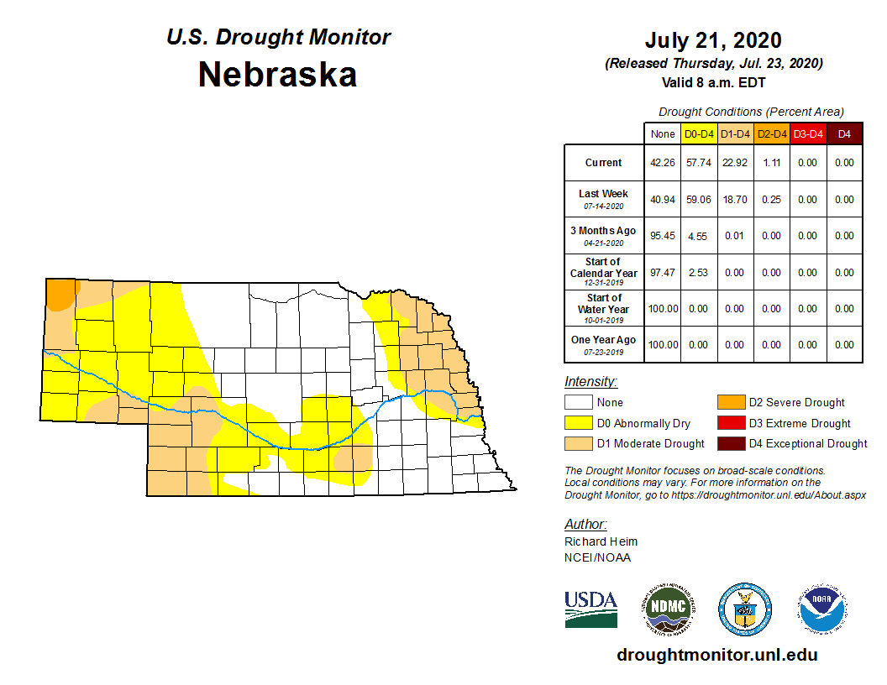
Recent conditions
Drought |
> 50% now in D0-D2
Changes mostly in the last two months
Source: https://droughtmonitor.unl.edu/maps/
Notes:
Here I outlined the similar trends for the Nebraska and global annual average temperature. I also point out the high variability in Nebraska and difference in regional vs. global scales. I use the analogy that global change is like an escalator that is increasing at an accelerating rate. The variability is like we jump up or down a few steps while still going up.

Slide 13
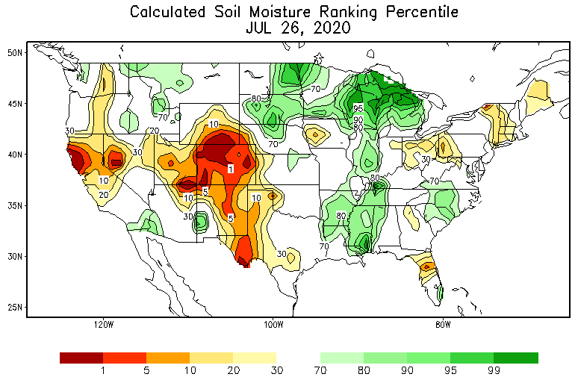
Soils
Soil moisture | Dryness apparent in moisture profiles in the west.
https://www.cpc.ncep.noaa.gov/products/Soilmst_Monitoring/US/Soilmst/Soilmst.shtml
Notes:
Here I outlined the similar trends for the Nebraska and global annual average temperature. I also point out the high variability in Nebraska and difference in regional vs. global scales. I use the analogy that global change is like an escalator that is increasing at an accelerating rate. The variability is like we jump up or down a few steps while still going up.

Slide 14
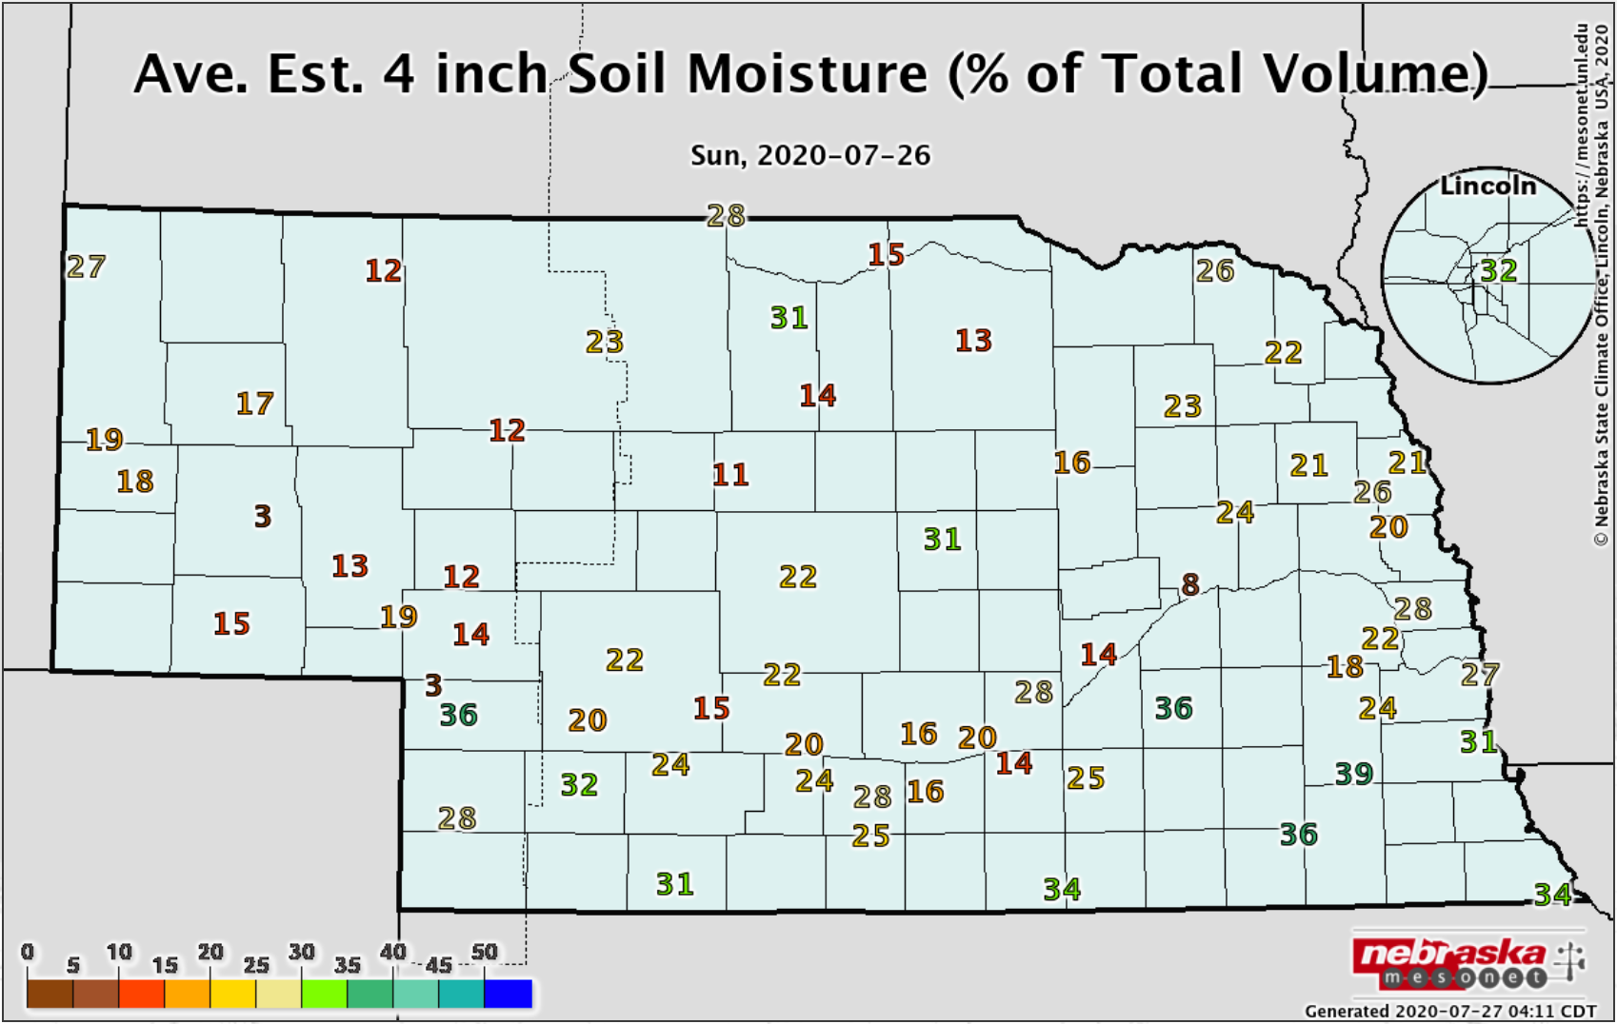
Soils
Soil moisture |
dryness apparent in moisture profiles in the west
wet in the southeast, Sandhills and where recent rain has fallen
Notes:
Here I outlined the similar trends for the Nebraska and global annual average temperature. I also point out the high variability in Nebraska and difference in regional vs. global scales. I use the analogy that global change is like an escalator that is increasing at an accelerating rate. The variability is like we jump up or down a few steps while still going up.

Slide 15
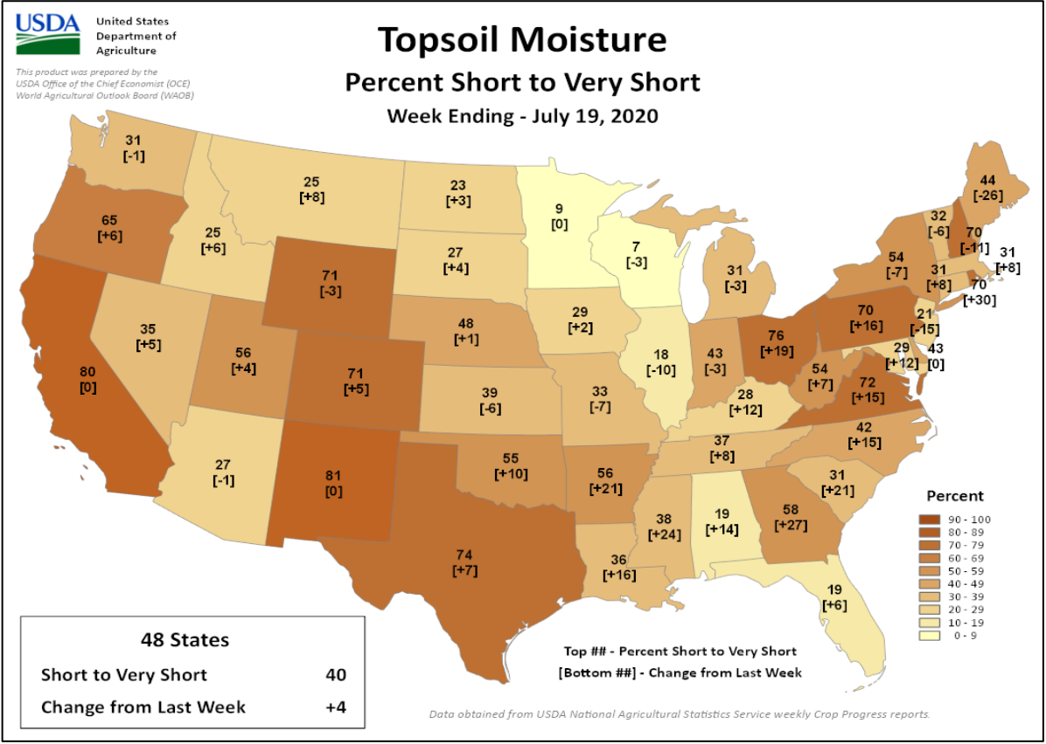
Soils
Soil moisture |
topsoil (6”) moisture worsening for many states
subsoil also showing declines (43% short to very short)
* short-very short: normal crop growth curtailed visible signs of stress
Thank you to Brad Rippey and USDA-OCE
https:// www.usda.library.cornell.edu/concern/publications/cj82k728n?locale=en
Notes:
Here I outlined the similar trends for the Nebraska and global annual average temperature. I also point out the high variability in Nebraska and difference in regional vs. global scales. I use the analogy that global change is like an escalator that is increasing at an accelerating rate. The variability is like we jump up or down a few steps while still going up.

Slide 16
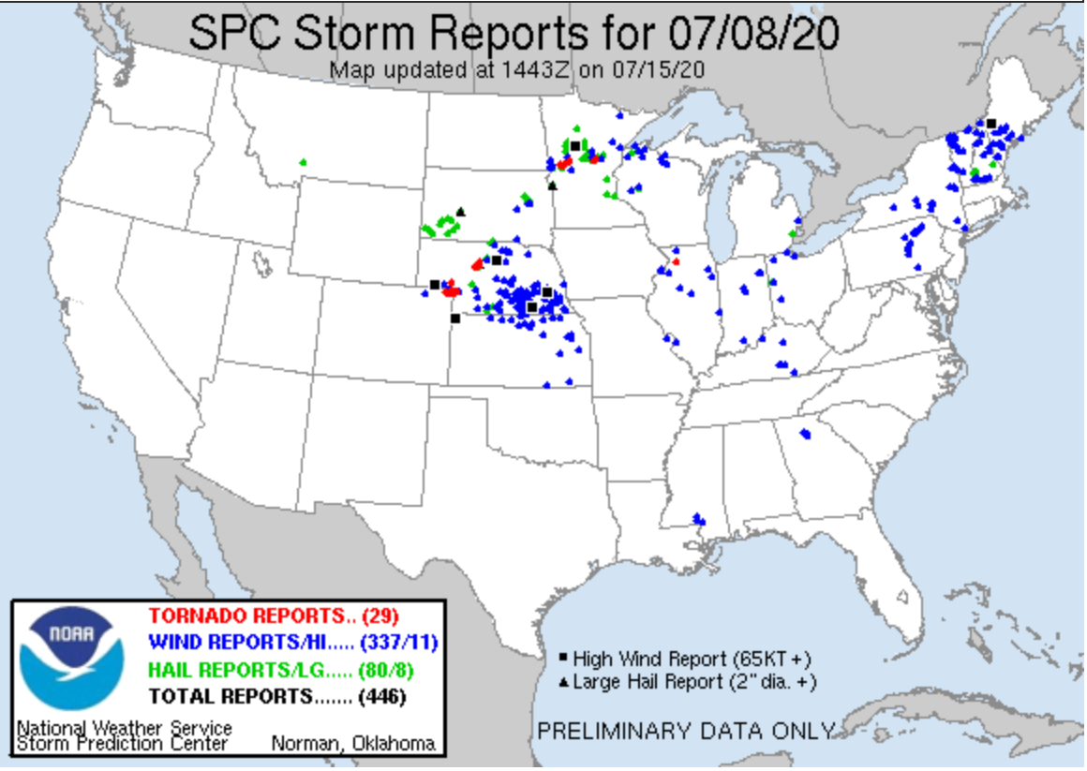
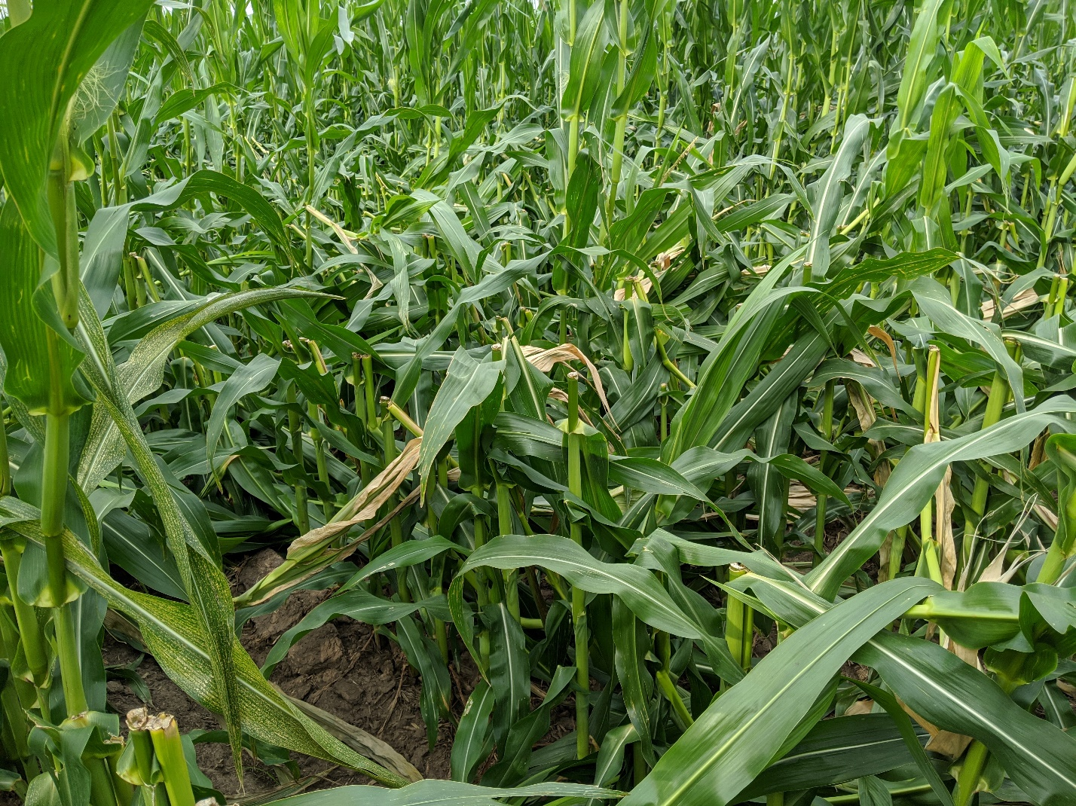
Severe weather
High wind |
gusts above 80 mph
significant impacts to corn reported in southcentral Nebraska
Photo courtesy Jenny Rees
Nebraska Extension
Notes:
Here I outlined the similar trends for the Nebraska and global annual average temperature. I also point out the high variability in Nebraska and difference in regional vs. global scales. I use the analogy that global change is like an escalator that is increasing at an accelerating rate. The variability is like we jump up or down a few steps while still going up.

Slide 17
Agriculture
Pasture and Range |
overall condition for the U.S. is worst since 2012
https:// www.usda.library.cornell.edu/concern/publications/cj82k728n?locale=en
Notes:
Here I outlined the similar trends for the Nebraska and global annual average temperature. I also point out the high variability in Nebraska and difference in regional vs. global scales. I use the analogy that global change is like an escalator that is increasing at an accelerating rate. The variability is like we jump up or down a few steps while still going up.

Slide 18
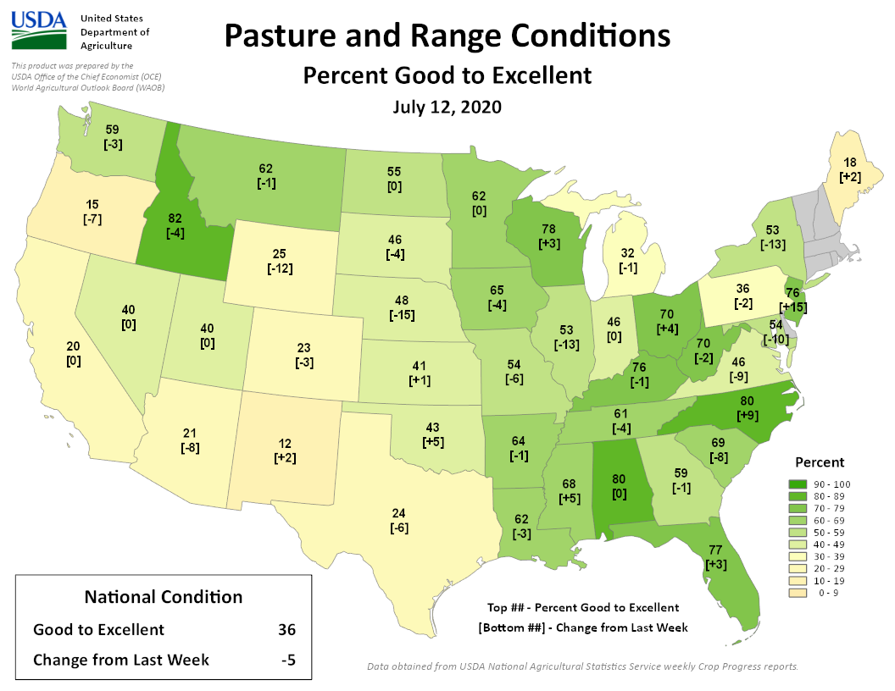
Agriculture
Pasture and Range |
particularly bad in the south and west
declining conditions
Notes:
Here I outlined the similar trends for the Nebraska and global annual average temperature. I also point out the high variability in Nebraska and difference in regional vs. global scales. I use the analogy that global change is like an escalator that is increasing at an accelerating rate. The variability is like we jump up or down a few steps while still going up.

Slide 19
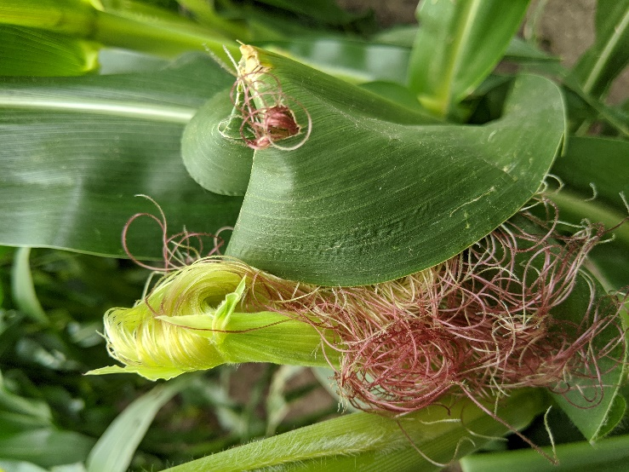
Heat impacts
Heat during corn pollination |
a lot of corn around the region is tasseling
high temperatures, particularly at night is harmful for reproduction
harmful to grain fill leading to reduced or lost yields
Photo courtesy Jenny Rees
Nebraska Extension
Notes:
Here I outlined the similar trends for the Nebraska and global annual average temperature. I also point out the high variability in Nebraska and difference in regional vs. global scales. I use the analogy that global change is like an escalator that is increasing at an accelerating rate. The variability is like we jump up or down a few steps while still going up.

Slide 20
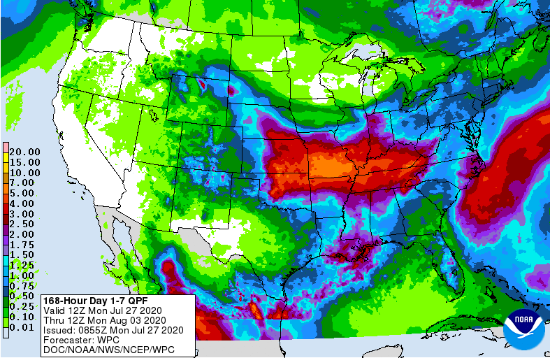
Precipitation outlook
central to southeast Nebraska could see 1.5 to 3 inches
areas that need the rain mostly missing out
https:// www. wpc.ncep.noaa.gov/qpf/day1-7.shtml
Notes:
Here I outlined the similar trends for the Nebraska and global annual average temperature. I also point out the high variability in Nebraska and difference in regional vs. global scales. I use the analogy that global change is like an escalator that is increasing at an accelerating rate. The variability is like we jump up or down a few steps while still going up.

Slide 21
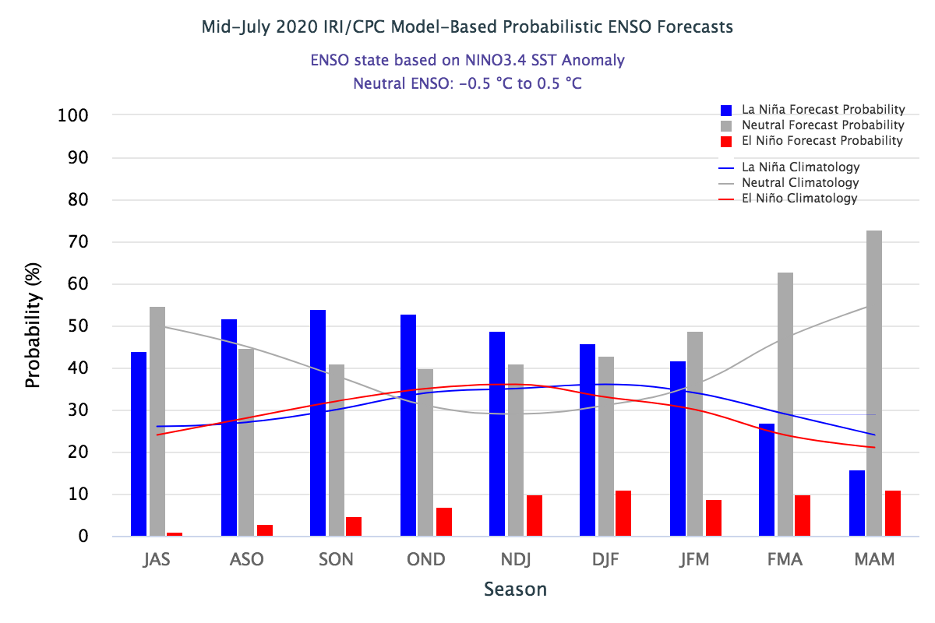
ENSO status
La Niña |
shift from neutral to La Niña probability by fall (slight) and favored through March
watch is now posted
https:// iri.columbia.edu/our-expertise/climate/forecasts/enso/current/
Notes:
Here I outlined the similar trends for the Nebraska and global annual average temperature. I also point out the high variability in Nebraska and difference in regional vs. global scales. I use the analogy that global change is like an escalator that is increasing at an accelerating rate. The variability is like we jump up or down a few steps while still going up.

Slide 22
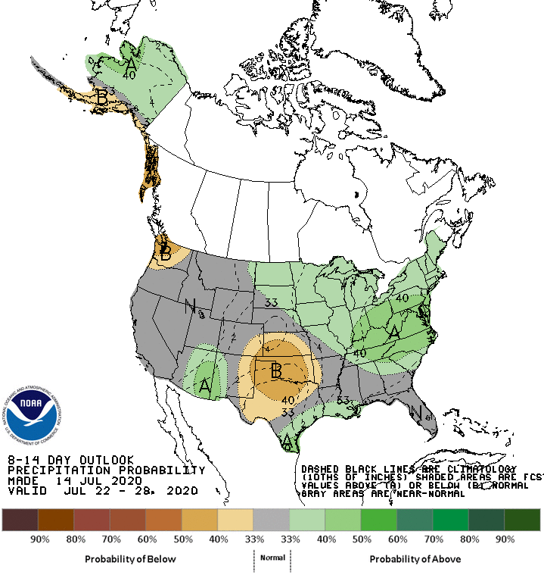
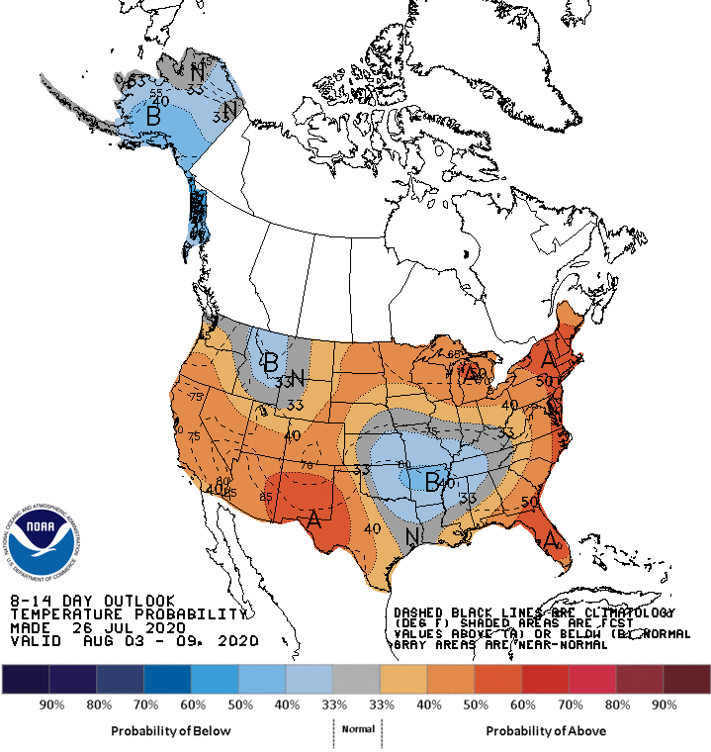
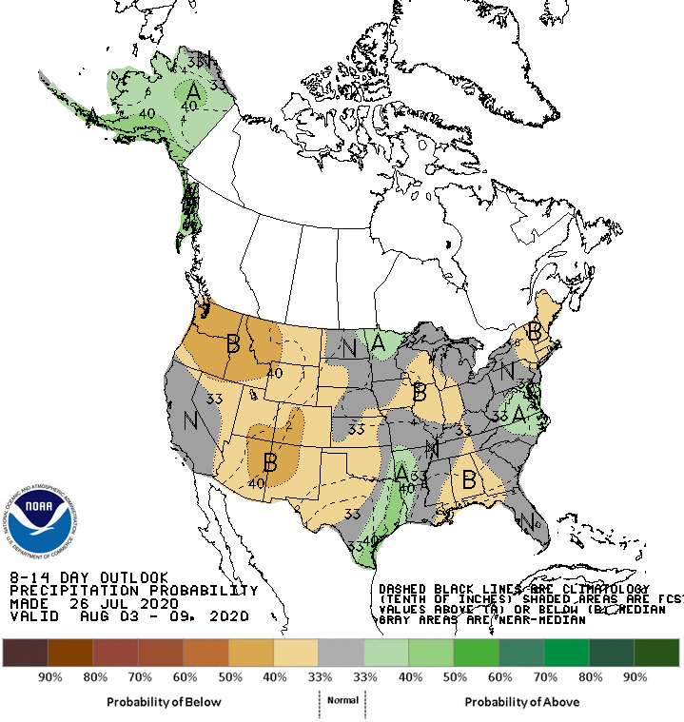
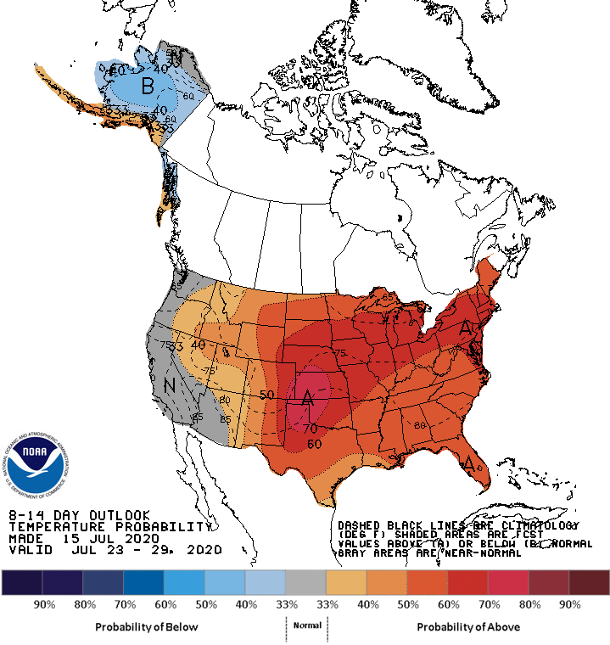
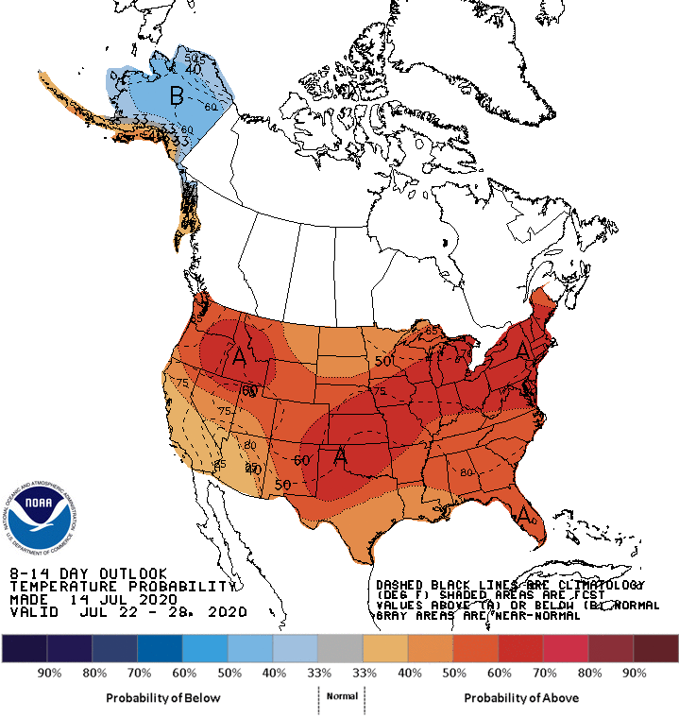
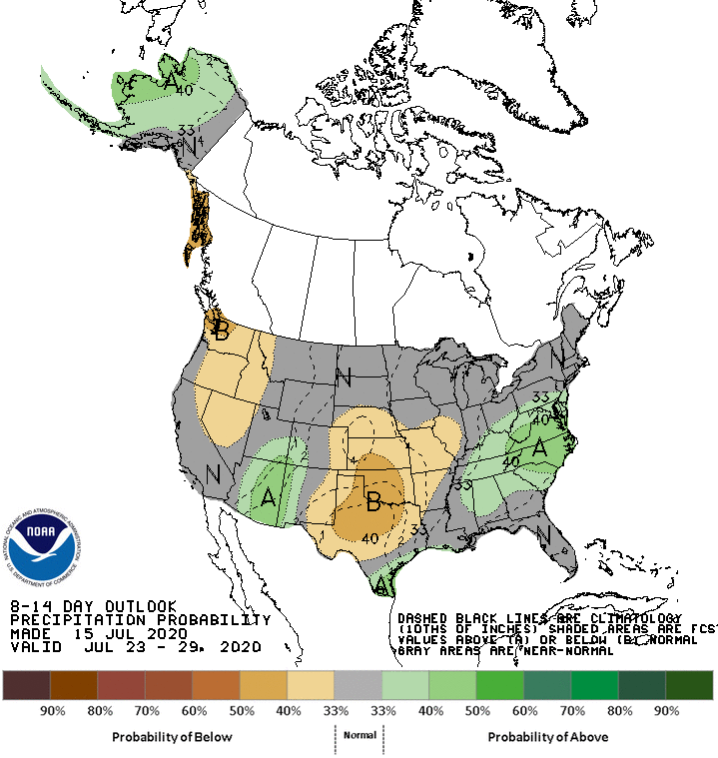
Climate outlook
- probability weighted to above normal temps, dryness
https:// www.cpc.ncep.noaa.gov
Notes:
Here I outlined the similar trends for the Nebraska and global annual average temperature. I also point out the high variability in Nebraska and difference in regional vs. global scales. I use the analogy that global change is like an escalator that is increasing at an accelerating rate. The variability is like we jump up or down a few steps while still going up.

Slide 23
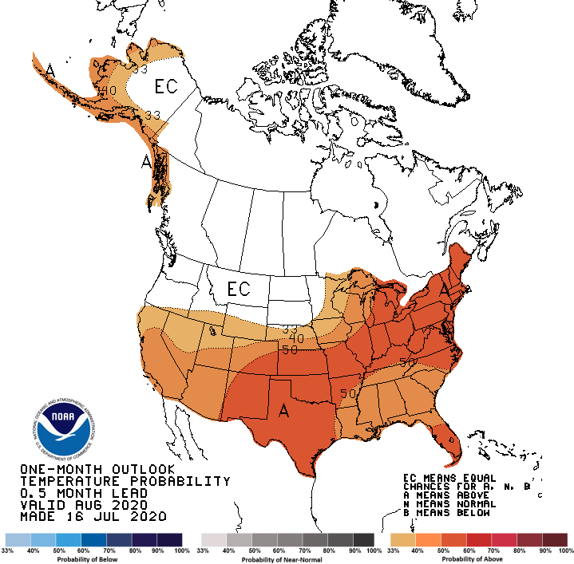
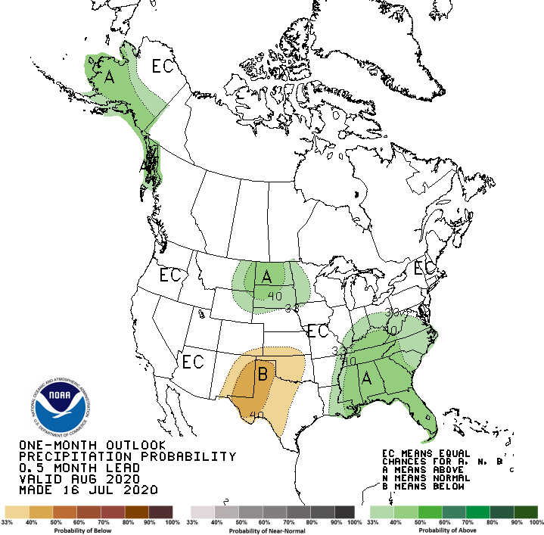
August outlook
- Warm signal for Nebraska; wet signals to our north
Notes:
Here I outlined the similar trends for the Nebraska and global annual average temperature. I also point out the high variability in Nebraska and difference in regional vs. global scales. I use the analogy that global change is like an escalator that is increasing at an accelerating rate. The variability is like we jump up or down a few steps while still going up.

Slide 24
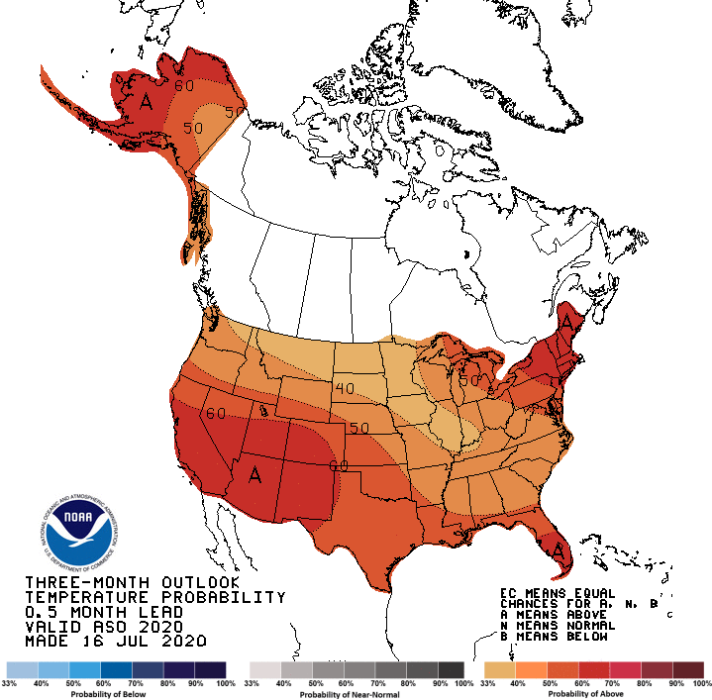
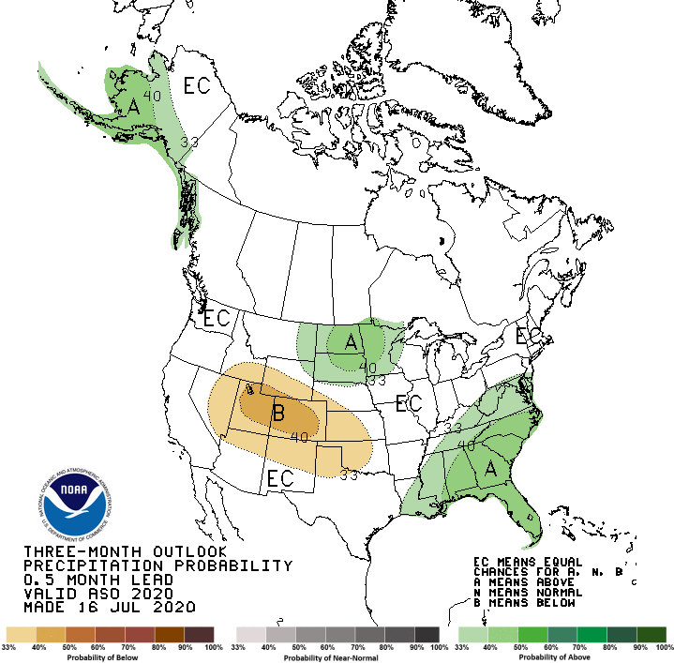
Aug-Sep-Oct outlook
- Warm signal across region; wet in the north, dry in southwest
Notes:
Here I outlined the similar trends for the Nebraska and global annual average temperature. I also point out the high variability in Nebraska and difference in regional vs. global scales. I use the analogy that global change is like an escalator that is increasing at an accelerating rate. The variability is like we jump up or down a few steps while still going up.

Slide 25
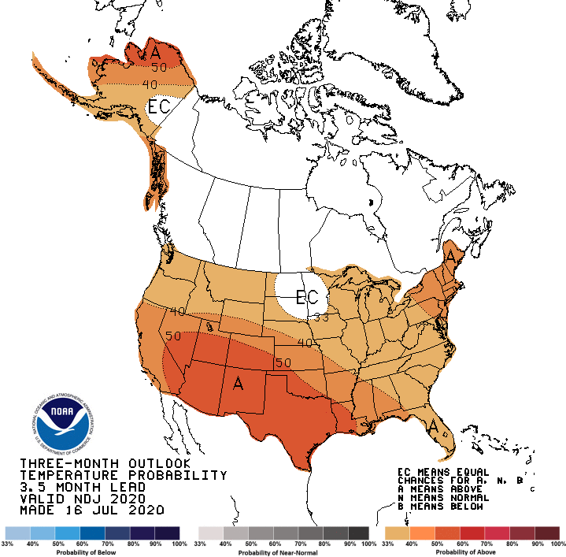
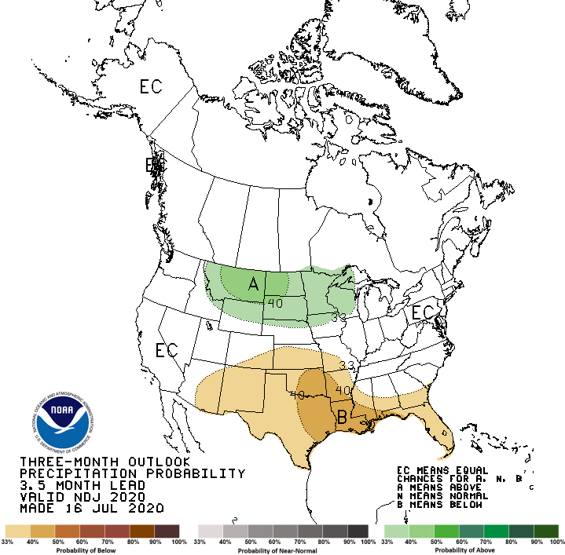
Nov-Dec-Jan outlook
- Warm signal continuation; wet in the north, dry in the south
Notes:
Here I outlined the similar trends for the Nebraska and global annual average temperature. I also point out the high variability in Nebraska and difference in regional vs. global scales. I use the analogy that global change is like an escalator that is increasing at an accelerating rate. The variability is like we jump up or down a few steps while still going up.

Slide 26
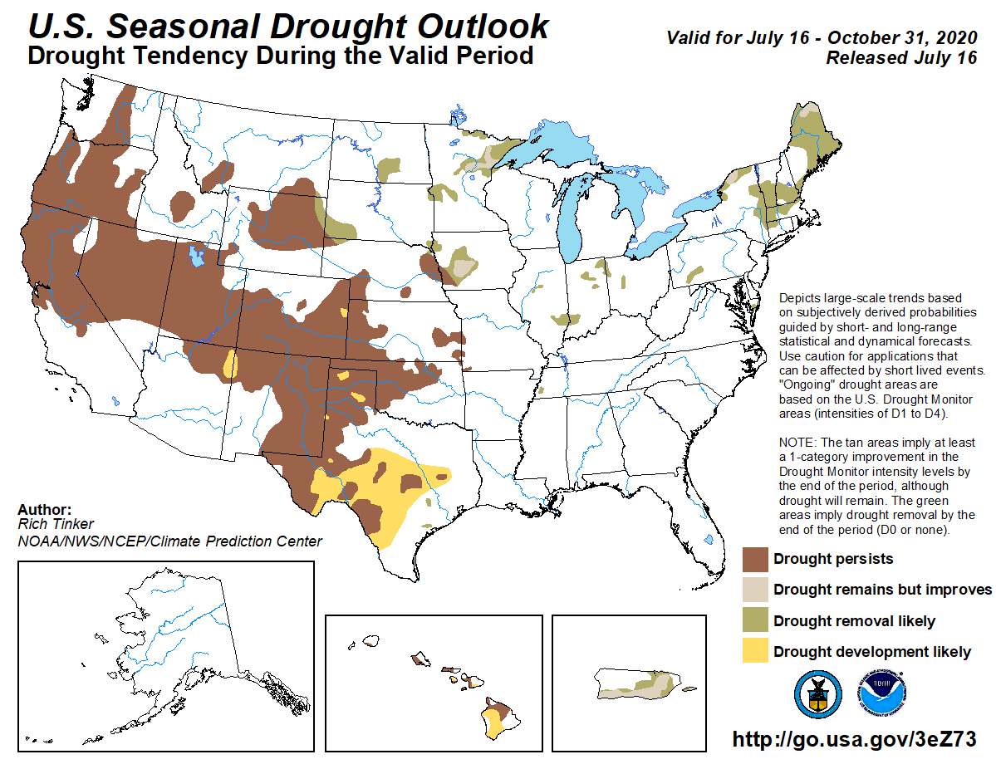
Drought outlook
improvements in eastern portion, north and SW SD, NE WY
persistence in the central and west
Notes:
Here I outlined the similar trends for the Nebraska and global annual average temperature. I also point out the high variability in Nebraska and difference in regional vs. global scales. I use the analogy that global change is like an escalator that is increasing at an accelerating rate. The variability is like we jump up or down a few steps while still going up.

Slide 27
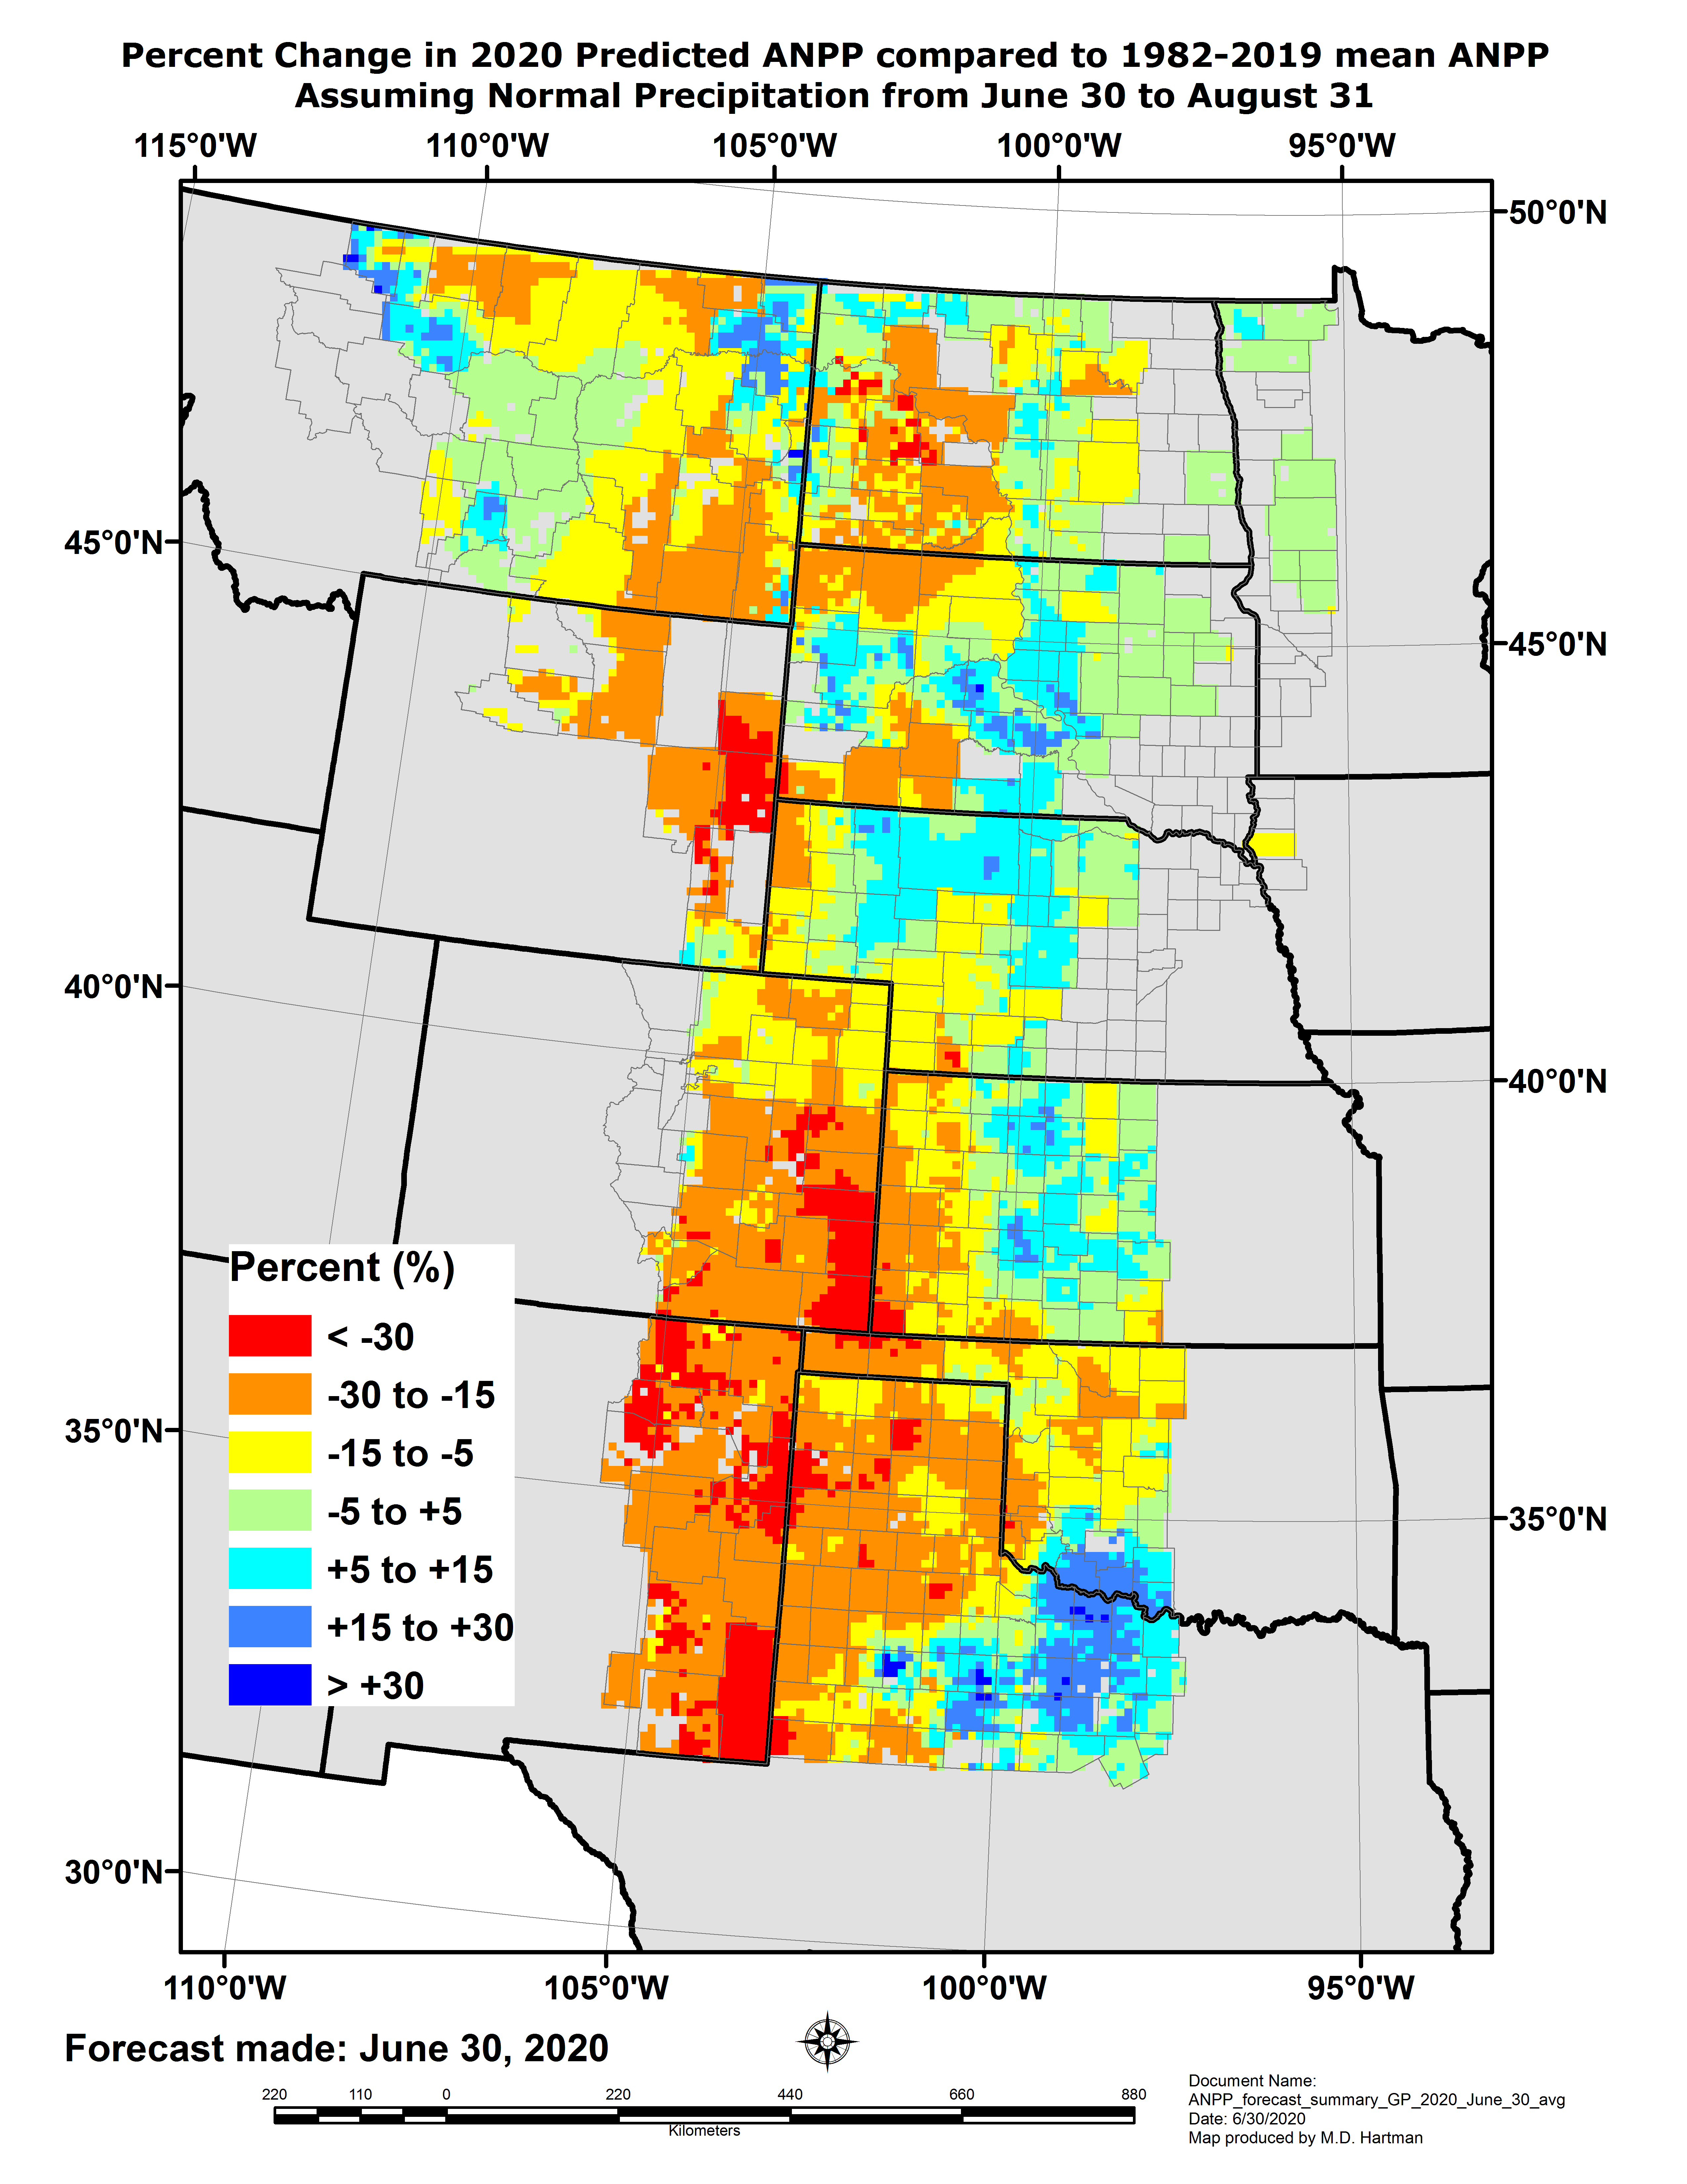
Grassland production
Assuming normal precipitation for July and August, grass production shows regional variability
Reduced productivity in the west, above normal in the east
https://grasscast.unl.edu/
Notes:
Here I outlined the similar trends for the Nebraska and global annual average temperature. I also point out the high variability in Nebraska and difference in regional vs. global scales. I use the analogy that global change is like an escalator that is increasing at an accelerating rate. The variability is like we jump up or down a few steps while still going up.

Slide 28
Key impacts
Increasing pattern of dryness across Nebraska in which half is abnormally dry or worse.
Slow start to severe weather season, but picking up lately.
Range and pasture conditions showing declines.
Notes:
Here I outlined the similar trends for the Nebraska and global annual average temperature. I also point out the high variability in Nebraska and difference in regional vs. global scales. I use the analogy that global change is like an escalator that is increasing at an accelerating rate. The variability is like we jump up or down a few steps while still going up.

Slide 29
Outlook summary
Warm signal expected to continue with generally above average temperatures for the monthly and seasonal outlooks.
Wet signal hangs on in the northern tier of the region while dryness has the highest probability in the south.
La Niña watch issued with slight probabilities through the winter and spring.
Notes:
Here I outlined the similar trends for the Nebraska and global annual average temperature. I also point out the high variability in Nebraska and difference in regional vs. global scales. I use the analogy that global change is like an escalator that is increasing at an accelerating rate. The variability is like we jump up or down a few steps while still going up.

Slide 30
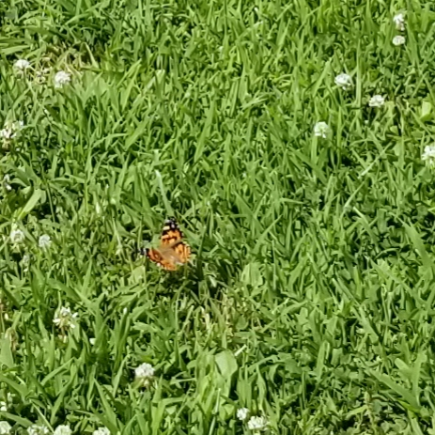
Questions
Martha Shulski: mshulski3@unl.edu, 402-472-6711
Photo courtesy Mark Junker Sac and Fox Tribe
Notes:
Here I outlined the similar trends for the Nebraska and global annual average temperature. I also point out the high variability in Nebraska and difference in regional vs. global scales. I use the analogy that global change is like an escalator that is increasing at an accelerating rate. The variability is like we jump up or down a few steps while still going up.

