Slide 1
Nebraska Climate Update
Martha D shulski
mshulski3@unl.edu
402-472-6711
School of natural resources
University of Nebraska LIncoln
CARC Meeting
12 November, 2021

Slide 2
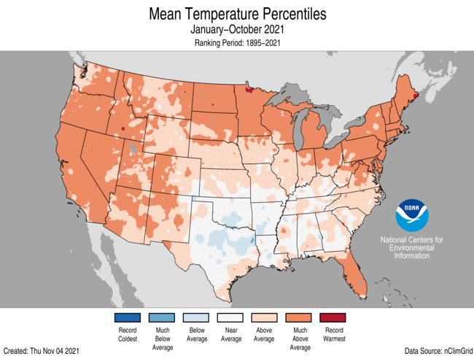
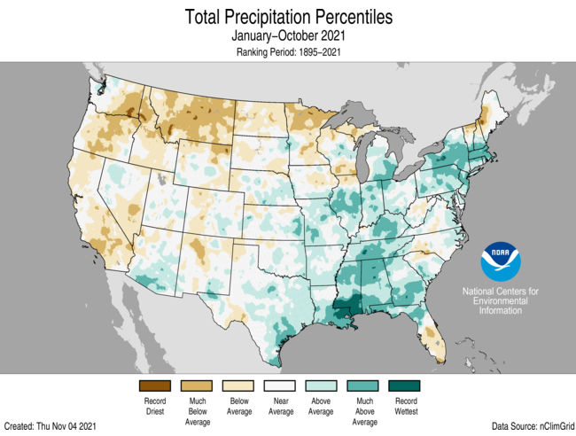
Recap
2021 YTD | above average temperatures; wet and dry pockets
Source: https://ncdc.noaa.gov/temp-and-precip/us-maps/
Notes:
Here I outlined the similar trends for the Nebraska and global annual average temperature. I also point out the high variability in Nebraska and difference in regional vs. global scales. I use the analogy that global change is like an escalator that is increasing at an accelerating rate. The variability is like we jump up or down a few steps while still going up.

Slide 3
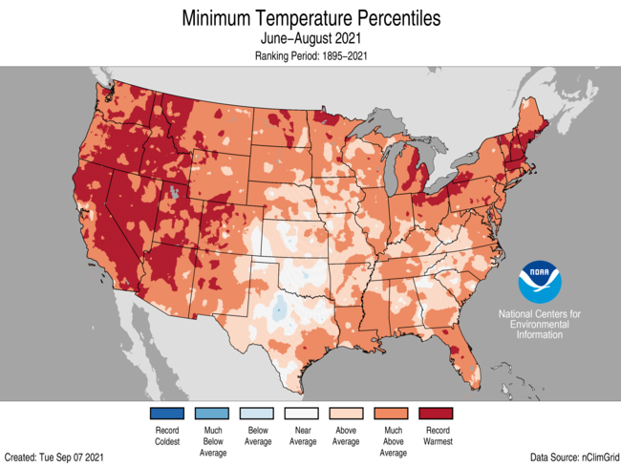
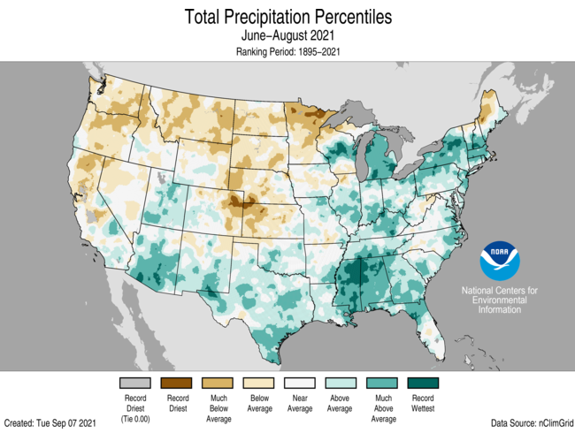
Recap
Jun-Jul-Aug | warm and generally dry summer
Source: https://ncdc.noaa.gov/temp-and-precip/us-maps/
Notes:
Here I outlined the similar trends for the Nebraska and global annual average temperature. I also point out the high variability in Nebraska and difference in regional vs. global scales. I use the analogy that global change is like an escalator that is increasing at an accelerating rate. The variability is like we jump up or down a few steps while still going up.

Slide 4
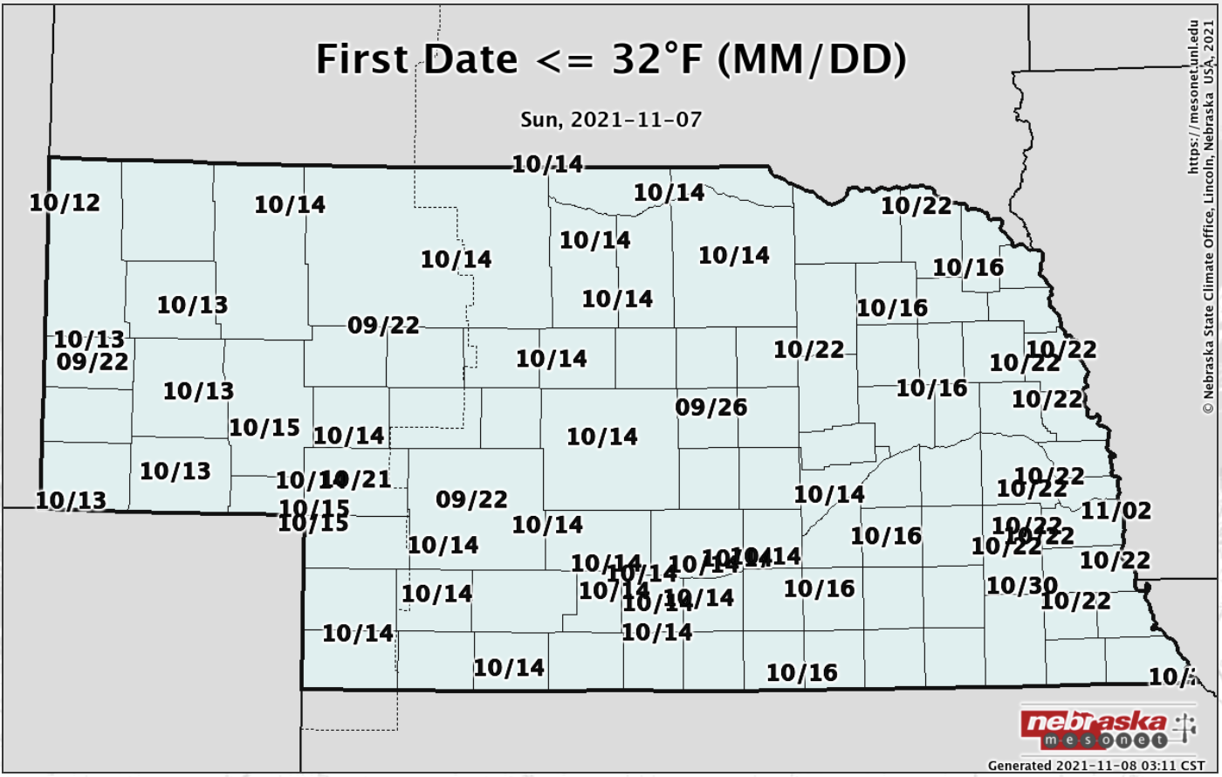
Recap
October temperature | About 3°F above normal statewide, first frost occurrence 2-3 weeks later than average.
Notes:
Here I outlined the similar trends for the Nebraska and global annual average temperature. I also point out the high variability in Nebraska and difference in regional vs. global scales. I use the analogy that global change is like an escalator that is increasing at an accelerating rate. The variability is like we jump up or down a few steps while still going up.

Slide 5
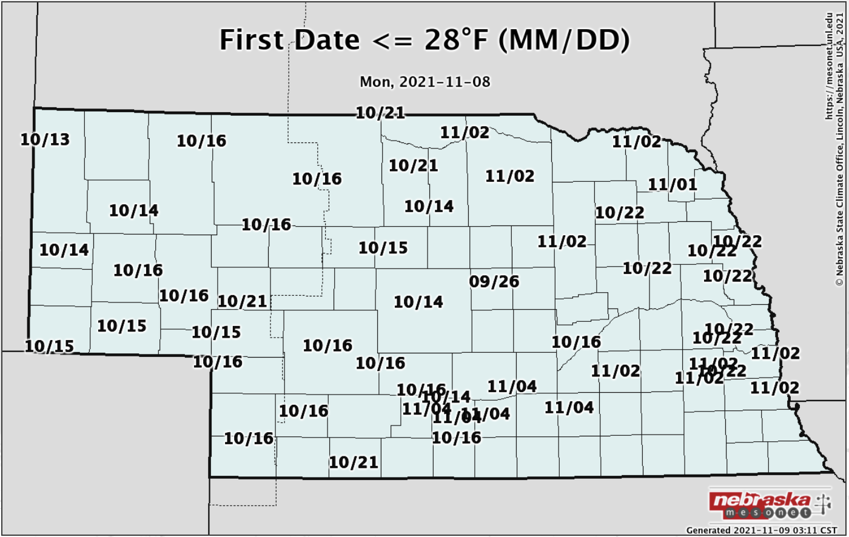
Recap
October temperature | First hard freeze yet to occur in extreme southeast counties
1-2 weeks later than average where it has occurred.
Notes:
Here I outlined the similar trends for the Nebraska and global annual average temperature. I also point out the high variability in Nebraska and difference in regional vs. global scales. I use the analogy that global change is like an escalator that is increasing at an accelerating rate. The variability is like we jump up or down a few steps while still going up.

Slide 6
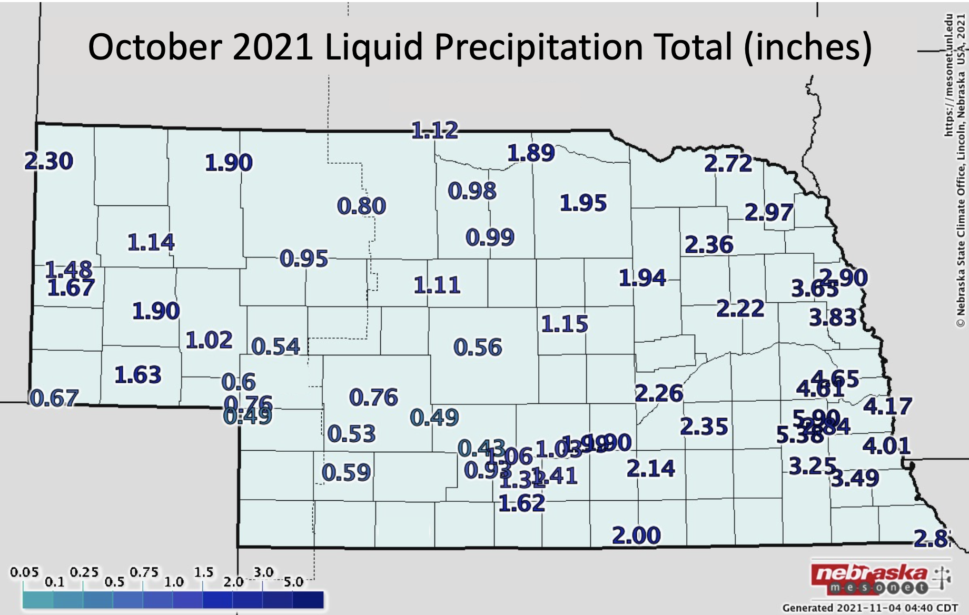
Recap
October precipitation | have’s and have not’s last month
Notes:
Here I outlined the similar trends for the Nebraska and global annual average temperature. I also point out the high variability in Nebraska and difference in regional vs. global scales. I use the analogy that global change is like an escalator that is increasing at an accelerating rate. The variability is like we jump up or down a few steps while still going up.

Slide 7
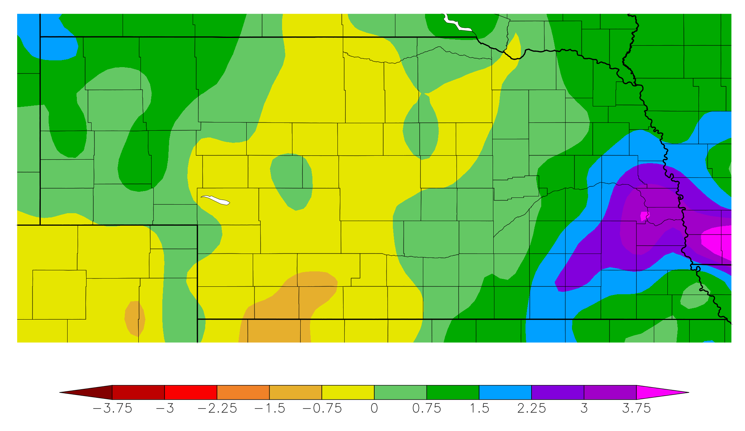
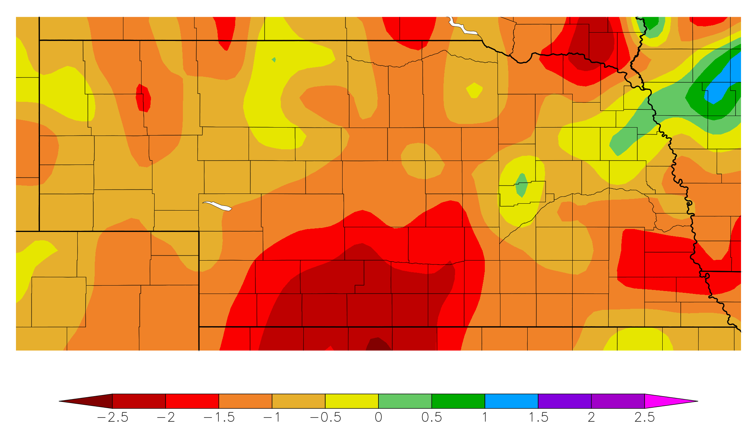
Recap
Precipitation | 1 month departure
30 day precipitation departure from normal
10 Oct – 8 Nov
Source: https:// hprcc.unl.edu/maps.php?map=ACISClimateMaps
Notes:
Here I outlined the similar trends for the Nebraska and global annual average temperature. I also point out the high variability in Nebraska and difference in regional vs. global scales. I use the analogy that global change is like an escalator that is increasing at an accelerating rate. The variability is like we jump up or down a few steps while still going up.

Slide 8
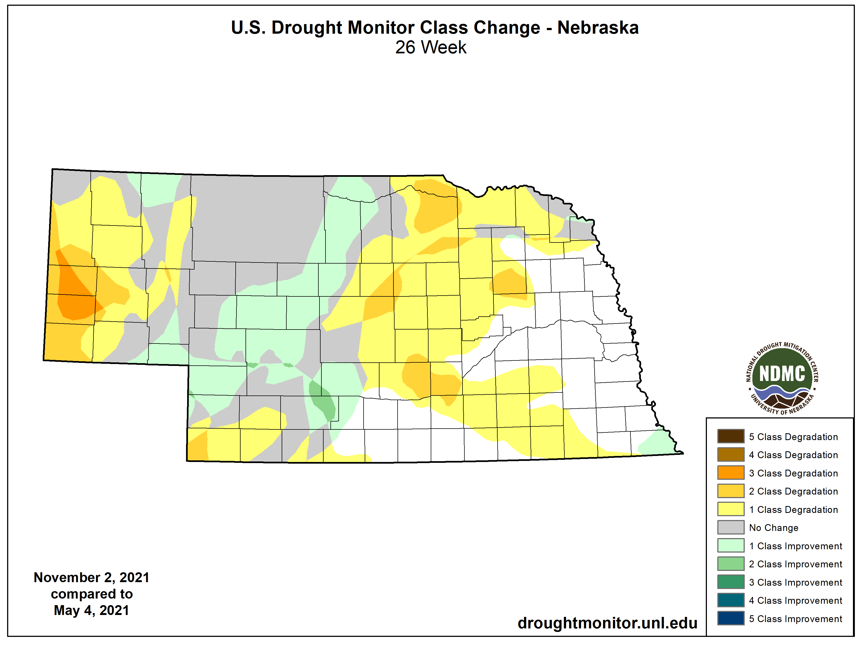
Recap
Drought |
Panhandle, southwest and east central have seen degradations since start of growing season.
Source: https://droughtmonitor.unl.edu/maps/
Notes:
Here I outlined the similar trends for the Nebraska and global annual average temperature. I also point out the high variability in Nebraska and difference in regional vs. global scales. I use the analogy that global change is like an escalator that is increasing at an accelerating rate. The variability is like we jump up or down a few steps while still going up.

Slide 9
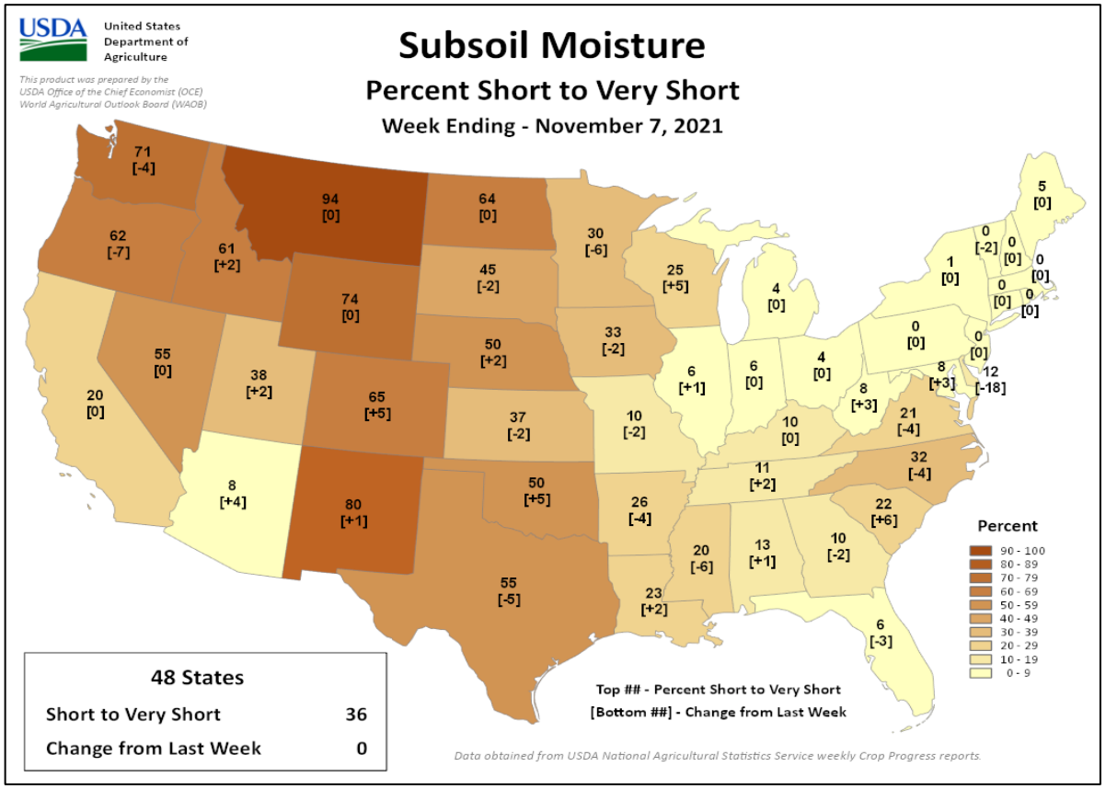
Soils
Soil moisture |
topsoil (6”) moisture 35% short to very short
subsoil 50% short to very short)
* short-very short: normal crop growth curtailed visible signs of stress
Thank you to Brad Rippey and USDA-OCE
https:// www.usda.library.cornell.edu/concern/publications/cj82k728n?locale=en
Notes:
Here I outlined the similar trends for the Nebraska and global annual average temperature. I also point out the high variability in Nebraska and difference in regional vs. global scales. I use the analogy that global change is like an escalator that is increasing at an accelerating rate. The variability is like we jump up or down a few steps while still going up.

Slide 10
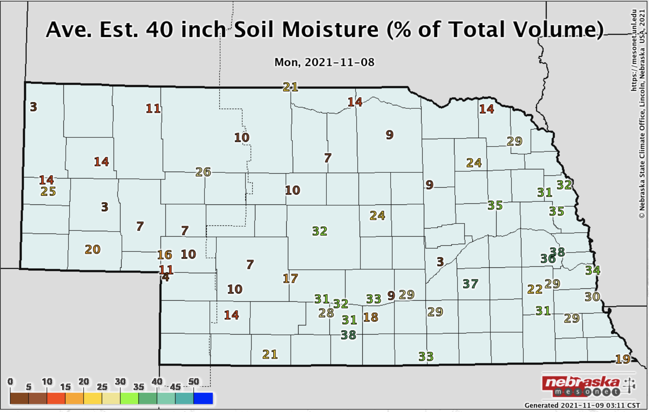
Soils
Soil moisture | Drought conditions (and lack of) apparent in the soil moisture profiles.
Notes:
Here I outlined the similar trends for the Nebraska and global annual average temperature. I also point out the high variability in Nebraska and difference in regional vs. global scales. I use the analogy that global change is like an escalator that is increasing at an accelerating rate. The variability is like we jump up or down a few steps while still going up.

Slide 11
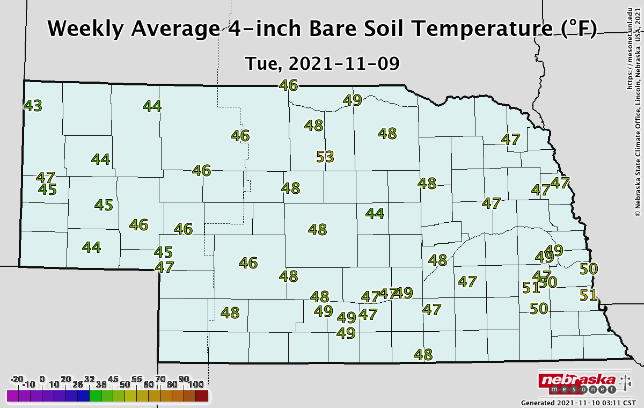
Soils
Soil temperature |
- Weekly average temperatures mostly in the 40s.
Notes:
Here I outlined the similar trends for the Nebraska and global annual average temperature. I also point out the high variability in Nebraska and difference in regional vs. global scales. I use the analogy that global change is like an escalator that is increasing at an accelerating rate. The variability is like we jump up or down a few steps while still going up.

Slide 12
Agricultural implications
Soil moisture values EC and SE Nebraska have reached levels similar to mid-January last year, but western third of Nebraska has used up September and October moisture due to the very late frost/freeze. Grasses still grew (somewhat) requiring moisture that was significantly less than received across the eastern quarter of Nebraska.
If we can keep ground freeze up at bay, there is still an opportunity to build soil moisture reserves given decent storm activity.
However, we are closing in on our dry season (DJF) where each month accounts for approximately 2-3 percent of our annual total.
Notes:
Here I outlined the similar trends for the Nebraska and global annual average temperature. I also point out the high variability in Nebraska and difference in regional vs. global scales. I use the analogy that global change is like an escalator that is increasing at an accelerating rate. The variability is like we jump up or down a few steps while still going up.

Slide 13
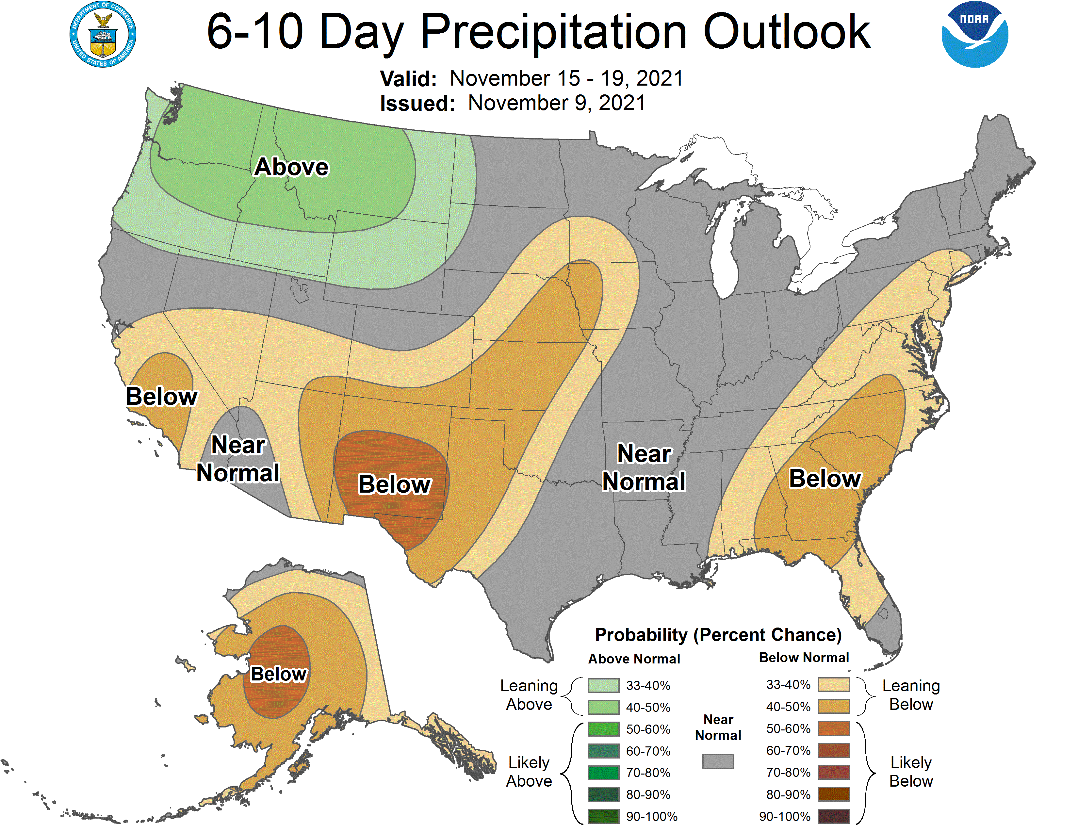
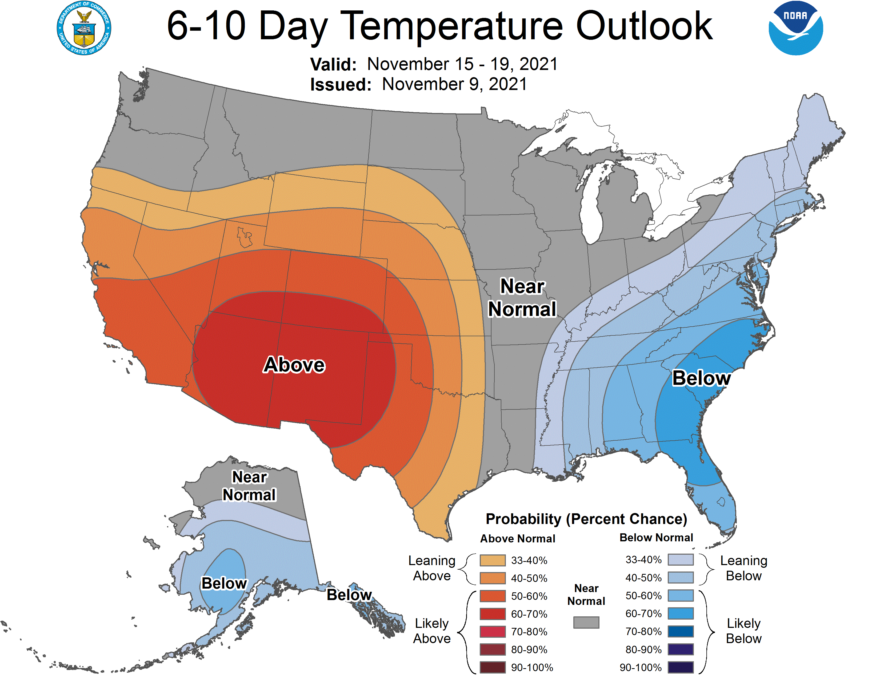
Precipitation outlook
Only very light precipitation in the forecast period over the next week to 10 days and leaning above normal temps.
Notes:
Here I outlined the similar trends for the Nebraska and global annual average temperature. I also point out the high variability in Nebraska and difference in regional vs. global scales. I use the analogy that global change is like an escalator that is increasing at an accelerating rate. The variability is like we jump up or down a few steps while still going up.

Slide 14
ENSO status
La Niña |
Weak La Niña conditions expected through winter.
Shift to neutral by spring is likely.
We will be watching for a potential transition to El Niño next year.
Could see a movement toward wetter conditions across the southern Plains by late summer to early fall (southern jet becomes stronger) and a drier precipitation pattern over the northern Plains (northern jet becomes weaker).
Notes:
Here I outlined the similar trends for the Nebraska and global annual average temperature. I also point out the high variability in Nebraska and difference in regional vs. global scales. I use the analogy that global change is like an escalator that is increasing at an accelerating rate. The variability is like we jump up or down a few steps while still going up.

Slide 15
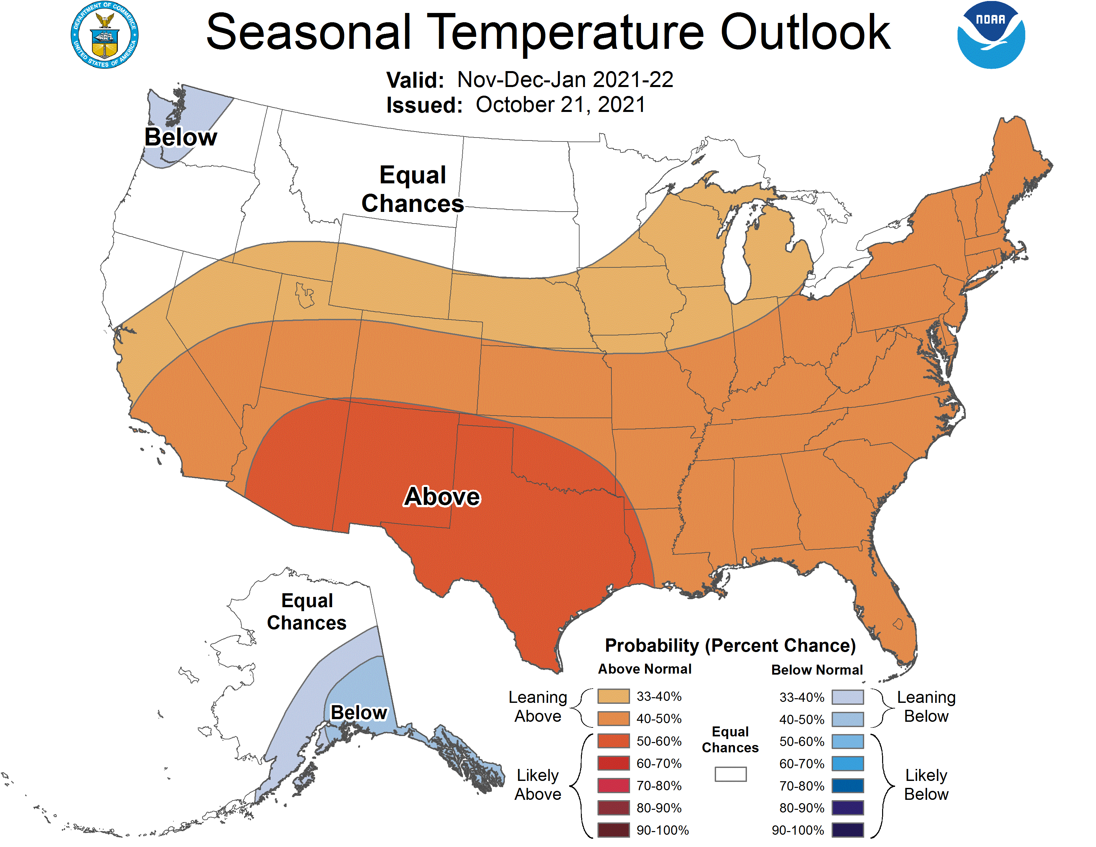
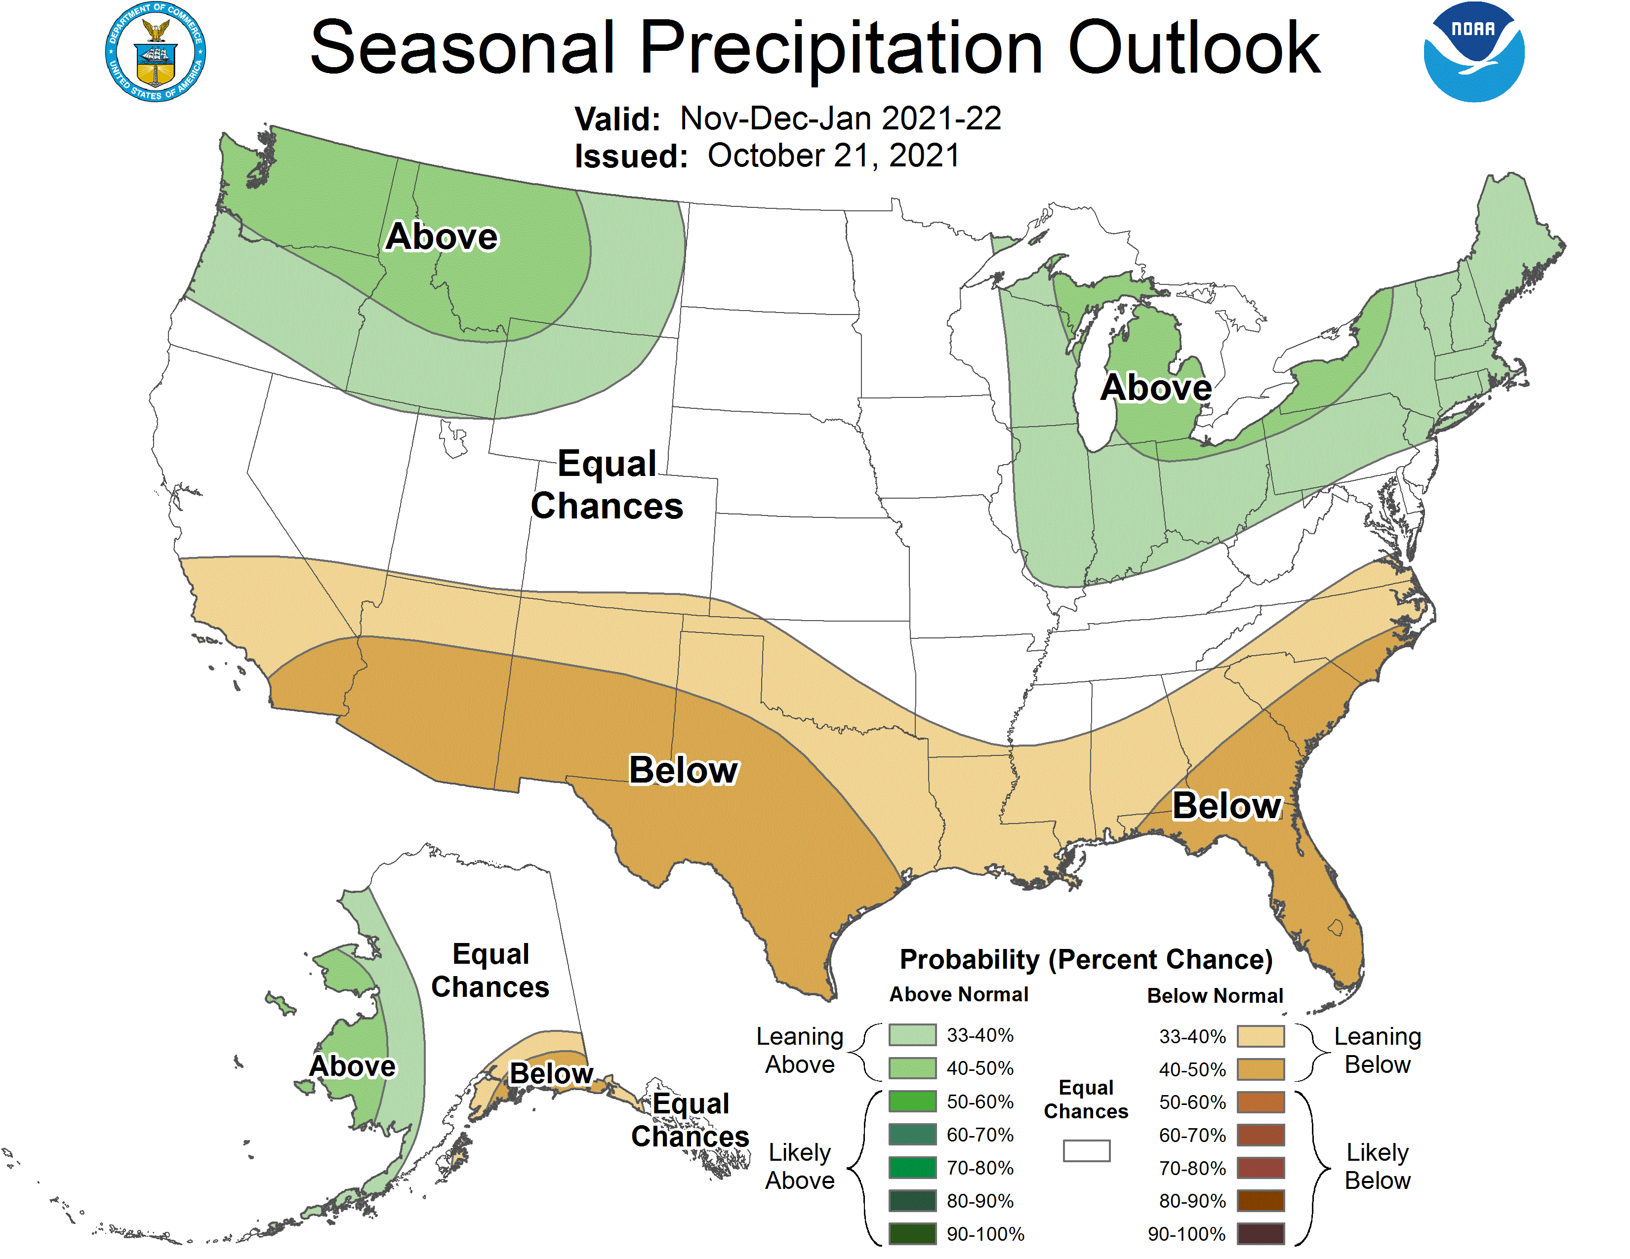
Nov-Dec-Jan outlook
- La Niña signal; general wet/cold in the north, warm/dry in south
Notes:
Here I outlined the similar trends for the Nebraska and global annual average temperature. I also point out the high variability in Nebraska and difference in regional vs. global scales. I use the analogy that global change is like an escalator that is increasing at an accelerating rate. The variability is like we jump up or down a few steps while still going up.

Slide 16
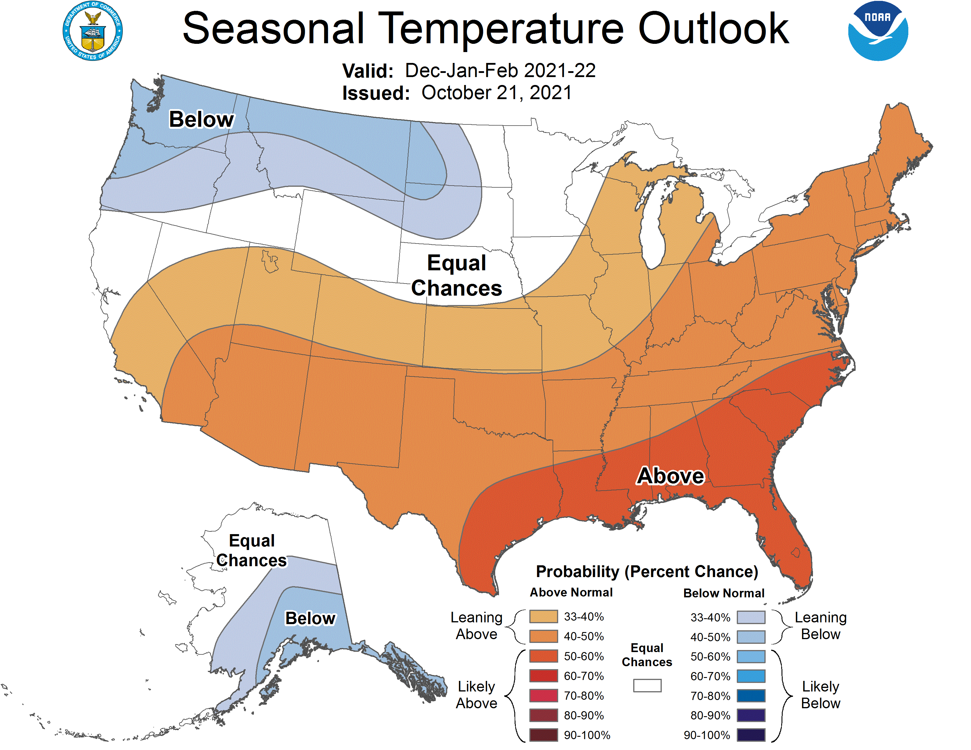
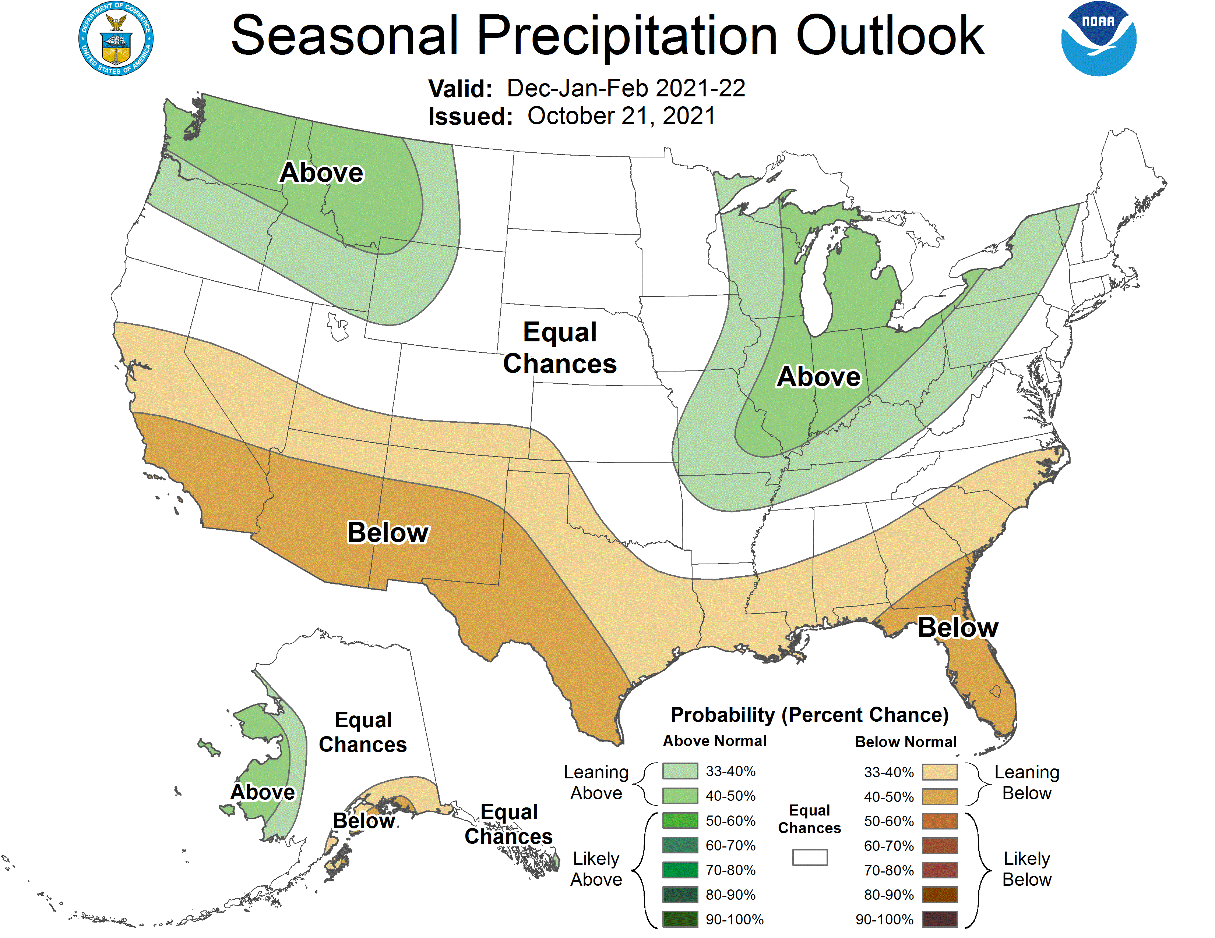
Dec-Jan-Feb outlook
- Equal chances remain for Nebraska
Notes:
Here I outlined the similar trends for the Nebraska and global annual average temperature. I also point out the high variability in Nebraska and difference in regional vs. global scales. I use the analogy that global change is like an escalator that is increasing at an accelerating rate. The variability is like we jump up or down a few steps while still going up.

Slide 17
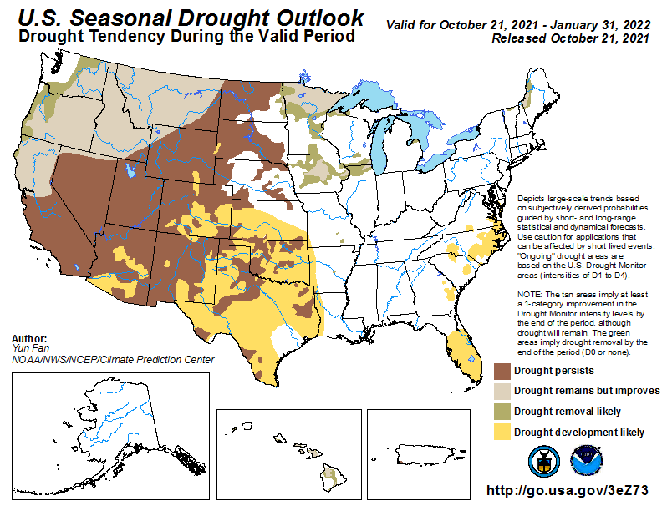
Seasonal drought outlook
Persistence across Nebraska and much of the region.
Alleviation in northwest and midwest.
Notes:
Here I outlined the similar trends for the Nebraska and global annual average temperature. I also point out the high variability in Nebraska and difference in regional vs. global scales. I use the analogy that global change is like an escalator that is increasing at an accelerating rate. The variability is like we jump up or down a few steps while still going up.

Slide 18
Outlook summary
Relatively weak La Niña, therefore other factors will come into play.
We will be watching atmospheric river events on the west coast. A very early event occurred late October and it translated eastward into a stormy pattern for the northern/central Plains.
Recent climate trends point to warm early winter and cold/wet late winter.
Northern Rockies should see above normal snowfall year, especially if the active pattern continues (at least one storm per week over the past two month).
Likely to have sufficient subsoil moisture to get crops off to a good start and enough to produce a respectable crop as long as dry conditions don’t develop before mid July.
Notes:
Here I outlined the similar trends for the Nebraska and global annual average temperature. I also point out the high variability in Nebraska and difference in regional vs. global scales. I use the analogy that global change is like an escalator that is increasing at an accelerating rate. The variability is like we jump up or down a few steps while still going up.

Slide 19
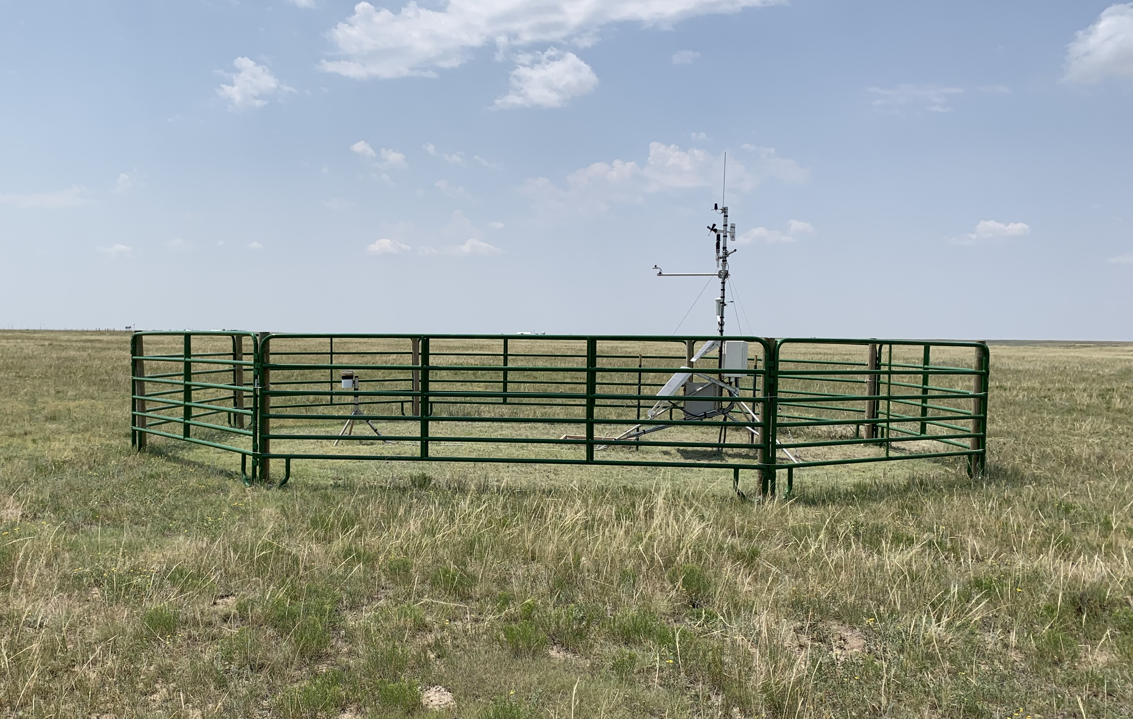
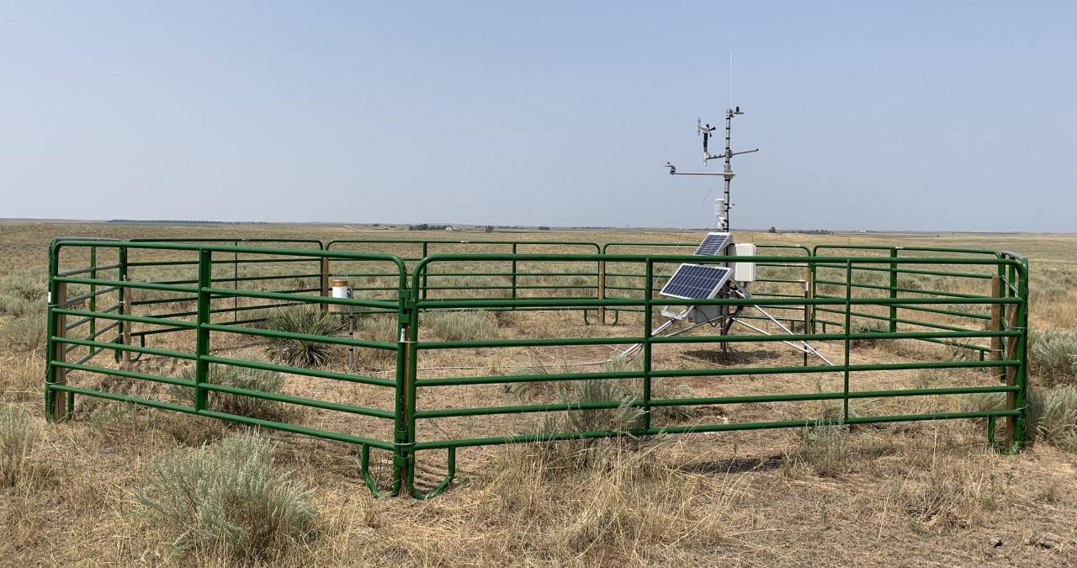
Questions
Martha Shulski: mshulski3@unl.edu, 402-472-6711
New Nebraska Mesonet station
Bushnell 12 SW (Kimball Co.)
New Nebraska Mesonet station
Enders 10SW (Dundy Co.)
Notes:
Here I outlined the similar trends for the Nebraska and global annual average temperature. I also point out the high variability in Nebraska and difference in regional vs. global scales. I use the analogy that global change is like an escalator that is increasing at an accelerating rate. The variability is like we jump up or down a few steps while still going up.

