Slide 1
Nebraska Climate Update
Martha D shulski
mshulski3@unl.edu
402-472-6711
School of natural resources
University of Nebraska LIncoln
CARC Meeting
8 December, 2020

Slide 2
Today’s presentation
Recap of 2020 and recent conditions
Impacts – quick end to harvest, overall worsening drought, dry soil profiles
Outlook – warmth and dryness to continue in December
Notes:
Here I outlined the similar trends for the Nebraska and global annual average temperature. I also point out the high variability in Nebraska and difference in regional vs. global scales. I use the analogy that global change is like an escalator that is increasing at an accelerating rate. The variability is like we jump up or down a few steps while still going up.

Slide 3
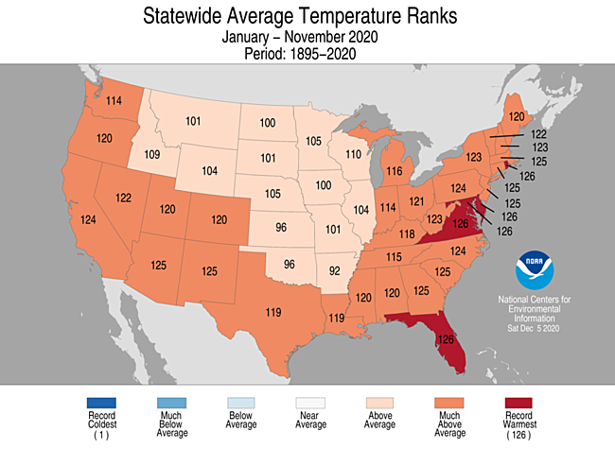
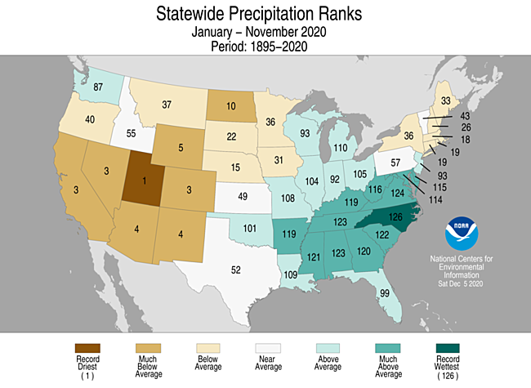
Recap
2020 YTD | above average temperatures; 15th driest
Source: https://ncdc.noaa.gov/temp-and-precip/us-maps/
Notes:
Here I outlined the similar trends for the Nebraska and global annual average temperature. I also point out the high variability in Nebraska and difference in regional vs. global scales. I use the analogy that global change is like an escalator that is increasing at an accelerating rate. The variability is like we jump up or down a few steps while still going up.

Slide 4
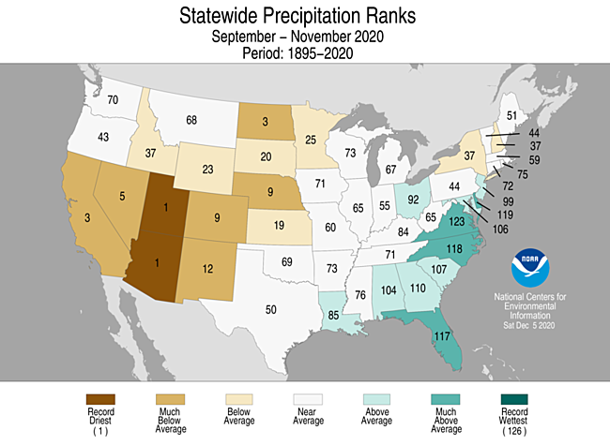
Recap
Sep-Oct-Nov | mostly warm and very dry fall
Source: https://ncdc.noaa.gov/temp-and-precip/us-maps/
Notes:
Here I outlined the similar trends for the Nebraska and global annual average temperature. I also point out the high variability in Nebraska and difference in regional vs. global scales. I use the analogy that global change is like an escalator that is increasing at an accelerating rate. The variability is like we jump up or down a few steps while still going up.

Slide 5
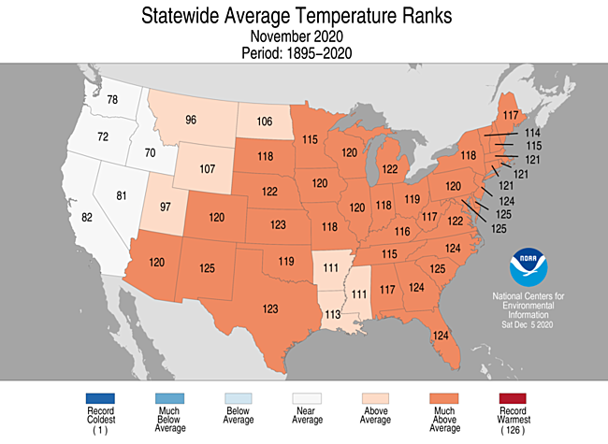
Recap
November temperature | much warmer than normal (5 – 7°F), ranks as 5th warmest
Source: https://ncdc.noaa.gov/temp-and-precip/us-maps/
Notes:
Here I outlined the similar trends for the Nebraska and global annual average temperature. I also point out the high variability in Nebraska and difference in regional vs. global scales. I use the analogy that global change is like an escalator that is increasing at an accelerating rate. The variability is like we jump up or down a few steps while still going up.

Slide 6
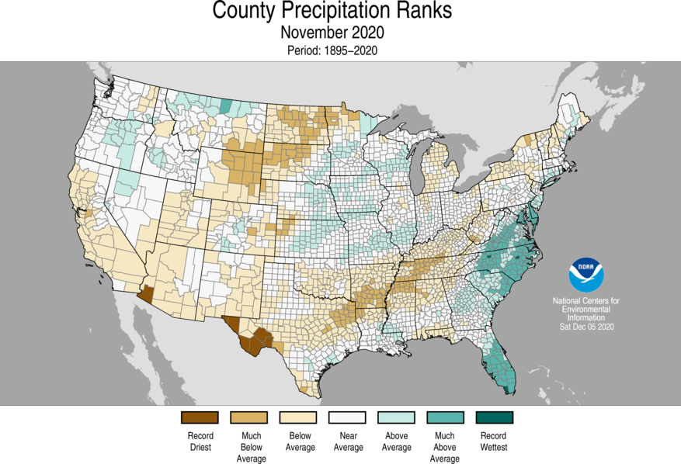
Recap
November precipitation | a dry month overall with areas in the east above normal
Source: https://ncdc.noaa.gov/temp-and-precip/us-maps/
Notes:
Here I outlined the similar trends for the Nebraska and global annual average temperature. I also point out the high variability in Nebraska and difference in regional vs. global scales. I use the analogy that global change is like an escalator that is increasing at an accelerating rate. The variability is like we jump up or down a few steps while still going up.

Slide 7
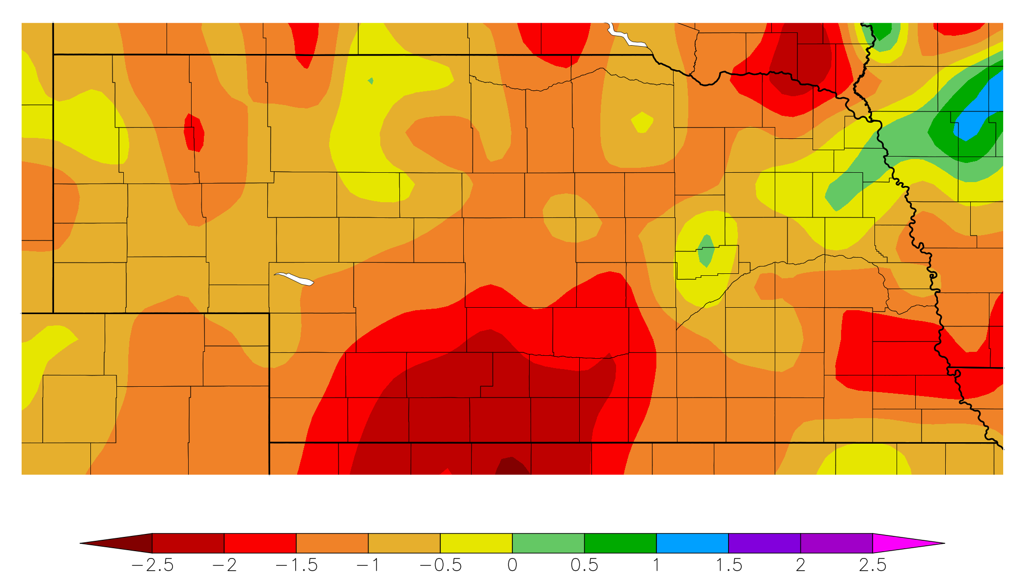
Recap
Precipitation | 2 month departures
60 day precipitation departure from normal
7 Oct – 5 Dec
Source: https:// hprcc.unl.edu/maps.php?map=ACISClimateMaps
Notes:
Here I outlined the similar trends for the Nebraska and global annual average temperature. I also point out the high variability in Nebraska and difference in regional vs. global scales. I use the analogy that global change is like an escalator that is increasing at an accelerating rate. The variability is like we jump up or down a few steps while still going up.

Slide 8
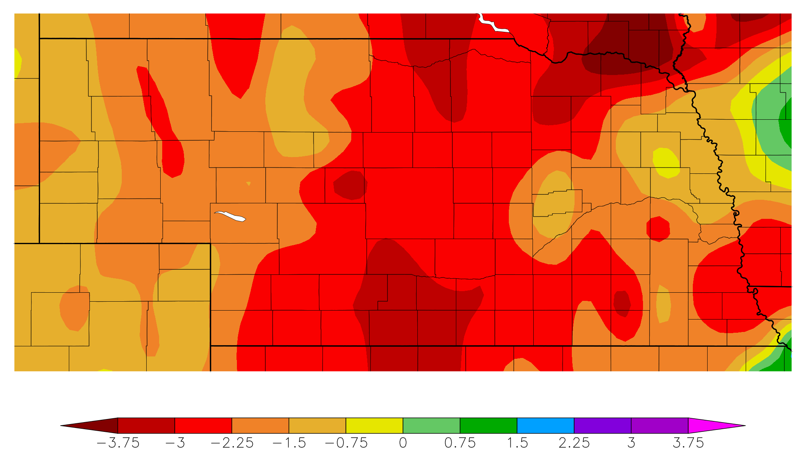
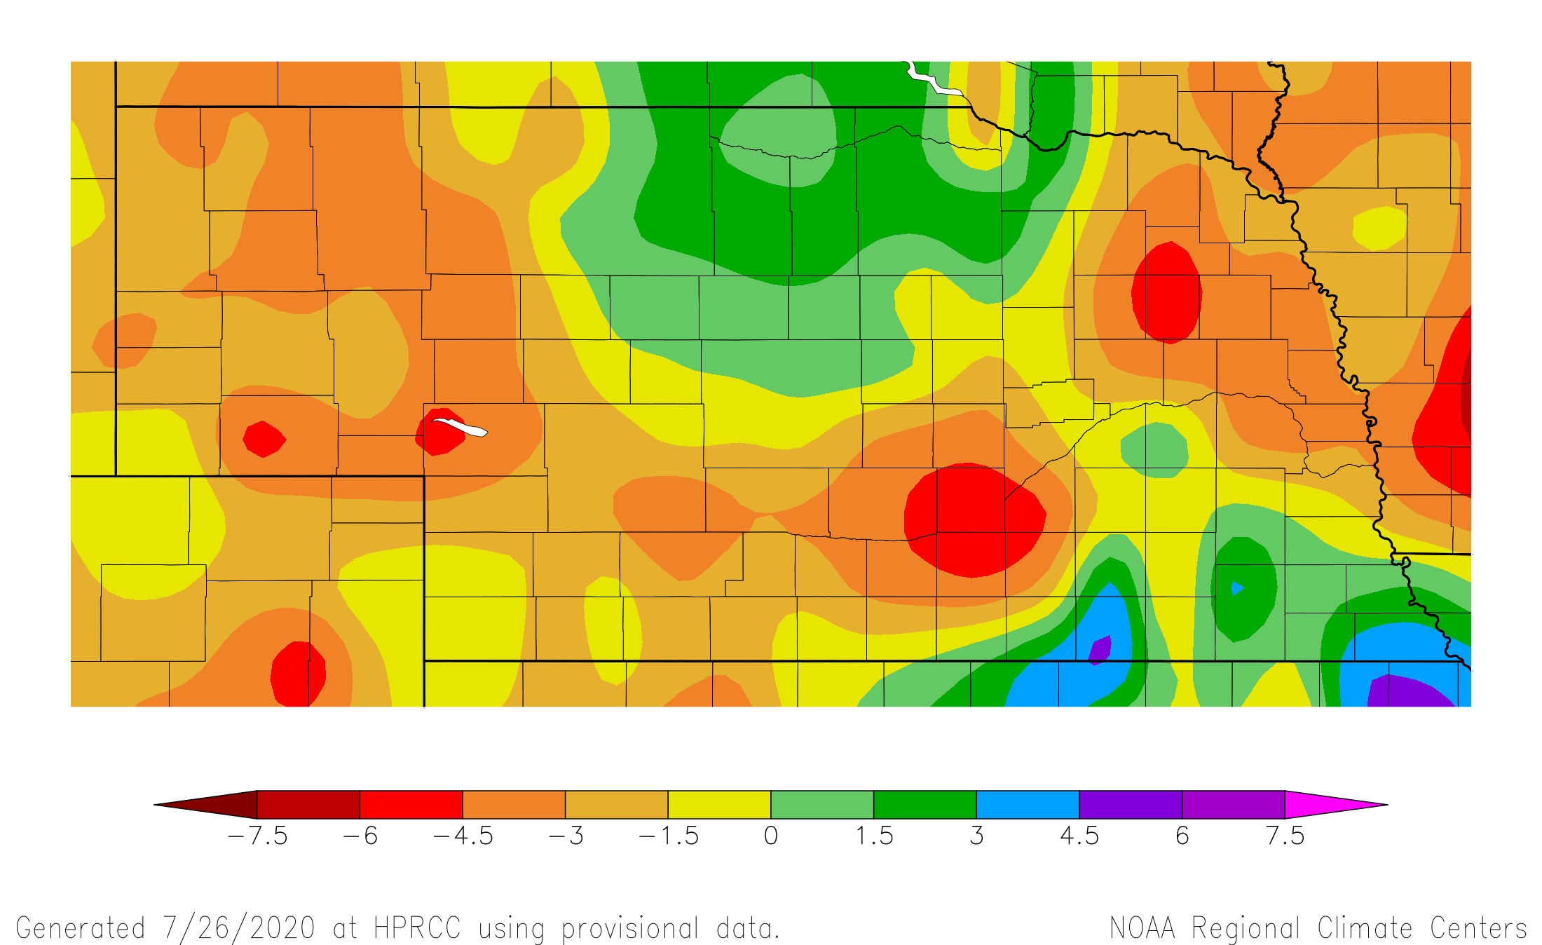
Recap
Precipitation | 3 month departures
90 day precipitation departure from normal
7 Sep – 5 Dec
Source: https:// hprcc.unl.edu/maps.php?map=ACISClimateMaps
Notes:
Here I outlined the similar trends for the Nebraska and global annual average temperature. I also point out the high variability in Nebraska and difference in regional vs. global scales. I use the analogy that global change is like an escalator that is increasing at an accelerating rate. The variability is like we jump up or down a few steps while still going up.

Slide 9
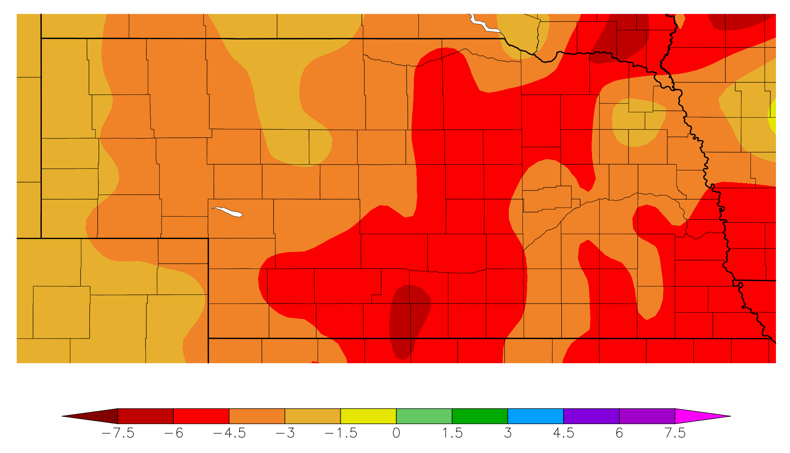
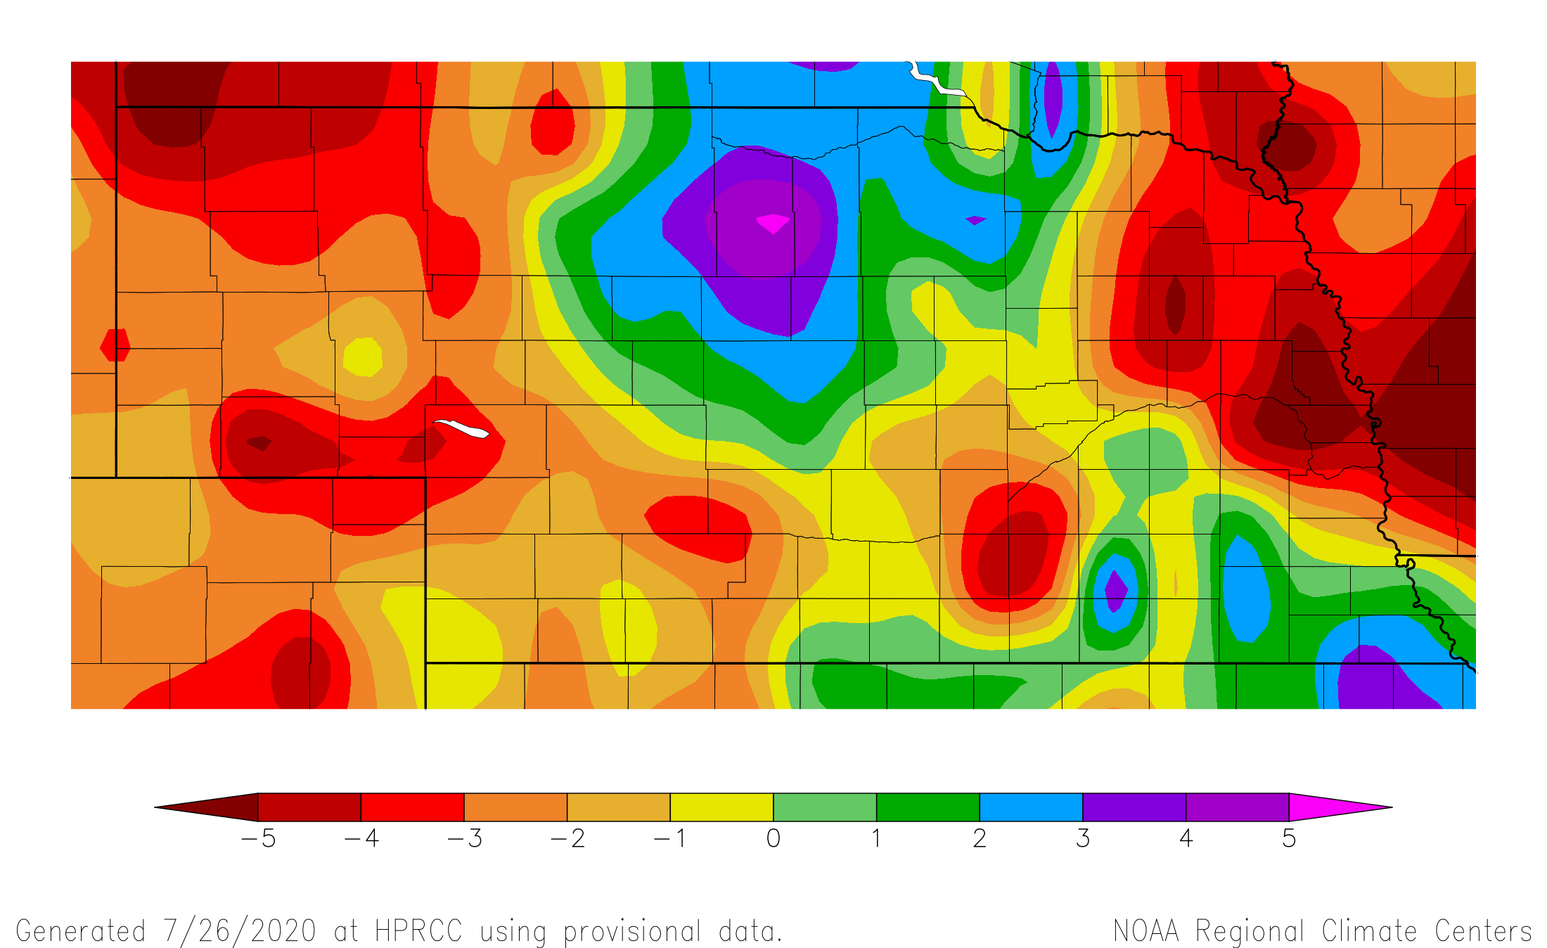
Recap
Precipitation | 4 month departures
120 day precipitation departure from normal
8 Aug – 5 Dec
Source: https:// hprcc.unl.edu/maps.php?map=ACISClimateMaps
Notes:
Here I outlined the similar trends for the Nebraska and global annual average temperature. I also point out the high variability in Nebraska and difference in regional vs. global scales. I use the analogy that global change is like an escalator that is increasing at an accelerating rate. The variability is like we jump up or down a few steps while still going up.

Slide 10
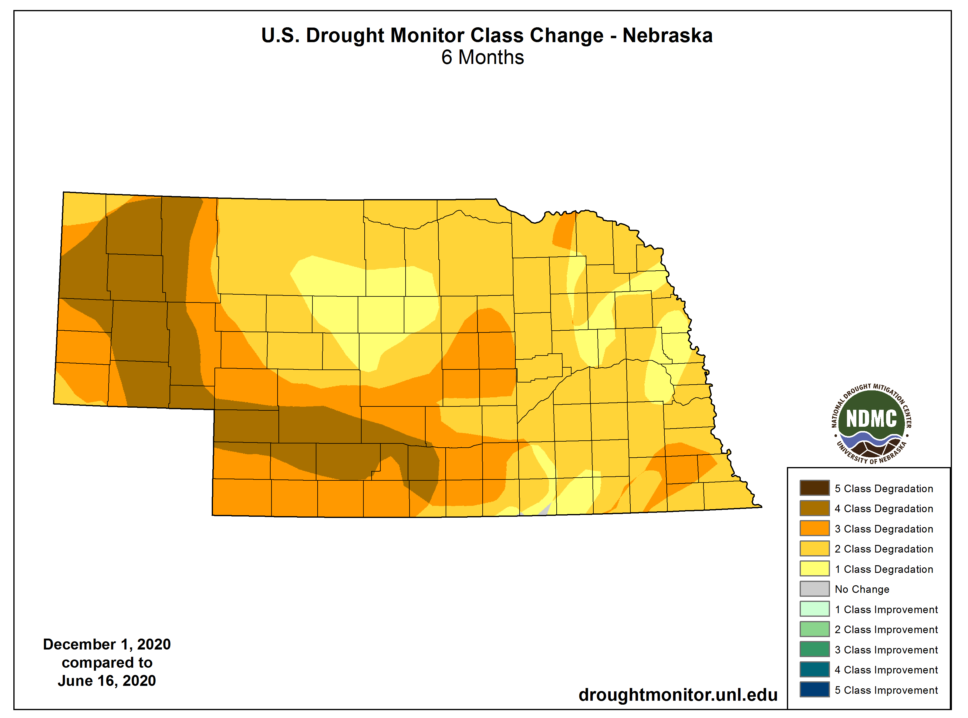
Recap
Drought |
one to four class degradations over the past 6 months
Source: https://droughtmonitor.unl.edu/maps/
Notes:
Here I outlined the similar trends for the Nebraska and global annual average temperature. I also point out the high variability in Nebraska and difference in regional vs. global scales. I use the analogy that global change is like an escalator that is increasing at an accelerating rate. The variability is like we jump up or down a few steps while still going up.

Slide 11
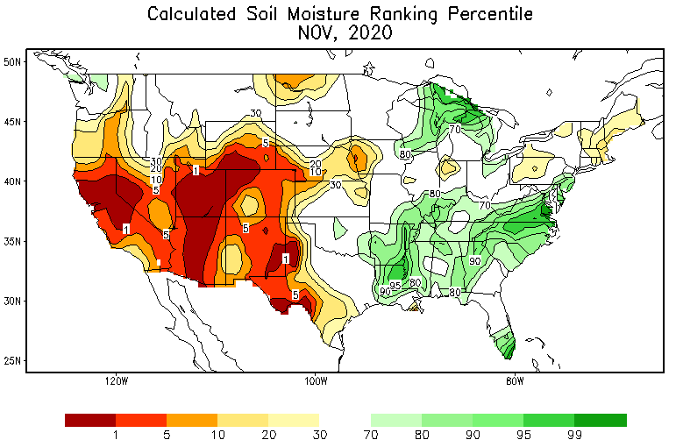
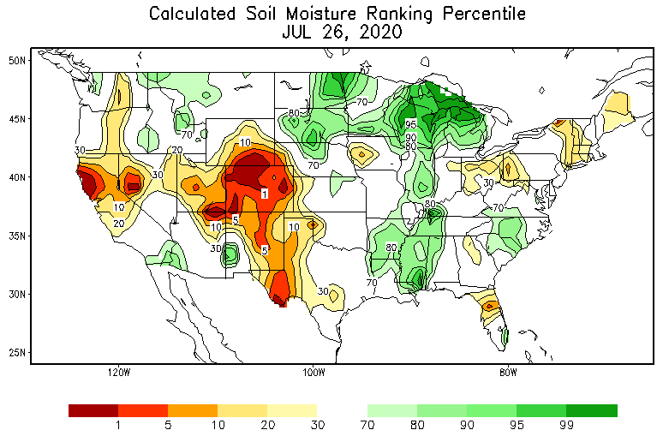
Soils
Soil moisture | Dryness apparent in moisture profiles across Nebraska.
https://www.cpc.ncep.noaa.gov/products/Soilmst_Monitoring/US/Soilmst/Soilmst.shtml
Notes:
Here I outlined the similar trends for the Nebraska and global annual average temperature. I also point out the high variability in Nebraska and difference in regional vs. global scales. I use the analogy that global change is like an escalator that is increasing at an accelerating rate. The variability is like we jump up or down a few steps while still going up.

Slide 12
Soils
Soil moisture |
topsoil (6”) moisture 65% short to very short
subsoil at 71% short to very short)
* short-very short: normal crop growth curtailed visible signs of stress
Thank you to Brad Rippey and USDA-OCE
https:// www.usda.library.cornell.edu/concern/publications/cj82k728n?locale=en
Notes:
Here I outlined the similar trends for the Nebraska and global annual average temperature. I also point out the high variability in Nebraska and difference in regional vs. global scales. I use the analogy that global change is like an escalator that is increasing at an accelerating rate. The variability is like we jump up or down a few steps while still going up.

Slide 13
Soils
Soil moisture | Dryness apparent in moisture profiles across Nebraska.
Notes:
Here I outlined the similar trends for the Nebraska and global annual average temperature. I also point out the high variability in Nebraska and difference in regional vs. global scales. I use the analogy that global change is like an escalator that is increasing at an accelerating rate. The variability is like we jump up or down a few steps while still going up.

Slide 14
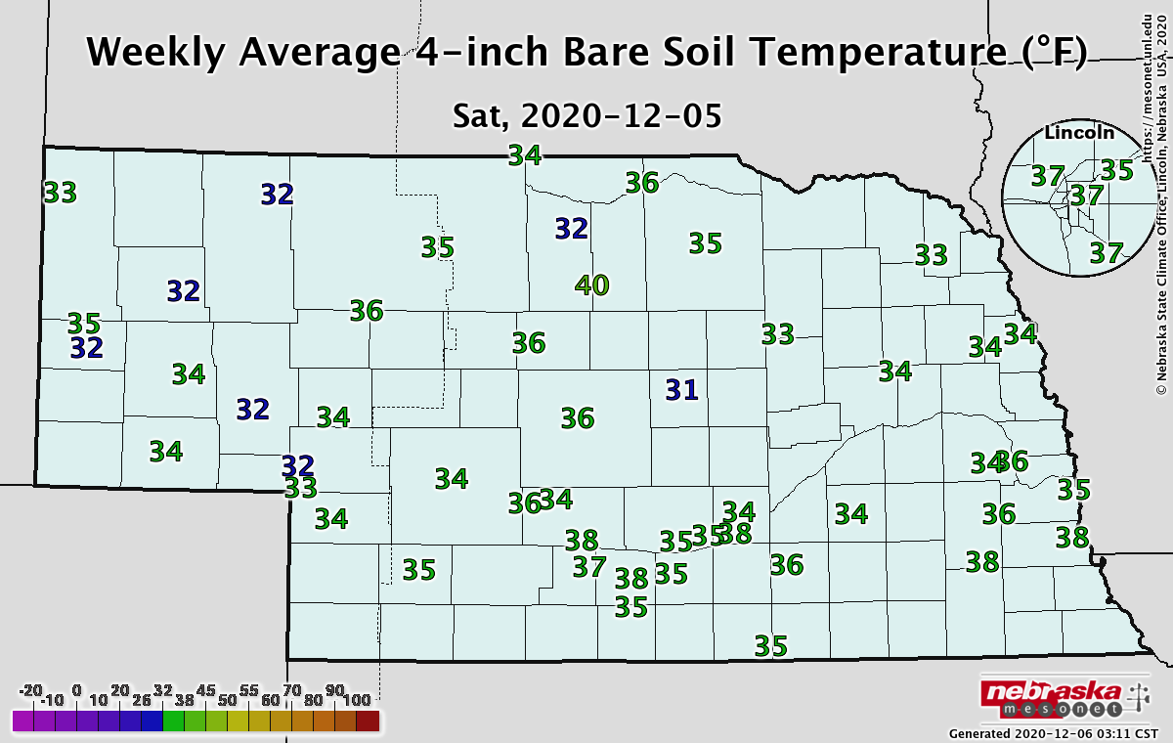
Soils
Soil temperature |
- Weekly average temperatures at and above freezing.
Notes:
Here I outlined the similar trends for the Nebraska and global annual average temperature. I also point out the high variability in Nebraska and difference in regional vs. global scales. I use the analogy that global change is like an escalator that is increasing at an accelerating rate. The variability is like we jump up or down a few steps while still going up.

Slide 15
Agriculture
Impacts |
- Dryness made for a good fieldwork window and grazing weather. - Lack of soil moisture stressing newly emerged wheat. - 45% of pastures and 26% of wheat rated poor to very poor (NASS).
Notes:
Here I outlined the similar trends for the Nebraska and global annual average temperature. I also point out the high variability in Nebraska and difference in regional vs. global scales. I use the analogy that global change is like an escalator that is increasing at an accelerating rate. The variability is like we jump up or down a few steps while still going up.

Slide 16
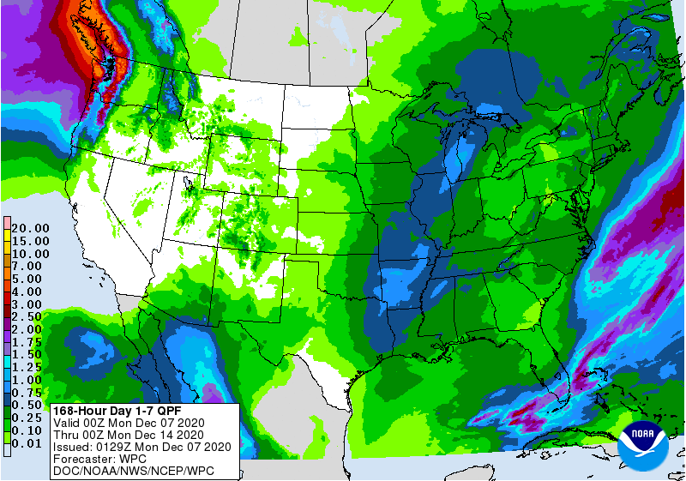
Precipitation outlook
Only very light precipitation in the forecast period over the next week.
https:// www. wpc.ncep.noaa.gov/qpf/day1-7.shtml
Notes:
Here I outlined the similar trends for the Nebraska and global annual average temperature. I also point out the high variability in Nebraska and difference in regional vs. global scales. I use the analogy that global change is like an escalator that is increasing at an accelerating rate. The variability is like we jump up or down a few steps while still going up.

Slide 17
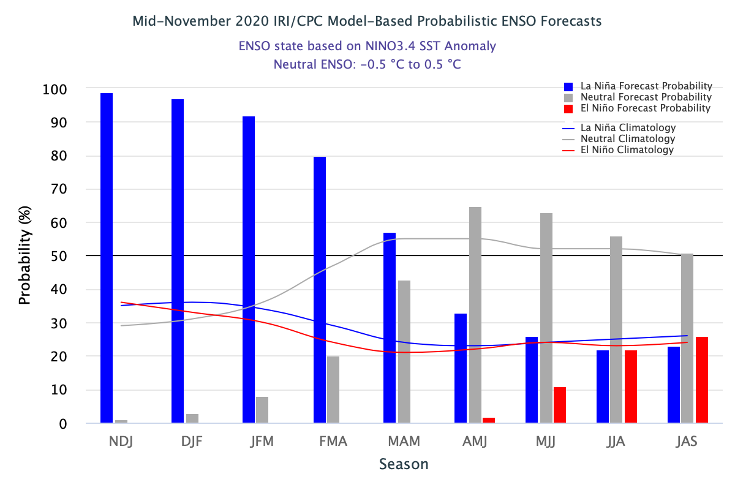
ENSO status
La Niña |
La Niña conditions expected through winter
Shift in probabilities by spring
https:// iri.columbia.edu/our-expertise/climate/forecasts/enso/current/
Notes:
Here I outlined the similar trends for the Nebraska and global annual average temperature. I also point out the high variability in Nebraska and difference in regional vs. global scales. I use the analogy that global change is like an escalator that is increasing at an accelerating rate. The variability is like we jump up or down a few steps while still going up.

Slide 18
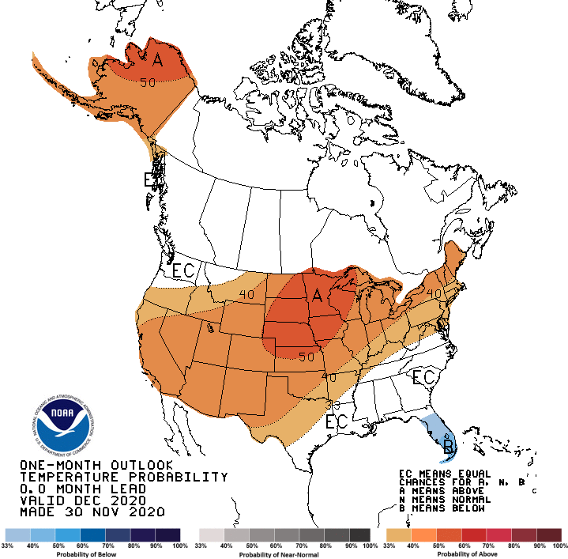
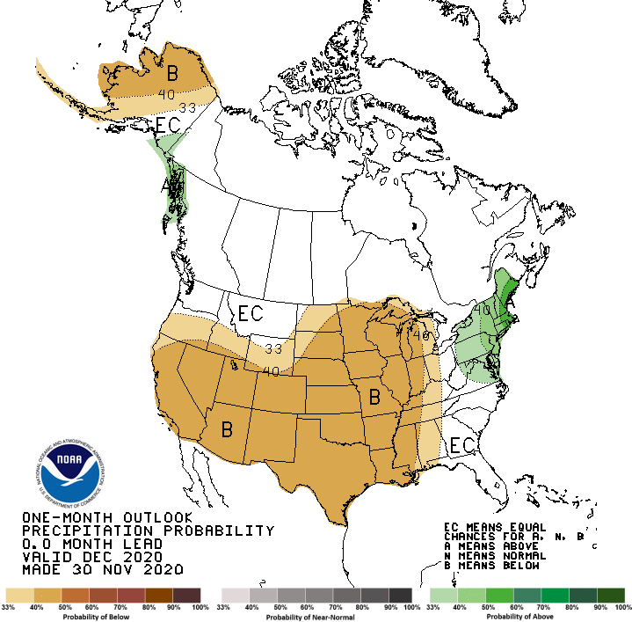
December outlook
- Warm and dry signal for Nebraska
Notes:
Here I outlined the similar trends for the Nebraska and global annual average temperature. I also point out the high variability in Nebraska and difference in regional vs. global scales. I use the analogy that global change is like an escalator that is increasing at an accelerating rate. The variability is like we jump up or down a few steps while still going up.

Slide 19
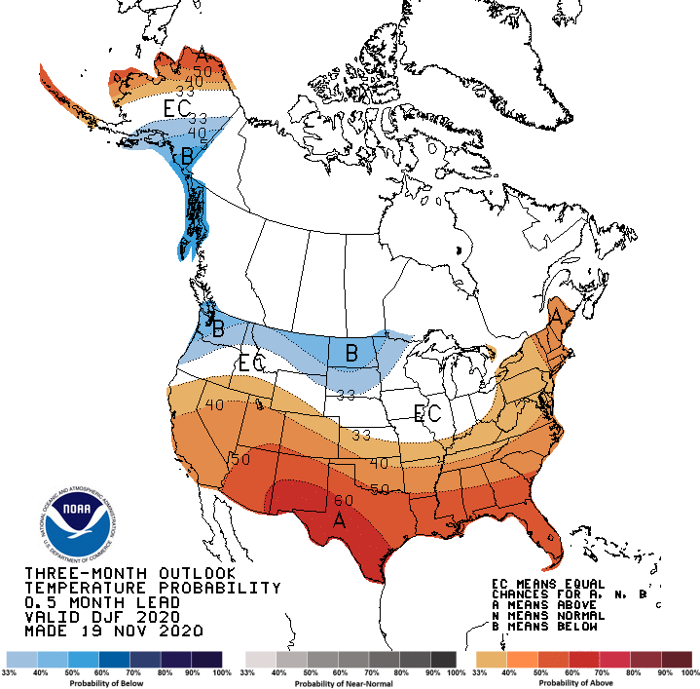
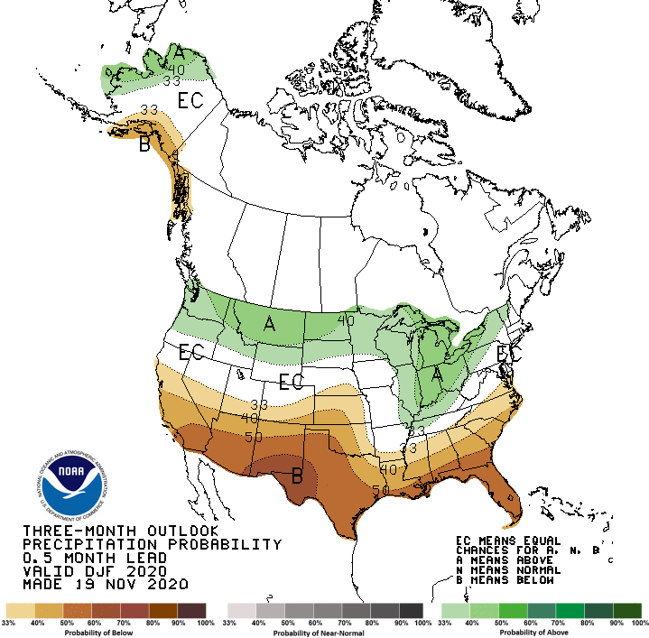
Dec-Jan-Feb outlook
- La Niña signal; wet/cold in the north, warm/dry in south
Notes:
Here I outlined the similar trends for the Nebraska and global annual average temperature. I also point out the high variability in Nebraska and difference in regional vs. global scales. I use the analogy that global change is like an escalator that is increasing at an accelerating rate. The variability is like we jump up or down a few steps while still going up.

Slide 20
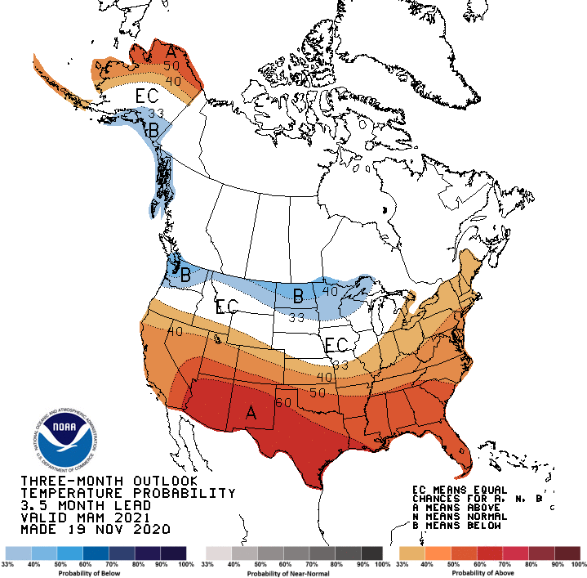
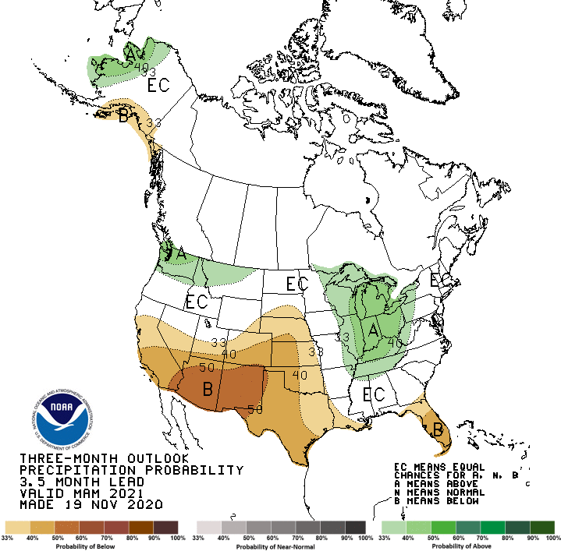
Mar-Apr-May outlook
- Dry signal continuation creeping into Nebraska
Notes:
Here I outlined the similar trends for the Nebraska and global annual average temperature. I also point out the high variability in Nebraska and difference in regional vs. global scales. I use the analogy that global change is like an escalator that is increasing at an accelerating rate. The variability is like we jump up or down a few steps while still going up.

Slide 21
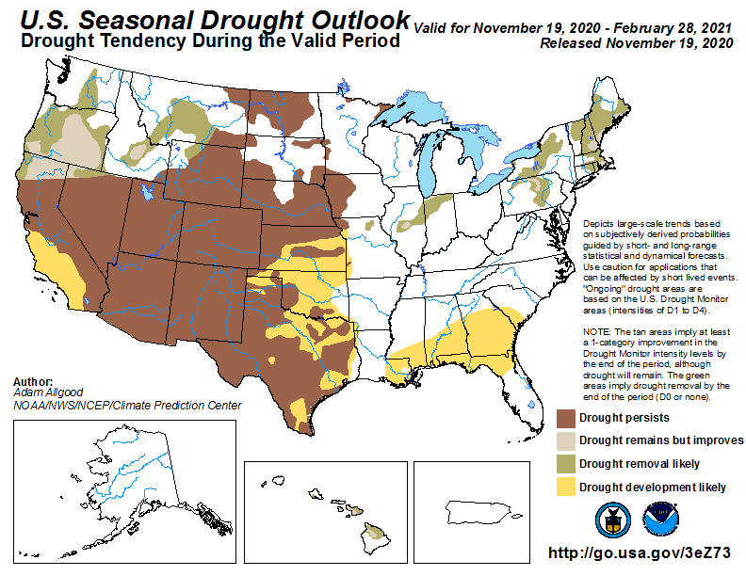
Winter drought outlook
persistence across Nebraska and much of the region
Notes:
Here I outlined the similar trends for the Nebraska and global annual average temperature. I also point out the high variability in Nebraska and difference in regional vs. global scales. I use the analogy that global change is like an escalator that is increasing at an accelerating rate. The variability is like we jump up or down a few steps while still going up.

Slide 22
Outlook summary
Widespread warm and dry signal for December (cold air outbreaks are not out of the question though).
Winter signal is less clear for Nebraska. Seasonal conditions dependent on storm track.
Drought conditions likely won’t see major improvements. Expect to start 2021 growing season with low soil moisture reserves.
Notes:
Here I outlined the similar trends for the Nebraska and global annual average temperature. I also point out the high variability in Nebraska and difference in regional vs. global scales. I use the analogy that global change is like an escalator that is increasing at an accelerating rate. The variability is like we jump up or down a few steps while still going up.

Slide 23
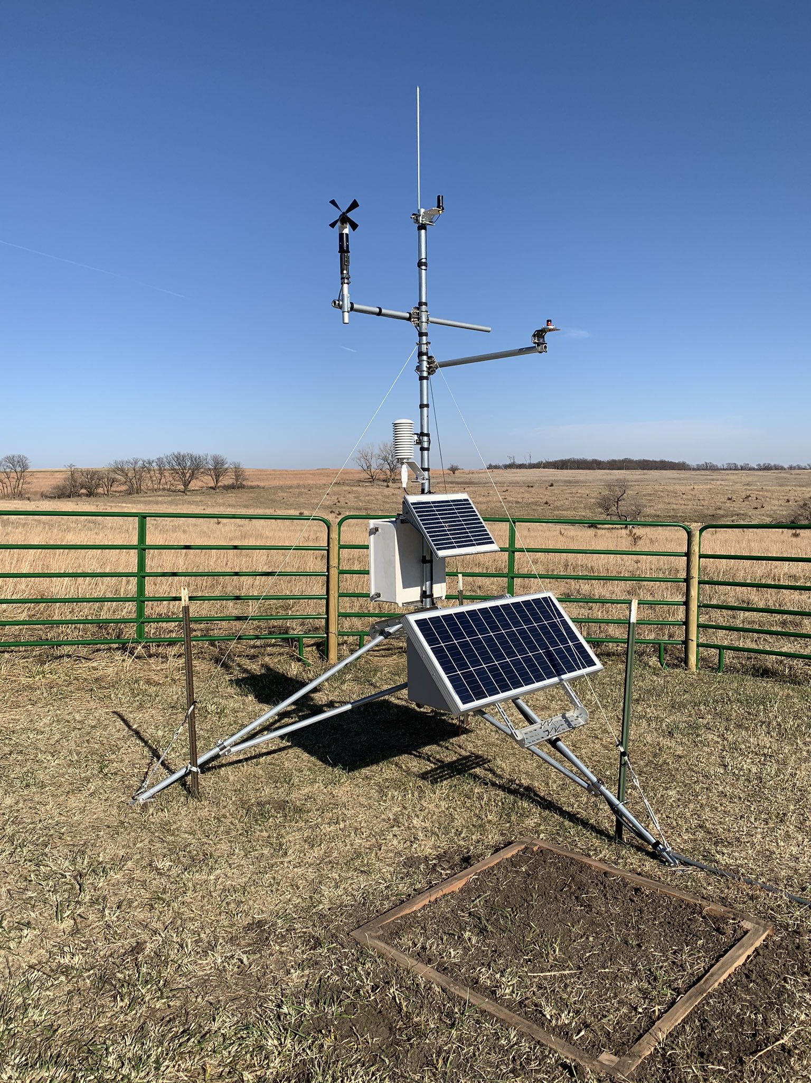
Questions
New Nebraska Mesonet station
Cook 4SW (Johnson Co.)
Martha Shulski: mshulski3@unl.edu, 402-472-6711
Notes:
Here I outlined the similar trends for the Nebraska and global annual average temperature. I also point out the high variability in Nebraska and difference in regional vs. global scales. I use the analogy that global change is like an escalator that is increasing at an accelerating rate. The variability is like we jump up or down a few steps while still going up.

