Slide 1
United States Department of Agriculture
National Agricultural Statistics Service
May Crop Report
June Acreage
July Crop Report
July 26 Crop Progress and Condition
Matt Gregg
USDA NASS
July 29, 2020

Slide 2
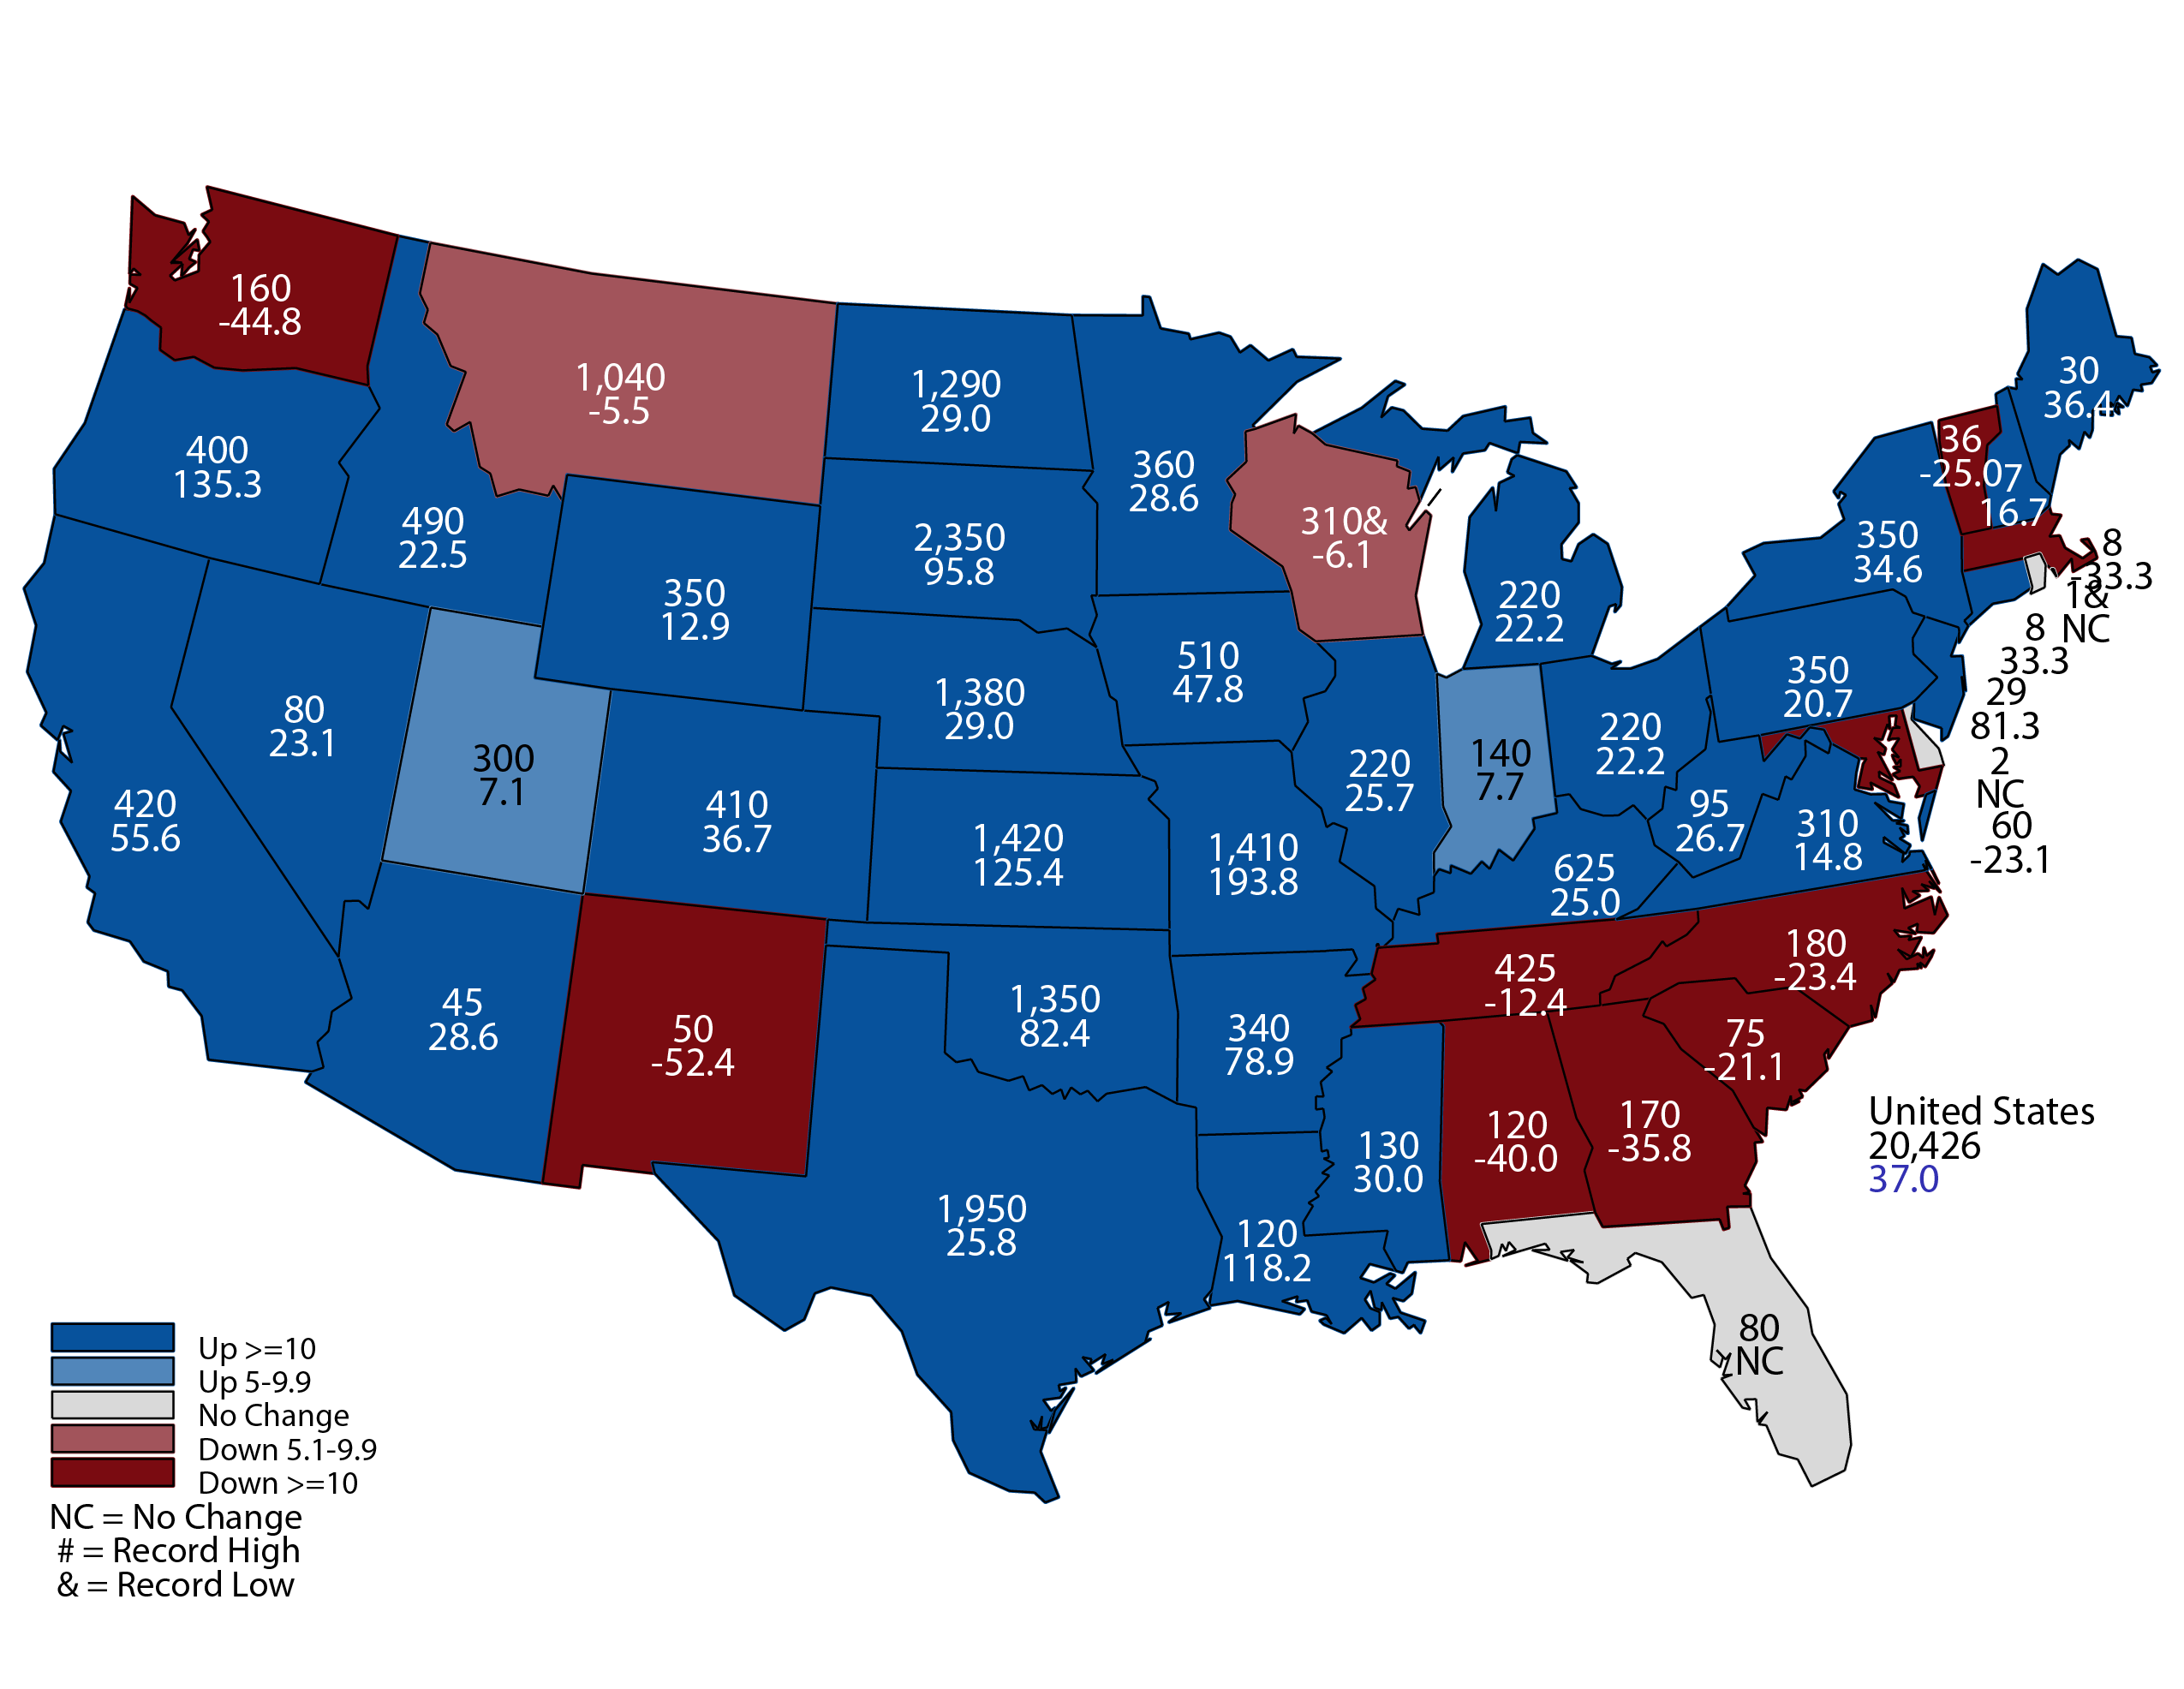
May 2020 Hay Stocks
Thousand Tons and Percent Change from Previous Year
May 12, 2020
Notes:
Hay Stocks
Highest Nebraska Stocks since 2016
Year Stocks in Nebraska
2020 1,380,000
2019 1,070,000
2018 700,000
2017 1,275,000
2016 1,450,000
2015 1,250,000
2014 1,150,000
2013 610,000
2012 1,070,000
2011 1,335,000
2010 1,000,000

Slide 3
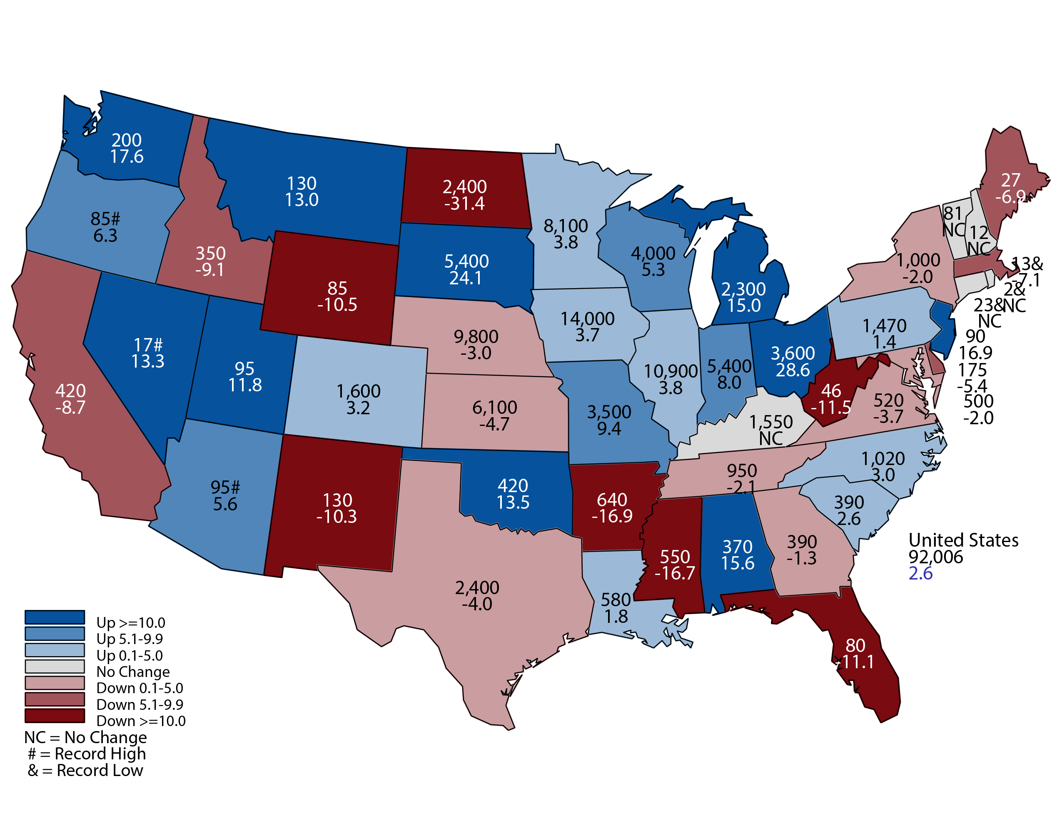
June 2020 Corn Planted Area
(000) Acres and Percent Change from Previous Year
June 30, 2020
Notes:
Corn Planted Acres
Nebraska 9.8 million acres planted down from 10.1 million last year.

Slide 4
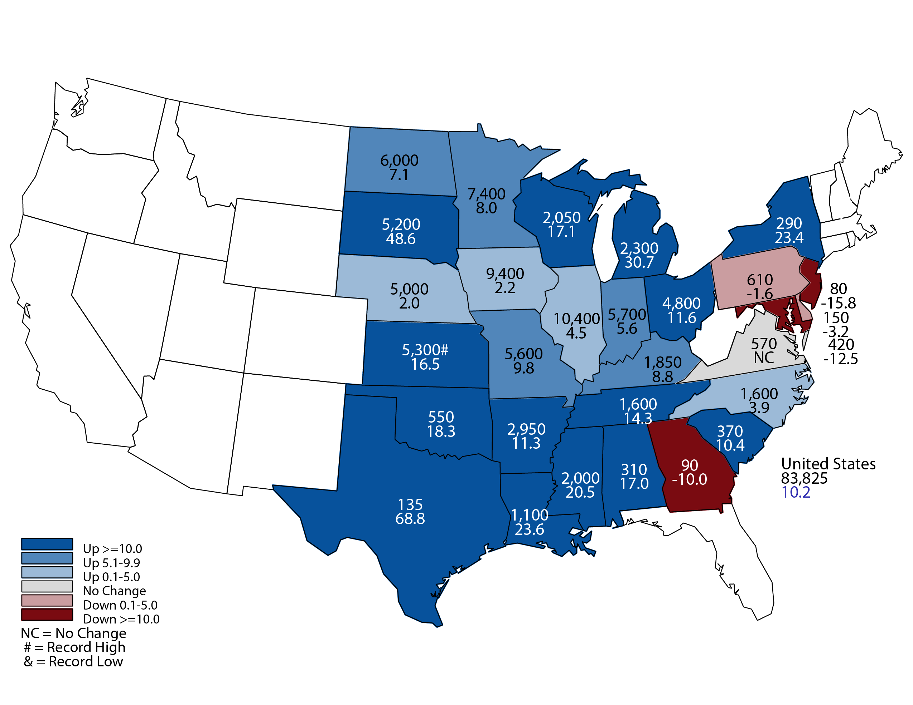
June 2020 Soybean Planted Area
(000) Acres and Percent Change from Previous Year
June 30, 2020
Notes:
Soybean Planted Acres
Nebraska 5 million acres up from 4.9 million acres last year.

Slide 5
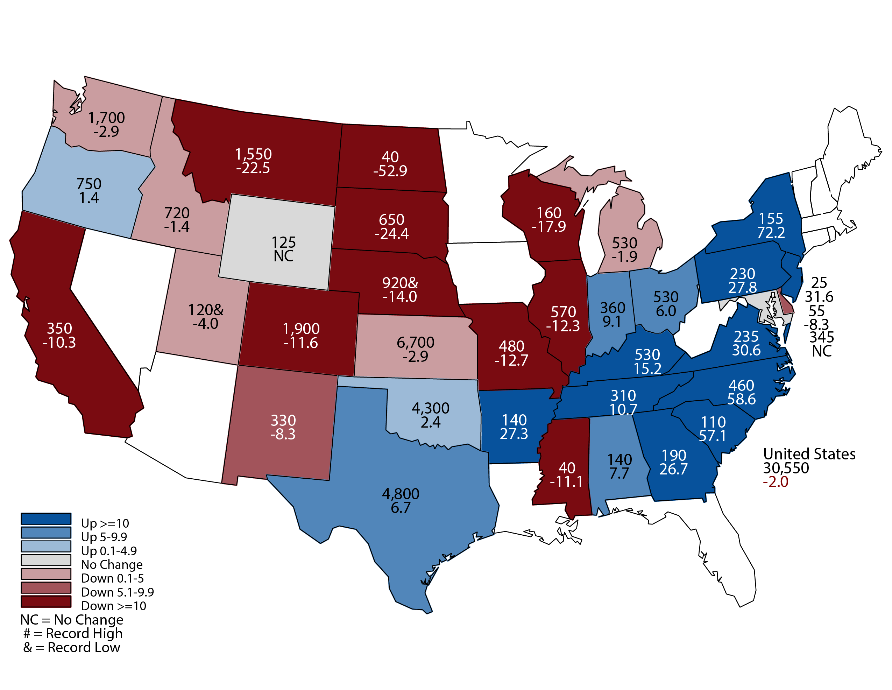
June 2020 Winter Wheat Planted Area
(000) Acres and Percent Change from Previous Year
June 30, 2020
Notes:
Winter Wheat Planted Acres
Nebraska 920,000 acres down from 1,070,000 last year.
Record low planted area in NE

Slide 6
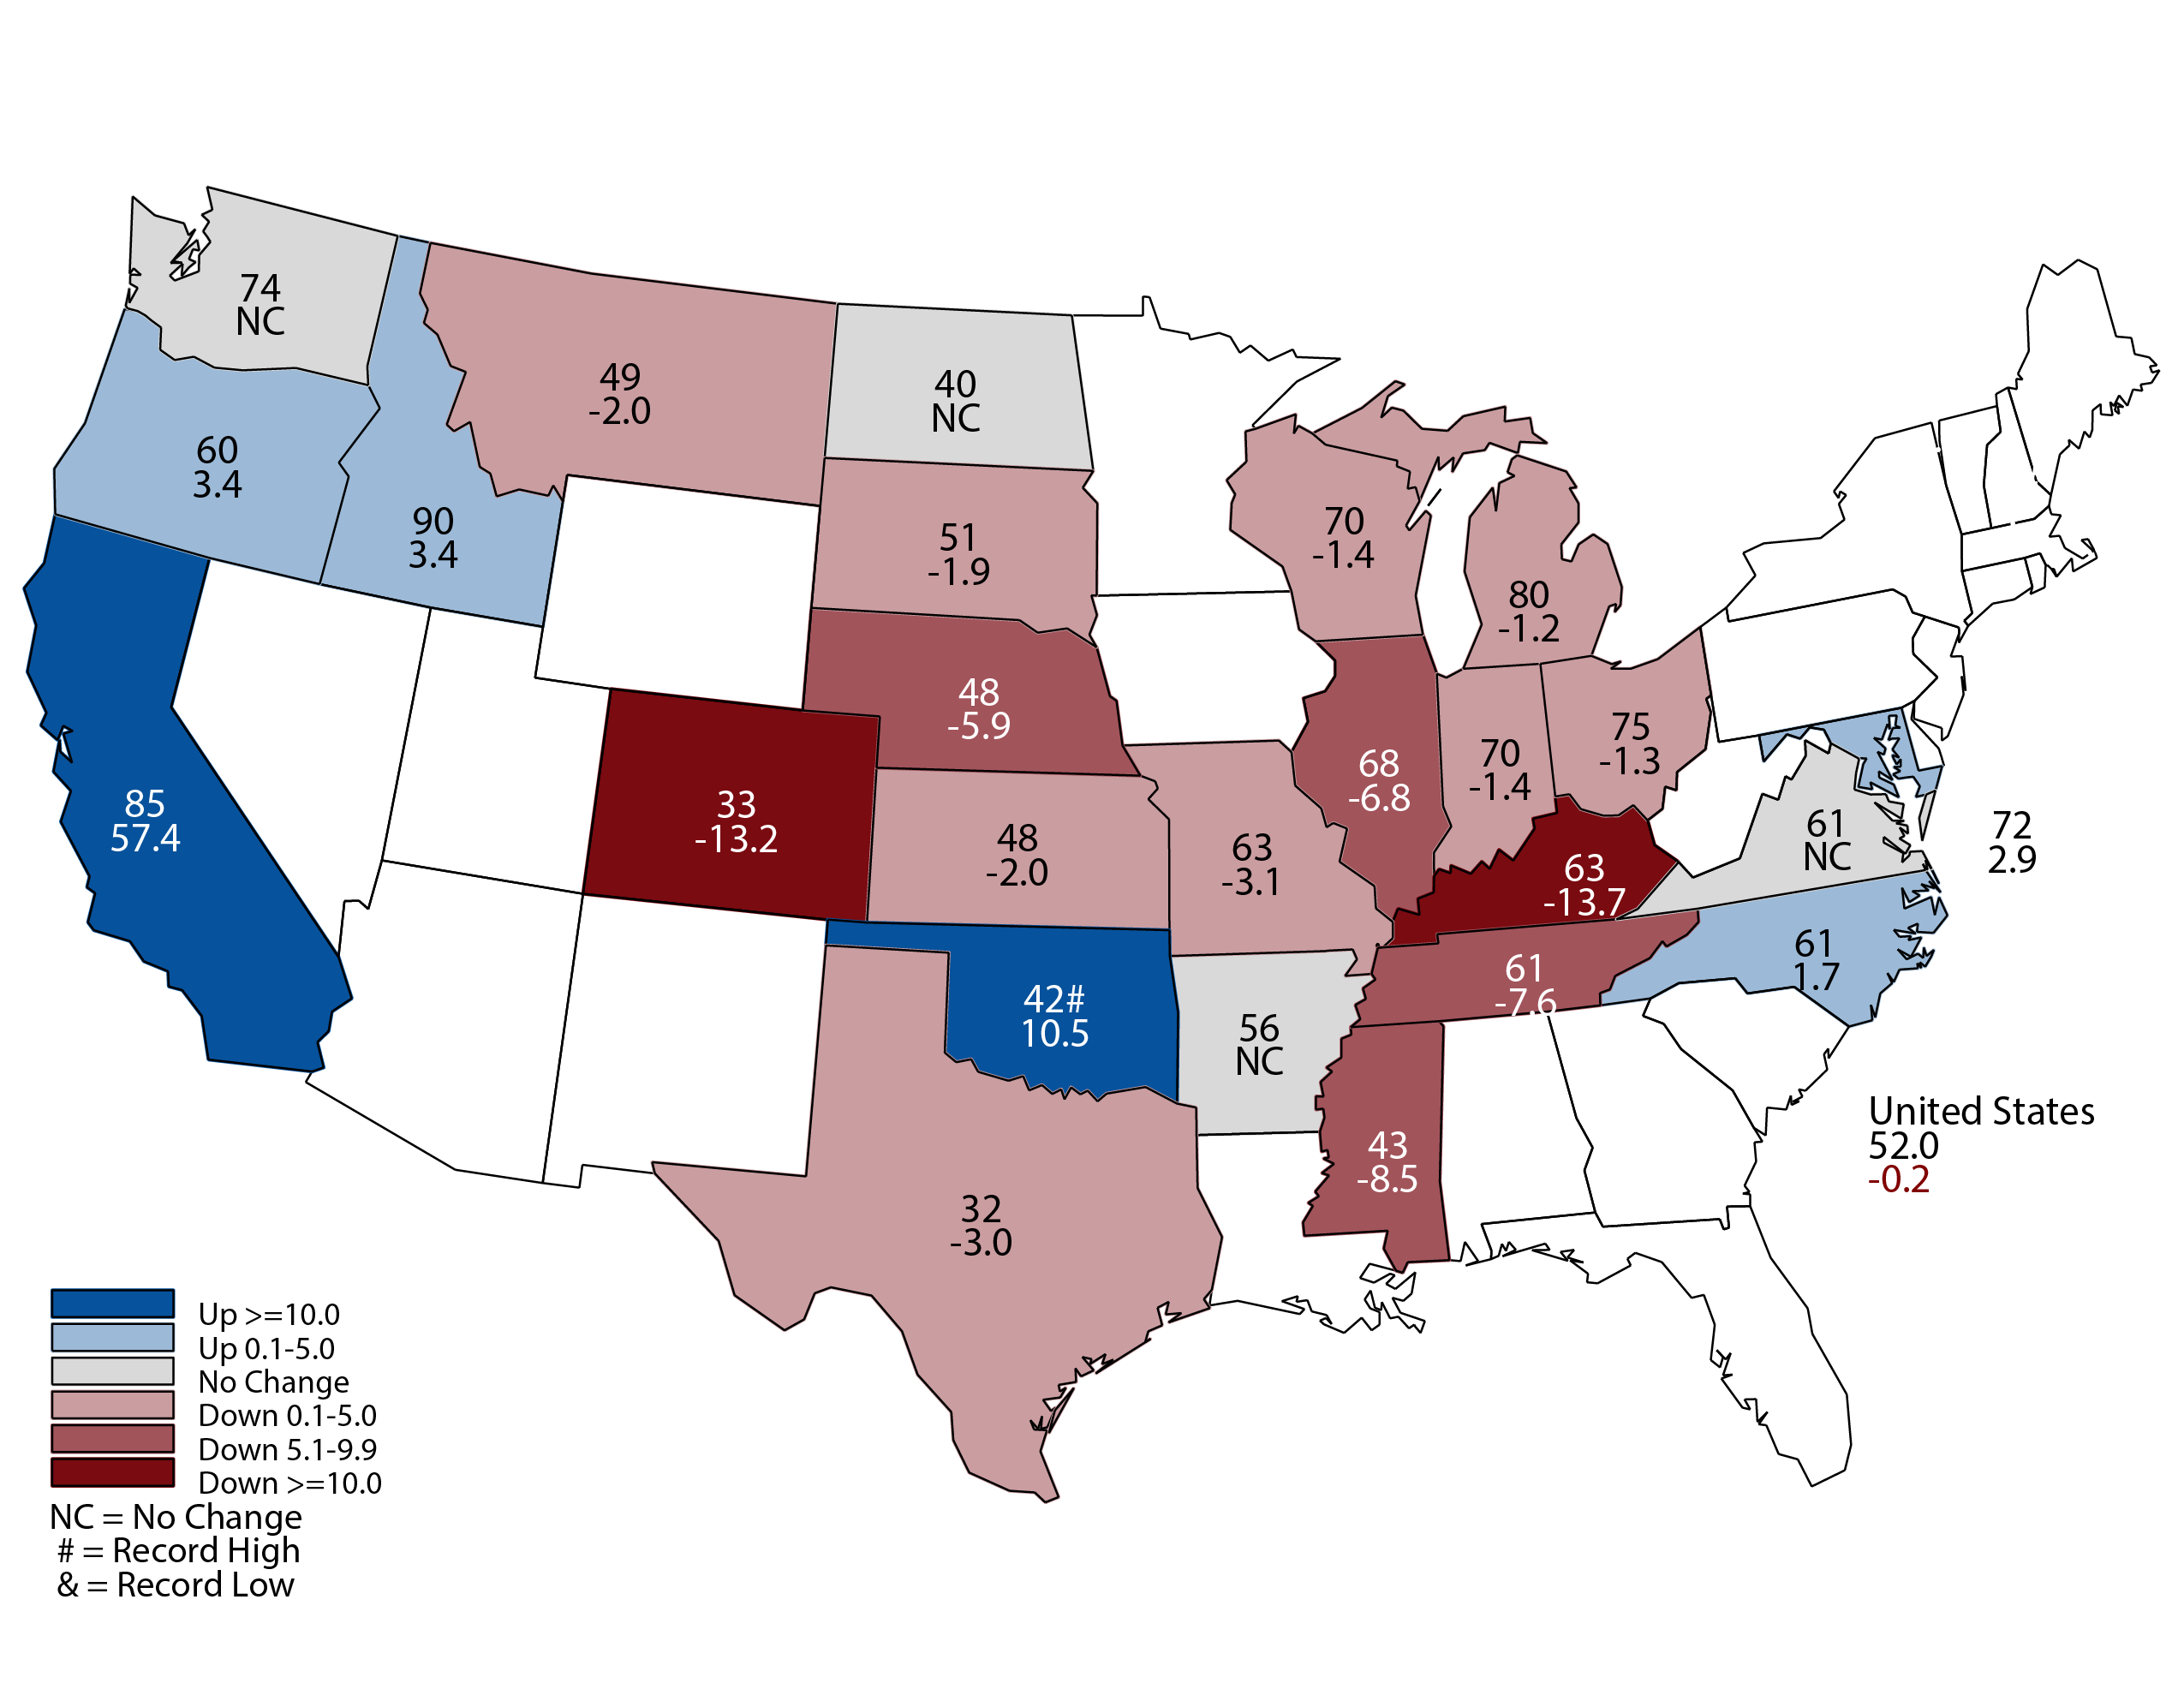
July 2020 Winter Wheat Yield
Bushels and Percent Change from Previous Month
July 10, 2020
Notes:
Winter Wheat Yield
Nebraska winter wheat yield is forecast at 48 bushels per acre, down 9 bushels from last year.
Production is forecast @ 40.8 million bushels, down 26% from last year.

Slide 7
Crop Progress and Condition July 26
 | Very Poor | Poor | Fair | Good | Excellent
Corn | 2% | 5% | 18% | 54% | 21%
Soybeans | 2% | 4% | 14% | 59% | 21%
Pasture and Range | 7% | 7% | 26% | 54% | 6%
 | Very Short | Short | Adequate | Surplus
Topsoil Moisture | 12% | 29% | 57% | 2%
Subsoil Moisture | 9% | 29% | 60% | 2%
USDA-NASS
7-27-20
Notes:
Corn is 75% good to excellent
Soybeans 80% good to excellent
Pasture and Range 60% good to excellent
Moisture
Topsoil is 59% Adequate to Surplus
Subsoil is 62 Adequate to Surplus

Slide 8
Crop Progress and Condition July 26
Notes:
Corn is 75% good to excellent

Slide 9
Crop Progress and Condition July 26
Notes:
Soybeans 80% good to excellent

Slide 10
Crop Progress and Condition July 26
Notes:
Pasture and Range 60% good to excellent

Slide 11
Crop Progress and Condition July 26
 | 7/26/2020 | Last Year | 5-Year Average
Winter Wheat: Harvested | 93% | 49% | 81%
Corn: Silking | 89% | 61% | 80%
Corn: Dough | 27% | 9% | 16%
Soybeans: Blooming | 90% | 60% | 76%
Soybeans: Setting Pods | 53% | 27% | 33%
USDA-NASS
7-27-20
Notes:
All crops are currently developing ahead of average.

Slide 12
Upcoming Reports
Release Date | Title
August 12 | Crop Production
August 21 | Cattle on Feed
August 28 | Cash Rent County Estimates
USDA-NASS
07-29-20
Notes:
August 12 Crop Production will have first survey based yield and production forecast for row crops and hay.

Slide 13
United States Department of Agriculture
National Agricultural Statistics Service
All Reports Available At
www.nass.usda.gov
For Questions
402-437-5541
800-582-6443

