Slide 1
United States Department of Agriculture
National Agricultural Statistics Service
November Crop Report
November 7 Crop Progress and Condition
Nick Streff
USDA NASS
November 12, 2021

Slide 2
7-19-21

Slide 3
Notes:
Harvest progressed ahead of normal this year which is quite a change from last year.
As of 11/15, corn was 96% harvested.

Slide 4
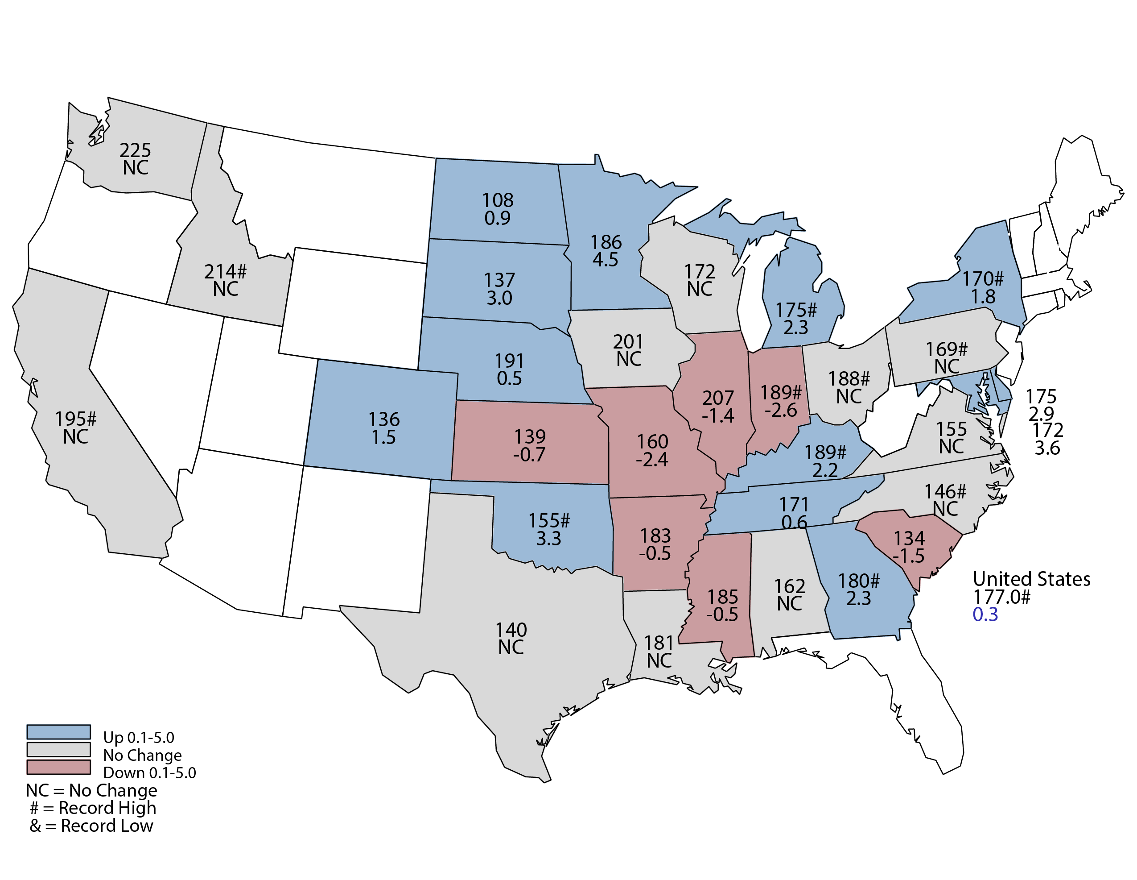
November 2021 Corn Yield
Bushels and Percent Change from Previous Month
November 9, 2021
Notes:
Corn Yield
NE Corn yield is forecast at 191 bu/ac. The record yield is 192 set in 2018.

Slide 5
November 2021 Corn Production
Nebraska
Billion Bushels
Notes:
Corn Production
Nebraska's 2021 corn crop is forecast at a record 1.83 billion bushels, up 3% from last year's production, according to the USDA's National Agricultural Statistics Service. Area to be harvested for grain, at 9.60 million acres, is down 3% from a year ago.

Slide 6
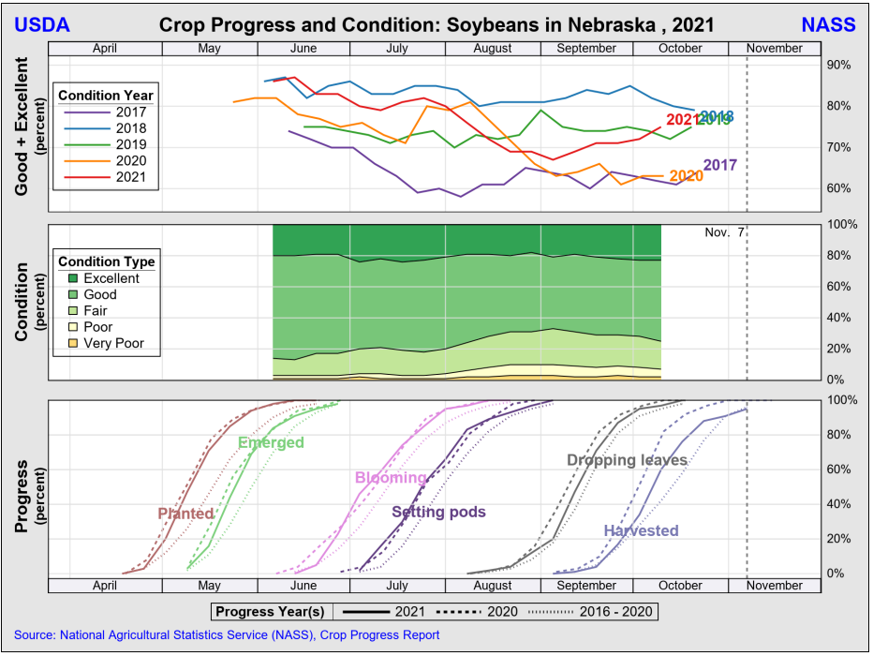

Slide 8
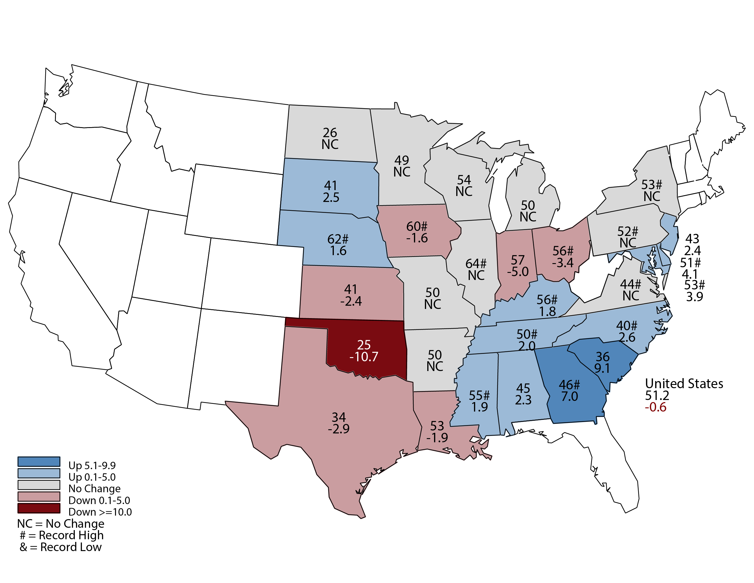
November 2021 Soybean Yield
Bushels and Percent Change from Previous Month
November 9, 2021
Notes:
Soybean Yield
NE Yield is forecast at 62 bu/ac, which would be a record. Previous record was 61 bu/ac set in 2016.

Slide 9
November 2021 Soybean Production
Nebraska
Million Bushels
Notes:
Nebraska Soybean production is forecast at a record 344 million bushels, up 15% from last year. Area for harvest, at 5.55 million acres, is up 8% from 2020.

Slide 10
October 2021 Crop Production
Nebraska
Alfalfa hay production, at 3.74 million tons, is up 15% from last year. Area for harvest, at 960,000 acres, is up 12% from a year ago. Yield of 3.90 tons per acre is up 0.10 ton per acre from 2020.
All other hay production, at 2.48 million tons, is down 20% from last year. Area for harvest, at 1.55 million acres, is down 18% from a year ago. Yield of 1.60 tons per acre is down 0.05 ton from 2020.

Slide 11
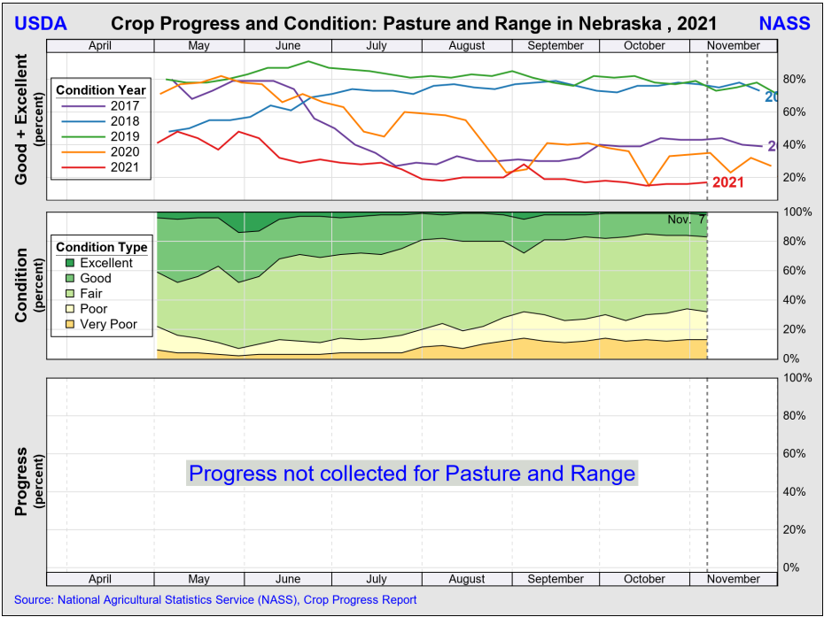

Slide 12
Crop Progress and Condition Report November 7, 2021
 | Very Short | Short | Adequate | Surplus
Topsoil Moisture | 6% | 29% | 63% | 2%
Subsoil Moisture | 10% | 40% | 49% | 1%
 | Very Poor | Poor | Fair | Good | Excellent
Winter Wheat Condition | 3% | 11% | 31% | 47% | 8%

Slide 13
Upcoming Events
Release Date | Title
November 19 | Cattle on Feed
December 9 | Small Grain County Estimates
December 23 | Cattle on Feed
December 23 | Hogs and Pigs
January 12 | Annual Crop Production
January 31 | Cattle

Slide 14
United States Department of Agriculture
National Agricultural Statistics Service
All Reports Available At
www.nass.usda.gov
For Questions
402-437-5541
800-582-6443

